Slide 1
Demo Pre-requisites
Create free Azure/Microsoft account
https://azure.microsoft.com/en-us/free/
Install python and pip

Slide 2
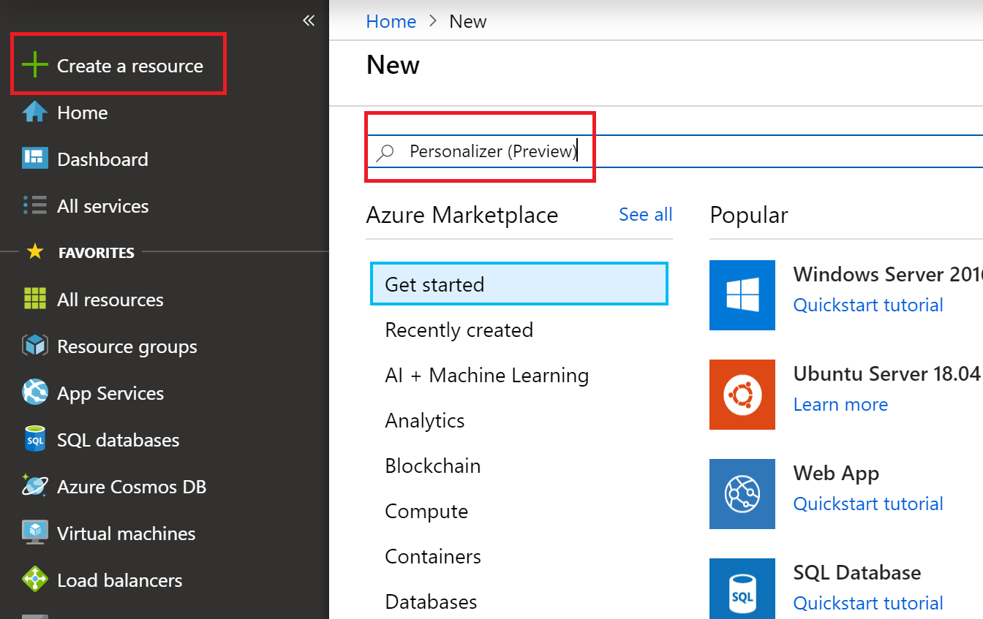
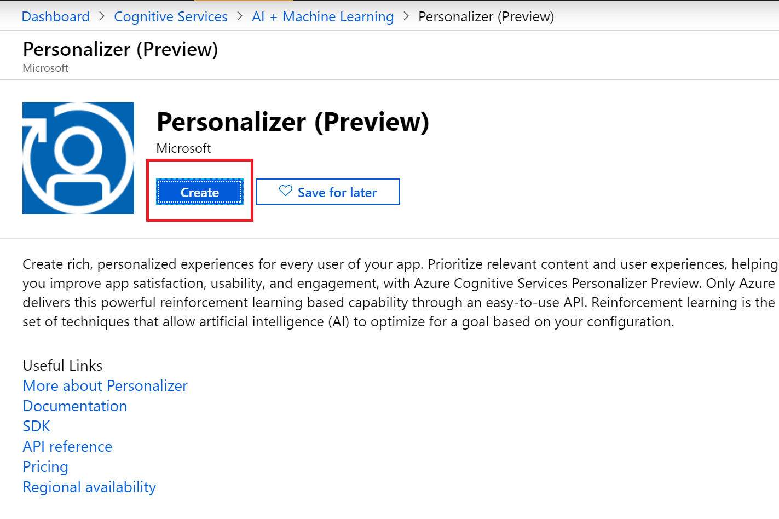
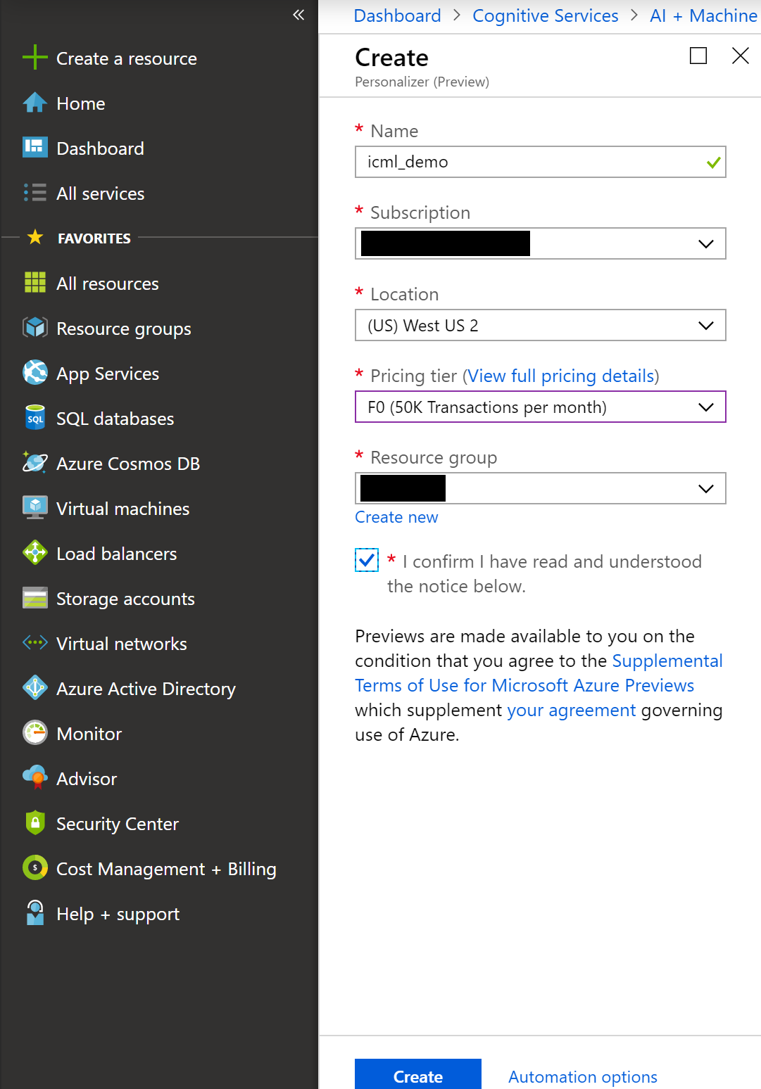
Create Personalizer Instance

Slide 3
Demo App
User
Your News
Website
APS
What content is relevant to this user?
Requests your home page
rank( user, content )
content to display
Render home page
Clicks on chosen content
reward( +1 )

Slide 4
Demo code & Libraries
git clone https://github.com/VowpalWabbit/workshop
pip install azure.cognitiveservices.personalizer

Slide 5
Code

Slide 6
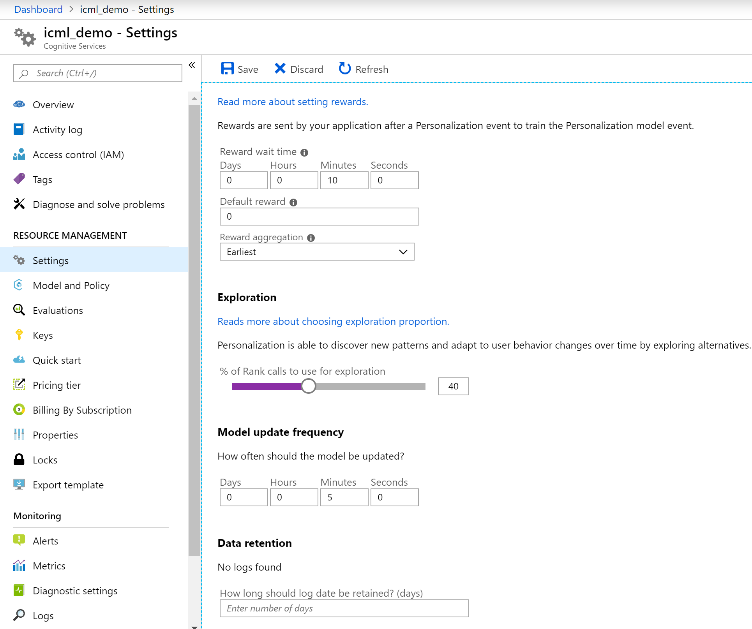
App Status

Slide 7
Docs
https://docs.microsoft.com/en-us/azure/cognitive-services/personalizer/
https://docs.microsoft.com/en-us/azure/cognitive-services/personalizer/concepts-features
https://docs.microsoft.com/en-us/azure/cognitive-services/personalizer/concept-rewards

