Slide 1

Counter Factual Evaluation
Pavithra Srinath
Some images from Google/Bing

Slide 2
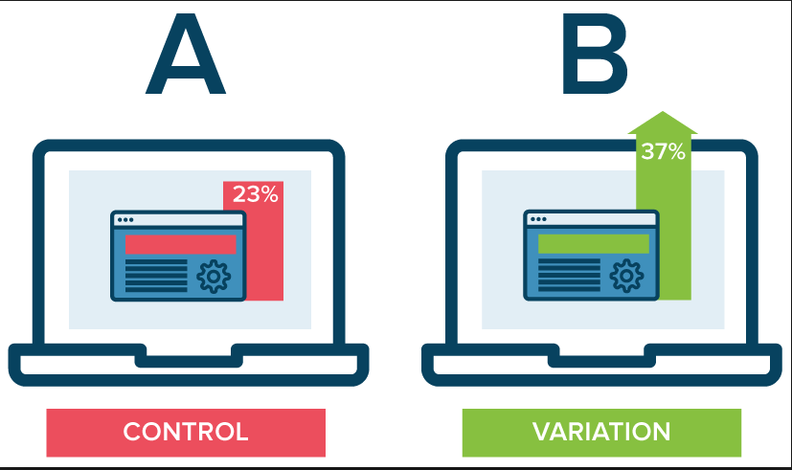
A/B testing

Slide 3

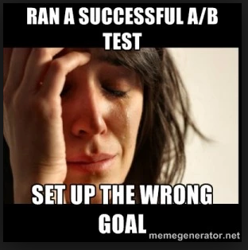

The BANE of A/B testing
You have a new idea
You have multiple ideas
You pitch it to your manager
Expensive
Money
Time
Multiple iterations
Results … Ummmm
WHAT IF ….. BETTER WAY

Slide 4

Counter factual evaluation
What If Analysis
Only using online experimentation data
- With a small twist
- Deploy explore/exploit models
Visualize different policies
Find a policy that works well
with confidence bounds

Slide 5




A/B vs. Counterfactual
A
Exploit best known inference
Exploration Policy
B
Explore new alternatives
A/B Test:
Design the Right Experiment
Test online once
Start over
Offline Experiment:
Use models that exploit and explore
Record User Interaction
Find the policy and model that fits reality

Slide 6
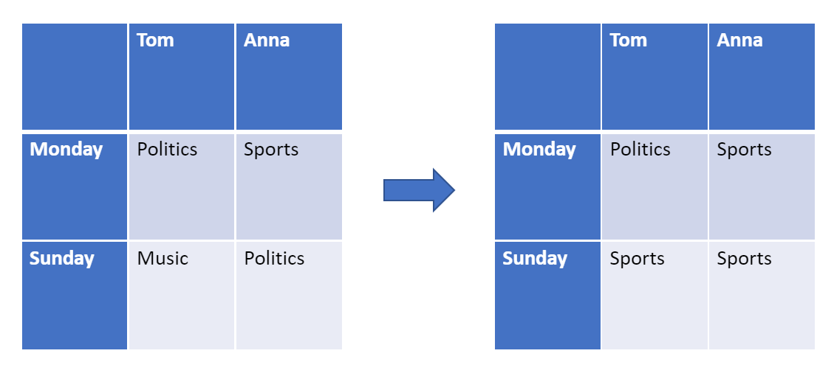
Use case REVIEW
MODEL
Function that we learnt
POLICY
Model that acts in the world

Slide 7
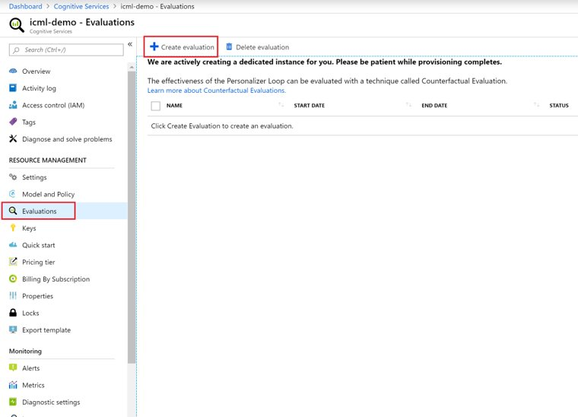
Create a counterfactual evaluation

Slide 8
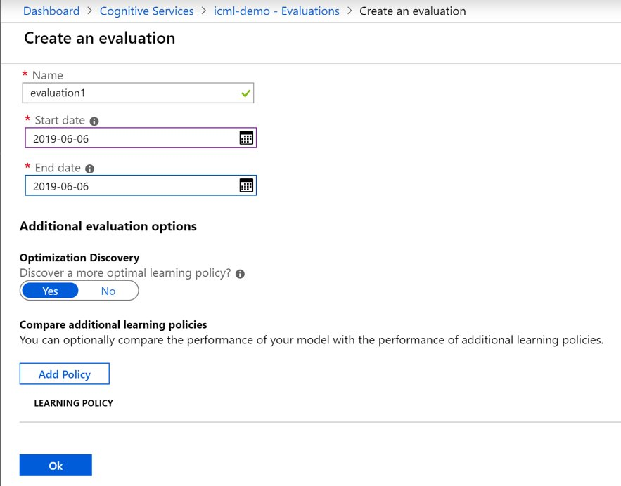
Create a counter factual evaluation

Slide 9
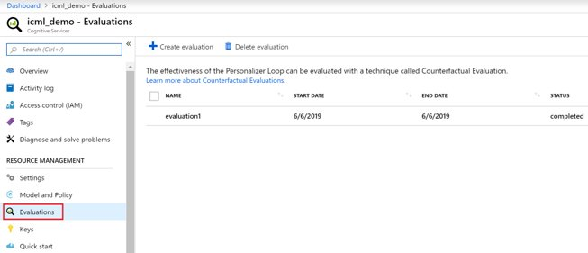
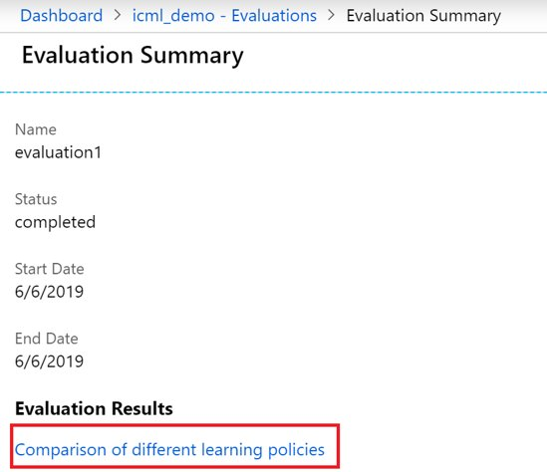
Counter factual evaluation

Slide 10
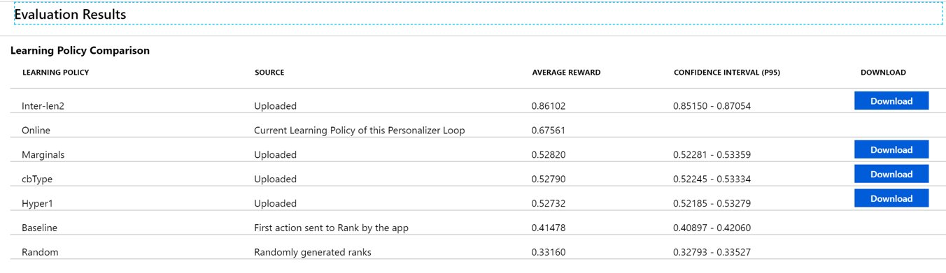
Counter factual evaluation results

Slide 11
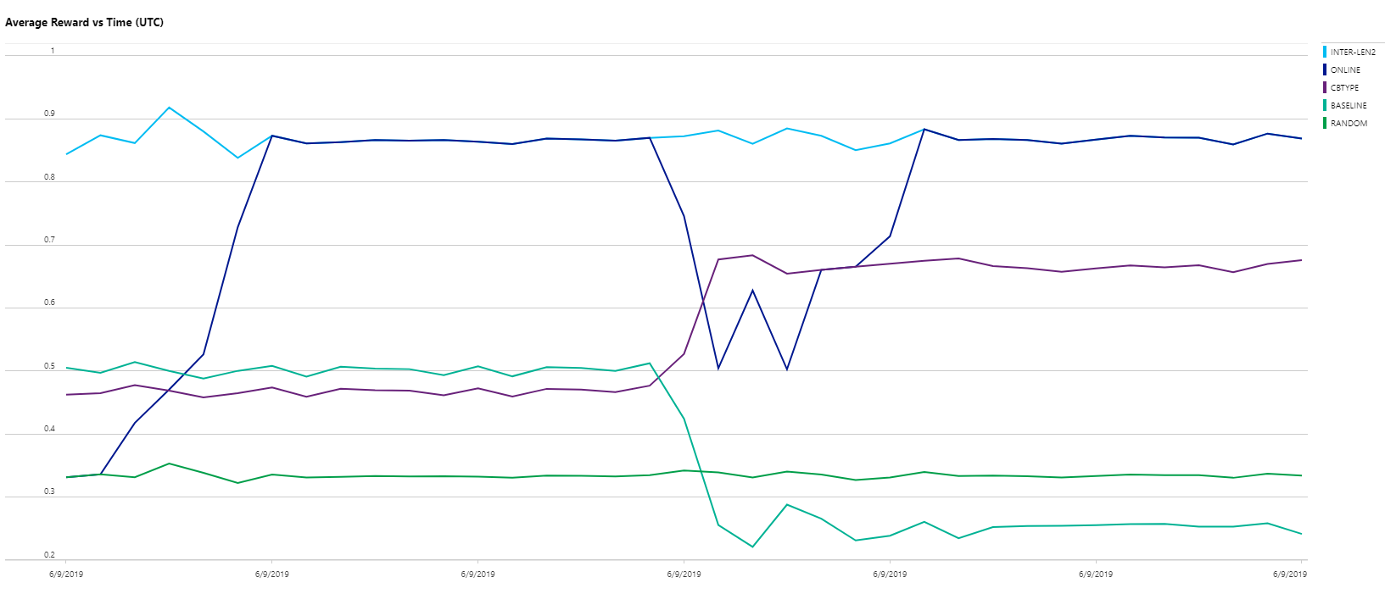
Counter factual evaluation dashboard

Slide 12
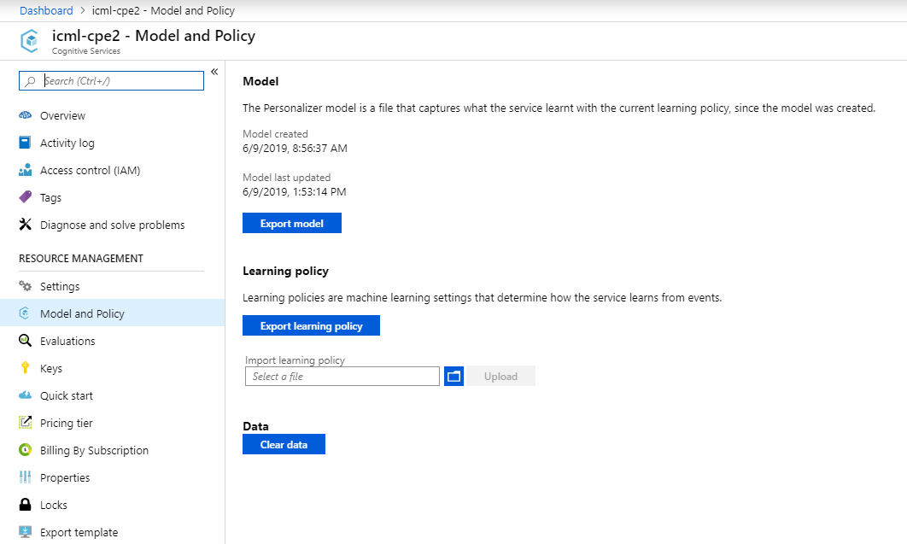
IMPORT POLICY

Slide 13
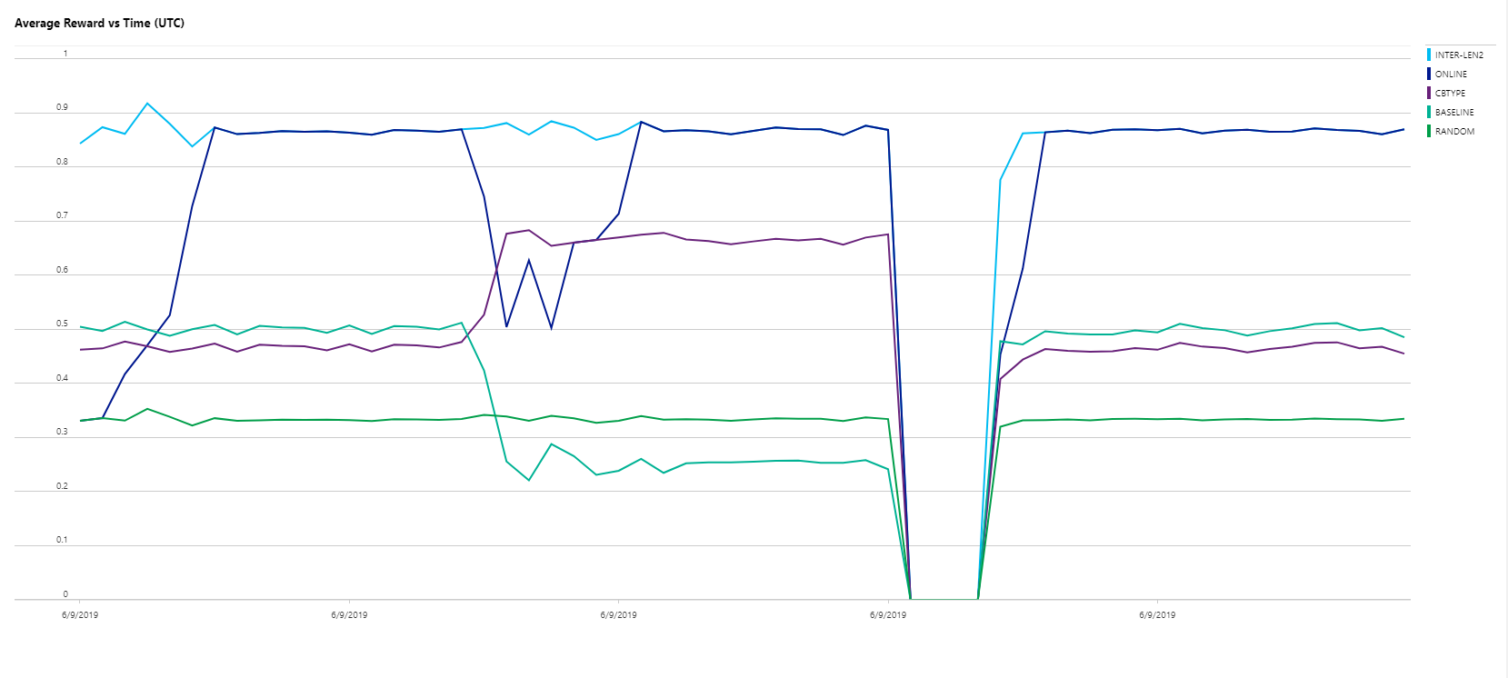
Counter factual evaluation dashboard

Slide 14
Questions?? THANK YOU!

