Slide 1

CSST 102 FINAL PROJECT

Slide 2
COURSE PROFILE
Program College | : : | BS Computer Science Computer Studies
Campus | : | Santa Cruz
Program Coordinator | : | Mark P. Bernardino, MSCS
Course Instructor | : | Mia Villar Villarica, DIT

Slide 3



Introduction
Members:
Javier, Geron Simon A.
Macapallag, Mhar Andrei C.
Valdeabella, Seanrei Ethan M.

Slide 4
Introduction
Domain: Computer Science Education
Reasoning Method: Causal Language Modeling
Machine Learning Algorithm Chosen: Transformer-based neural network

Slide 5
Data Preparation

Slide 6
Data preparation
Dataset Description
The dataset is a synthetically generated dataset that contains an input (student queries) and a corresponding output (chatbot responses) tailored for a computer science guidance chatbot.
The dataset is specifically designed to provide tailored advice based on the student’s query and knowledge level.

Slide 7
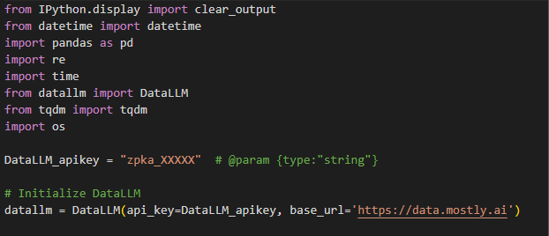
Data preparation
Dataset Generation
For the dataset generation, we first imported the DataLLM library and initialized it with an API key. The DataLLM’s purpose is to create synthetic datasets based on the descriptions and column configurations
Figure 1. Importing the DataLLM library

Slide 8
Data preparation
Dataset Generation
The dataset description is provided to guide the generation of relevant data. The column configurations include the user input, chatbot output, intent, sentiment, and difficulty level.
The user input column simulates a student query. The chatbot output column simulates a chat bot’s response. The intent column represents the purpose behind the student query. The sentiment captures the emotional tone. Lastly, the difficulty level corresponds to the complexity of the query

Slide 9
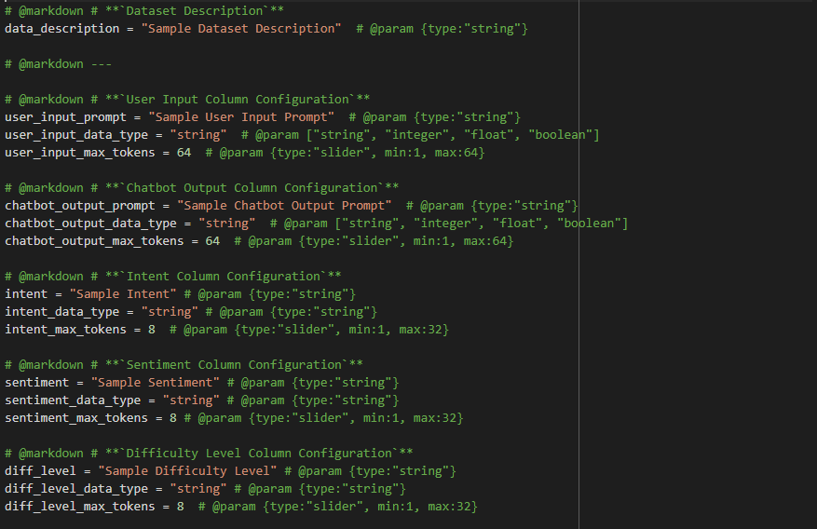
Data preparation
Figure 2. Dataset Description and Column Configuration

Slide 10
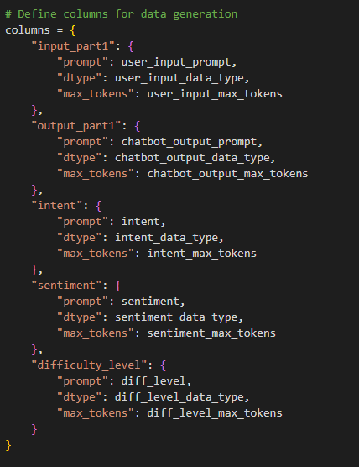
Data preparation
Dataset Generation
Each column is configured with a prompt, data type, and max tokens. The prompt is a short description that will later guide the data generation for the corresponding column. The data type is self-explanatory. The max tokens is the maximum length for the text generated in the corresponding column.
Figure 3. Defining Columns for Data Generation

Slide 11
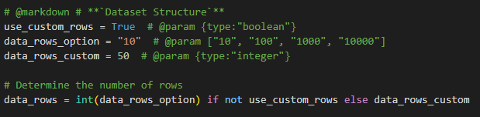
Data preparation
Dataset Generation
We have also set the number of rows for the dataset which can be customized. It sets how many rows the dataset will generate for each loop.
Figure 4. Rows Configuration

Slide 12
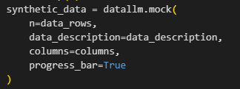
Data preparation
Dataset Generation
The dataset is then generated with the datallm.mock() function that takes the rows, dataset description, and columns as its arguments. The generated dataset is stored in the synthetic_data variable
Figure 5. datallm.mock() function

Slide 13
Data preparation
Preprocessing Steps
As recently stated, we normalized the texts generated by setting max tokens to control the length of each text. This prevents overly long or irrelevant responses. It also ensures the text is the expected format for training conversational models.
Generating synthetic data may not always end with a complete thought or sentence. That’s why we made sure that it does not generate anything that is not complete or incomprehensible

Slide 14
Data preparation
Preprocessing Steps
The functions is_complete_sentence() and generate_complete_text() ensure that the generated data is not incomplete and has complete thought.
If it is incomplete, it iteratively appends additional text to the response by re-invoking the DataLLM model until either the text is complete or a predefined maximum number of iterations is reached.

Slide 15
Data preparation
Preprocessing Steps
The functions is_complete_sentence() and generate_complete_text() ensure that the generated data is not incomplete and has complete thought.
If it is incomplete, it iteratively appends additional text to the response by re-invoking the DataLLM model until either the text is complete or a predefined maximum number of iterations is reached.

Slide 16
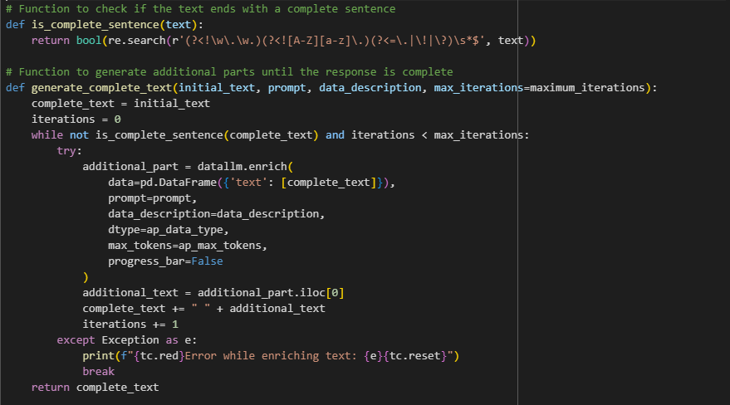
Data preparation
Figure 6. is_complete_sentence() and generate_complete_text() functions

Slide 17
Data preparation
Preprocessing Steps
We then cleaned the dataset by reusing synthetic_data. We iterated every row of it and used the generate_complete_text() to ensure each row has complete text. We then dropped the first generated input and output (input_part1 and output_part1) to reduce clutter in the final dataset. Then we reordered the columns for consistency and to ensure the dataset has a logical structure. The synthetic dataset is now generated and is now taken to the final stage of the preprocessing step.

Slide 18
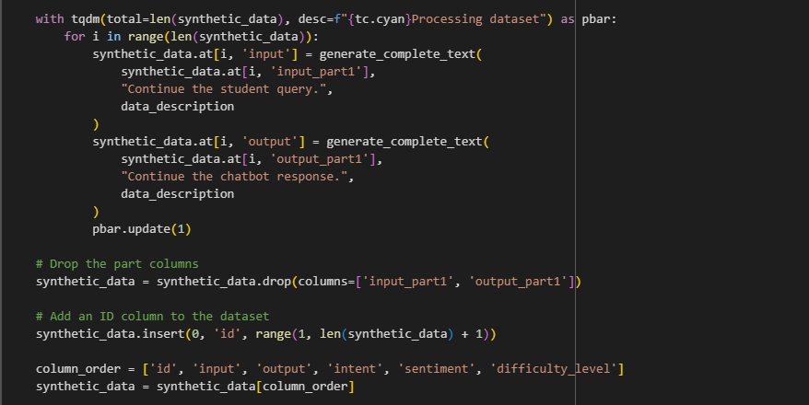
Data preparation
Figure 7. Regenerating the synthetic_data and cleaning via generate_complete_text()

Slide 19
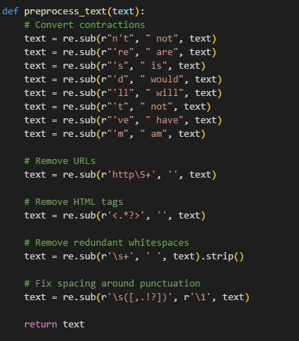
Data preparation
Preprocessing Steps
The final preprocessing step takes the generated synthetic data and undergoes text preprocessing and spelling correction. The preprocess_text() function transforms every contraction word to its expanded form. The final preprocessing step also involves the removal of URLs, HTML tags, white space, and fixing the spacing around punctuation marks. All of these were done by using regex.
Figure 8. preprocess_text() function

Slide 20
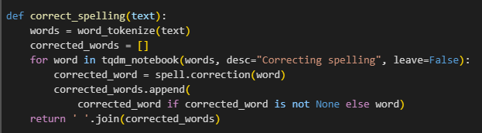
Data preparation
Preprocessing Steps
The correct_spelling() function checks if a word is misspelled. First, it tokenizes the text, then it checks if the word is spelled incorrectly, and lastly, it replaces the word with the most likely correct word from the SpellChecker dictionary.
Figure 9. correct_spelling() function

Slide 21
Data preparation
Preprocessing Steps
After applying these preprocessing techniques, the preprocessed dataset is uploaded to our hugging face accounts via our hugging face token and repository name, ready to use for training the model.

Slide 22
Model Implementation

Slide 23
Model Implementation
Selected Reasoning Technique and ML Algorithm
‘Causal Language Modeling’ is the main approach for the text generation in the chatbot. This technique allows the model to understand and generate coherent sentences and text based on the previously given words.
The main algorithm being utilized is the Transformer-based neural network which is chosen for its self-attention mechanism that makes it possible to recognize more extended dependencies in text.

Slide 24
Model Implementation
Selected Reasoning Technique and ML Algorithm
The mechanism of self-attention helps the model to decide on the different weights of the words when creating output which results in a superior understanding of context than the conventional Recurrent Neural Networks (RNN)

Slide 25
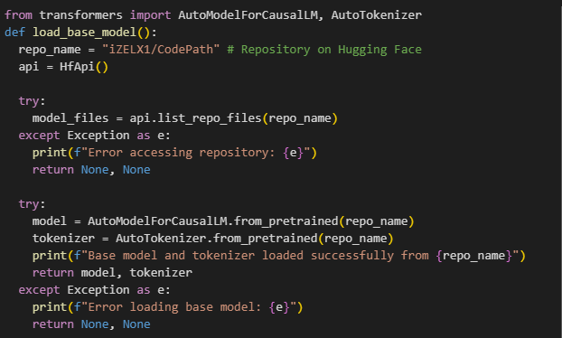
Model Implementation
Loading the Base Model and Tokenizer
The load base model function is responsible for the action that loads the pre-trained model and tokenizer. These components are accessed from the Hugging Face Model Hub using the repository name given.
Figure 10. Loading the Base Model and Tokenizer

Slide 26
Model Implementation
Loading the Base Model and Tokenizer
AutoModelForCausalLM and AutoTokenizer are used to automatically load the appropriate model and tokenizer based on the repository. This function will ensure that the necessary components will be available to run the chatbot.

Slide 27
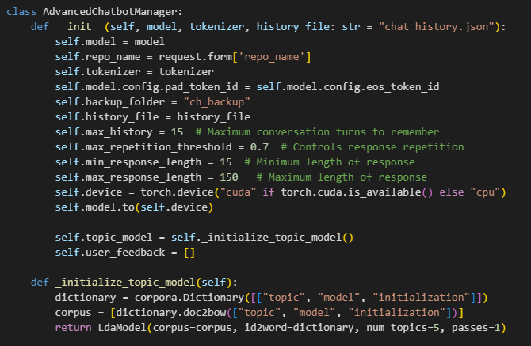
Model Implementation
Chatbot Class (AdvancedChatbotManager) Initialization
The AdvancedChatbotManager class is initialized with the loaded model and tokenizer. The __init__ method sets up some essential parameters and configurations for the chatbot
Figure 11. AdvancedChatbotManager Class

Slide 28
Model Implementation
Chatbot Class (AdvancedChatbotManager) Initialization
The main parameters that will be set here are max_history, max_repetition_threshold, min_response_length, and max_response_length. These will define the behavior of the chatbot. A simple LDA topic model is also initialized for basic conversation analysis

Slide 29
Model Implementation
Response Generation (generate_response)
The generate_response function is the core of the chatbot, responsible for generating responses based on user input and conversation history. It uses the model to generate text and applies several checks to ensure the quality of the response

Slide 30
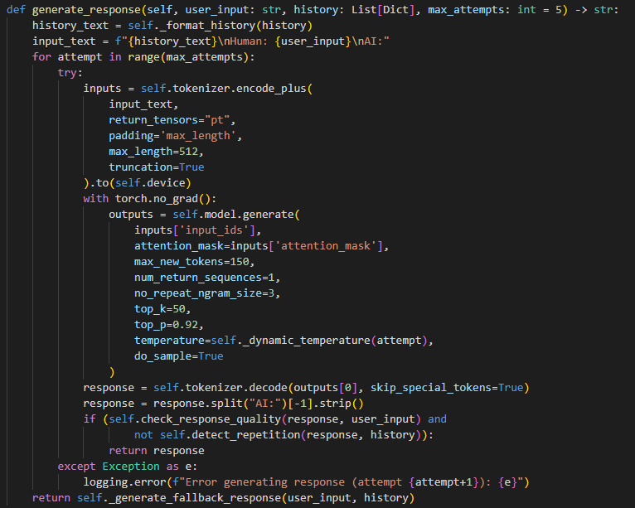
Model Implementation
Figure 12. generate_response() function

Slide 31
Model Implementation
Response Generation (generate_response)
The function formats the conversation history, tokenizes the input, and uses model.generate() to produce a response. Parameters like max_new_tokens, no_repeat_ngram_size, top_k, top_p, and temperature control the generation process. The function also includes error handling and a fallback mechanism

Slide 32
Model Implementation
Conversation History Management
These functions handle the loading, saving, formatting, and resetting of the conversation history. The history is stored as a list of dictionaries, with each dictionary representing a turn in the conversation

Slide 33
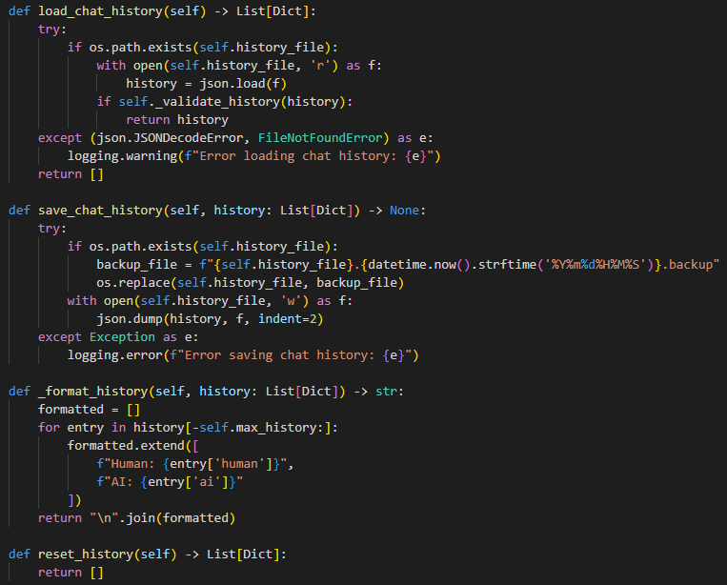
Model Implementation
Figure 13. History Management Functions

Slide 34
Model Implementation
Conversation History Management
These functions ensure that the conversation history is properly managed and can be used to provide context for generating responses.

Slide 35
Model Implementation
Special Command Handling and Intent Detection
The chatbot can handle special commands and detect user intents. The handle_special_commands() function processes commands like “reset,” “analyze,” “help,” and “feedback.” The detect_user_intent() function categorizes user input into intents such as “greeting,” “question," or "command."

Slide 36
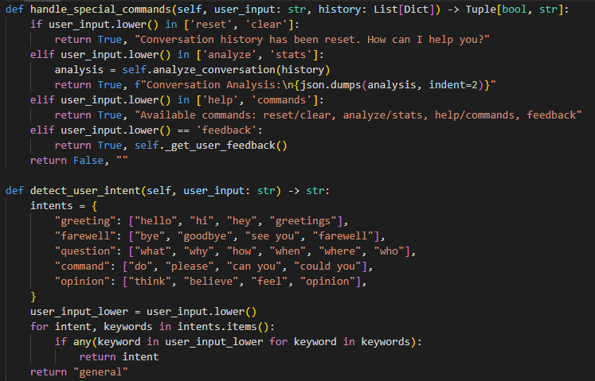
Model Implementation
Figure 14. handle_special_command() and detect_user_intent() functions

Slide 37
Model Implementation
Special Command Handling and Intent Detection
These functions enhance the chatbot's ability to interact with users by understanding and responding to specific commands and intents.

Slide 38
Training The Model

Slide 39
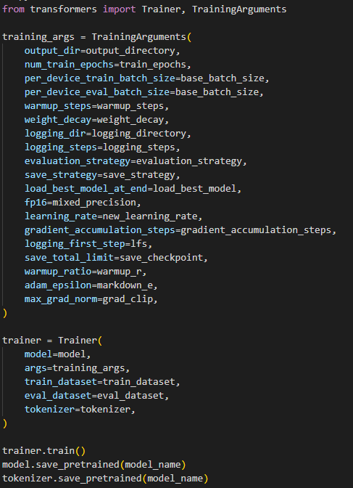
Training the model
Display Training Code
The training code uses the Trainer and TrainingArguments classes from the transformers library. This code sets up the training parameters and initiates the training process.
Figure 15. Training Code

Slide 40
Training the model
Key Parameters
The TrainingArguments class sets various hyperparameters for training . These parameters control aspects of the training process such as the number of epochs, batch size, learning rate, and more
output_dir: Specifies the directory for saving model checkpoints and logs
num_train_epochs: Sets the number of iterations over the training dataset
per_device_train_batch_size: Defines the number of training examples per batch on each device
per_device_eval_batch_size: Similar to per_device_train_batch_size, but for evaluation
warmup_steps: Gradually increases the learning rate during the initial steps

Slide 41
Training the model
Key Parameters
weight_decay: Applies regularization to prevent overfitting
logging_dir: Sets the directory for training logs
logging_steps: Determines the frequency of logging
evaluation_strategy: Specifies when to perform evaluation (steps or epochs)
save_strategy: Determines when to save model checkpoints (steps or epochs)
load_best_model_at_end: Loads the best model checkpoint at the end of training
fp16: Enables mixed-precision training for faster performance
learning_rate: Sets the initial learning rate for the optimizer
gradient_accumulation_steps: Accumulates gradients over multiple steps before updating
save_total_limit: Limits the number of saved checkpoints.

Slide 42
Testing and Evaluation

Slide 43
Training the model
The evaluation of the model demonstrates strong performance across several metrics. The model achieved a high accuracy of 0.9998, indicating that it correctly classifies the relationship between inputs and outputs the vast majority of the time.
Similarly, the precision of 0.8333 shows that when the model predicts a relationship between the input and output, it is correct most of the time. The recall is 1.0000, which means that the model correctly identified all instances of the expected relationship. The F1 score of 0.9091, which balances precision and recall, confirms that the model is highly effective. The average BLEU score of 0.0990 suggests that while the model's responses may not be perfect matches to the reference outputs, they are still reasonably similar and relevant.

Slide 44
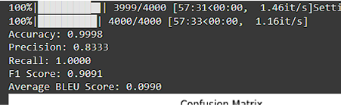
Training the model
Figure 15. Evaluation Metrics

Slide 45
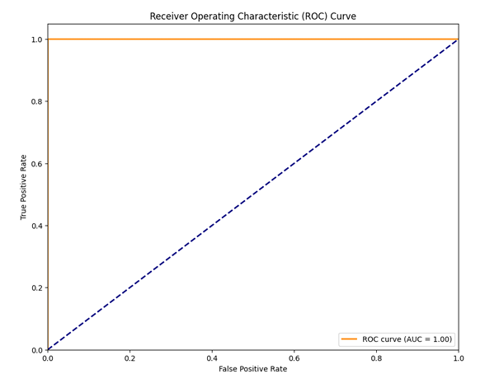
Training the model
Additionally, the model shows a high AUC-ROC of 1.00, indicating an excellent ability to distinguish between positive and negative cases.
Figure 16. ROC Curve

Slide 46
Training the model
Further, the token-level accuracy is also very high, and this means that individual words and tokens are very likely to be correct. These metrics, combined with the confusion matrix and response length distribution, demonstrate that the model performs effectively in terms of classification, response generation, and overall understanding. The high performance across multiple metrics indicates that the model is well-suited for its intended tasks, and analysis of the score distribution can inform future improvements.

Slide 47
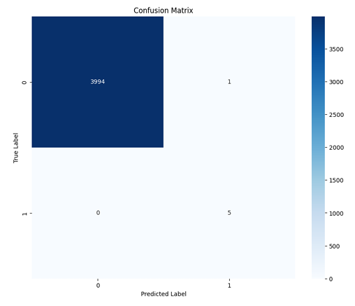
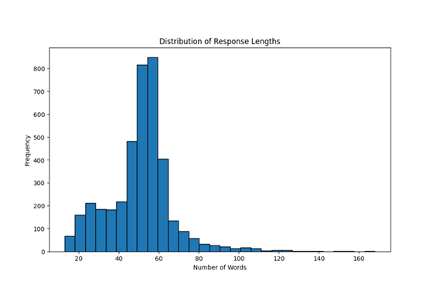
Training the model
Figure 17. Confusion Matrix
Figure 18. Distribution of Response Lengths

Slide 48
Challenges

Slide 49
Challenges
As we developed and implemented our chatbot, we encountered several significant challenges.
Our primary problem was ensuring data quality and diversity. We strived to create a synthetic dataset that accurately represented real-world queries while maintaining a balance across various topics and difficulty levels. Fine-tuning our model required us to carefully optimize hyperparameters, aiming to achieve a proper balance between generalization and specialization.
We found that effective context management was crucial yet complex, particularly in maintaining coherence during extended conversations. Accurate intent recognition, especially for ambiguous or multi-faceted queries, demanded that we implement sophisticated natural language understanding capabilities.

Slide 50
Challenges
We persistently worked on generating high-quality responses that avoid repetition and adapt to the user's knowledge level. Ethical considerations were at the forefront of our minds, and we carefully implemented safeguards to prevent the generation of inappropriate content and maintain general integrity.
We also focused on scalability and performance optimization to ensure smooth user experiences, even with concurrent users.
Lastly, we faced the ongoing challenge of developing a system for continuous learning and updating to keep our chatbot current with evolving computer science knowledge.

Slide 51
Conclusion

Slide 52
Conclusion
We have successfully developed and implemented an advanced chatbot for computer science-based queries, using a Transformer-based neural network with causal language modeling.
Our robust evaluation process demonstrated the chatbot's high performance, with impressive accuracy, precision, and recall scores. The implementation of our AdvancedChatbotManager class has resulted in a user-friendly interface with advanced functions for response generation, conversation history management, and special command handling.
Initial of our observations suggest that the chatbot effectively stimulates an interactive and engaging learning environment, providing real-time assistance to computer science users/students.

Slide 53
Conclusion
We've optimized the system for scalability and implemented ethical safeguards to maintain integrity. While we've achieved our primary objectives, we've identified areas for future improvement, including enhancing data quality and diversity, refining the model's fine-tuning process, and expanding the chatbot's capabilities.
As we continue to develop this tool, we anticipate it will play an increasingly important role in computer science field, providing students and users with accessible, accurate, and accurate support in their learning and studies.

Slide 54

Thank you very much

