Slide 1
Headaches – the missed causes
ETCM Congress, Prague, 2004
Henryk Dyczek
TCM practitioner & chiropractor Poland

Slide 2
Introduction 1
Headaches is one of the most widespread complaints in modern society. Traditional Chinese Medicine differentiates between headaches of internal and external origin. The improvements in living conditions make the frequency of the headaches of external origin few and far between (Maciocia, 2004).

Slide 3
Introduction 2
Exogenous types of headaches that are of external origin, on the whole, respond well to the TCM treatment protocols.
As far as the endogenous headaches are concerned, which are of internal origin, the complex diagnosis of the cause is needed and the positive effects of the TCM treatment are commonly slow to appear and require from the patient an increased level of commitment to make the positive effect of the TCM treatment long-lasting (The English-Chinese Encyclopaedia of Practical Chinese Medicine, 1990) .

Slide 4
Introduction 3
Over the years I have been looking for other modalities of treatment that would be more palpable and quicker in action.
Moreover, for the patient benefit I tried to find out the comprehensive reason for their headaches, which they can control and not become enslaved buy them.

Slide 5
Methodology 1
To to commence with I looked closely at the anatomical structure of the elements the head is made of, and its associations with the body.
Then I looked for the possible causes of the pathology of the structures.
Finally, I tried to work out the method of action that would reverse the apparent pathology of the tissue.

Slide 6
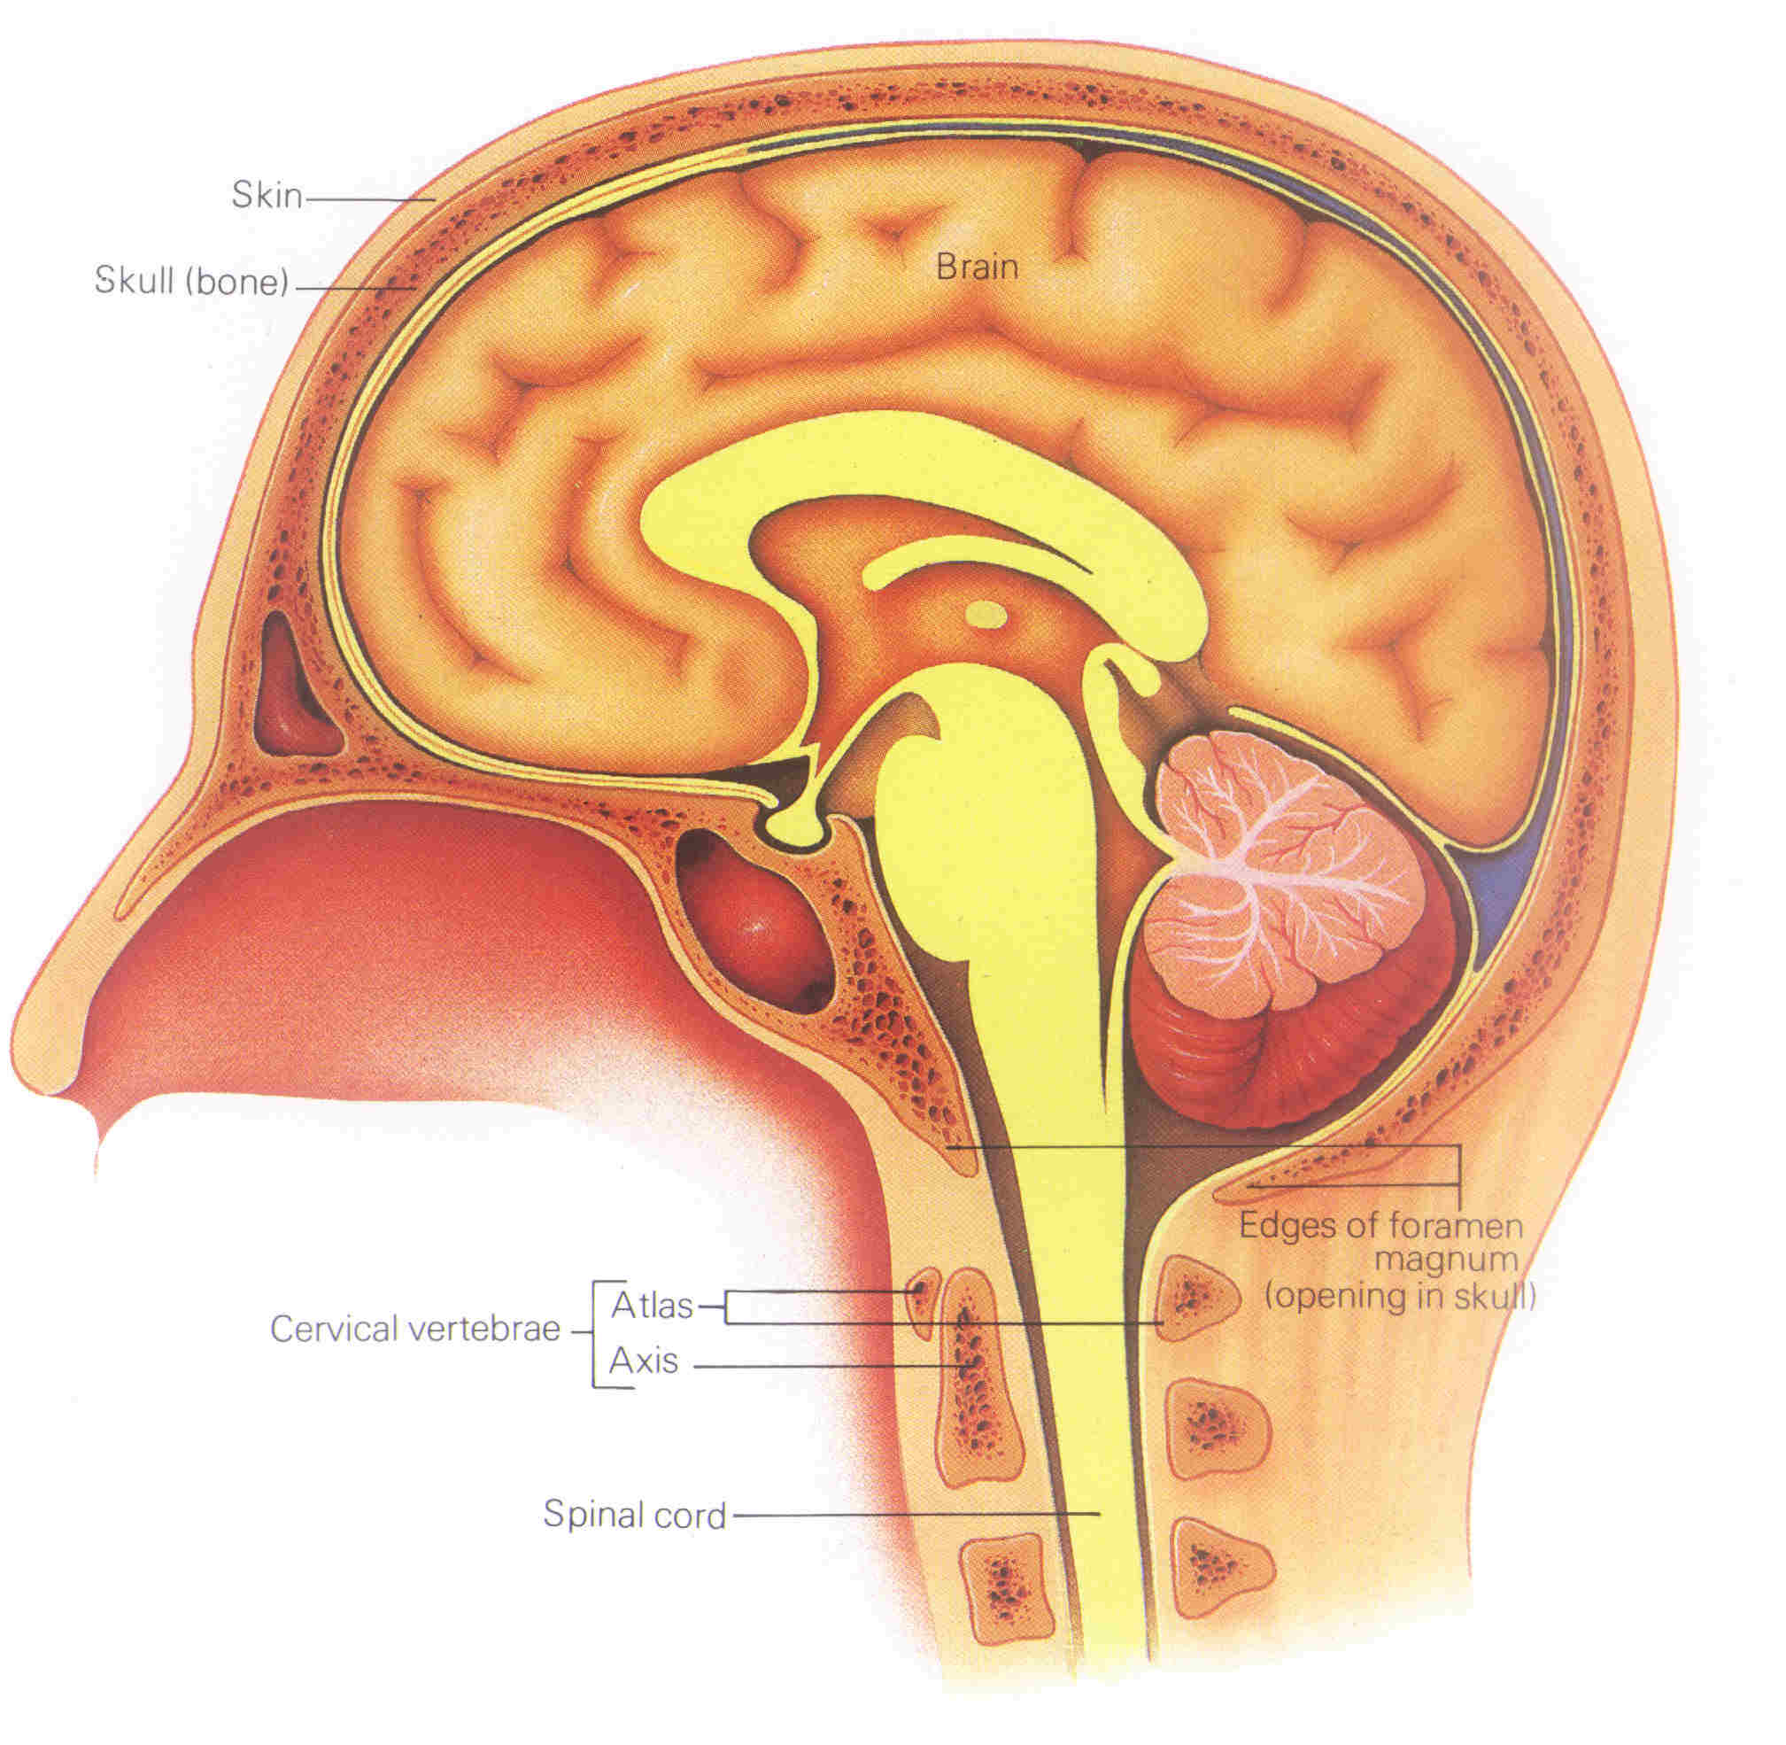
Fact 1
The soft tissue
fills the cranial
cavity.
(Atlas of Anatomy,
1985:13)

Slide 7
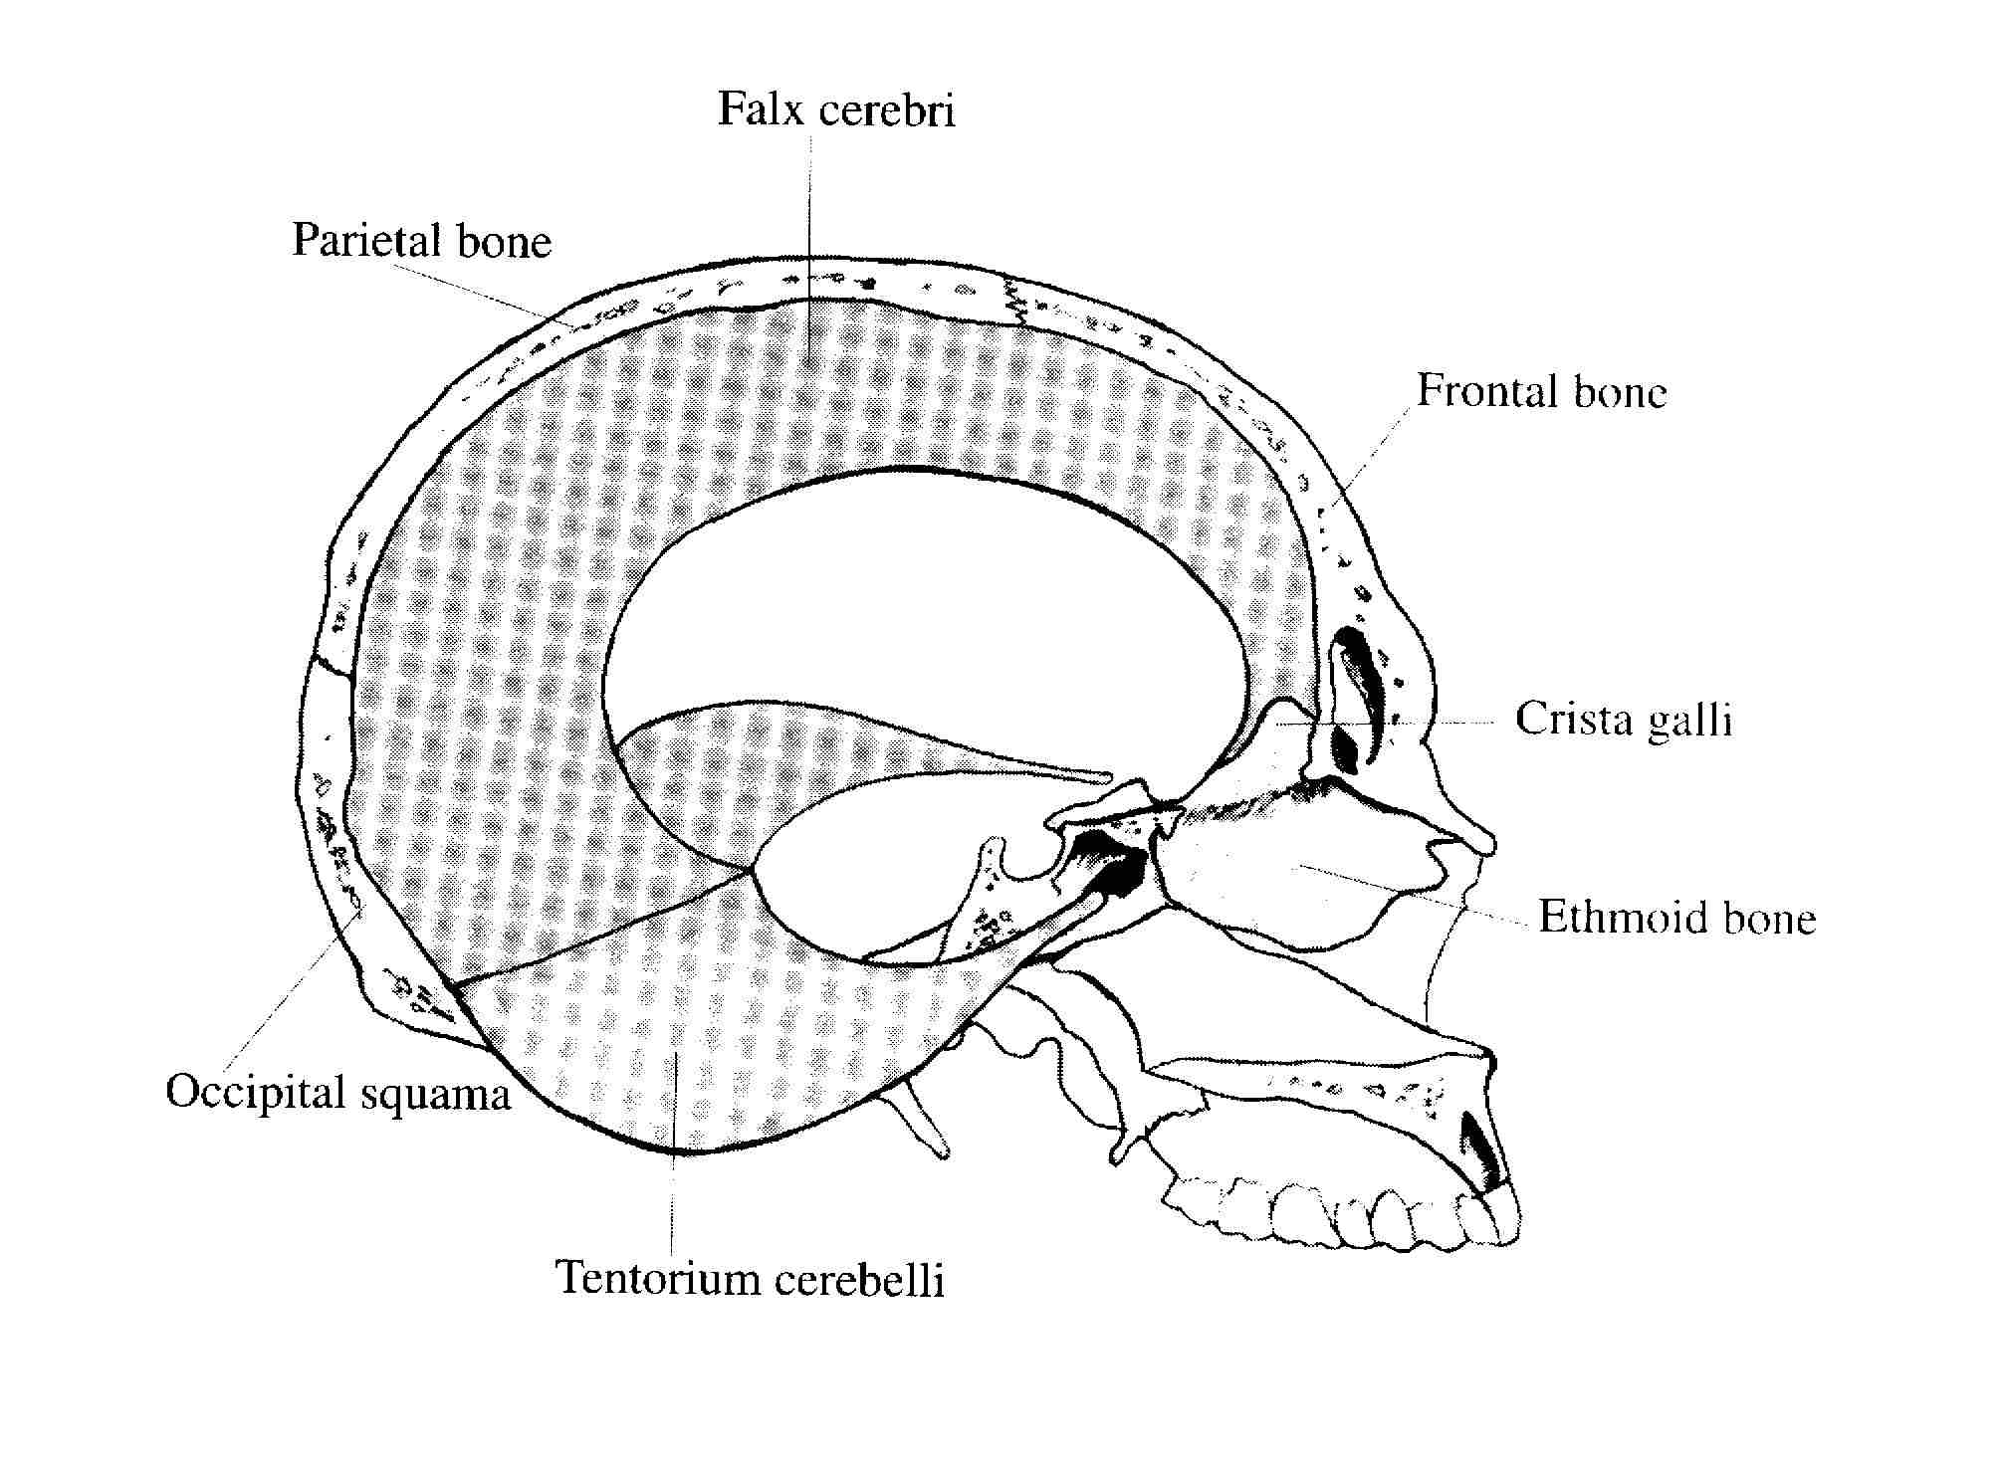
Fact 2
The system of
dural membranes
creates partitions,
which form
the support
for the cerebellum
and
cerebral hemispheres.
(Sills, 2001:22 & 24)

Slide 8
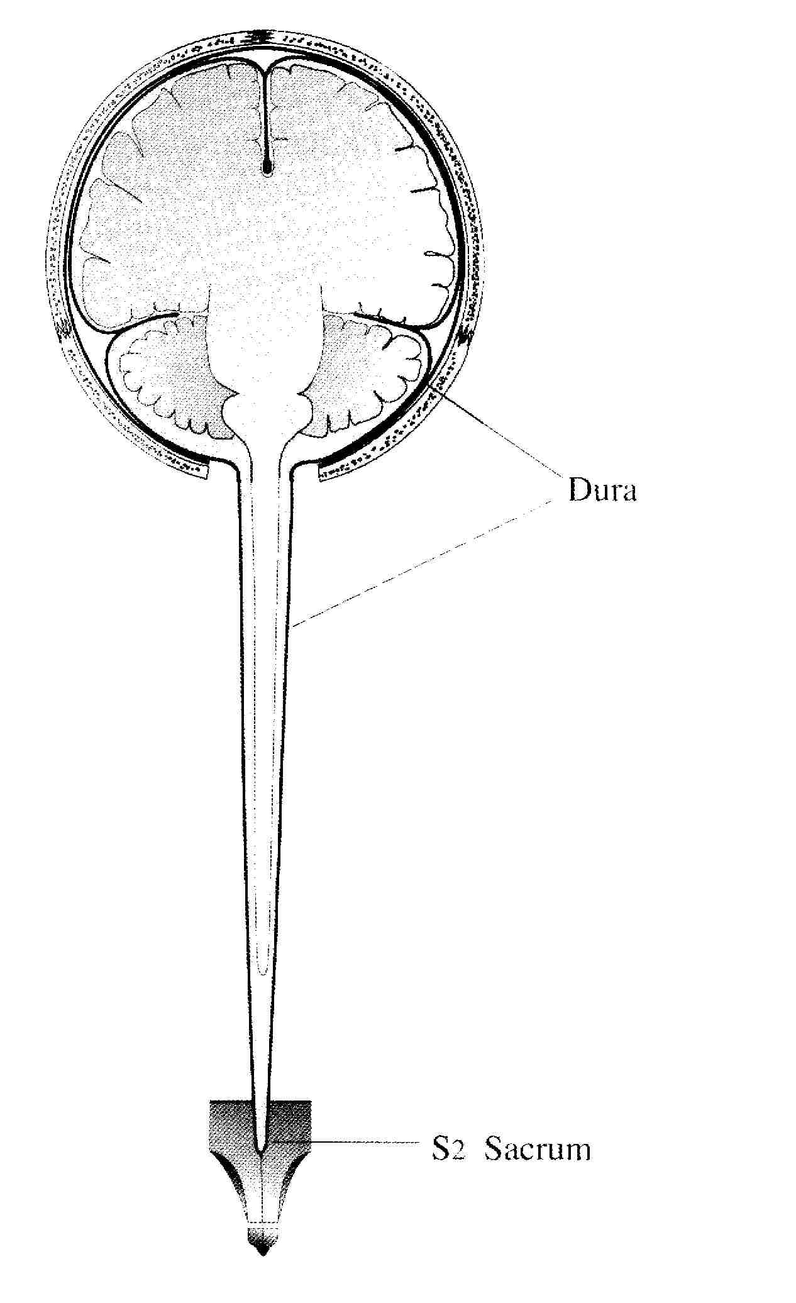
Fact 3
The cranial dural membrane
is continuous with the
spinal dural membrane.
(Sills, 2004:53)

Slide 9
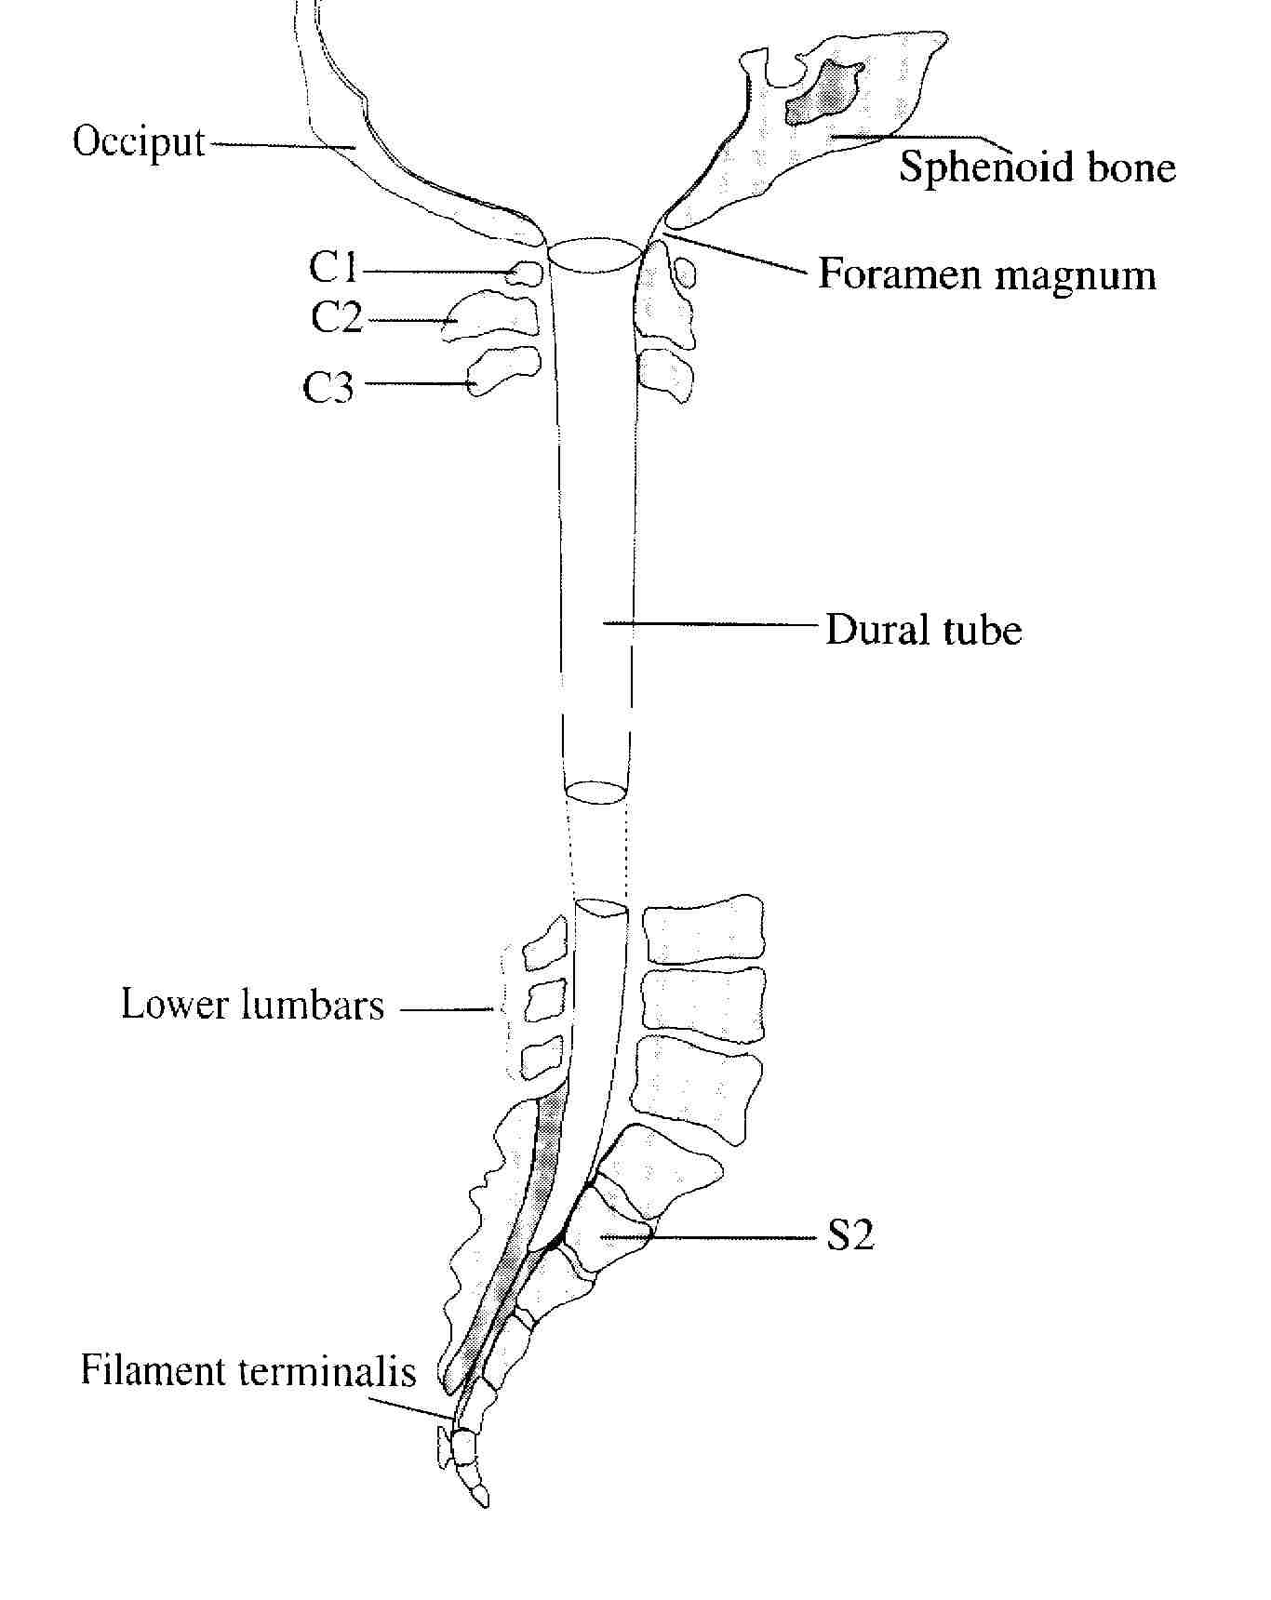
Fact 4
The spinal dural
membrane
attaches firmly
at the level of
foramen magnum
and the
second sacral
segment.
(Sills, 2001:29)

Slide 10
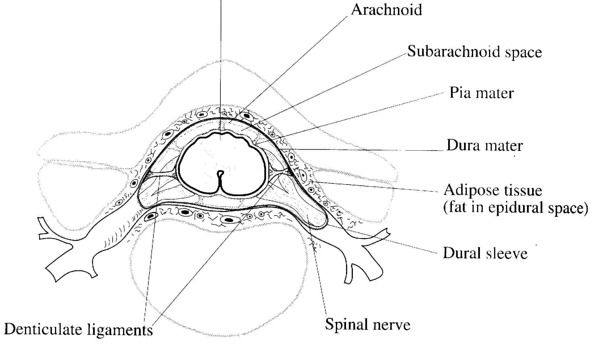
Fact 5
The spinal cord is anchored to the the dural tube via denticulate ligaments that stabilize the spinal cord within the dural spinal tube (Sills, 2004:56).

Slide 11
Fact 6
Sills (2004:56) says:
„ I have seen dissections of the spinal canal in which this internal ligaments have been severely torsioned, generating adhesions between the meaningeal layers.
This was clearly because of torsioning of the dural tube as the whole.

Slide 12
Fact 7
These patterns are commonly generated by torsioned relationship between:
the occiput
and the sacrum,
and can also relate to rotations between vertebrae.

Slide 13
Fact 8
Adhesions within the meninges due to the denticulate ligaments being torsioned will have a profound effect on the dynamics of potencies (the force of flow), fluids (cerebro-spinal fluid), and tissues.”

Slide 14
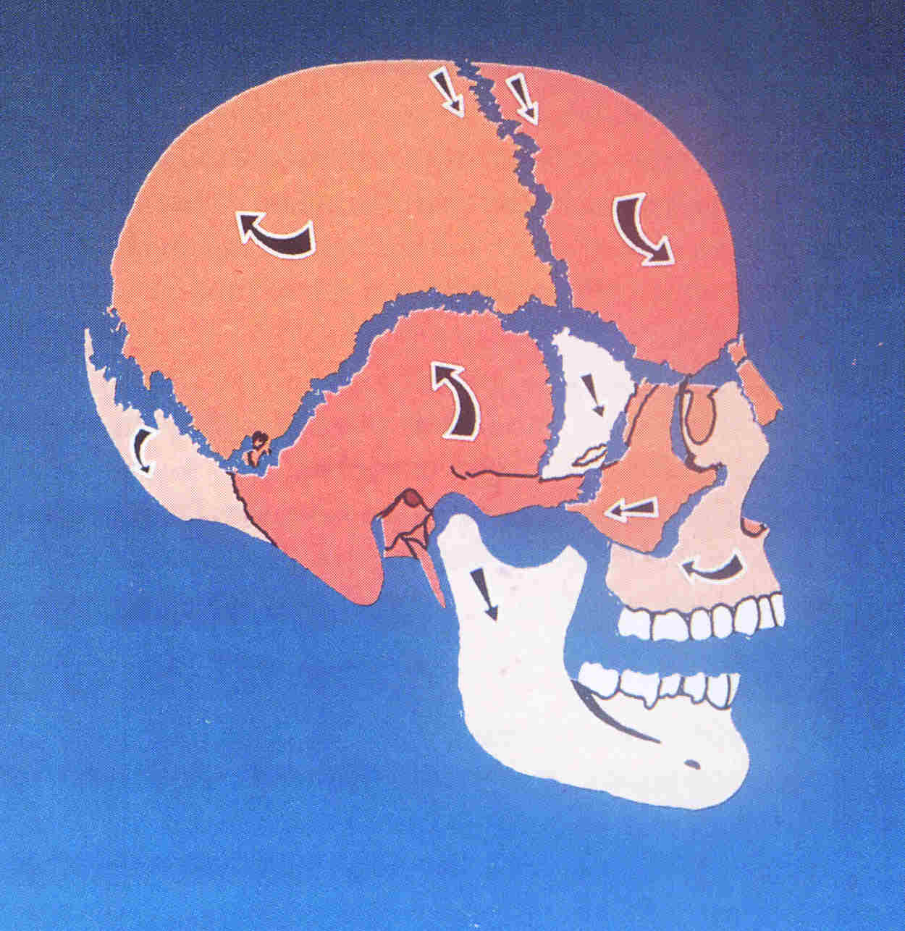
Fact 9
The occipital bone
(the occiput)
is one of the
elements
in the dynamic
structure of the
skull.
(Cranial Communication
Systems, Oxford)

Slide 15
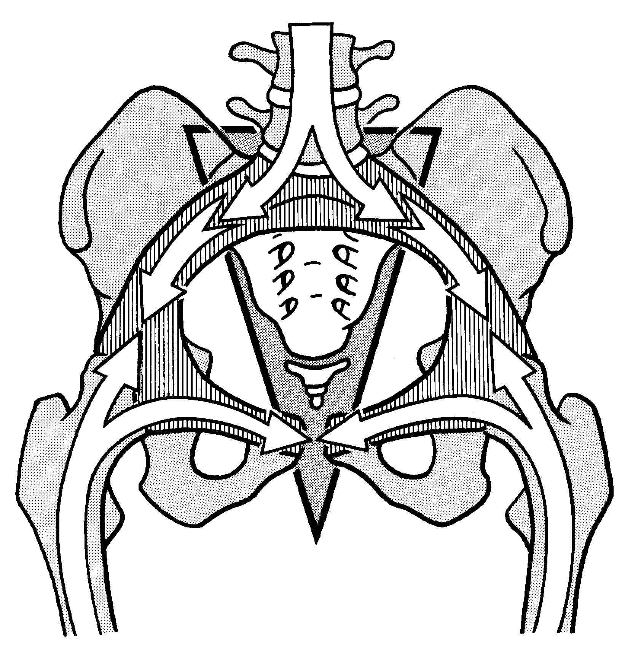
Fact 10
The sacral bone
(the sacrum) is
the basement bone
of the human spine
and the key
(central) bone
to the pelvis.
(Kapandji, 1998:57)

Slide 16
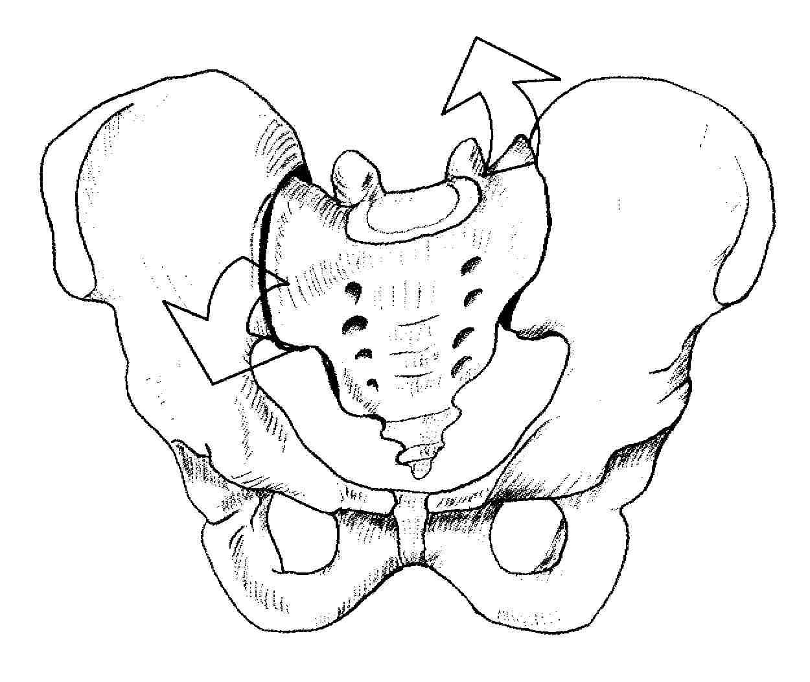
Fact 11
Princiapally,
pelvic
biodynamics
are responsible
for the vertebral
anomalies.
(Sills, 2004:99)

Slide 17
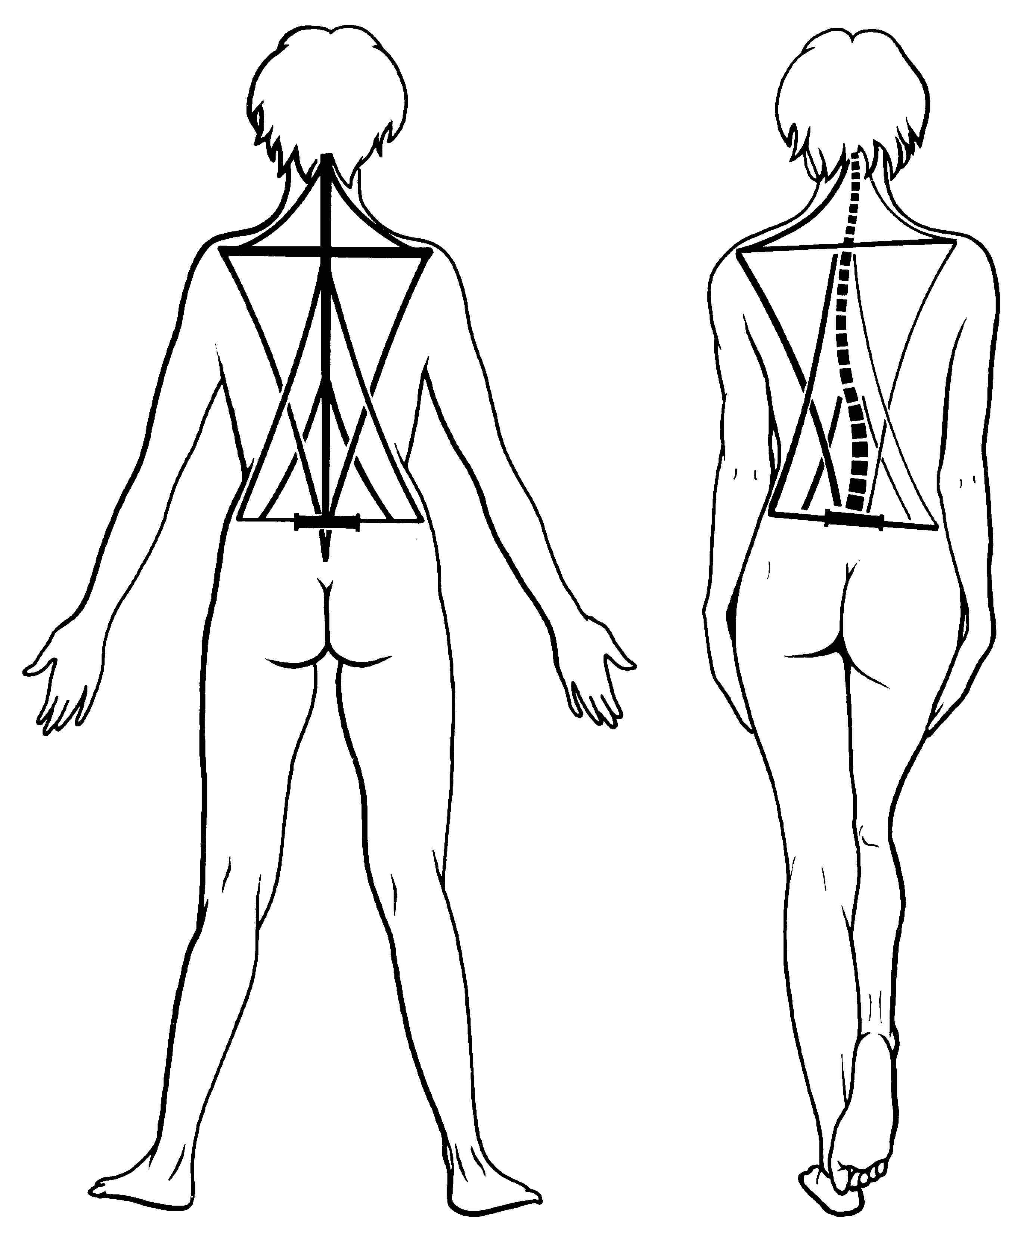
Fact 12
Incidentally,
the human posture
is totally
dependent
on the position
of the pelvis.
(Kapandji, 1998:11)

Slide 18
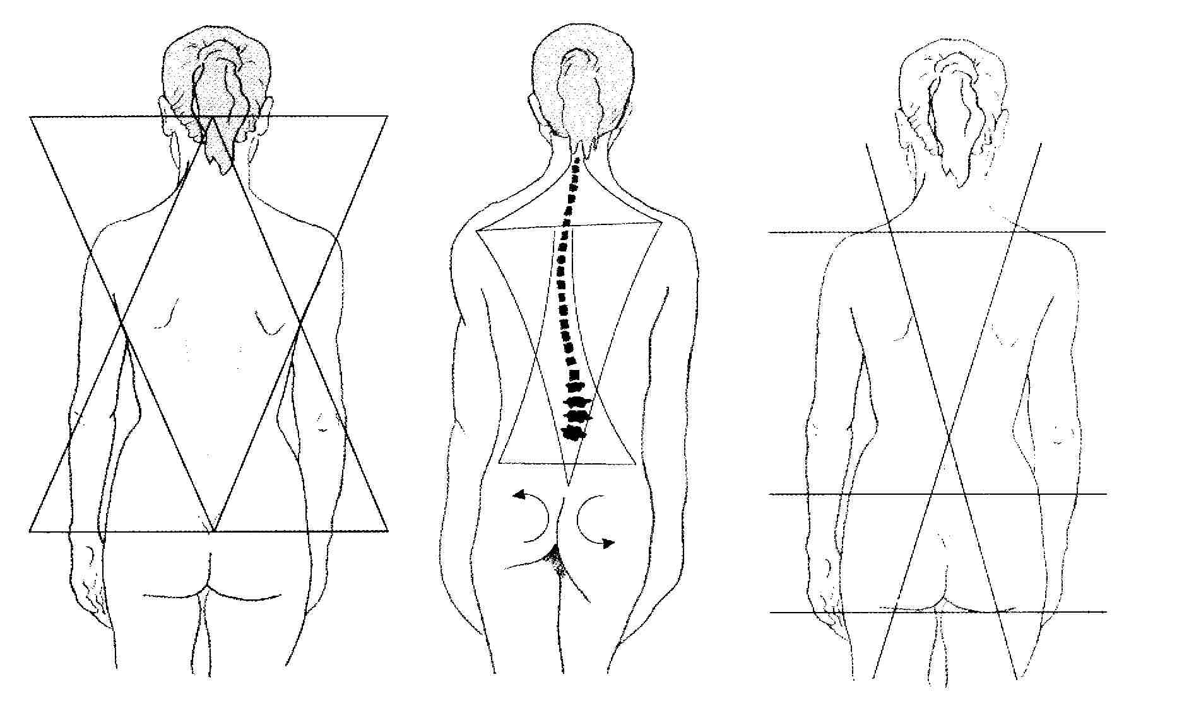
Fact 13
The pelvic biodynamic not only affects the spine, but the base of the skull, i.e.
the occipital bone (Sills, 2004:71).

Slide 19
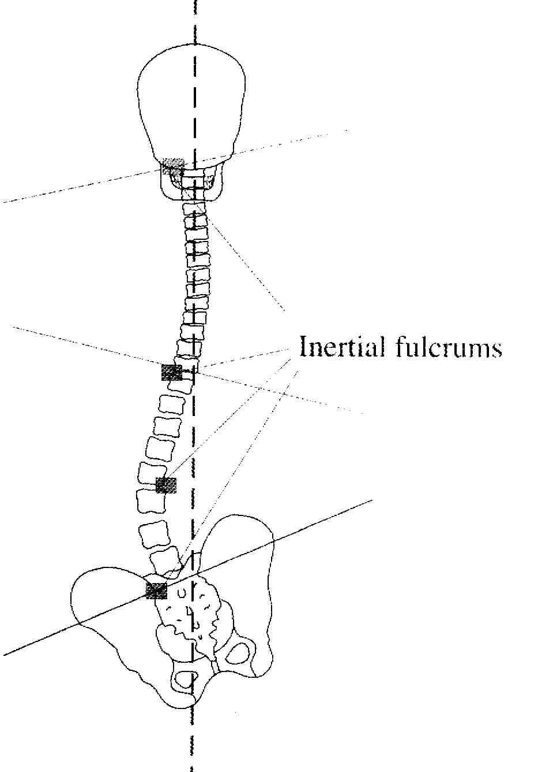
Fact 14
A fixation
within the pelvic
biodynamic
system
will manufacture
compensation
in the whole
spine
(Sills, 1998:72)

Slide 20
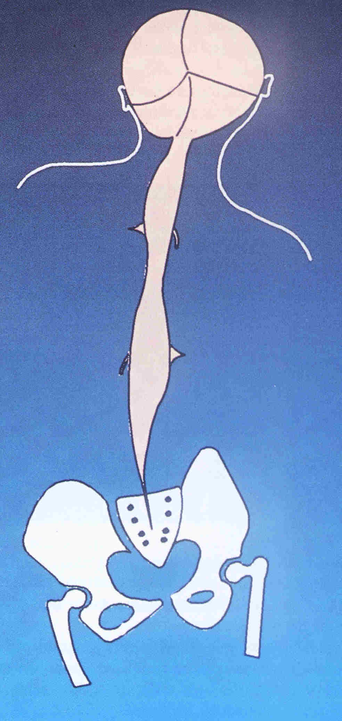
Fact 14
The compensation
mechanisms
located
anywhere in
the body
create unnatural
tension throughout
the tissue of the body.
(CCS, Oxford)

Slide 21
Hypothesis 1
Headaches may be the result of unnatural tension of the tissue.
Tissue tension naturally manifests as pain.

Slide 22
Hypothesis 2
Tensed soft tissue irritates, compresses and pulls the surrounding structures such as:
bones – causing their misplacement;
nerves – decreasing their physiological performance;
blood vessels – reducing blood supply.

Slide 23
Hypothesis 3
Bone displacement,
according to Sills (2004), particularly the vertebrae and the cranial bones produces a pathological tension of the meninges.
In my experience the meaningeal tension is a factor that contributes to headaches.

Slide 24
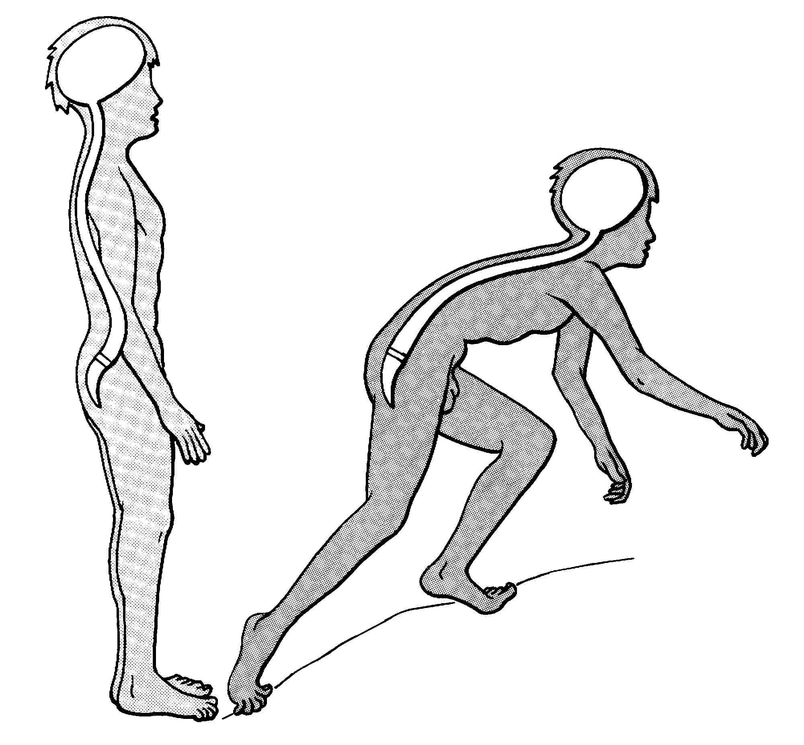
Conclusion 1
Human body
has to be seen
as a whole.
(Kapandji, 1998:17)

Slide 25
Conclusion 2
Headaches may be the result of the soft tissue tension.
Vertebral, sacral and pelvic fixations manufacture tissue tension and therefore contribute to the meaningeal adhesions that may produce the symptoms of a headache.

Slide 26
Conclusion 3
The treatment of headaches may require modalities of treatment that recognize the afore mentioned facts.
In my experience McTimoney-Corley chiropractic and / or cranio-sacral therapy proved sufficient in the elevation of headaches.

Slide 27
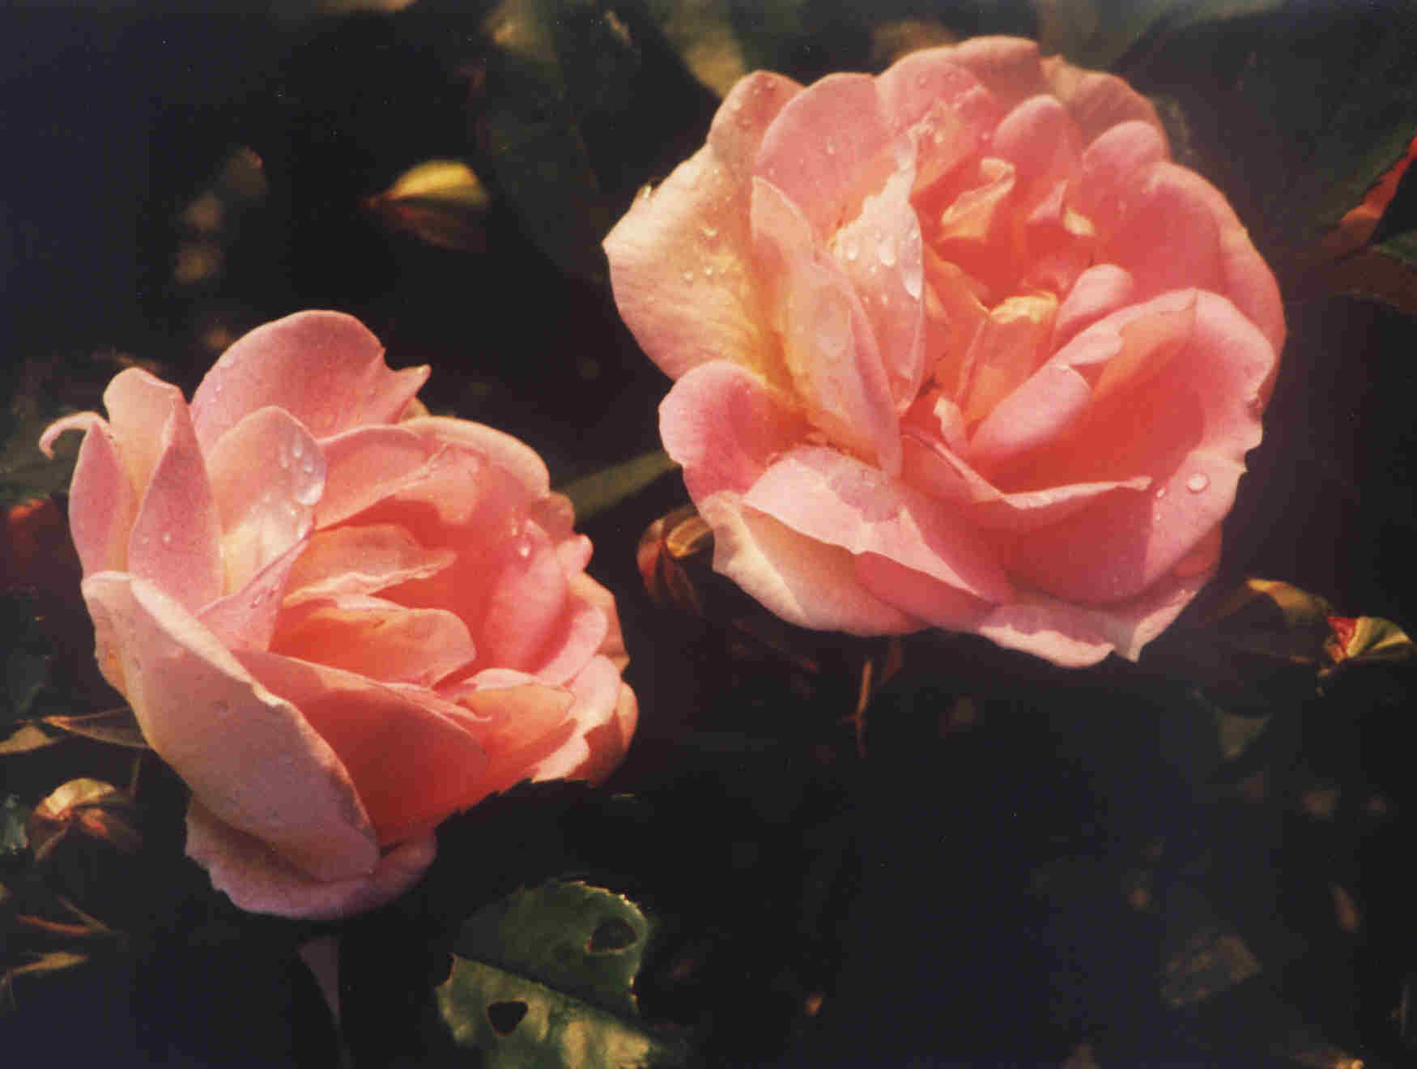
Ladies & gentlemen thank you for your attention!

Slide 28
Henryk Dyczek
henryk.dyczek@man.torun.pl
Poland

Slide 29
Literature
Atlas of Anatomy. 1985. London: Marshal Cavendish
Cranial Communication Systems (CCS), 14 Holyoak Rd. Oxford OX3 8AE
Kapandji I.A. 1998. The Physiology of the Joints. Edinburgh: Churchill Livingstone
Sills F. 2001. Craniosacral Biodynamics. California: North Atlantic Books
Sills F. 2004. Craniosacral Biodynamics. California: North Atlantic Books

