Slide 1
The analysis of the amalgamation of acupuncture into the mainstream medicine in the period of time from 1965 to August 2003
ETCM Congress, Prague, 2004
        Henryk Dyczek,
        TCM practitioner
        & chiropractor
        Poland

Slide 2
Abstract 1
Alternative medicine, namely acupuncture, chiropractic and homeopathy, appeared in the Western Europe in the sixties of the last century. To start with, it was feared and looked down on, but at present, it occupies the space of the majority of the medical journals, and the public demand for its services is on the increase.

Slide 3
Abstract 2
This presentation will focus on acupuncture.
Nevertheless, the author of the presentation carried out similar analysis for chiropractic and homeopathy.

Slide 4
Introduction 1
Taking up the study of Traditional Chinese Medicine at the College of Traditional Chinese Acupuncture in Leamington Spa, U.K. in 1985 was like venturing on a trip without a map into a nomad land. The notion of the word acupuncture caused some noticeable symptoms of bewilderment in interlocutors and for the majority it was a taboo word.

Slide 5
Introduction 2
At that time the medical profession regarded acupuncture as an absolute witchcraft that should not be even touched with a barge pole. The climate for acupuncture have got even worse after a courageous medic from Northamptonshire punctured too deep with an excessively long needle an elderly person chest causing her to develop pneumothorax after which the patient died.

Slide 6
Introduction 3
The climate for acupuncture began to change for better in the early nineties, since more sensational articles about a miracle cure with acupuncture appeared in the popular press, and that was followed by scientific research, which demonstrated and proved the benefits of acupuncture.

Slide 7
Introduction 4
In mid nineties the interest in acupuncture was so widespread that I even conducted some workshops on acupuncture with the fifth year medical students at Oxford University both in their campus and in my private practice.

Slide 8
Introduction 5
Since the fact that I have been living through the evolution of alternative medicine into the mainstream medicine in the U.K., I thought about collecting the available data on the topic of acupuncture, chiropractic and homeopathy, and subject it to the critical evaluation in order to see whether my afore presented assumptions, on the status of Alternative Medicine in the Western world, throughout the years, can be justified.

Slide 9
Methodology 1
In the first step of my analysis I have collected all the articles on the subject of acupuncture,
which were available at the PUBMED Webside from
1965 – to August 25th, 2003
that gave me the database consisting of:
4085 entries for acupuncture

Slide 10
Methodology 2
For the clarity of my analysis I have decided to divide, within the set fields, all corpora in the 10-year periods:
• 1965 – 1974
• 1975 – 1984
• 1985 – 1994
• 1995 - 2003

Slide 11
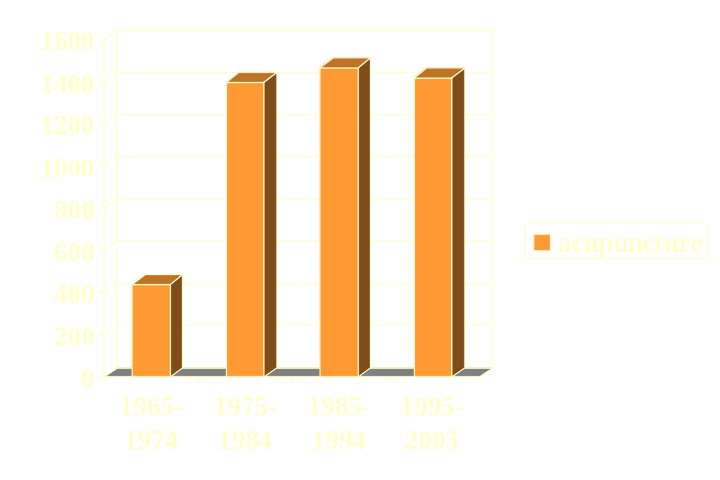
Methodology 3
Number of articles about acupunture:

Slide 12
Methodology 4
In the next step I removed all the redundant information, leaving just the title of the article. Below I present an example of a PUBMED entry out of which I have left only the title (for emphasis printed in bold italics).
1187: Hu J.
Acupuncture treatment of manic psychosis.
J Tradit Chin Med. 1996 Sep;16(3):238-40. No abstract available

Slide 13
Methodology 5
My choice of the article titles for the analysis is justified by the fact that both Singer (1990) and Simonton (1992) say that titles of articles and most of the written material, without bias, represent the essence of the topic presented and the character of an article. What's more, the titles assist us to retain and to embrace the information contained in the text topic.

Slide 14
Methodology 6
Additionally, according to Hongenraad & Bestgen (1992:2):
raw data of scientific articles is more appropriate to the content analysis , as titles are void of many redundancies usually found in language. Computer-aided content analysis might also be best suited to that purpose because it rests on algorithmic procedures that dispense with the necessity of having their own discourse analysed.

Slide 15
Methodology 7
All the most frequently appearing words, as well as semantic titles, were content analysed for their general, permanent, and reproducible meaning with the use of the relevant dictionaries. I used the Blakiston’s Pocket Medical Dictionary (1980), Dictionary of Mind and Body (1995), and Webster’s Third New International Dictionary (1993) for the assessment of the point of reference directly associated with theme and meaning.

Slide 16
Methodology 8
In the second step of my research,
the prepared corpora of acupuncture was compared to BNC written sample in four time periods (i.e. 1965-1974, 1975-1984, 1985-1994, 1995-2003) with the use of Wmatrix program, thanks to the courtesy of Lancaster University, U.K..

Slide 17
Methodology 9
The categories of word and semantic frequencies, were collated for the purpose of my examination in the form of the table, at the set periods, for the purpose of my analysis.

Slide 18
Methodology 10
Thirdly, I have evaluated the meaning of the topics appearing in the frequency lists with the help of medical dictionary and then through the scrutiny of the associations present amid the most frequently appearing words in each Medline entry. The choice of the words presented in my results and discussion has been dominated by the relevance of the word and its meaning to the topic of my study.

Slide 19
Methodology 11
In my experiment I have endeavoured to demonstrate an authoritative technique of obtaining an amalgamated view of the history of the development of acupuncture into the mainstream medicine of the Western World.

Slide 20
Methodology 12
The words and the semantic fields put under my scrutiny held the minimum LogLielihood (LL) value of 3.3

Slide 21
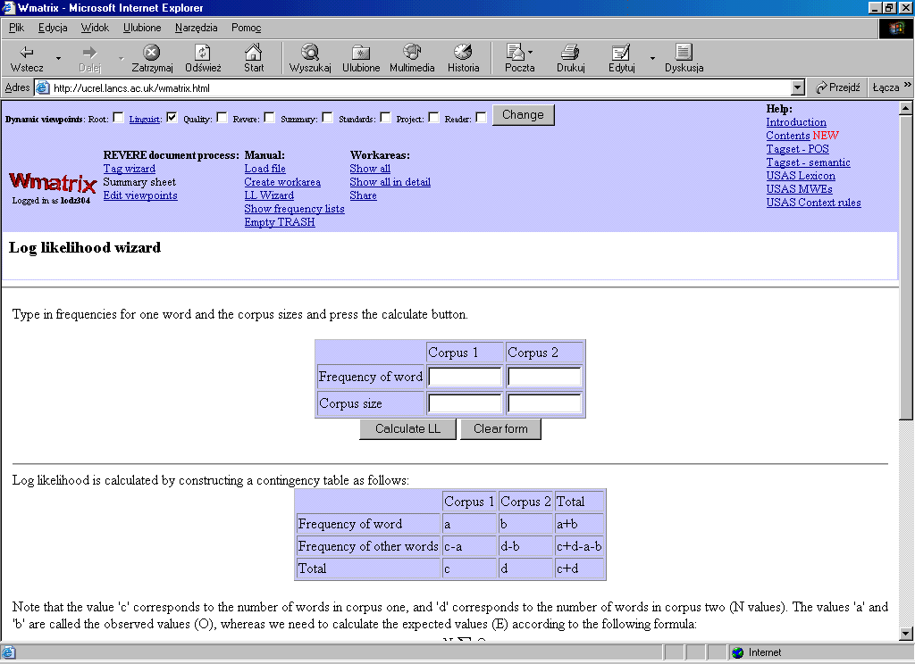

Slide 22
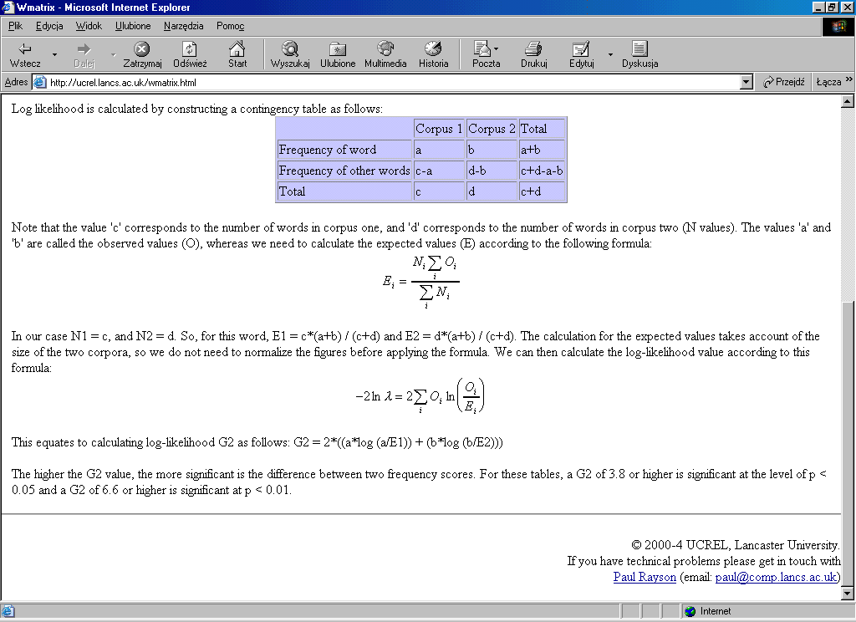

Slide 23
Results and discussion 1
In my choice of the words and semantic subjects I have strived to select, the same words, e.g. effects / effect, or semantic subjects i.e. caution

Slide 24
Results and discussion 2
In the choice of the words and the semantic areas I have been guided by the possible relevance of the theme and the meaning to subject of my examination, though as already indicated.

Slide 25
Results and discussion 3
Consequently the words like acupuncture, chiropractic, homeopathy, manipulation, spinal, allergic, etc. have purposely been ignored .

Slide 26
Results and discussion 4
Some other words that are connected with the modalities of medical processes (e.g. anesthesia, electromyography, radiology), names of bodily pathologies (e.g. angina, back pain, hernitation, migraines), names of the fields of medicine (e.g. orthopedic, neurology, pediatric) have been regrettably omitted, since their critical analysis would require a lot of discussion space, which would go beyond the scope and the set limits of this presentation.

Slide 27
Results and discussion 5
(1965-74)
Acupuncture v/s the BNC written sample
1965- 1974
This period is characterized by a number of studies, which seem to look for the possible application of acupuncture treatment. It seems from the corpus examples containing the keywords such as effect, effects, evaluation, effectiveness and results that acupuncture was primarily used in anaesthesiology.

Slide 28
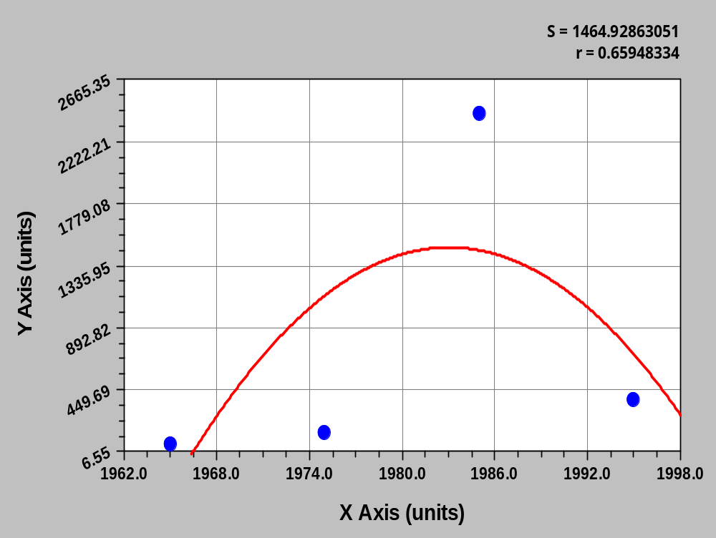
Results and discussion 6
EFFECT / EFFECTS

Slide 29
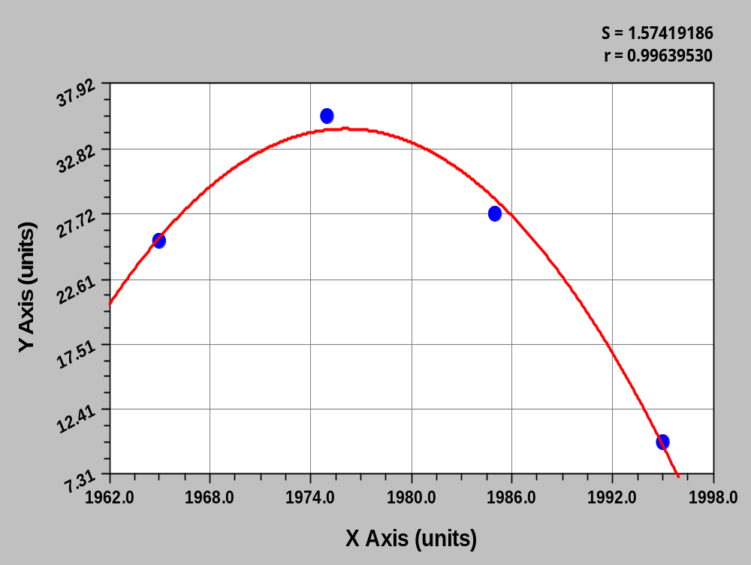
Results and discussion 7
EVALUATION

Slide 30
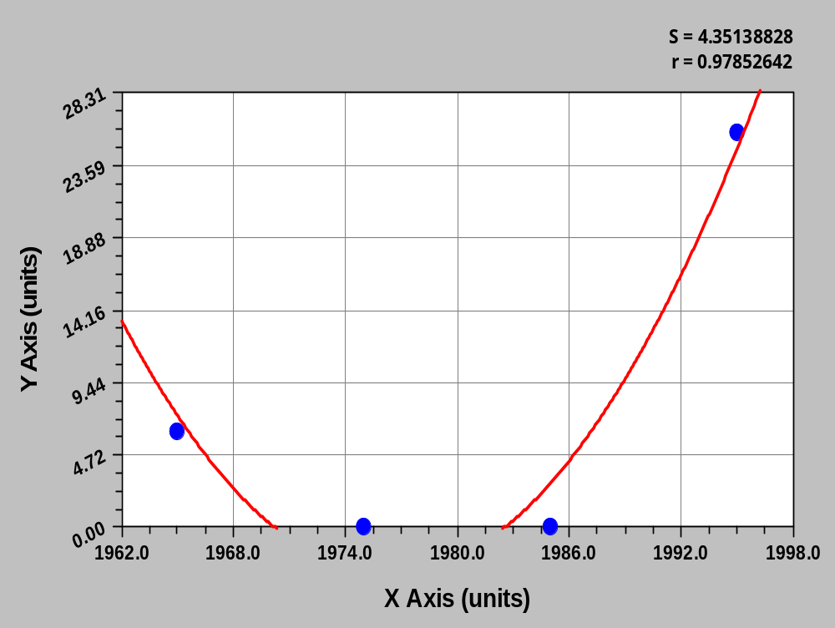
Results and discussion 7
EFFECTIVENESS

Slide 31
Results and discussion 8
(1964-1974)
In the period 1964-1974, there were attempts to evaluate acupuncture:
Clinical evaluation of acupuncture;
Methodology in the evaluation of the changes in autonomic regulation during Acupuncture (evaluation keyword),

Slide 32
Results and discussion 9
(1964-1974)
as well as attempts to understand it:
Acupuncture and scientific medicine; Modern scientific medical acupuncture (scientific keyword),
Some general mechanisms of the effect of acupuncture (effect keyword),
Acupuncture: dilemmas, problems, perspectives (perspective keyword),
Acupuncture: witchcraft or wizardry? (witchcraft keyword).

Slide 33
Results and discussion 10
(1964-1974)
The examination of the meaning behind the key semantic fields of that period substantiates the process acupuncture went through:
Acupuncture anesthesia in operations in shock and critical cases (fear/bravery key semantic field).

Slide 34
Results and discussion 11
(1964-1974)
One can also notice, from the titles of the articles that at the time the nature of acupuncture was not totally understood in the Western World:
Enlightenment in body contacts; The nature of acupuncture ( learn and green issue key semantic fields).

Slide 35
Results and discussion 11
(1975-1984)
In this period there is a clear sign of wide-ranging application of acupuncture that is not being just limited to acupuncture anaesthesia, as it appears in the effect and complications list of the examples for the keywords:

Slide 36
Results and discussion 12
(1975-1984)
The effect of acupuncture using reinforcing and reducing methods on nail
microcirculation and local skin temperature.

Slide 37
Results and discussion 13
(1975-1984)
Effect of acupuncture therapy on external respiratory function in bronchial asthma patients.
The effect of acupuncture in 300 cases of acute lumbar sprain.
Effects of acupuncture anesthesia on the pituitary gland.

Slide 38
Results and discussion 14
(1975-1984)
Effect of acupuncture on the body's immunobiological reactivity of sailors.
The bronchodilating effect of acupuncture in patients with acute asthma.
Radioisotope study of the effect of acupuncture on the articular
vascularization of the knee.
The effect of acupuncture in curing the smoking habit, 210 cases.
Role of acupuncture in the treatment of standard postoperative complications.

Slide 39
Results and discussion 15
(1975-1984)
It would be unnatural, not to find any negatively critical voices about acupuncture in its early days, which is offered in the complications and hazards list of examples for the key words:
Adverse reactions, contraindications and complications of acupuncture and
moxibustion.

Slide 40
Results and discussion 16
(1975-1984)
Complications in acupuncture therapy
The hazards of acupuncture.

Slide 41
Results and discussion 17
(1975-1984)
The titles quoted so far do not indicate clearly, whether acupuncture had gained any noticable applause from the scientific community.
However, the title:
Reception of acupuncture by the scientific community: from scorn to a degree of interest.
Calls for a review of my statement.

Slide 42
Results and discussion 18
(1975-1984)
Moreover, the listed titles confirm that the scientific community sees acupuncture as a valuble form of medicine.
The potential of acupuncture for the behavioral sciences.
The scientific site of acupuncture
The scientific basis and practice of acupuncture and homeopathy

Slide 43
Results and discussion 19
(1975-1984)
Scientific aspects of acupuncture.
Toward establishing scientific credibility in acupuncture research.
Scientific advance in acupuncture.
Scientific valuation of acupuncture.

Slide 44
Results and discussion 20
(1975-1984)
The scientific research into the issue of acupuncture contributed enormously to its credibility, since it was not rare, at the time in Europe and America to come across the idea unambiguously stated in the title:
Science, acupuncture and Satanism .

Slide 45
Results and discussion 21
1985-1994
The list of examples for the keywords effect and effects there is a talk about the influence acupuncture might have on human, animal and plant physiology, rather then just looking at curing named diseases with acupuncture, which is the sign of change in the perception of acupuncture and of an effort to understand its nature.

Slide 46
Results and discussion 22
1985-1994
Effects of acupuncture on blood pressure, SOD,LPO and five kinds of trace elements to stenosis of renal artery caused hypertension in rats.

Slide 47
Results and discussion 23
1985-1994
The experimental study of prevention and treatment of the side-effects of chemotherapy with acupuncture (comparison among the effect of acupuncture at different acupoint).

Slide 48
Results and discussion 24
1985-1994
Effects of acupuncture and transcutaneous stimulation analgesia on plasma hormone levels during and after major abdominal surgery.
Experimental evidence of a plant meridian system: I. Bioelectricity and acupuncture effects on electrical resistance of the soybean.

Slide 49
Results and discussion 25
1985-1994
There is also a suggestion of the application of acupuncture for the treatment of mental complaints, and not only physical complaints as it was the case so far:
A controlled study of clinical therapeutic effects of laser acupuncture for Schizophrenia.
Effects of sham and real auricular needling: implications for trials of acupuncture for cocaine addiction.

Slide 50
Results and discussion 26
1985-1994
The existing controversy about the efficacy of acupuncture treatment is being taken up in the title:
Controversy corner revisited: Scientific evaluation of "acupuncture: The position paper of the National Council Against Health Fraud".

Slide 51
Results and discussion 27
1985-1994
From the quoted title it is rather difficult to decide whether the evaluation was positive, or negative about acupuncture treatment, nevertheless, the fact that the issue was taken up by the National Council is the sign of the widespread use of acupuncture in treatment and research.

Slide 52
Results and discussion 28
1985-1994
The titles suggest, however, that the National Council’s opinion was in favour of acupuncture.
The scientific rationale, clinical practice, and future of acupuncture in the United States.
Acupuncture and scientific point of view-there are no short cuts to health.
The scientific basis of acupuncture.

Slide 53
Results and discussion 29
1985-1994
In the key semantic fields of that period, in the safety/danger key semantic fields, there is a talk about the strength of acupuncture for pregnant women of a risk group,
but the need to introduce strict sterilizing needle procedure is indicated to eliminate the possibility of passing blood born infectious diseases, i.e. hepatitis B.

Slide 54
Results and discussion 30
1995-2003
In this period the titles included in the record of examples for the keywords: effect, adverse and complications is loaded with warning about possible misfortunes of acupuncture treatment:
Risks and adverse effects of acupuncture therapy.

Slide 55
Results and discussion 31
1995-2003
Acupuncture may be associated with serious adverse events.
Fatal and adverse events from acupuncture: allegation, evidence, and the implications.
Rare but serious complications of acupuncture: traumatic lesions.
Acupuncture: complications, contraindications and informed consent.

Slide 56
Results and discussion 32
1995-2003
But despite the criticism of acupuncture there is a strong hint in the following titles of the same list of examples for the keywords that the mishaps of the treatment are not caused by acupuncture itself, but rather, or most likely, through its careless administration.

Slide 57
Results and discussion 33
1995-2003
Learning from adverse events of acupuncture.
Traumatic complications of acupuncture. Therapists need to know human anatomy.

Slide 58
Results and discussion 34
1995-2003
Scientific research seems to be still struggling to understand in the traditional scientific terms the nature of acupuncture:
Feels acupuncture lacks scientific evidence .
Can Western science provide a foundation for acupuncture?

Slide 59
Results and discussion 35
1995-2003
On the other hand, it seems that the science carries out more studies, which purpose is to show how acupuncture works (the list of examples for the keywords: science, scientific and research):
Scientific bases of acupuncture analgesia;

Slide 60
Results and discussion 36
1995-2003
Acupuncture-from empiricism to science: functional background to acupuncture effects in pain and disease;
On the evaluation of the clinical effects of acupuncture: a problem reassessed and a framework for future research;

Slide 61
Results and discussion 37
1995-2003
Bridging the gap in complementary and alternative medicine research:
manualization as a means of promoting standardization and flexibility of treatment in clinical trials of acupuncture;

Slide 62
Results and discussion 38
1995-2003
Finally the scientific community speculates how to place acupuncture into a complementary medicine bag:
A scientific perspective on developing acupuncture as a complementary medicine.

Slide 63
Results and discussion 39
1995-2003
which then can possibly be implemented, as an option, in health care services, since the title hints:
National Health Service funding for complementary medicine research: the NHS acupuncture trials.

Slide 64
Results and discussion 40
1995-2003
The subject of possible implementation is as well hinted in the title:
Acupuncture outcomes, expectations, patient-provider relationship, and the placebo effect: implications for health promotion.

Slide 65
Results and discussion 41
1995-2003
Lastly, the title:
The reporting of clinical acupuncture research: what do clinicians need to know?
suggests that possibly some conclusion was reached how to carry out research in acupuncture to make its therapeutic effects objective, so they can stand up against the tough scientific scrutiny.

Slide 66
Conclusion 1
I have studied the process of the amalgamation of acupuncture into the mainstream medicine in the period of time from 1965 to August 2003 for which the core data, which was discussed and analyzed, was taken from the PUBMED list of articles published on the subject in the examined period.

Slide 67
Conclusion 2
The analysed periods could be labeled as:
1965- 1974 Fascination
1975-1984 Distrust
1985-1994 Widening the perception
1995-2003 Possible implementation in
health care

Slide 68

Ladies & gentelmen thank you for your attention.

Slide 69
Henryk Dyczek
henryk.dyczek@man.torun.pl
Poland

Slide 70
Literature 1
Blakistone’s Pocket Medical Dictionary. 1980. McGraw-Hill, Inc
Hogenraad, R. & Bestgen, Y. Nov92. PSYCHOLOGY AS LITERATURE. Genetic, Social & General Psychology, 87567547, Vol. 118, Issue 4. URL: EBSCO host.mht. Accessed on 25 August, 2003
Medline. August, 2003. URL: PubMed Central Home.mht. Accessed on 25 August, 2003

Slide 71
Literature 2
Simonton D. K. 1992. Leaders of American psychology, 1879-1967: Career development, creative output, and professional achievement. Journal of Personality and Social Psychology, 62, 5-17.
Singer M. 1990. Psychology of language. An introduction to sentence and discourse processes. Hillsdale, NJ: Erlbaum.

Slide 72
Literature 3
Volosinov V. N. 1986. Marxism and the philosophy of language (L. Matejka & I. R. Titunik, Trans.). Cambridge, MA: Harvard University Press. (Original work published 1929)
Watson, D 1995. A Dictionary of Body and Mind. London. André Deutsch Limited,
Webster’s Third New International Dictionary. 1993. Cologne. Könemann.

