Slide 1

COSMIC HORIZONS
Guided by:
Ms. Gargi Singh
Presented by:
Abhijeet Srivastava (2100291520004)
Shaashwat Sharma (2100291520050)
Abhishek Tripathi (2100291520008)
Shivansh Rastogi (2100291520052)
Group No. : G-3 DEPARTMENT OF CSE(AI),
KIET GROUP OF INSTITUTIONS, GHAZIABAD, UTTAR PRADESH
(AFFILIATED TO DR. A.P.J. ABDUL KALAM TECHNICAL UNIVERSITY, LUCKNOW, UTTAR PRADESH, INDIA)

Slide 2
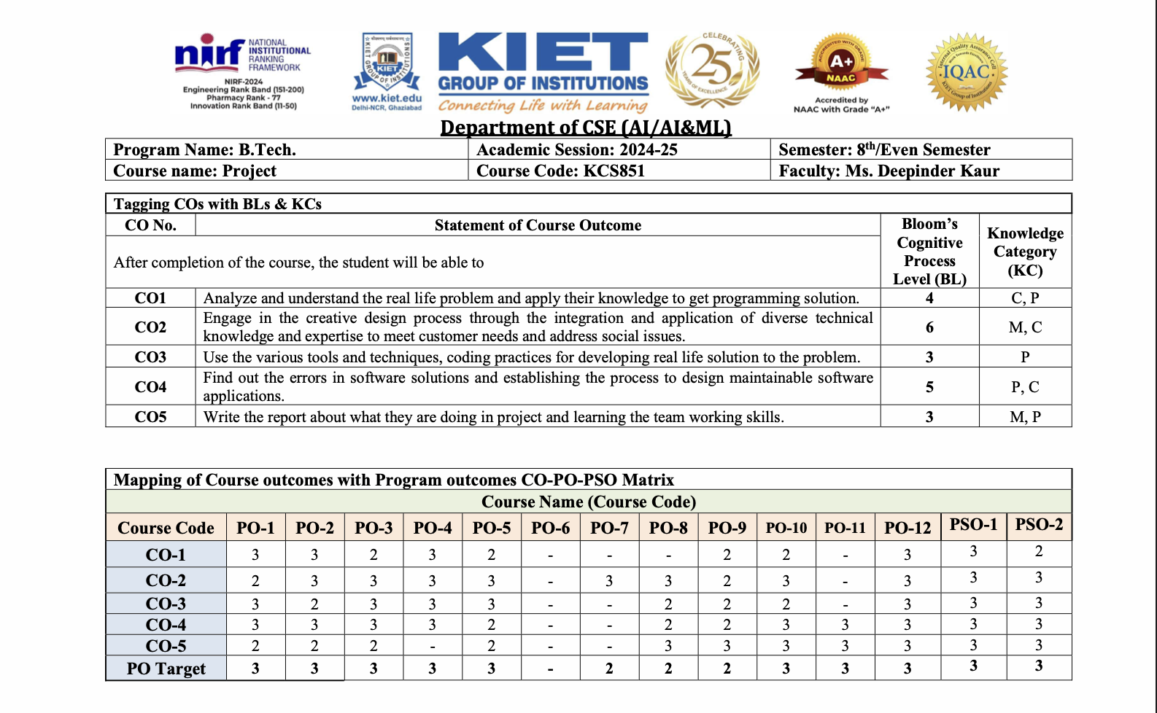
CO–PO Mapping Matrix

Slide 3
Abstract
"Man must rise above the Earth—to the top of the atmosphere and beyond—for only thus will he fully understand the world in which he lives.”
- Socrates
COSMIC HORIZONS is a community-driven astronomy website aimed at enthusiasts, students, and educators. The platform offers accurate celestial object locations, curated articles, and educational resources to create a collaborative astronomical journey.

Slide 4
Introduction
Our mission is to provide a platform that fosters exploration of the universe. COSMIC HORIZONS enables users to track space bodies, stay informed on space news, and access educational content. It is designed for a global community of stargazers seeking to expand their cosmic knowledge.

Slide 5
Objectives
- Use advanced astronomy APIs to locate space bodies in real-time.
- Deliver space news and events for community engagement.
- Build a collaborative community of astronomy enthusiasts.
- Provide outreach through educational tools and resources.

Slide 6
Technology Used
- Astronomy API
- ISROSTATS API
- NASA APIs
- React.JS, Django Rest Framework
-HTML5, CSS3, Tailwind CSS
- JavaScript, Typescript, Firebase , Postgresql
APIs in Action:
- JSON Requests/Responses
- Image Responses for space data
- Live Night Sky Map with real-time updates

Slide 7
Result (So Far)
- Developed a functioning platform with real-time Information.
- Integrated various APIs to support space news and live maps.
- Built an interactive and informative user interface.

Slide 8
Future Scope
- Implement immersive 3D and VR-based astronomical visualizations.
- Launch interactive courses in astrophysics for learners at all levels.
- Start citizen science projects to involve the public in real research.

Slide 9
References
- https://api.le-systeme-solaire.net
- https://api.nasa.gov
- https://isrostats.com
- AstronomyStackExchange, NASA.gov, ISRO.org

Slide 10
THANK YOU

