Slide 1
Improved Bengali Image Captioning via deep convolutional neural network based encoder-decoder model
Fahim Faisal Rafi • 19201081
1

Slide 2
Introduction
Automatic image captioning is the process of generating human-like descriptions of images in natural language.
This paper presents an end-to-end image captioning system for Bengali using a multimodal architecture that combines a one-dimensional CNN for sequence processing.
2

Slide 3
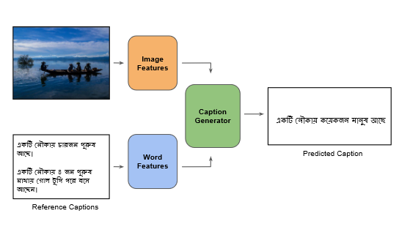
How it works
The document provides a comparison between the predictions made by the model and the scores given by human evaluators for different image captions.
3

Slide 4
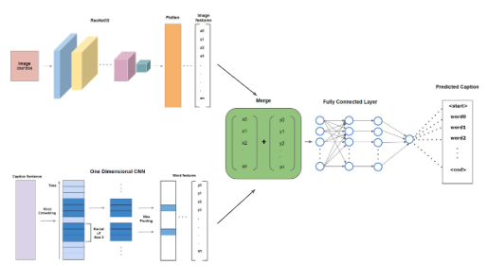
The Model
The CNN language model, combined with the merge architecture, captured fine-grained sentence structure information and produced accurate and humanoid captions compared to traditional LSTM models.
4

Slide 5
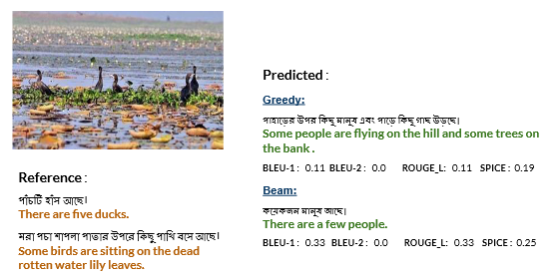
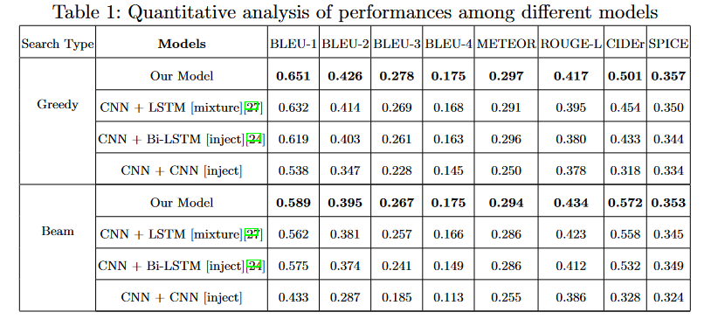
Results
5

Slide 6
Conclusion
The paper presents a CNN-CNN merged encoder-decoder-based image captioning system for Bengali. The model performed well on the BanglaLekhaImageCaptions dataset, demonstrating its effectiveness.
6

