Slide 1
CSE 438
Chittron: An Automatic Bangla Image Captioning
System : A review
By Fahim Faisal Rafi 19201081
1

Slide 2
Introduction
This presentation discusses the development of an automatic image annotating system called 'Chittron' in Bangla. It explores the model used, its training process, and the results obtained. It also highlights the system's limitations and areas for improvement.
2

Slide 3
Dataset
A Dataset of 16,000 images were produced due to the lack of Bangla images with proper captions, It was named the BanglaLekhaImageCaptions dataset.
2

Slide 4
Model Integration
Integration of pre-trained VGG16 image embedding model
Stacked LSTM layers for caption generation
Model then trained to predict the bangla captions
3

Slide 5
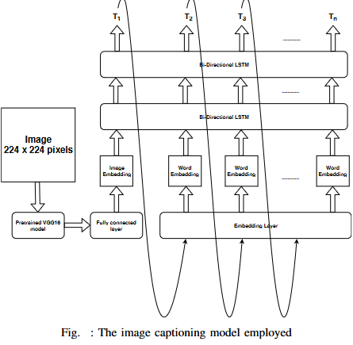
Training Process
Dataset of 16,000 images with single captions
Limitation of dataset size for capturing full diversity of Bangla geocontextual images
4

Slide 6

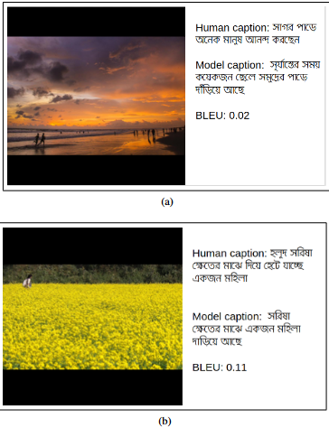

Results and Evaluation
It is seen that the BLEU scores are quite low on the captions but it is undeniable that the captions are something a human would describe
5

Slide 7
Conclusion
So the paper reports on the successful development of “Chittron”, a system to automatically generating Bangla image captions using VGG16 with Stacked LSTM Layers on the BanglaLekhaImageCaption Dataset.
6

