Slide 1
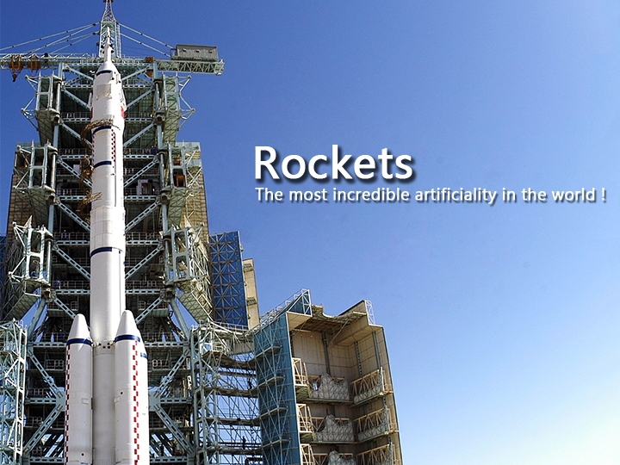

Slide 2

What's the rockets
Orbits
Rockets
Age of Discovery

Slide 3
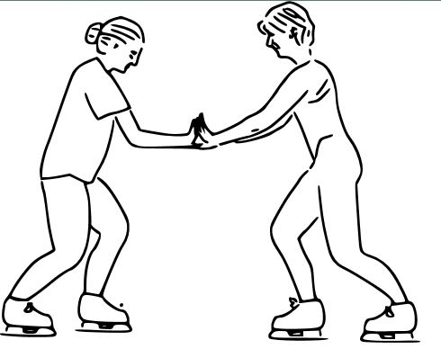
What's the rockets

Slide 4

What's the rockets

Slide 5
Orbits
Do anyone know the first cosmic velocity?
The weight of the earth: 5.972E24kg
Gravitational constant: 6.67E-11
Earth radius: 6371km
Velocity: 7907.13km/s

Slide 6
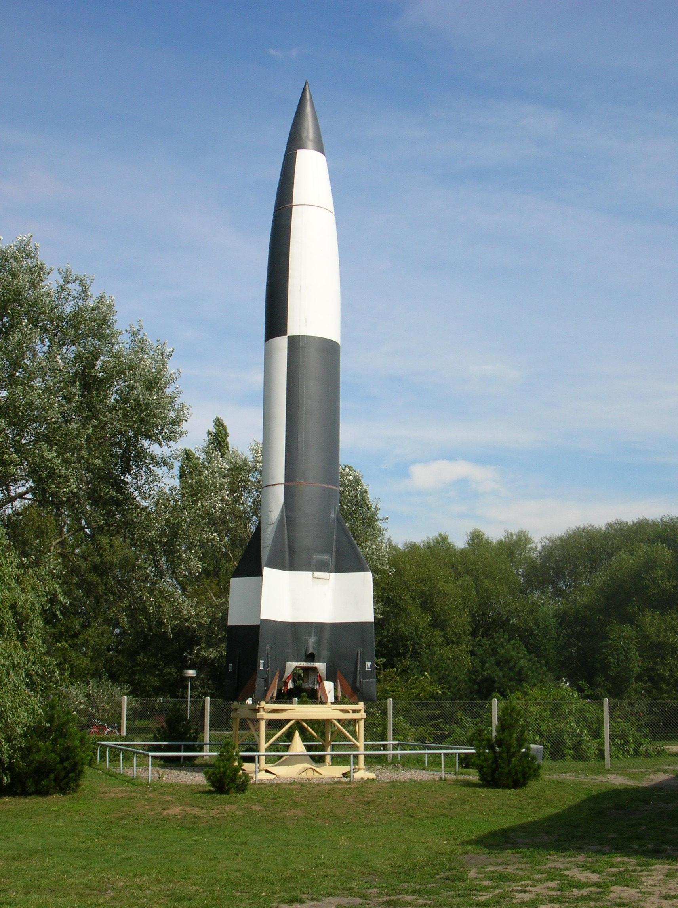
Rockets

Slide 7
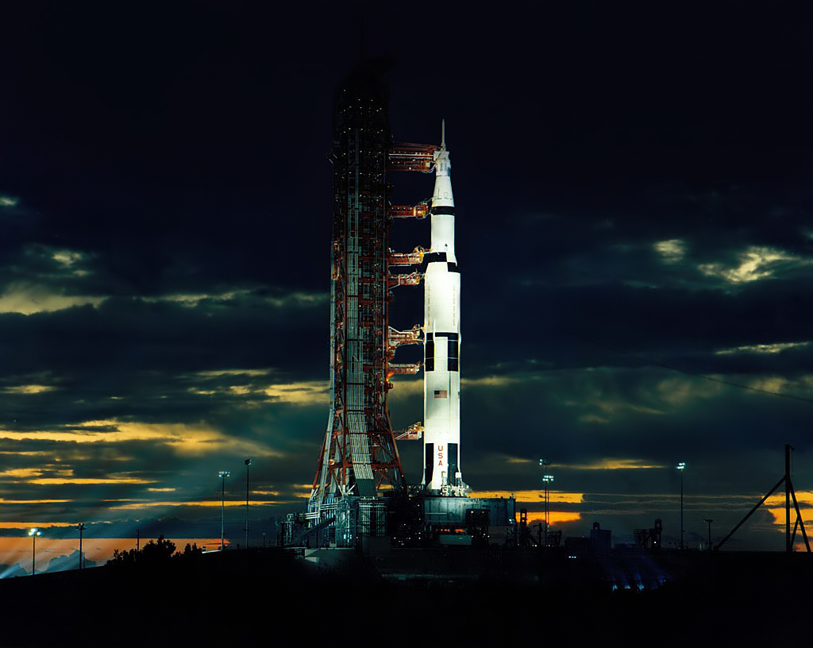
Rockets

Slide 8
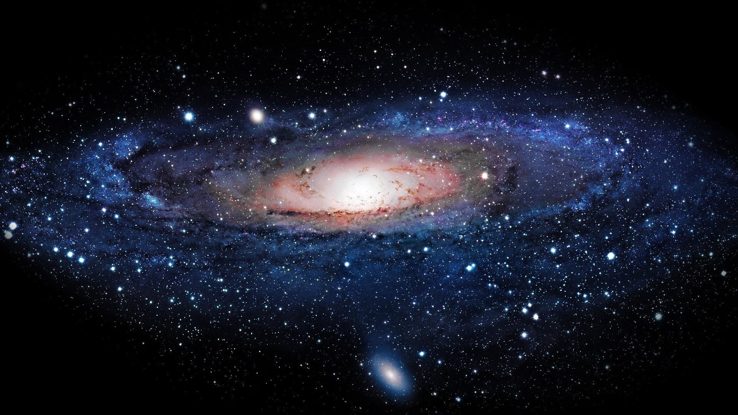
Age of Discovery

