Slide 2
Quadratic Equations
Graphs of Quadratic Equations

Slide 3
Contents
Roots using Graphical Method
Maximum Value
Minimum Value
Condition for Common Roots

Slide 4
Geometrical Representation of Quadratic Equations
Vertex
y-intercept
Root
Root
The geometric representation of Quadratic Equations is parabolic in nature.

Slide 5
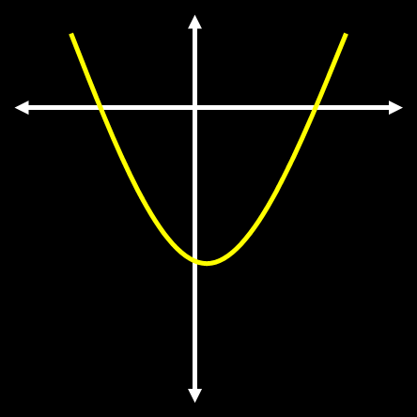
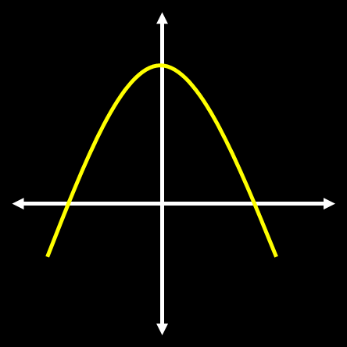
Geometrical Representation of Quadratic Equations
$$a>0$$
$$a<0$$

Slide 6
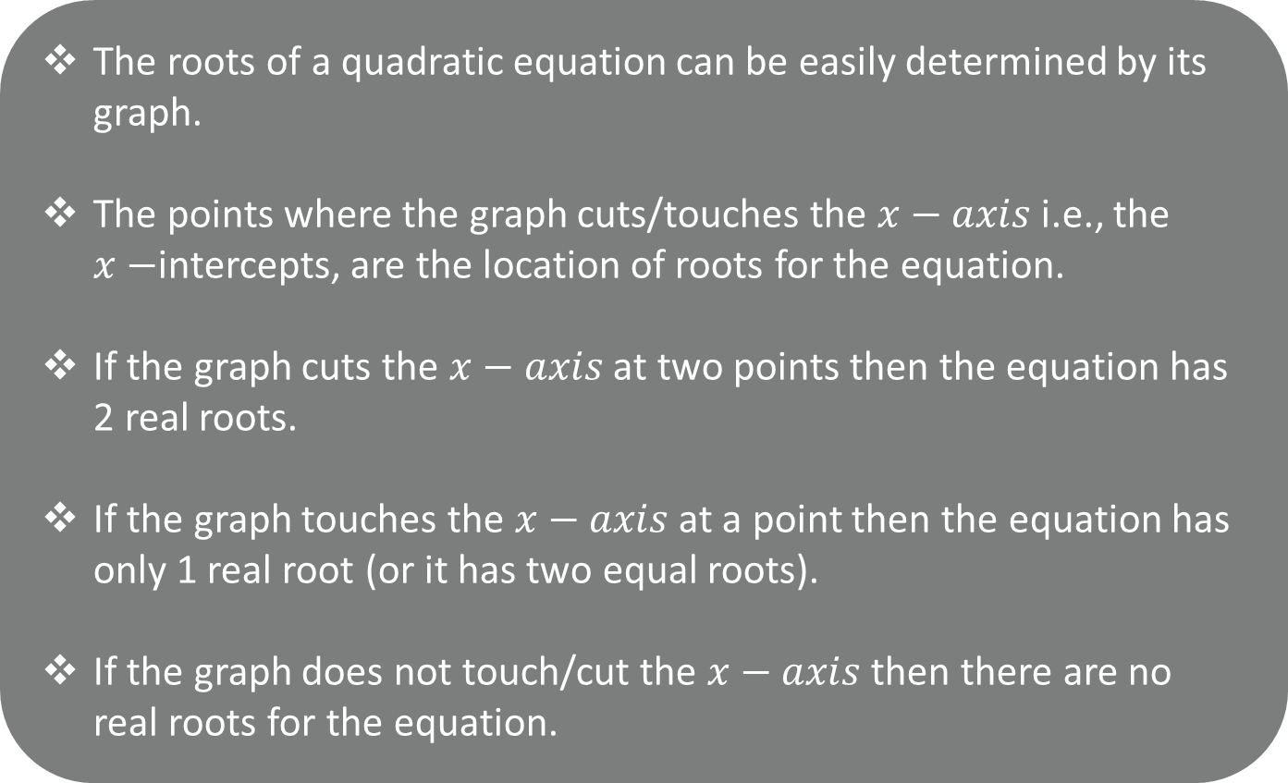
Roots using Graph
The roots of a quadratic equation can be easily determined by its graph.
The points where the graph cuts/touches the $x−axis$ i.e., the $x−$intercepts, are the location of roots for the equation.
If the graph cuts the $x−axis$ at two points then the equation has 2 real roots.
If the graph touches the $x−axis$ at a point then the equation has only 1 real root (or it has two equal roots).
If the graph does not touch/cut the $x−axis$ then there are no real roots for the equation.

Slide 7
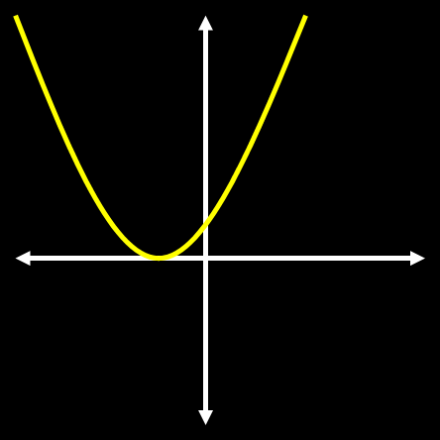
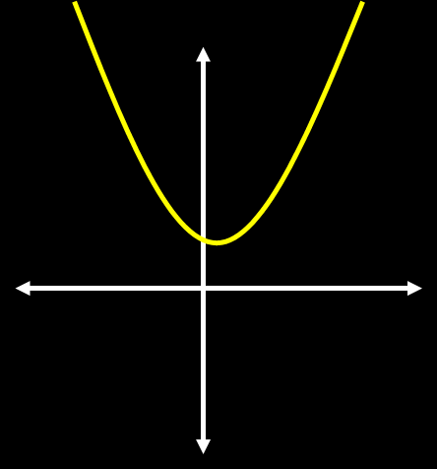
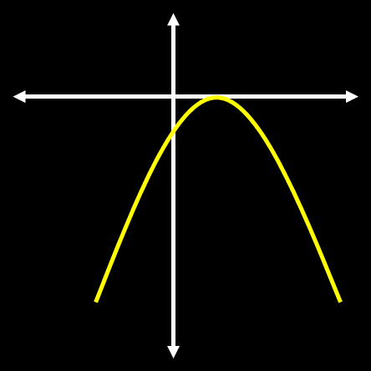
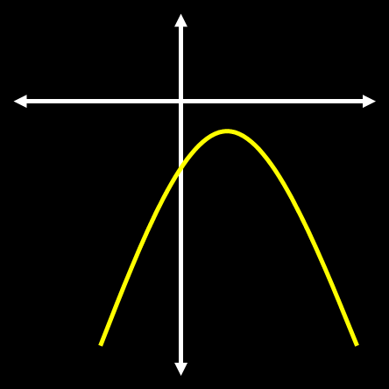

Roots using Graph
Characteristics of the Function | $$b^{2}−4ac>0$$ | $$b^{2}−4ac=0$$ | $$b^{2}−4ac<0$$
$$a>0$$
$$a<0$$

Slide 8
Question
If vertical axis is the y axis and horizontal axis is the x axis which of the following can be a graph for the quadratic equation
$−3x^{2}+4x−2=0$?
(a)
(b)
(c)
(d)

Slide 9
Graph of a Quadratic Equation
Plot the graph for $x^{2}−5x+6=0$

Slide 10
Relationship Between Signs of Roots
and Coefficients
$ax^{2}+bx+c=0; a≠0$

Slide 11
Sign of Roots
$2x^{2}−11x+12=0$

Slide 12




Question
Find the signs of both roots for the equation $2x^{2}−x−15=0$
(a) $\text{Both} \text{roots} \text{positive}$
(b) $\text{Both} \text{roots} \text{negative}$
(c) $\text{One} \text{positive} \text{one} \text{negative}$
(d) $\text{Can}\text{′}\text{t} \text{be} \text{determined}$

Slide 13
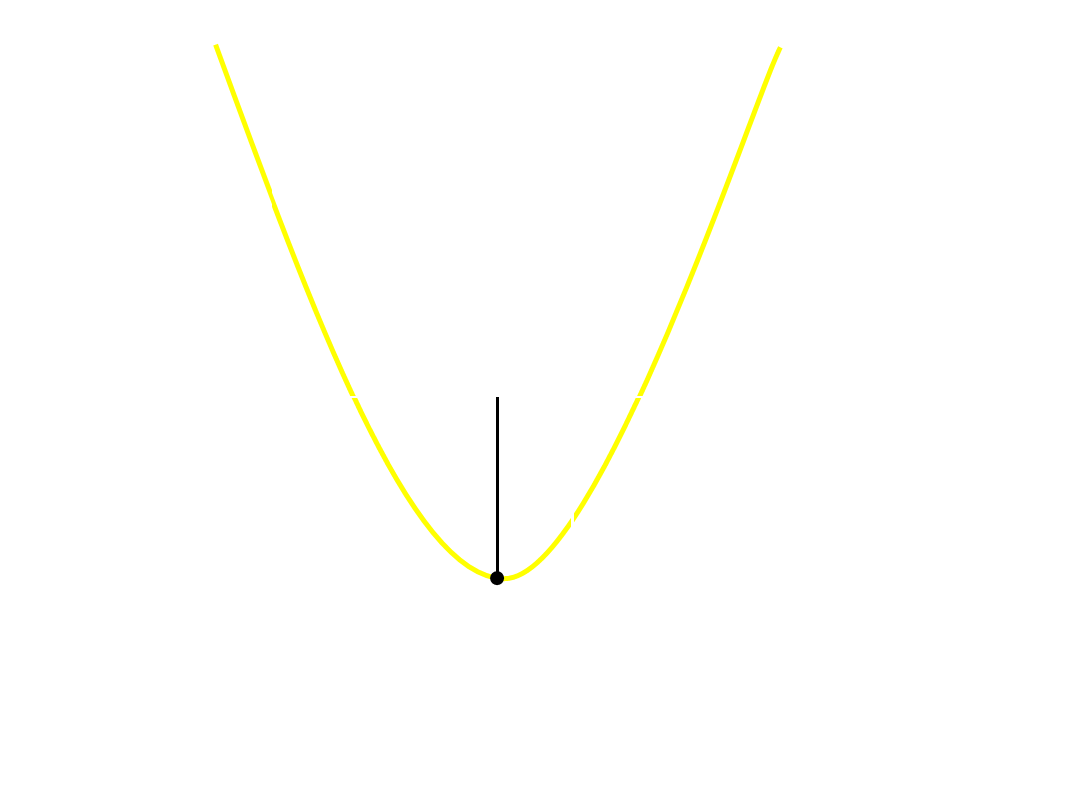
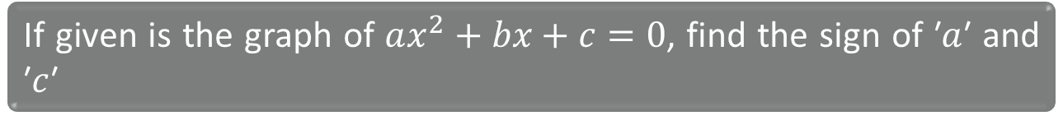




Question
If given is the graph of $ax^{2}+bx+c=0$, find the sign of ′$a$′ and ′$c$′
(a) $a>0, c<0$
(b) $a<0, c>0$
(c) $a<0, c<0$
(d) $a>0, c>0$

Slide 14
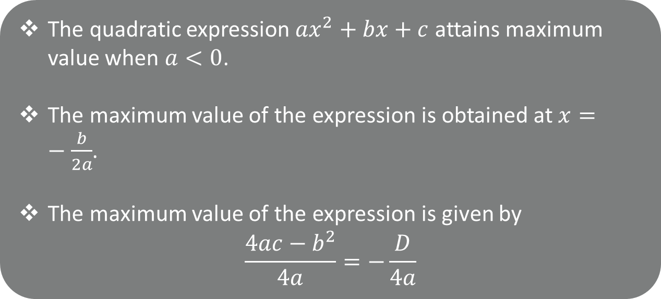
Maximum Value
The quadratic expression $ax^{2}+bx+c$ attains maximum value when $a<0$.
The maximum value of the expression is obtained at $x=−\frac{b}{2a}$.
The maximum value of the expression is given by
$$\frac{4ac−b^{2}}{4a}=−\frac{D}{4a}$$

Slide 15
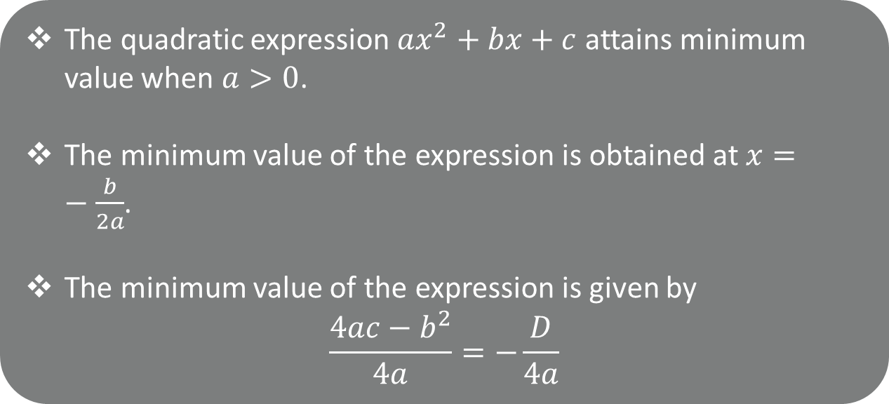
Minimum Value
The quadratic expression $ax^{2}+bx+c$ attains minimum value when $a>0$.
The minimum value of the expression is obtained at $x=−\frac{b}{2a}$.
The minimum value of the expression is given by
$$\frac{4ac−b^{2}}{4a}=−\frac{D}{4a}$$

Slide 16
Question
Find the maximum or minimum value for $x2 − 5x + 6$
y
(1,0)
(2,0)
x
(3,0)

Slide 17
Question
Find the maximum or minimum value for $x2 − 7x + 12$
y
(3,0)
x
(4,0)

Slide 18
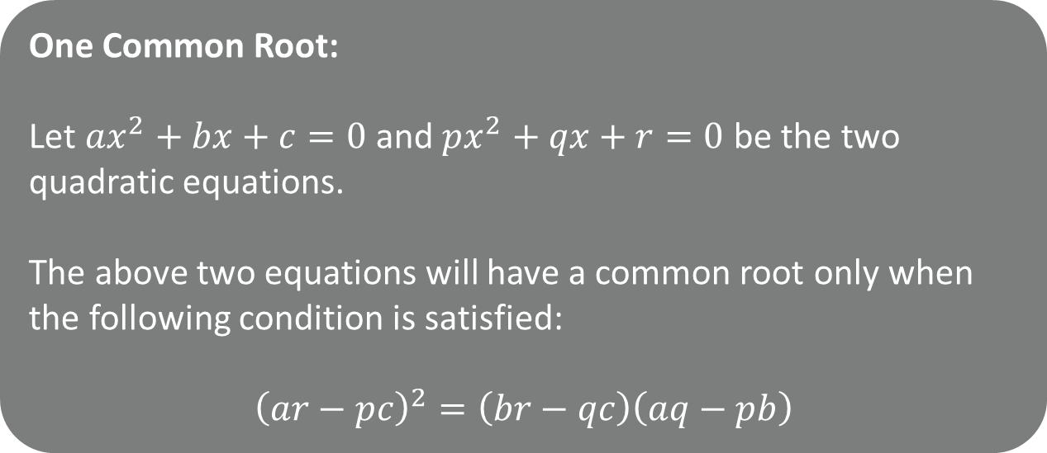
Condition for Common Roots
One Common Root:
Let $ax^{2}+bx+c=0$ and $px^{2}+qx+r=0$ be the two quadratic equations.
The above two equations will have a common root only when the following condition is satisfied:
$${\left(ar−pc\right)}^{2}=\left(br−qc\right)\left(aq−pb\right)$$

Slide 19
Condition for Common Roots
One Common Root:

Slide 20
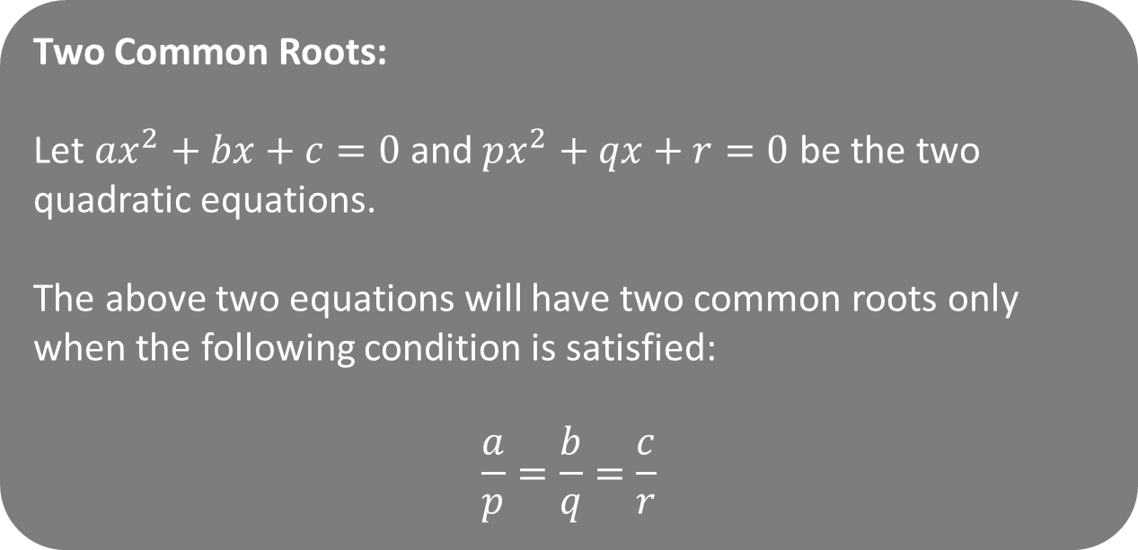
Condition for Common Roots
Two Common Roots:
Let $ax^{2}+bx+c=0$ and $px^{2}+qx+r=0$ be the two quadratic equations.
The above two equations will have two common roots only when the following condition is satisfied:
$$\frac{a}{p}=\frac{b}{q}=\frac{c}{r}$$

Slide 21
Condition for Common Roots
Two Common Roots:

Slide 22



Question
If the equations $2x^{2}+kx−5=0$ and $x^{2}−3x−4=0$ have exactly one common root, then find the value of $k$
(a) $−3$
(b) $−\frac{27}{4}$
(c) Both (a) and (b)
(d) None of these

Slide 23
Question
If the equations $2x^{2}+kx−5=0$ and $x^{2}−3x−4=0$ have exactly one common root, then find the value of $k$

Slide 24
Solution

Slide 25

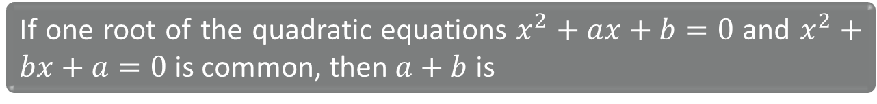



Question
If one root of the quadratic equations $x^{2}+ax+b=0$ and $x^{2}+bx+a=0$ is common, then $a+b$ is
(a) $1$
(b) $−1$
(c) $2$
(d) $0$

Slide 26
Question
If one root of the quadratic equations $x^{2}+ax+b=0$ and $x^{2}+bx+a=0$ is common, then $a+b$ is

Slide 27
Solution

Slide 28

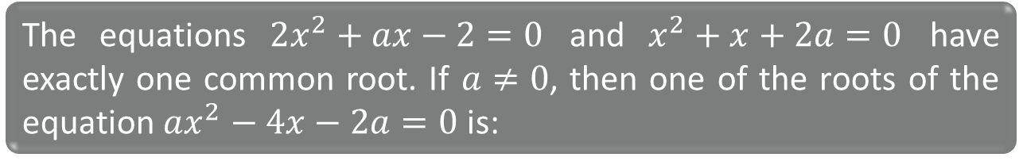



Question
The equations $2x^{2}+ax−2=0$ and $x^{2}+x+2a=0$ have exactly one common root. If $a≠0$, then one of the roots of the equation $ax^{2}−4x−2a=0$ is:
(a) $2$
(b) $−2$
(c) $\frac{−4+\sqrt{22}}{3}$
(d) $\frac{−2+\sqrt{22}}{3}$

Slide 29
Question
The equations $2x^{2}+ax−2=0$ and $x^{2}+x+2a=0$ have exactly one common root. If $a≠0$, then one of the roots of the equation $ax^{2}−4x−2a=0$ is:

Slide 30
Solution

Slide 31
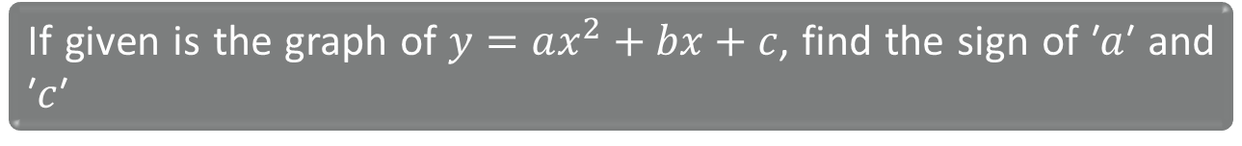
Solution
If given is the graph of $y=ax^{2}+bx+c$, find the sign of ′$a$′ and ′$c$′

Slide 32





The value of the expression $x2 + 2bx + c$ will be positive for all real $x$ if :
Question
A. $b2 − 4c > 0$
B. $b2 − 4c < 0$
C. $c2 < b$
D. $b2 < c$

Slide 33


The value of the expression$x2 + 2bx + c$ will be positive for all real $x$ if :
Question
Characteristics of the Function | $$b^{2}−4ac>0$$ | $$b^{2}−4ac=0$$ | $$b^{2}−4ac<0$$
$$a>0$$

Slide 34
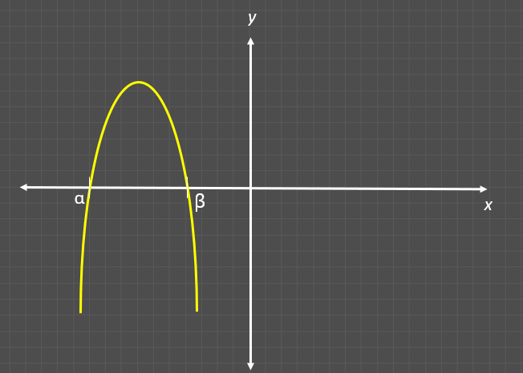

For the following graphs of $y = ax2 + bx + c$ with $a, b, c$ as real numbers, comment on the sign of
Question
i. a
ii. b
iii. c
iv. D
v. α
vi. β

Slide 35
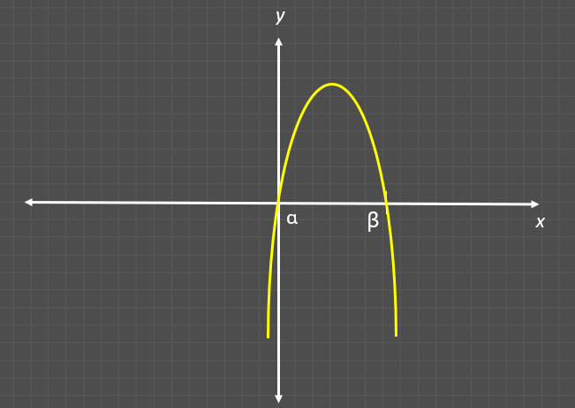

For the following graphs of $y = ax2 + bx + c$ with $a, b, c$ as real numbers, comment on the sign of
Question
i. a
ii. b
iii. c
iv. D
v. α
vi. β

Slide 36
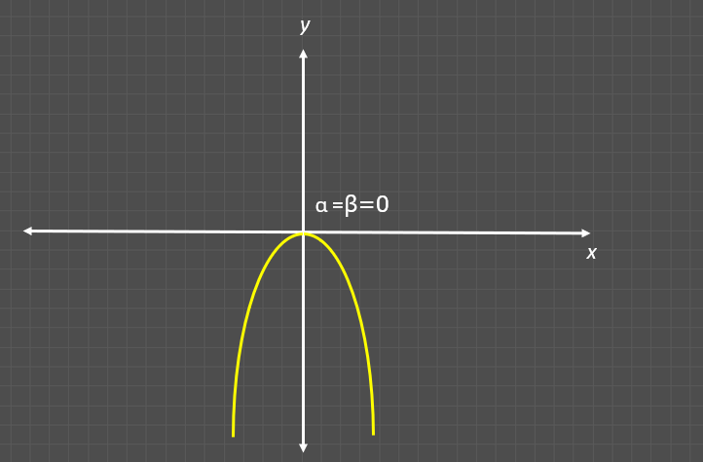
For the following graphs of $y = ax2 + bx + c$ with $a, b, c$ as real numbers, comment on the sign of
Question
i. a
ii. b
iii. c
iv. D
v. α
vi. β

Slide 37

Question
Find the maximum or minimum value for $−(x2 − 7x + 12)$
(3,0)
(4,0)
x

Slide 38
Question
Find the maximum or minimum value of $x2 − 5x + 6$
(1,0)
(2,0)
x
(3,0)

Slide 39
Find the minimum value of $3x2 − 2x + 1$
Question

Slide 40
Solution

Slide 41





The graph of the equation $y=2x^{2}+4x+3$ has its lowest point at:
Question
NSEJS
A. $\left(−1,9\right)$
B. $\left(1,9\right)$
C. $\left(−1,1\right)$
D. $\left(0,3\right)$

Slide 42
The graph of the equation $y=2x^{2}+4x+3$ has its lowest point at:
Question
NSEJS

Slide 43

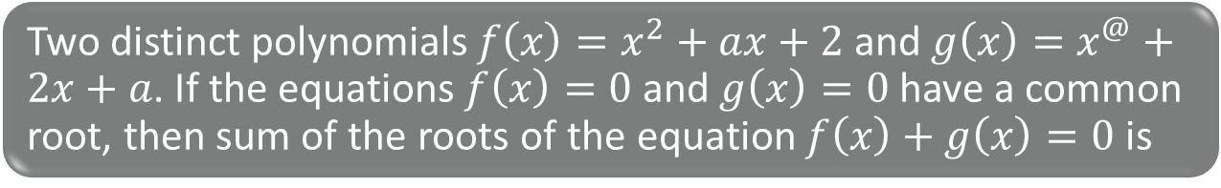



Two distinct polynomials $f\left(x\right)=x^{2}+ax+2$ and $g\left(x\right)=x^{@}+2x+a$. If the equations $f\left(x\right)=0$ and $g\left(x\right)=0$ have a common root, then sum of the roots of the equation $f\left(x\right)+g\left(x\right)=0$ is
Question
KVPY
A. $−\frac{1}{2}$
B. $0$
C. $\frac{1}{2}$
D. $1$

Slide 44
Two distinct polynomials $f\left(x\right)=x^{2}+ax+2$ and $g\left(x\right)=x^{@}+2x+a$. If the equations $f\left(x\right)=0$ and $g\left(x\right)=0$ have a common root, then sum of the roots of the equation $f\left(x\right)+g\left(x\right)=0$ is
Question
KVPY

Slide 45
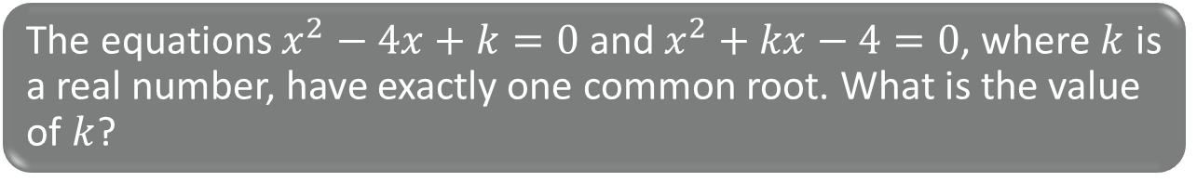
The equations $x^{2}−4x+k=0$ and $x^{2}+kx−4=0$, where $k$ is a real number, have exactly one common root. What is the value of $k$?
Question
PRE-RMO

Slide 46
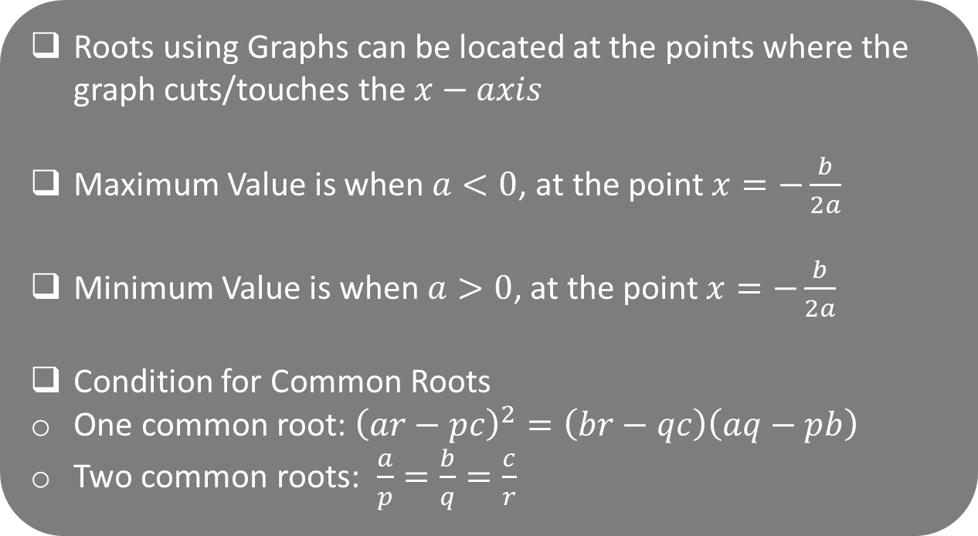
Contents
Roots using Graphs can be located at the points where the graph cuts/touches the $x−axis$
Maximum Value is when $a<0$, at the point $x=−\frac{b}{2a}$
Minimum Value is when $a>0$, at the point $x=−\frac{b}{2a}$
Condition for Common Roots
One common root: ${\left(ar−pc\right)}^{2}=\left(br−qc\right)\left(aq−pb\right)$
Two common roots: $\frac{a}{p}=\frac{b}{q}=\frac{c}{r}$

Slide 47
Thank You

