Slide 1
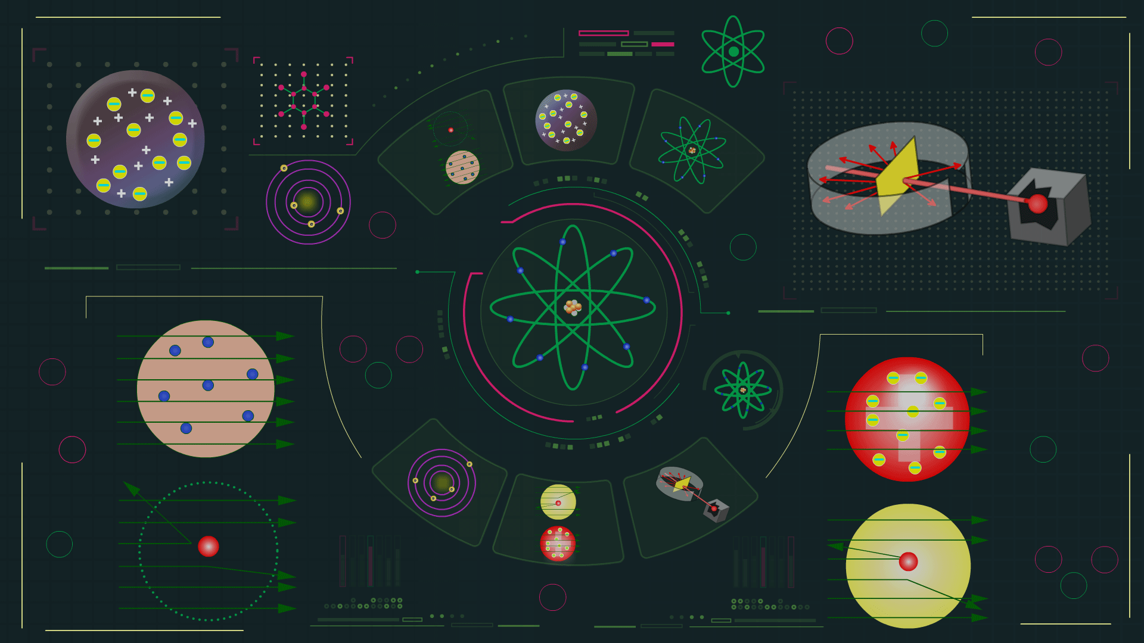

Slide 2
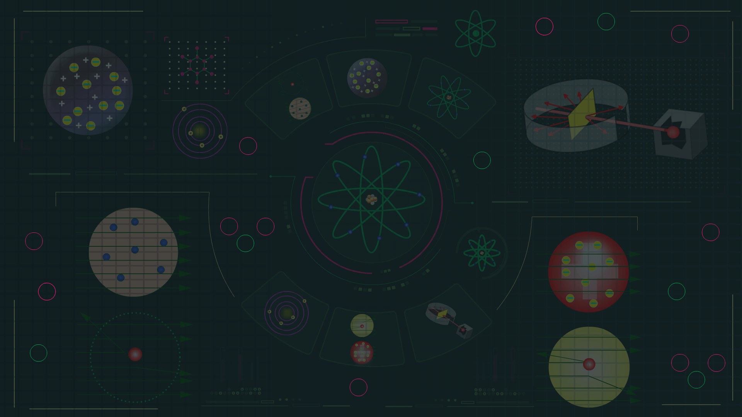
Quantum Mechanical Model

Slide 3
Introduction to Schrodinger’s Wave Mechanical Model
Classical mechanics which is based on Newton’s law of motion, describes the motion of all macroscopic objects.
Classical mechanics is based upon the particle nature of the object and that’s why it fails when applied to microscopic objects like electron.

Slide 4
Introduction to Schrodinger’s Wave Mechanical Model
Classical mechanics also ignores the dual behaviour of matter and concept of uncertainty principle.

Slide 5
Introduction to Schrodinger’s Wave Mechanical Model
The branch of science that considers dual behaviour (wave and particle nature) of matter is Quantum mechanics.
Quantum mechanics when applied to macroscopic objects generates the same results as given by classical mechanics.

Slide 6
Introduction to Schrodinger’s Wave Mechanical Model
Quantum mechanics was developed independently by Werner Heisenberg and Erwin Schrodinger.

Slide 7
Quantum Mechanical Model of Atom
This model is based upon Schrodinger wave equation.
This fundamental equation of quantum mechanics was developed by Schrodinger, in 1926. For a system (such as atom or molecule, whose energy does not change with time), the schrodinger’s equation is given as
$\hat{\text{H}}$ψ = Eψ

Slide 8

Quantum Mechanical Model of Atom
where $\hat{\text{H}}$ is a mathematical operator called Hamitlonian, E is total energy of the system and ψ is the wave function or amplitude of matter wave.

Slide 9

Quantum Mechanical Model of Atom
Schrodinger Wave Equation–
$\frac{\text{d}\text{2}\text{y}}{\text{dx}\text{2}}$ + $\frac{\text{d}\text{2}\text{y}}{\text{dy}\text{2}}$ + $\frac{\text{d}\text{2}\text{y}}{\text{dz}\text{2}}$ + $\frac{\text{8}\text{p}\text{2}\text{m}}{\text{h}\text{2}}$ (E – V)ψ = 0
h = Planck’s constant
m = mass of electron
E = total energy (denotes quantised energy)
V = Potential energy

Slide 10
Quantum Mechanical Model of Atom
Where x, y and z are three space co-ordinates
ψ = wave function
⇒ double differentiation of ψ w.r.t. x, y and z axis

Slide 11
Quantum Mechanical Model of Atom
ψ = ψ (r) ⋅ ψ (θ, φ)
z
r
θ
y
φ
x

Slide 12
Important Features of Quantum Mechanical Model
1. In this model, Schrodinger assumed electron as 3D wave which is present in positive field of nucleus.

Slide 13
Important Features of Quantum Mechanical Model
2. This model is based upon Schrodinger wave equation.

Slide 14
Important Features of Quantum Mechanical Model
3. The solution of equation gives possible energy levels the electron can occupy, and the corresponding wave function of electron associated with each energy level.

Slide 15
Important Features of Quantum Mechanical Model
4. The energy of electrons in atoms is quantized.

Slide 16
Important Features of Quantum Mechanical Model
5. Each value of wave function is associated with orbital.

Slide 17
Important Features of Quantum Mechanical Model
6. Orbital is the space where probability of finding an electron is maximum. This model does not consider the presence of well-defined circular path as it is based on Heisenberg uncertainty principle.

Slide 18

Quantum Mechanical Model of Atom
This model is based upon Schrodinger wave equation.
Schrodinger wave equation–
$\frac{\text{d}\text{2}\text{y}}{\text{dx}\text{2}}$ + $\frac{\text{d}\text{2}\text{y}}{\text{dy}\text{2}}$ + $\frac{\text{d}\text{2}\text{y}}{\text{dz}\text{2}}$ + $\frac{\text{8}\text{p}\text{2}\text{m}}{\text{h}\text{2}}$ (E – V)ψ = 0
h = Planck’s constant
m = mass of electron
E = total energy (denotes quantised energy)
V = Potential energy

Slide 19
Quantum Mechanical Model of Atom
ψ = ψ (r) ⋅ ψ (θ, φ)
z
r
θ
y
φ
x

Slide 20
Radial part of Schrodinger Wave Equation
Radial wave function gives the dependence of orbital upon the distance of electron from the nucleus.

Slide 21
Nodes
Region of space around the nucleus where probability of finding electron is zero.
Types of nodes:
1. Radial Node
2. Angular Node

Slide 22
Nodes
Radial Node (Spherical Node): Spherical region where probability of finding electron is zero.
Node
Nodes
1s
2s
3s

Slide 23
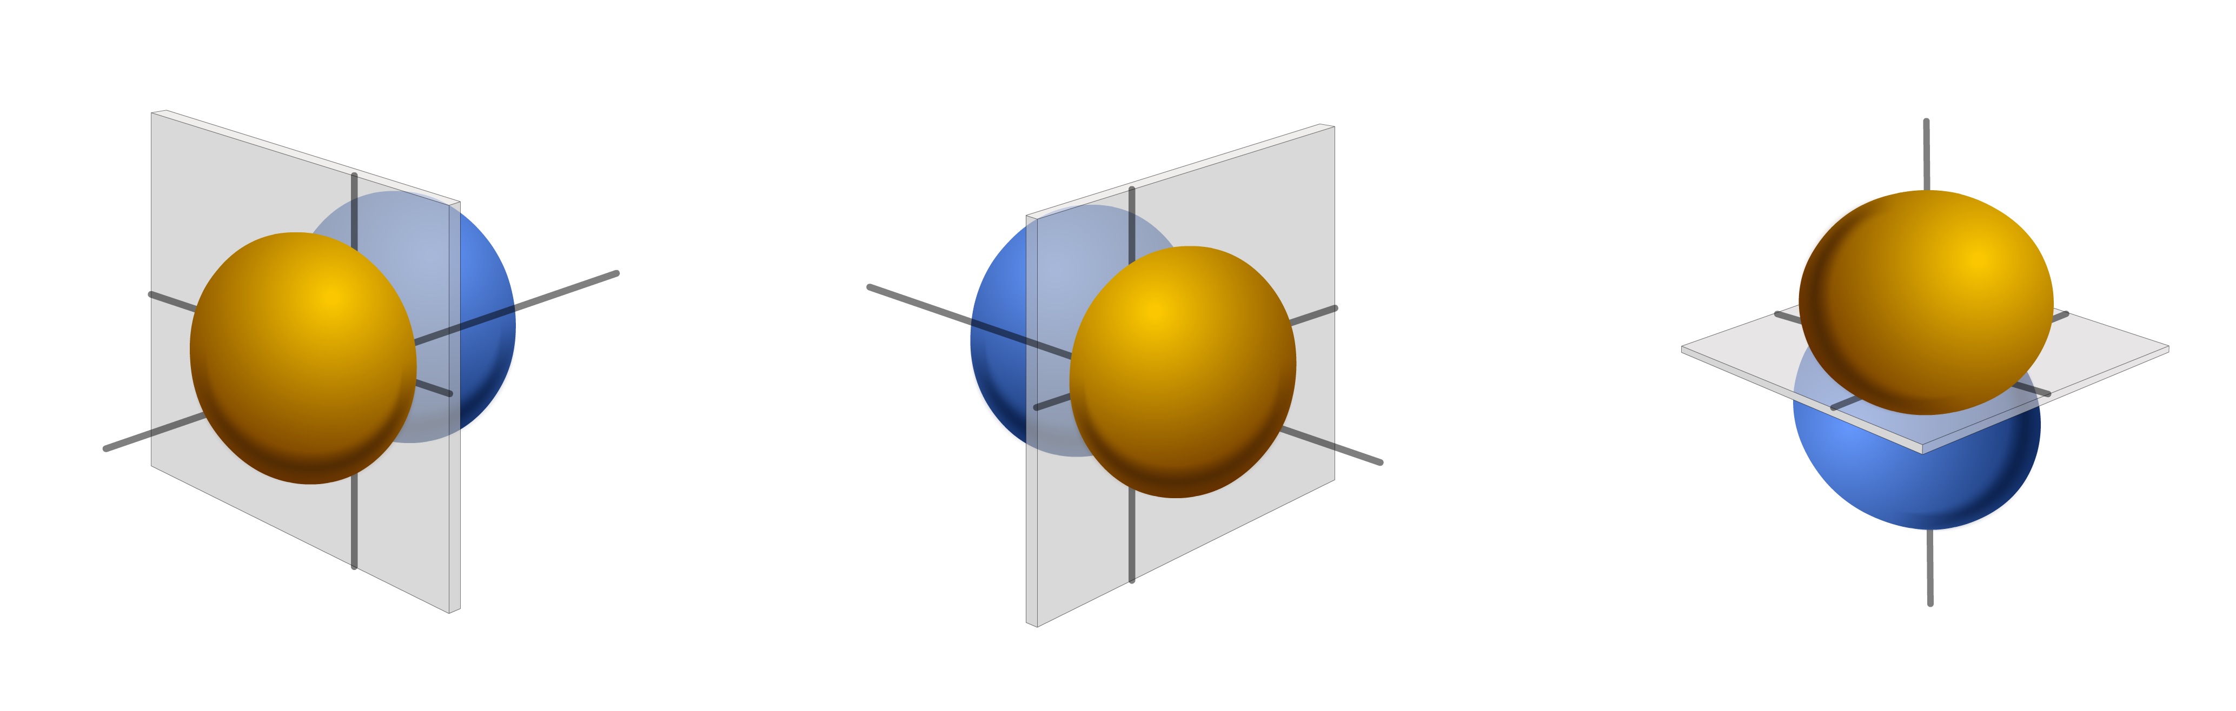
Nodes
Angular node (nodal plane): The plane in which probability of finding an electron is zero.
Nodal
plane
z
z
z
x
y
x
y
x
y
2p_{x}
2p_{y}
2p_{z}

Slide 24
Graphs of Radial Part of Schrodinger Wave Equation
The square of radial wave function gives the probability of finding electron in a unit volume around a particular point.

Slide 25
Graphs of Radial Part of Schrodinger Wave Equation
Orbital
Radial function curve
1s
2s
ψ(r)
ψ(r)
r
r

Slide 26
Graphs of Radial Part of Schrodinger Wave Equation
Orbital
Radial probability density curve
ψ²(r)
ψ²(r)
r
r

Slide 27
Graphs of Radial Part of Schrodinger Wave Equation
2p
ψ
ψ²
r
r

Slide 28
Radial Probability Distribution Function
It gives the probability of finding electron at a distance r from the nucleus in thin shell.

Slide 29
Radial Probability Distribution Function
r
r+
dr
dV = $\frac{\text{4}}{\text{3}}$ π (r + dr)³ – $\frac{\text{4}}{\text{3}}$ π r³
= $\frac{\text{4}}{\text{3}}$ π {r³ + 3dr r² + 3dr² r + dr³ – r³}

Slide 30

Radial Probability Distribution Function
= $\frac{\text{4}}{\text{3}}$ π {3 dr r²}
= 4 π r² dr
Radial probability distribution function
= 4 π r² ψ²(r)
= P(r)

Slide 31
Radial Probability Distribution Function
P(r)
(r)
1s, 2p, 3d, 4f

Slide 32
Radial Probability Distribution Function
P(r)
(r)
2s, 3p, 4d, 5f

Slide 33
Radial Probability Distribution Function
P(r)
(r)
3s, 4p, 5d, 6f

Slide 34
Angular Part of Schrodinger Wave Equation
Angular wave function gives idea about the shape of orbital and depends upon m and l.
On solving angular part of Schrodinger wave equation, we get different values of l and m which corresponds to different set of orbitals.

Slide 35
Angular Part of Schrodinger Wave Equation
l = 0 for s subshell for which 1 orbital is allowed.
The hydrogen s orbitals correspond to l = 0 and only allow m_{l} = 0. In this case, the solution for the angular wavefunction, Y_{0,0} (θ,φ) is a constant. As a result, the ψ_{n,0,0}(r,θ,φ) wavefunction only depend on r and the s orbitals are all spherical in shape.

Slide 36
Angular Part of Schrodinger Wave Equation
l = 1 for p subshell for which 3 orbitals are allowed.
l = 2 for d subshell for which 5 orbitals are allowed.
l = 3 for f subshell for which 7 orbitals are allowed.

Slide 37

Shape of Atomic Orbitals

Slide 38
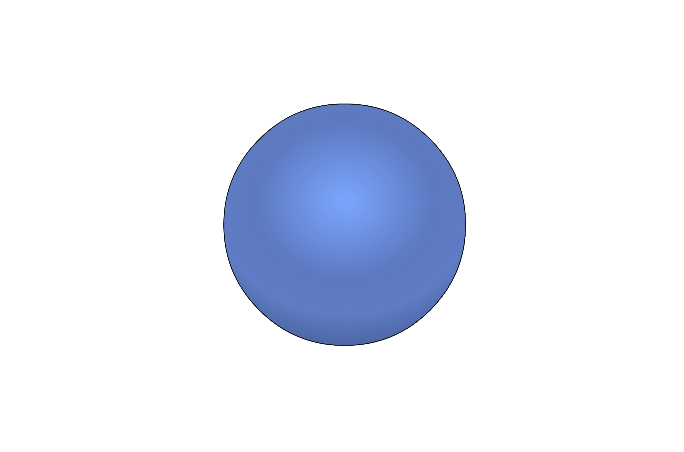
Shape of Atomic Orbitals
s orbital is spherical in shape and has zero nodal plane.
z
y
x
s

Slide 39
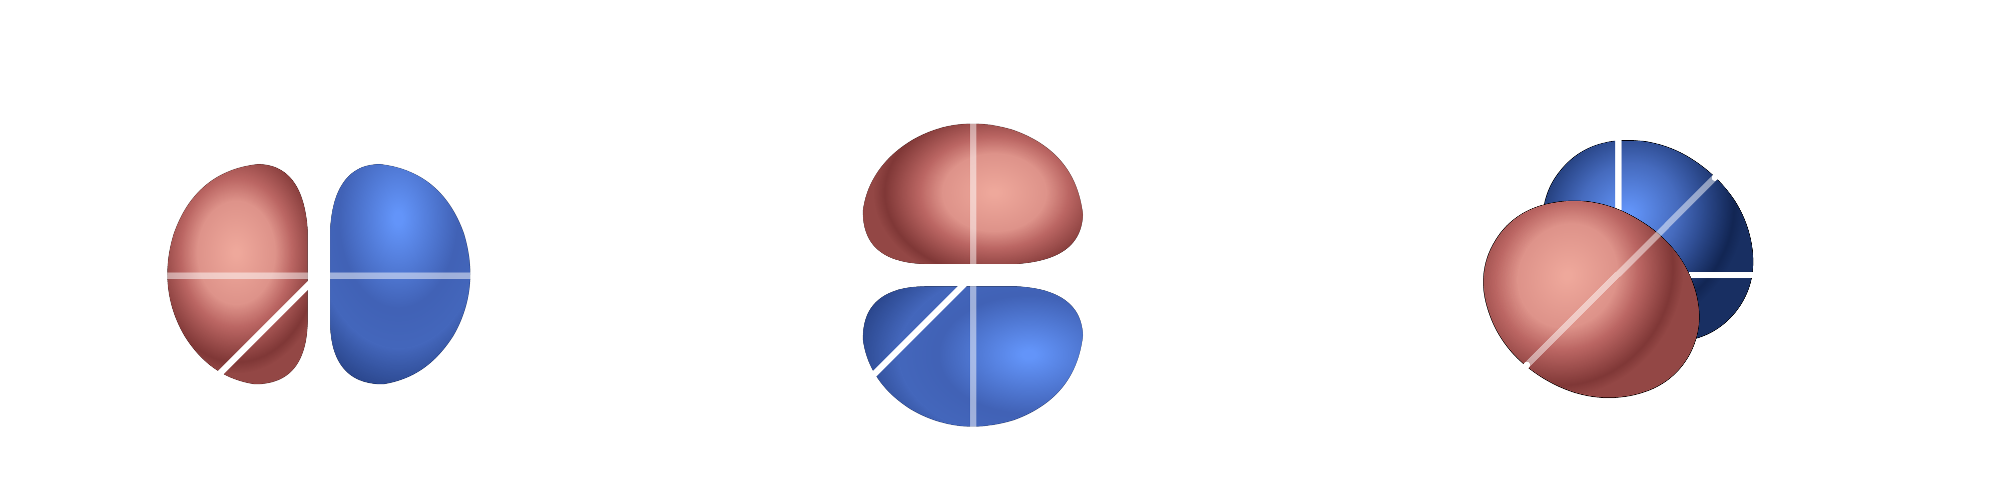
Shape of Atomic Orbitals
p orbital has dumb-bell shape, and each orbital has 1 nodal plane.
z
z
z
y
y
y
x
x
x
p_{x}
p_{z}
p_{y}

Slide 40
Shape of Atomic Orbitals
Axial orbitals: orbitals in which lobes are present on the axis.
Non-axial orbitals: orbitals in which lobes are present in between the axis.

Slide 41
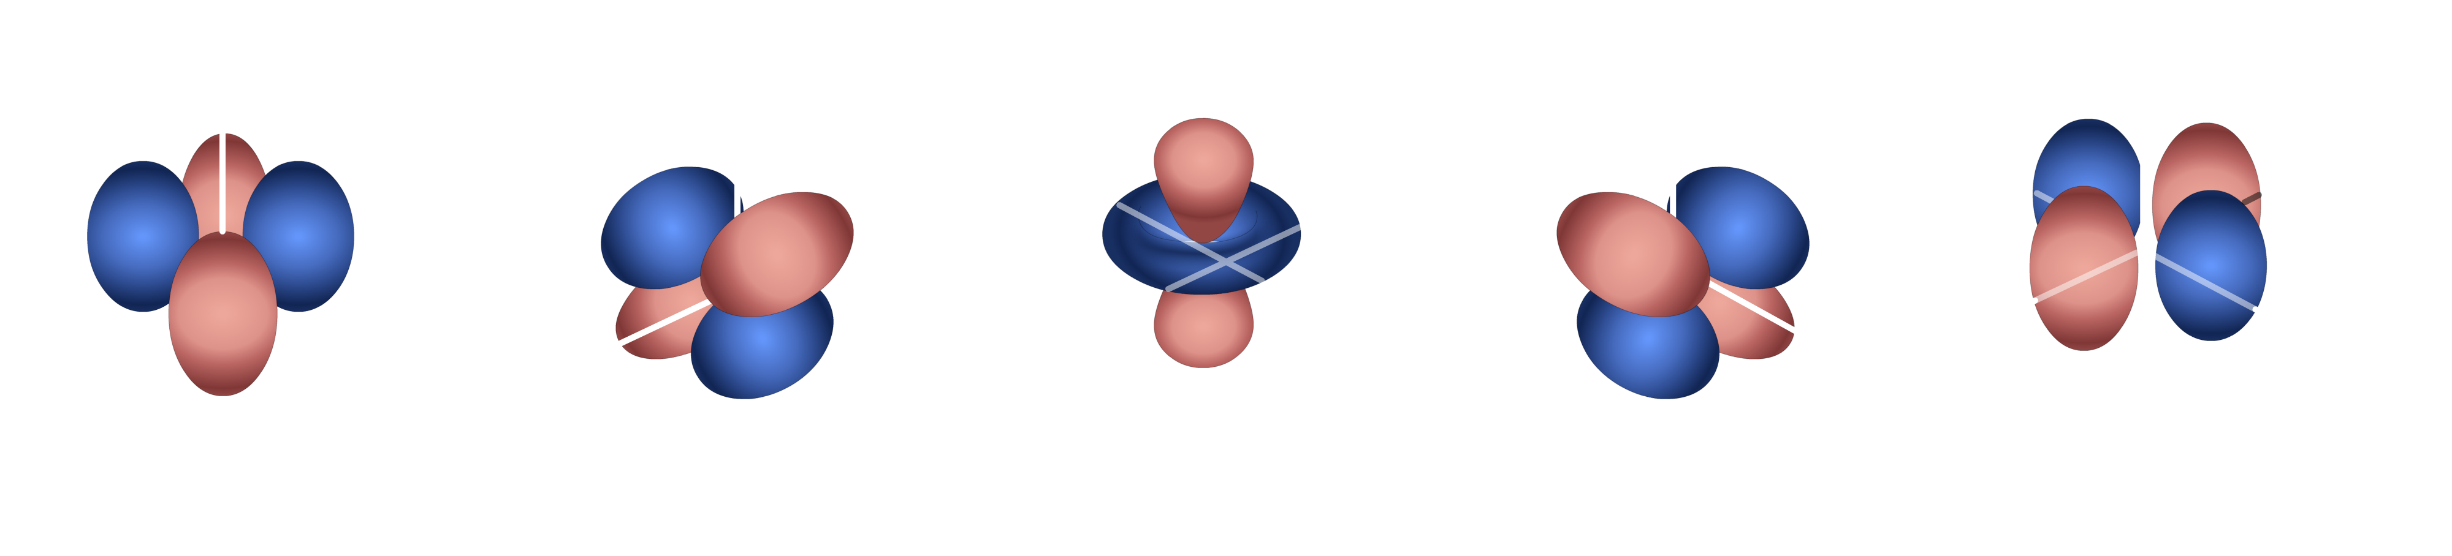
Shape of Atomic Orbitals
d orbital has double dumb-bell shape, and each orbital has 2 nodal planes with one exceptional case.
z
z
z
z
z
y
y
y
y
y
x
x
x
x
x
d_{xy}
d_{xz}
d_{xz}
d_{yz}
d_{x}
–
_{y}
²
²
²

Slide 42
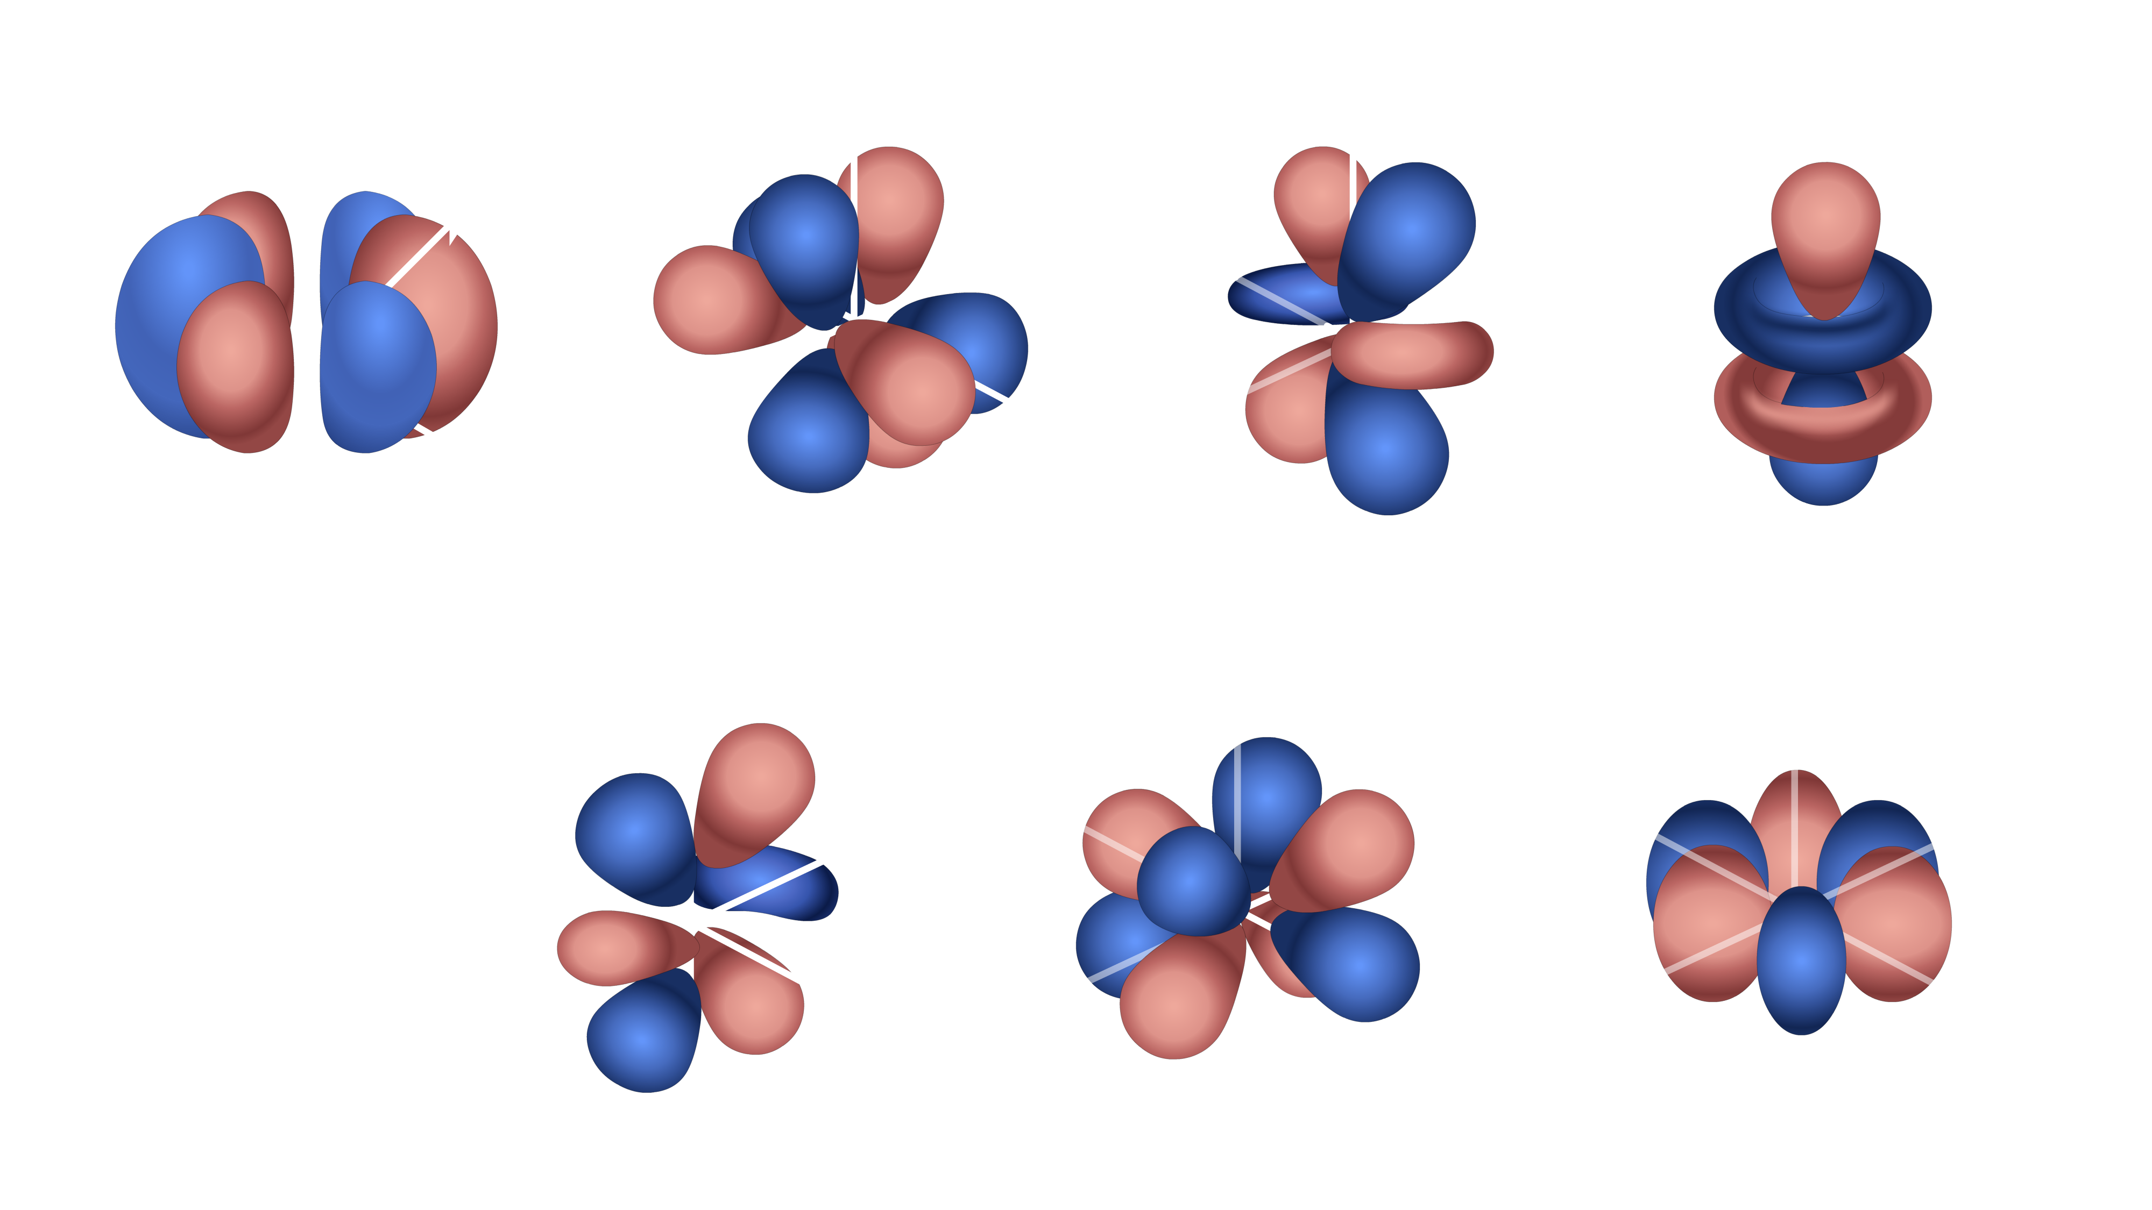
Shape of Atomic Orbitals
f orbital has clove shape or complex shape.
z
z
z
z
y
y
y
y
x
x
x
x
f_{y}(x² – z²)
f_{xz}
f_{z}
³
f_{x}(x² – 3y²)
²
z
z
z
y
y
y
x
x
x
f_{yz}
f_{xyz}
f_{y}(3x² – y²)
²

