Slide 1

data visualization
- Created By vaishnavipatil0624
Powered By

Slide 2
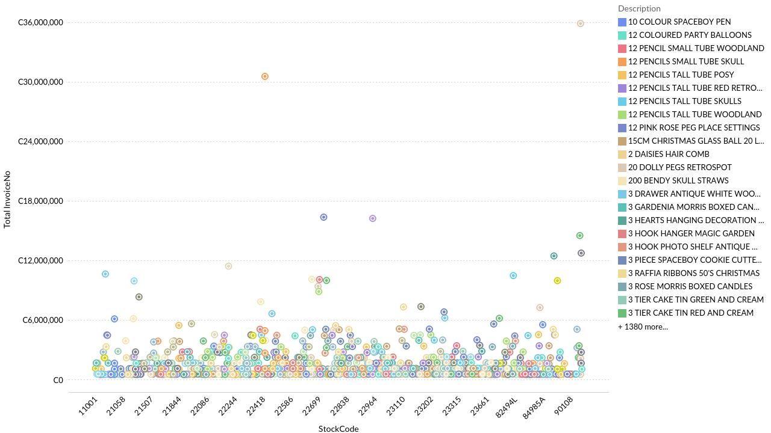
online retail dataset
Powered By

Slide 3
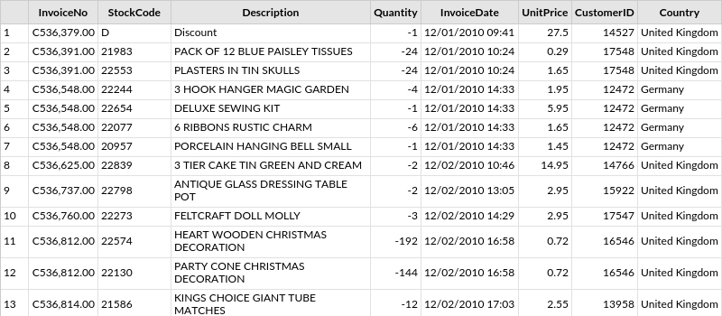
Online+Retail+Data+Set
Powered By

Slide 4
Thank you
Powered By

