Slide 1

Cloud Condensation to Precipitation
November 10th, 2021

Slide 2
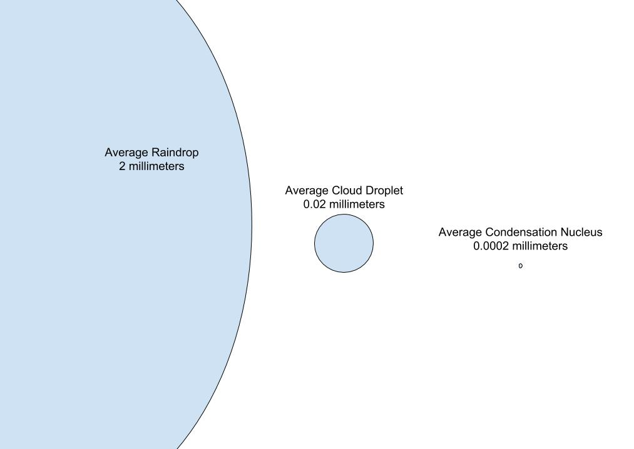
Necessary steps towards Cloud Formation to Precipitation
Moist air rises after heating
Supersaturation occurs
Reaching critical radius
Convection/turbulence pushes air through cloud
Figure: The comparison of Raindrop to a Cloud drop to CCN (From Nugent et al)
Notes:
To understand why Clouds form, the concept of Saturation vapour pressure needs ot be introduced.
Saturation vapour pressure : The maximum amount of water vapour necessary to keep moist air in equllibrium with a surrounding face of pure water or ice. It represents the maximum amount of water vapour that the air can hold at any given temp and pressure
To maintain equilibrium in the system, water out = water in. the higher temps mean faster moving particles which eans more water vapour necessary to saturate the air.
Essentials of Meteorology Ahrens
Dominguez_Microphysics.pdf

Slide 3
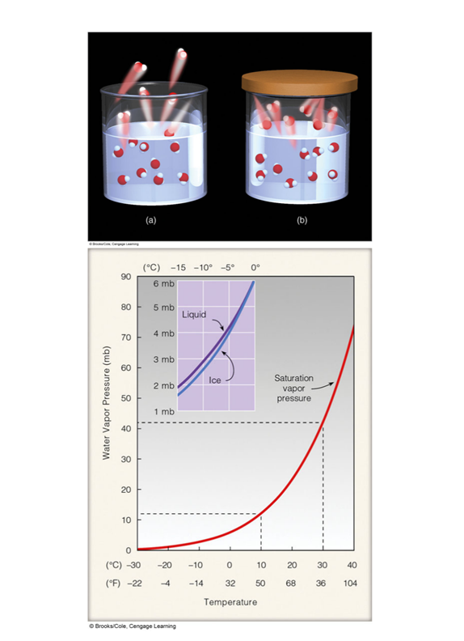
Saturation Vapour Pressure
Figure: The representation of an open (a) and a closed(b) system for the equilibrium of vapour to water. (Taken from Dominguez)
Figure: Saturation Vapour increases with temperature. (From Ahrens, 2005, pg. 81 )
Notes:
To understand why Clouds form, the concept of Saturation vapour pressure needs ot be introduced.
Saturation vapour pressure : The maximum amount of water vapour necessary to keep moist air in equllibrium with a surrounding face of pure water or ice. It represents the maximum amount of water vapour that the air can hold at any given temp and pressure
To maintain equilibrium in the system, water out = water in. the higher temps mean faster moving particles which eans more water vapour necessary to saturate the air.
Essentials of Meteorology Ahrens
Dominguez_Microphysics.pdf

Slide 4
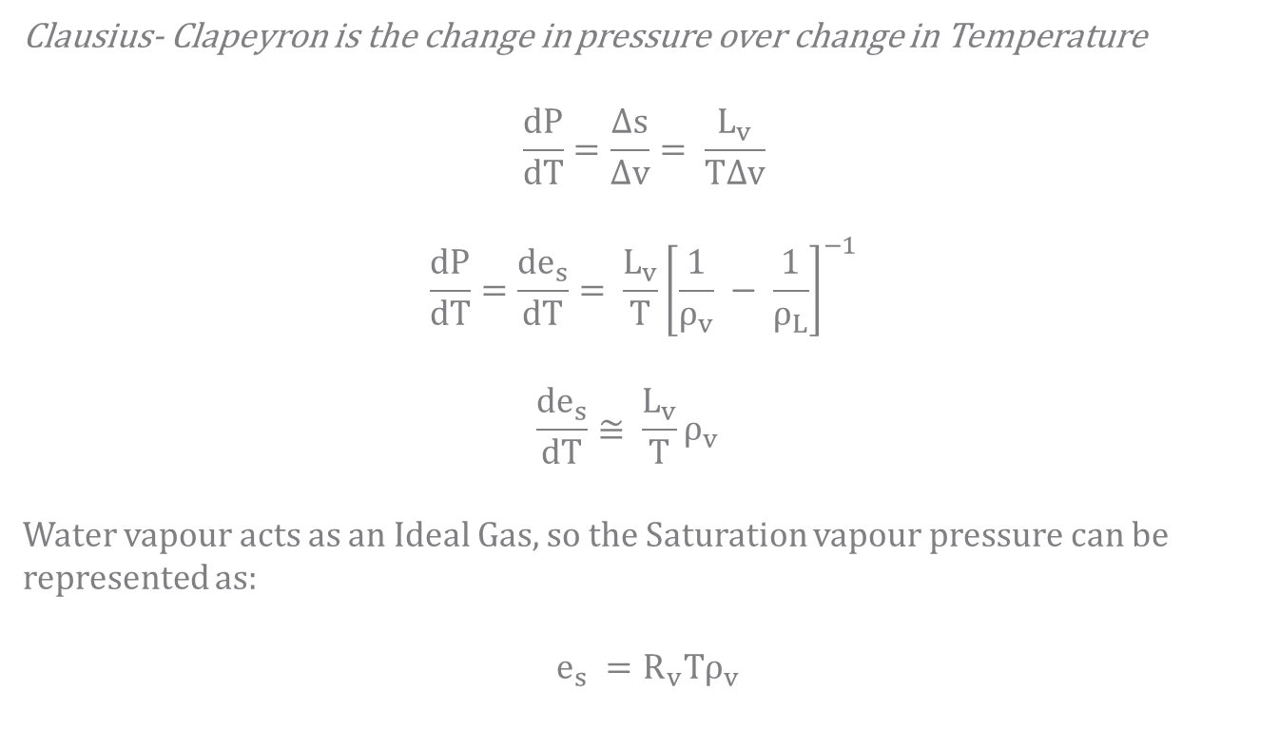
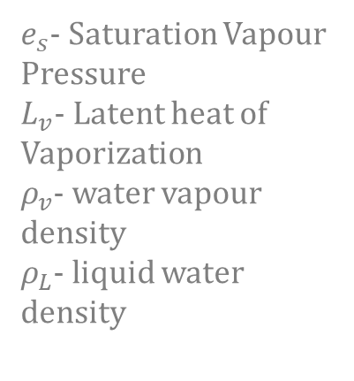
The Clausius-Clapeyron Equation
Clausius- Clapeyron is the change in pressure over change in Temperature
$$\frac{dP}{dT}=\frac{∆s}{∆v}= \frac{L_{v}}{T∆v}$$
$$\frac{dP}{dT}=\frac{{de}_{s}}{dT}= \frac{L_{v}}{T}{\left[\frac{1}{ρ_{v}} − \frac{1}{ρ_{L}}\right]}^{−1}$$
$$\frac{{de}_{s}}{dT}≅ \frac{L_{v}}{T}ρ_{v}$$
Water vapour acts as an Ideal Gas, so the Saturation vapour pressure can be represented as:
$$e_{s} =R_{v}Tρ_{v}$$
$e_{s}$- Saturation Vapour Pressure
$L_{v}$- Latent heat of Vaporization
$ρ_{v}$- water vapour density
$ρ_{L}$- liquid water density
Notes:
The Clausius_Clapeyron equation characterizes a discontinuous phase transition between two phases of matter and
is the initial step into achieving cloud nuclei condensation. As discussed, there needs to be a certain level of saturation in the atmosphere for the air to be considered supersaturated.
Since liquid water density is much grater than water vapor density, the first equation can be approximated to the second equation.
Additionally, water vapour acts as an ideal gas, so the ideal gas law for water vapor is the third equation.
https://geo.libretexts.org/Bookshelves/Meteorology_and_Climate_Science/Book%3A_Practical_Meteorology_(Stull)/04%3A_Water_Vapor/4.00%3A_Vapor_Pressure_at_Saturation
https://chem.libretexts.org/Bookshelves/Physical_and_Theoretical_Chemistry_Textbook_Maps/Physical_Chemistry_(McQuarrie_and_Simon)/23%3A_Phase_Equilibria/23.04%3A_The_Clausius-Clapeyron_Equation
http://bingweb.binghamton.edu/~suzuki/ThermoStatFIles/16.8%20PT%20Clausius%20Clapeyron%20equation.pdf

Slide 5

The Clausius-Clapeyron Equation
By rearranging the equation, a simple ODE is formed:
$$\frac{{de}_{s}}{e_{s}}= \frac{L_{v}}{{R_{v}T}^{2}}dT$$
$$\int_{e_{0}}^{e_{s}}{\frac{de_{s}}{e_{s}}= \int_{T_{0}}^{T}{\frac{L_{v}dT}{R_{v} T^{2}}}}$$
$$ln⁡(\frac{e_{s}}{e_{0}})= \frac{L_{v}}{R_{v}}{\left[\frac{1}{T_{0}} − \frac{1}{T}\right]}^{}$$
Notes:
One interpretation of this curve is that as unsaturated humid air is cooled, a temperature is reached at which point the air is saturated. Further cooling forces some water vapor to condense into liquid, creating clouds and rain and releasing latent heat. Hence, the Clausius-Clapeyron equation is important for understanding cloud condensation.
https://geo.libretexts.org/Bookshelves/Meteorology_and_Climate_Science/Book%3A_Practical_Meteorology_(Stull)/04%3A_Water_Vapor/4.00%3A_Vapor_Pressure_at_Saturation
https://chem.libretexts.org/Bookshelves/Physical_and_Theoretical_Chemistry_Textbook_Maps/Physical_Chemistry_(McQuarrie_and_Simon)/23%3A_Phase_Equilibria/23.04%3A_The_Clausius-Clapeyron_Equation
http://bingweb.binghamton.edu/~suzuki/ThermoStatFIles/16.8%20PT%20Clausius%20Clapeyron%20equation.pdf

Slide 6
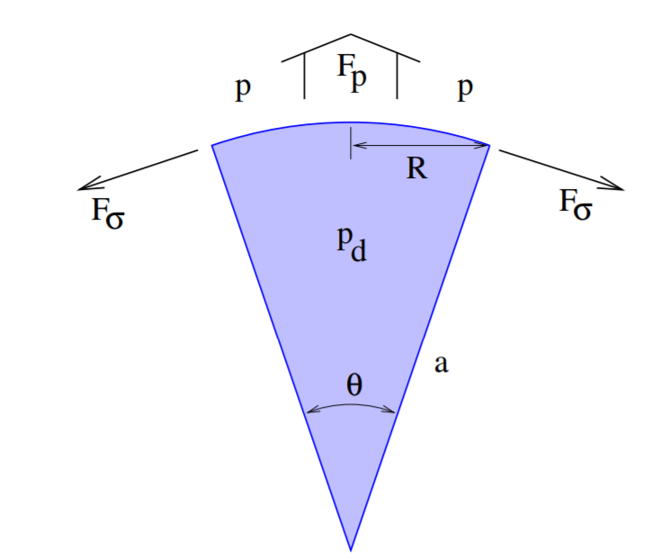
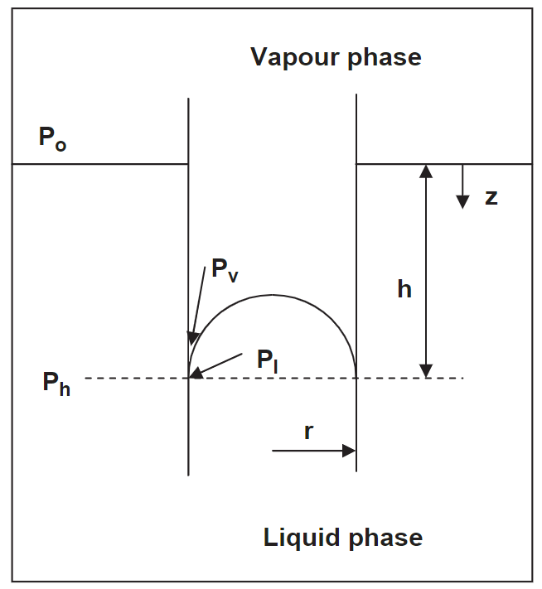
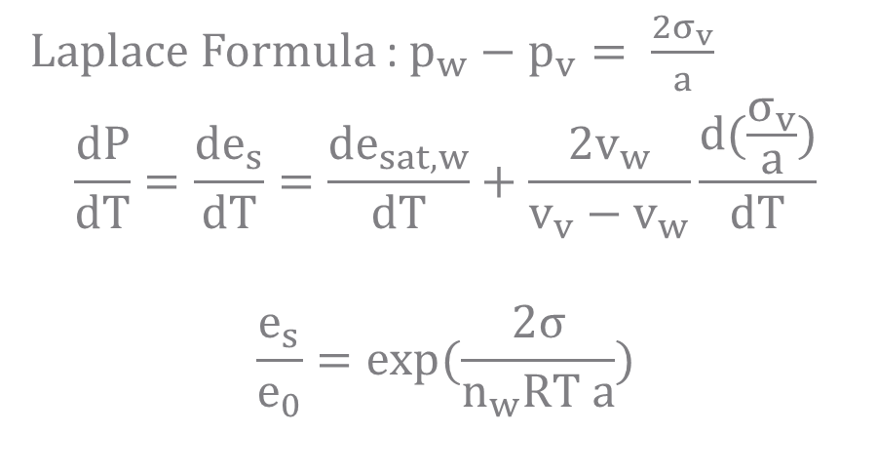

Kelvin Effect
Laplace Formula : $p_{w}−p_{v}= \frac{2σ_{v}}{a}$
$$\frac{dP}{dT}=\frac{{de}_{s}}{dT}=\frac{{de}_{sat,w}}{dT}+\frac{2v_{w}}{v_{v}−v_{w}}\frac{d(\frac{σ_{v}}{a})}{dT}$$
$$\frac{e_{s}}{e_{0}}=exp⁡(\frac{2σ}{n_{w}RT a})$$
(From Cloud Microphysics)
$$v_{w}=1/n_{w}$$
Figure: Experimental set up for simplistic derivation of the Kelvin law (From Galvin, 2005)
Notes:
A system containing a pure homogeneous vapour and liquid inequilibrium. In a “thought experiment” a non-wetting tube is inserted intothe liquid, causing the liquid in the tube to move downwards. The vapourpressure above the curved interface is then higher than that for the planarinterface. This picture provides a simple conceptual basis for the Kelvinequation
A system containing a pure homogeneous vapour and liquid inequilibrium. In a “thought experiment” a non-wetting tube is inserted intothe liquid, causing the liquid in the tube to move downwards. The vapourpressure above the curved interface is then higher than that for the planarinterface. This picture provides a simple conceptual basis for the Kelvinequation
https://www.e-education.psu.edu/meteo300/node/676
https://reader.elsevier.com/reader/sd/pii/S000925090500268X?token=D227961777C0EEBDCD2EB8255F7224D240F1AF28F87288895A4B6E3CE1D6B1BB06DDAA0B334D90119D748F5530986C04&originRegion=us-east-1&originCreation=20211110063515
https://mpimet.mpg.de/fileadmin/staff/bansedorothea/DFB_diploma_app3.pdf

Slide 7
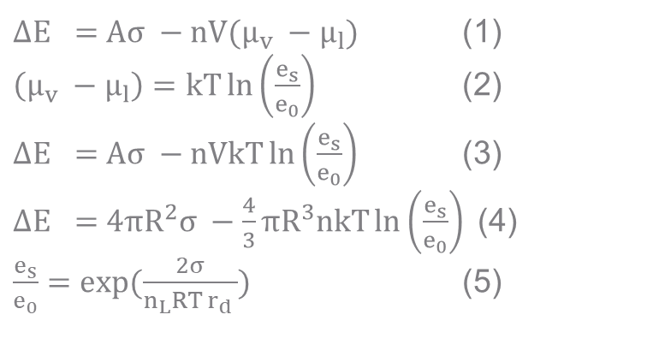
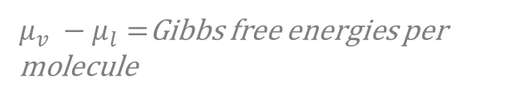
Gibbs Free Energy
Equation 1 is the Gibbs free energy as a balance between Evaporation and Condensation.
Applying gas law and system parameters produces Equation 4
${∆E}_{}=Aσ −nV(μ_{v} −μ_{l})$ (1)
$\left(μ_{v} −μ_{l}\right)=kT\ln\left(\frac{e_{s}}{e_{0}}\right)$ (2)
${∆E}_{}=Aσ −nVkT\ln\left(\frac{e_{s}}{e_{0}}\right)$ (3)
${∆E}_{}=4πR^{2}σ −\frac{4}{3}πR^{3}nkT\ln\left(\frac{e_{s}}{e_{0}}\right)$(4)
$\frac{e_{s}}{e_{0}}=exp⁡(\frac{2σ}{n_{L}RT r_{d} })$ (5)
$μ_{v} −μ_{l}=$Gibbs free energies per molecule
Notes:
https://www.e-education.psu.edu/meteo300/node/676
https://reader.elsevier.com/reader/sd/pii/S000925090500268X?token=D227961777C0EEBDCD2EB8255F7224D240F1AF28F87288895A4B6E3CE1D6B1BB06DDAA0B334D90119D748F5530986C04&originRegion=us-east-1&originCreation=20211110063515
https://mpimet.mpg.de/fileadmin/staff/bansedorothea/DFB_diploma_app3.pdf

Slide 8
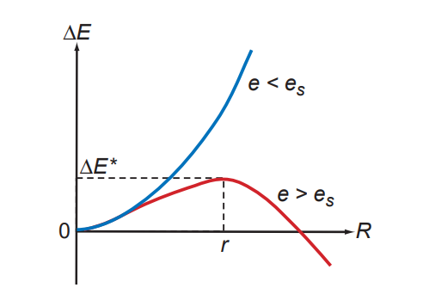
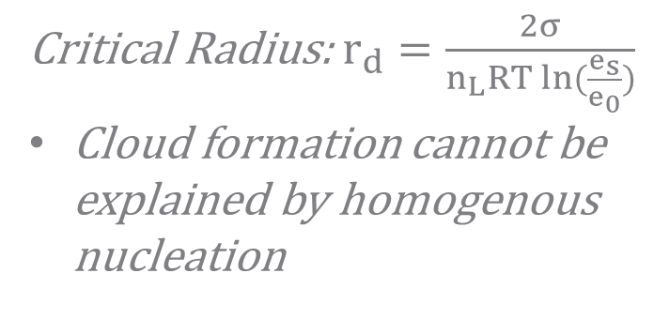
Gibbs Free Energy
Critical Radius: $r_{d}=\frac{2σ}{n_{L}RT ln⁡(\frac{e_{s}}{e_{0}})}$
Cloud formation cannot be explained by homogenous nucleation
Figure: Blue is droplet in a subsaturated environment, Red is a droplet in a supersaturated environment. The change in energy as a function of droplet radius (From Wallace and Hobbs, 2006)
Notes:
https://www.e-education.psu.edu/meteo300/node/676
https://reader.elsevier.com/reader/sd/pii/S000925090500268X?token=D227961777C0EEBDCD2EB8255F7224D240F1AF28F87288895A4B6E3CE1D6B1BB06DDAA0B334D90119D748F5530986C04&originRegion=us-east-1&originCreation=20211110063515
https://mpimet.mpg.de/fileadmin/staff/bansedorothea/DFB_diploma_app3.pdf
http://www.eebweb.arizona.edu/faculty/saleska/SWES.410.510/LECTURES/Dominguez_Microphysics.pdf

Slide 9
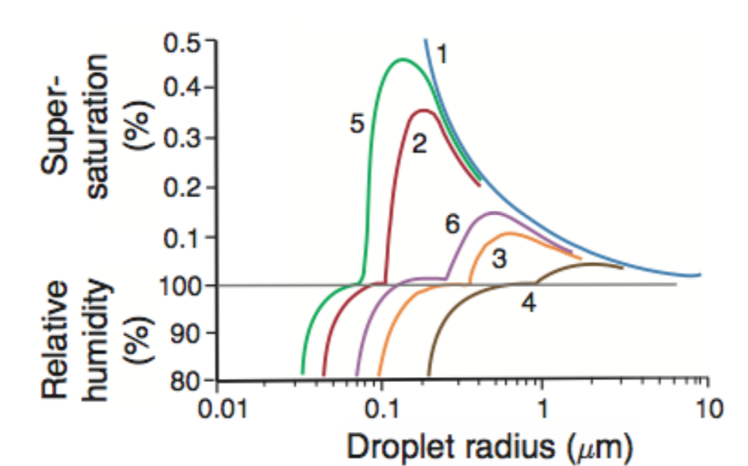
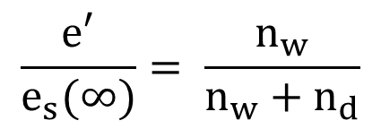
Raoult’s Solution and Kohler’s Curves
$$\frac{e′}{e_{s}(∞)}= \frac{n_{w}}{n_{w}+n_{d}}$$
Figure: Combination solution for Raoult and Kelvin (From Dominguez)
Notes:
The condensation of water onto aerosols is termed Cloud Condensation nuclei. Much more likely than random condensation.
The equation represents the saturation pressure over solution droplets,
It is a fraction which represents the reduction in the water vapour pressure due to soluables.
Applying the fraction to relative humidty , we obtain a kohler curve. Below a certain droplet radius the relative humity adjacent is ess than that which is in equilibrium with a plane. With increase of size the kelvin curve becomes the deominant
Guggenheim, E. A. (1937). The theoretical basis of Raoult's law. Transactions of the Faraday Society, 33, 151-156.
Wallace and Hobbs, 2005

Slide 10
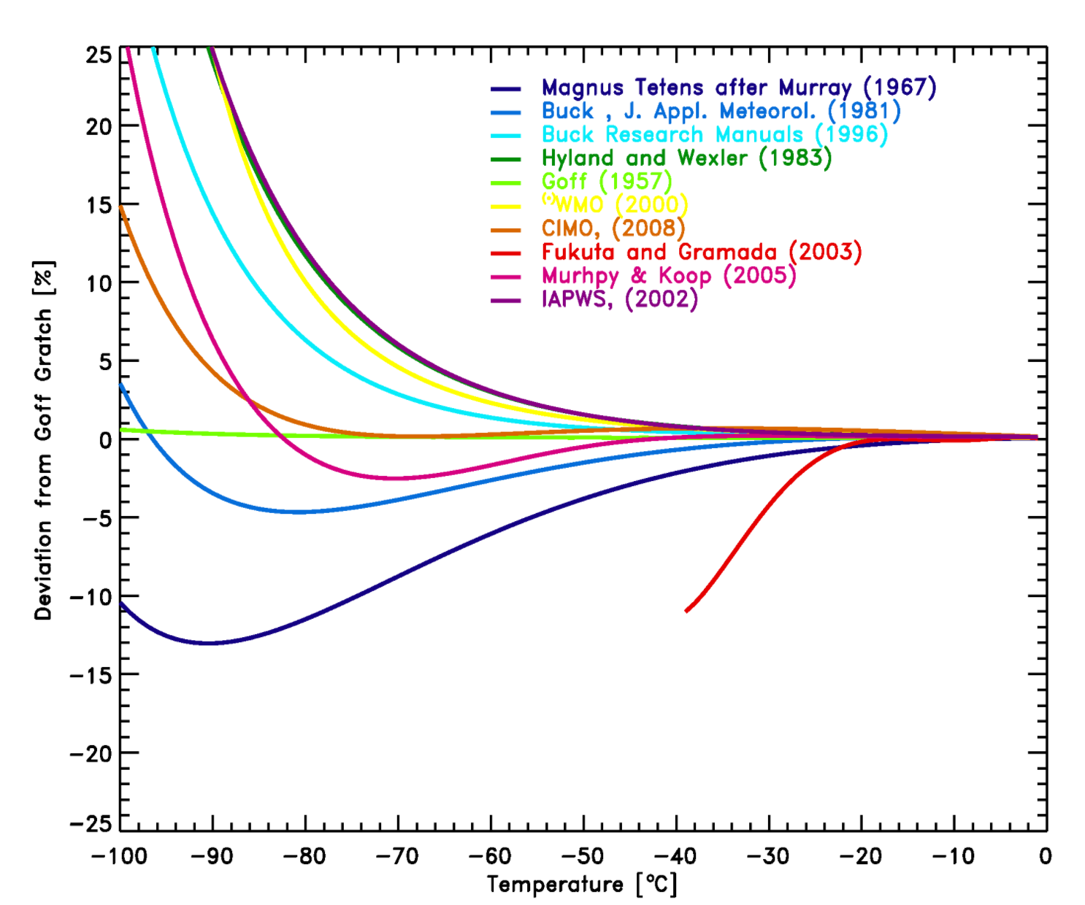
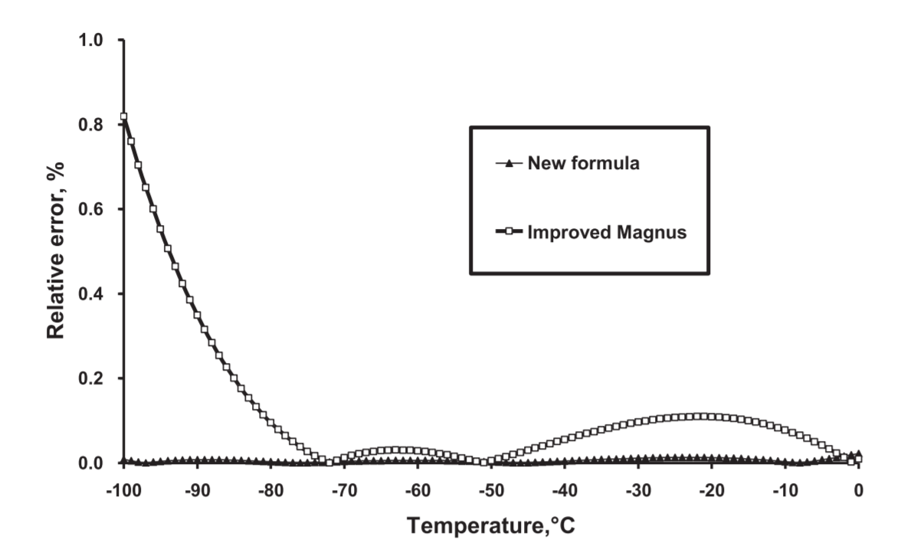
Goff –Gratch
Figure: (From Huang 2017)
Figure: (From Vomel 2013)
Notes:
A Simple Accurate Formula for Calculating Saturation Vapor Pressure of Water and Ice
https://www.eas.ualberta.ca/jdwilson/EAS372_13/Vomel_CIRES_satvpformulae.html

Slide 11

Not Condensation?
Must be Collision
Presentation Title Here

Slide 12
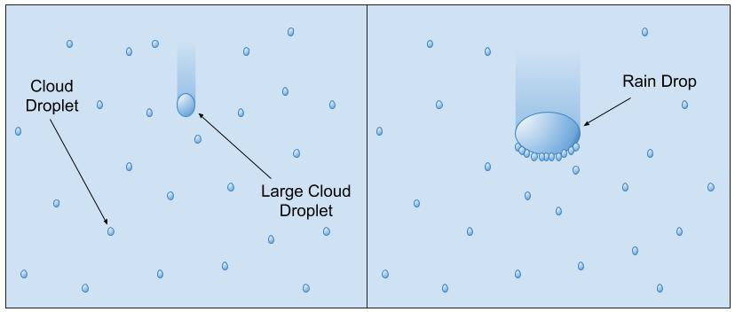
Collisional Coalescence
Figure: Process as large cloud nuclei fall through and collide with smaller droplets. Achieving coalescence. (From Nugent et al)
Notes:
Collisions between Small Precipitation Drops Part II
http://pressbooks-dev.oer.hawaii.edu/atmo/chapter/chapter-7-precipitation-processes/

Slide 13
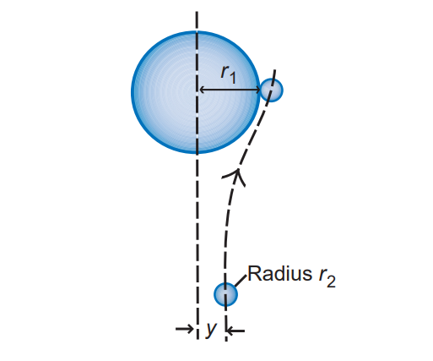
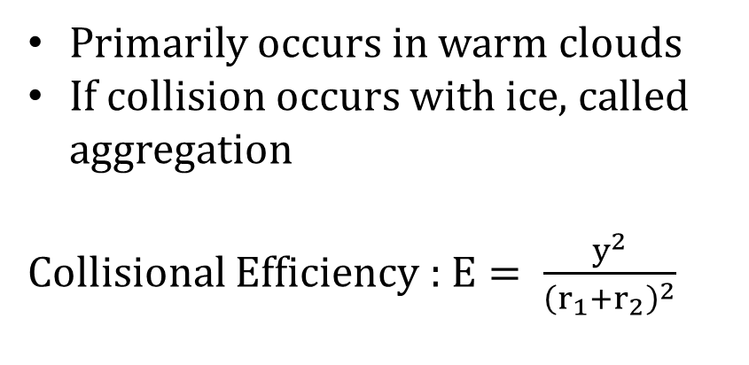
Collisional Coalescence
Primarily occurs in warm clouds
If collision occurs with ice, called aggregation
Collisional Efficiency : $E= \frac{y^{2}}{{\left(r_{1}+r_{2}\right)}^{2}}$
Figure: Collisional setup. The droplet below misses the falling drop unless within the critical distance due to drag. (From Wallace and Hobb, 2006)
Notes:
Collisions between Small Precipitation Drops Part II
Wallace and Hobbs

Slide 14
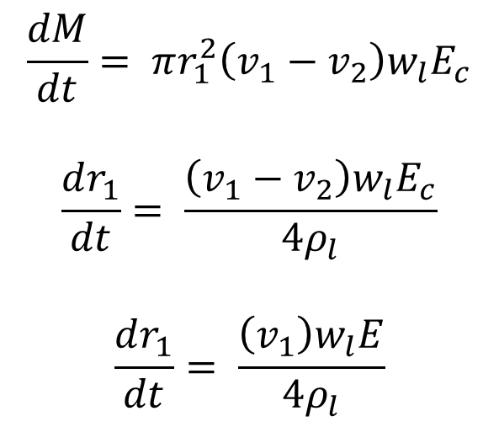
Collisional Coalescence
$$\frac{dM}{dt}= πr_{1}^{2}\left(v_{1}−v_{2}\right)w_{l}E_{c}$$
$$\frac{dr_{1}}{dt}= \frac{\left(v_{1}−v_{2}\right)w_{l}E_{c}}{4ρ_{l}}$$
$$\frac{dr_{1}}{dt}= \frac{\left(v_{1}\right)w_{l}E}{4ρ_{l}}$$
Continuous Collection model
Assume uniform distribution through space
Uniform collection rate
Uniform size
Notes:
Collisions between Small Precipitation Drops Part II
ecause v1 increases as r1 increases (see Box 6.2), and E also increases with r1 (see Fig. 6.20), it follows from (6.28) that dr1dt increases with increasing r1; that is, the growth of a drop by collection is an accelerating process

Slide 15
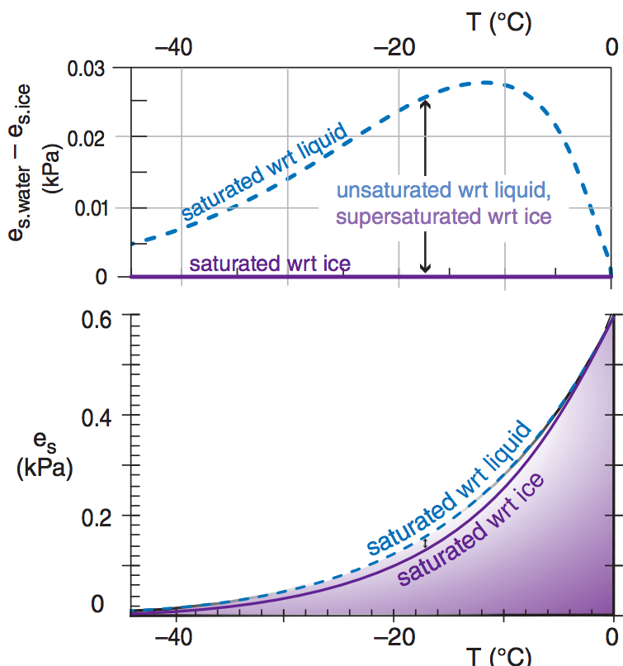
Bergeron Process
Accretion of ice particles onto CCN
In warm columns, produces rain
Cool columns allow for Snow, Slush and Freezing rain
Much easier to condense on surface of Ice vs Liquid
Notes:
Water vapour pressure over ice can acheive supersaturation earlier, meaning it is easier for water to condense onto an ice surface earlier. If the number density of ice is small compared to liquid water, the ice crystals can grow large enough to fall out of the cloud, melting into rain drops if lower level temperatures are warm enough.

Slide 16
The End

