Slide 1

Viewing Comparisons of Radar and Lidar on Particle scatterers
Victoria Pinnegar, Callum Dewsnap
Department of Physics and Astronomy
Department of Physics and Astronomy

Slide 2
Indigenous Forecasting
Chugachmiut Traditional Weather Forecasting:
Weatherman- time observation for speed, direction, shape of clouds
(Traditional Ecological Knowledge (TEK)) Low atmosphere winds-> Current days weather, High atmosphere winds -> Large storm systems
Cloud halo around sun and moon indicate weather is going to turn for the worse
“Cloud streaks high in the sky means it is going to be windy.” - Mary Malchoff, Port Graham
“Dark clouds means there will be rain, snow, or wind.” - Tom Yeaton Sr., Port Graham
Plains People:
Damp, foggy weather precedes cold and storms
Omaha People - Curlew Call in the morning foretells cloudless day
1
Department of Physics and Astronomy
Victoria Pinnegar, Callum Dewsnap
Notes:
[7], [4]

Slide 3
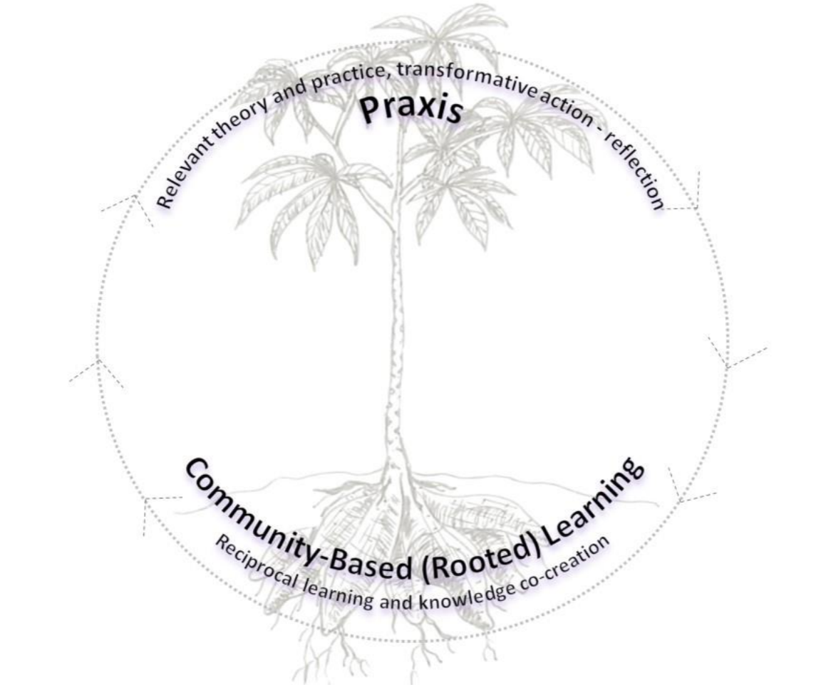
Decolonizing Research and use of Indigenous Knowledge
Utilizing and publishing indigenous knowledge follows a trend of disrespect, lack of documentation, lack of care, and follow up on research for communities
Proposed Research system from : Yuca-Cassava growth System:
Built around Yuca growth system from Caribbean Indigenous population the
Community based, reciprocal learning, and knowledge co-creation
Nurture growth for Praxis -> Transformative Action-Reflection
Community members are considered Participant researchers, and are allowed to participate as co-authors
Inclusion of Storywork
2
Department of Physics and Astronomy
Victoria Pinnegar, Callum Dewsnap
Notes:
[8], [5]

Slide 4
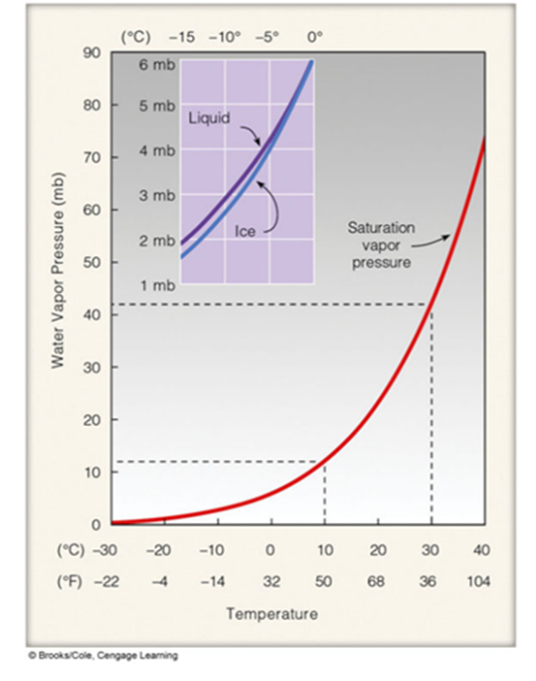
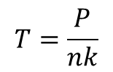
Cloud Formation Parameters -Forecasting
Relative Humidity
More easily formed in lower temperatures due to Saturation Vapour Pressure
Water acts as an Ideal gas, so if the cloud formation occurs more efficiently at lower temperature, what change in parameters allows better cloud formation?
If nk ~ 100 :
T increases, harder to condense into clouds
If nk ~ 10 :
T decreases, easier condensation
If P decreases:
T decreases, easier condensation
$$T=\frac{P}{nk}$$
3
Department of Physics and Astronomy
Victoria Pinnegar, Callum Dewsnap
Notes:
(Ahrens)

Slide 5
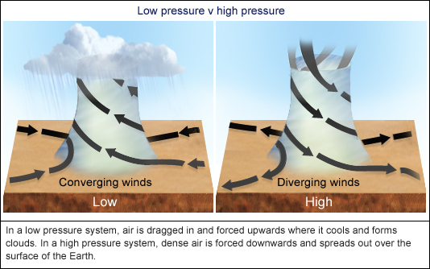
Cloud Formation Parameters -Forecasting
Tracking of High- Low pressure zones through the atmosphere
Clouds form more easily in lower pressure zones alongside upward circulation and convergence of ai
Low-pressure and High-pressure systems follow large scale atmospheric circulation:
Hadley Cells- Closed Circulation loop near the Equator, low pressure zone near equator → rises up → travels to 30th parallel to a high- pressure zone → sinks → circulates back to equator
Polar Cell- Air rises → moves towards pole and eastward → descends → moves towards equator and west
Ferrell Cell- Transition between 60 ͦto poles, Eddy created by Polar and Hadley
4
Department of Physics and Astronomy
Victoria Pinnegar, Callum Dewsnap
Notes:
[15] [14]

Slide 6
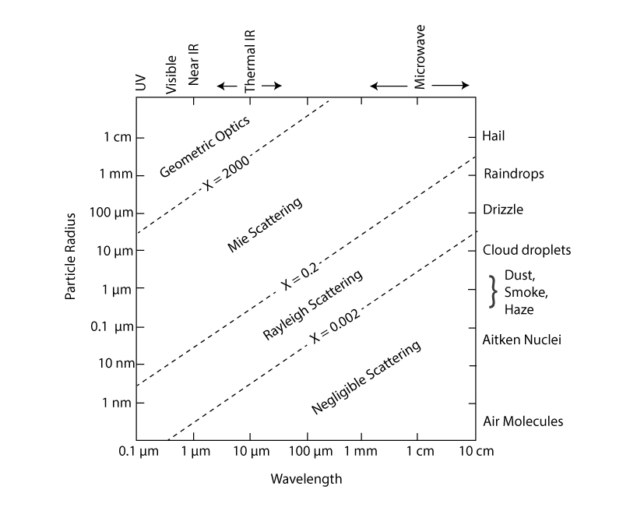

Backscatter in Remote Observation
Scattering of radiation through the atmosphere
Radiation interacts (Absorbs or Scatters) with a particle
Absorption removes photon and converts to Energy
Scattering shoots radiation into a new direction
Depends on Wavelength, Size, Shape and Composition
The Size Parameter: $x= \frac{2πr}{λ}$
5
Department of Physics and Astronomy
Victoria Pinnegar, Callum Dewsnap
Notes:
[1]

Slide 7

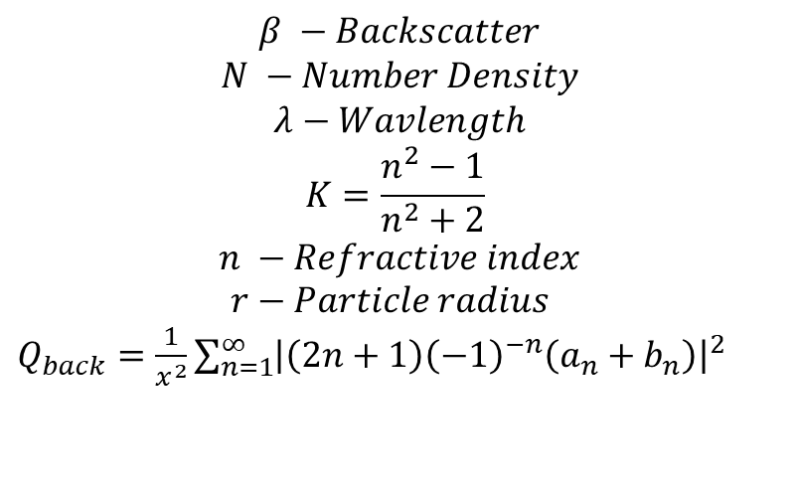
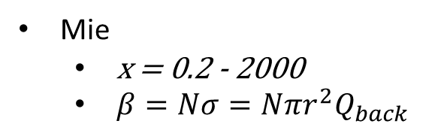
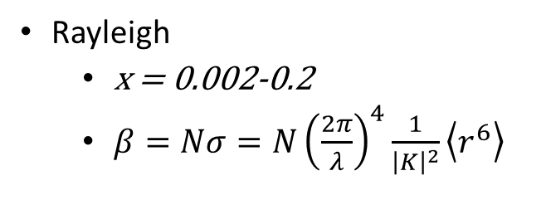
Backscatter in Remote Observation
Geometric optics
x > 2000
Traditional optical principles
Rayleigh
x = 0.002-0.2
$β=Nσ=N{\left(\frac{2π}{λ}\right)}^{4}\frac{1}{{\left|K\right|}^{2}}\left\langle r^{6}\right\rangle$
Mie
x = 0.2 - 2000
$β=Nσ=Nπr^{2}Q_{back}$
$$β −Backscatter$$
$$N −Number Density$$
$$λ−Wavlength$$
$$K=\frac{n^{2}−1}{n^{2}+2}$$
$$n −Refractive index$$
$r−Particle radius$
$Q_{back}=\frac{1}{x^{2}}\sum_{n=1}^{∞}{{\left|\left(2n+1\right){\left(−1\right)}^{−n}\left(a_{n}+b_{n}\right)\right|}^{2}}$
6
Department of Physics and Astronomy
Victoria Pinnegar, Callum Dewsnap
Notes:
[2] [9]

Slide 8
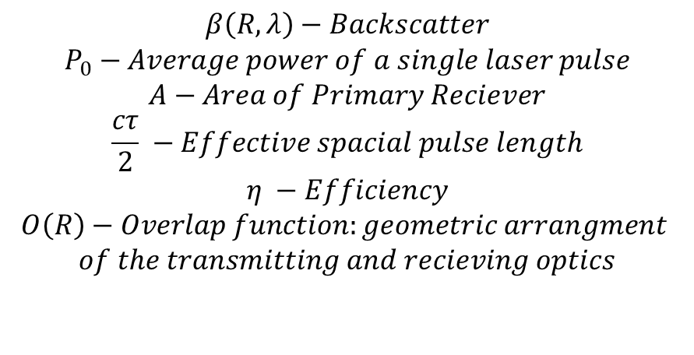
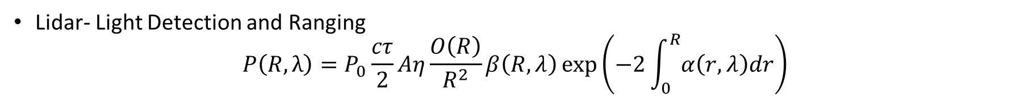
Lidar Observation
Lidar- Light Detection and Ranging
$$P\left(R, λ\right)=P_{0}\frac{cτ}{2}Aη\frac{O\left(R\right)}{R^{2}}β\left(R,λ\right)\exp\left(−2\int_{0}^{R}{α\left(r, λ\right)dr}\right)$$
$$β\left(R,λ\right)−Backscatter$$
$$P_{0}−Average power of a single laser pulse$$
$$A−Area of Primary Reciever$$
$$\frac{cτ}{2} −Effective spacial pulse length$$
$$η −Efficiency$$
$$O\left(R\right)−Overlap function:geometric arrangment$$
$$of the transmitting and recieving optics$$
Rayleigh scattering for small particles (Molecular Scattering)
Mie scattering for large particles (Particulate Scattering)
7
Department of Physics and Astronomy
Victoria Pinnegar, Callum Dewsnap
Notes:
[19]

Slide 9
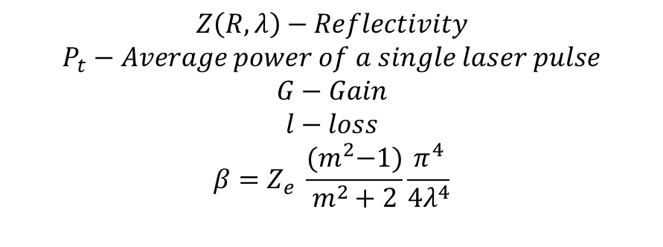
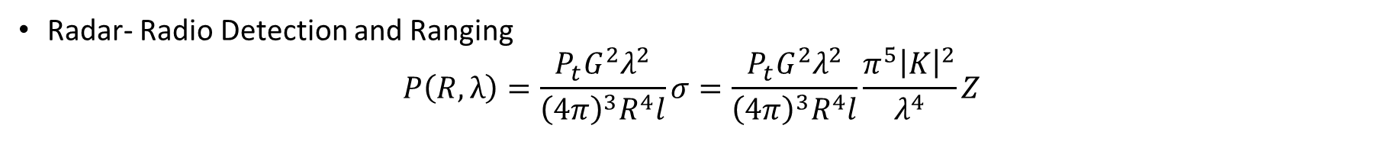
Radar Observation
Radar- Radio Detection and Ranging
$$P\left(R, λ\right)=\frac{P_{t}G^{2}λ^{2}}{{\left(4π\right)}^{3}R^{4}l}σ=\frac{P_{t}G^{2}λ^{2}}{{\left(4π\right)}^{3}R^{4}l}\frac{π^{5}{\left|K\right|}^{2}}{λ^{4}}Z$$
$$Z\left(R,λ\right)−Reflectivity$$
$$P_{t}−Average power of a single laser pulse$$
$$G−Gain$$
$$l−loss$$
$$β=Z_{e} \frac{{(m}^{2}−1)}{m^{2}+2}\frac{π^{4}}{4λ^{4}}$$
Radar wavelengths are so long, the particles are all small by comparison
All particulates used are in Rayleigh range (Cloud, Aerosol)
Molecular backscatter is negligible
8
Department of Physics and Astronomy
Victoria Pinnegar, Callum Dewsnap
Notes:
[10], [16], [9]

Slide 10
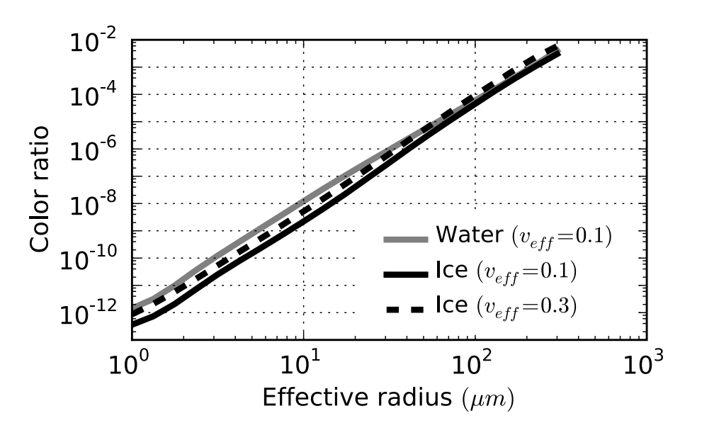
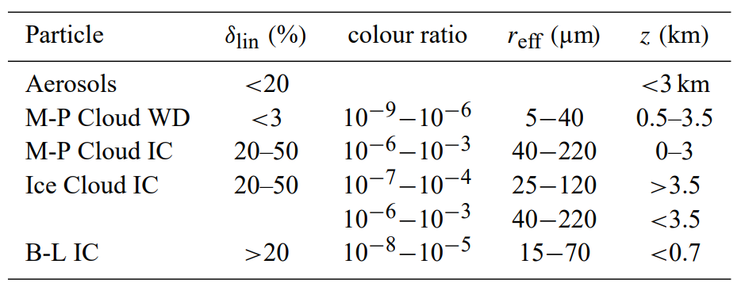
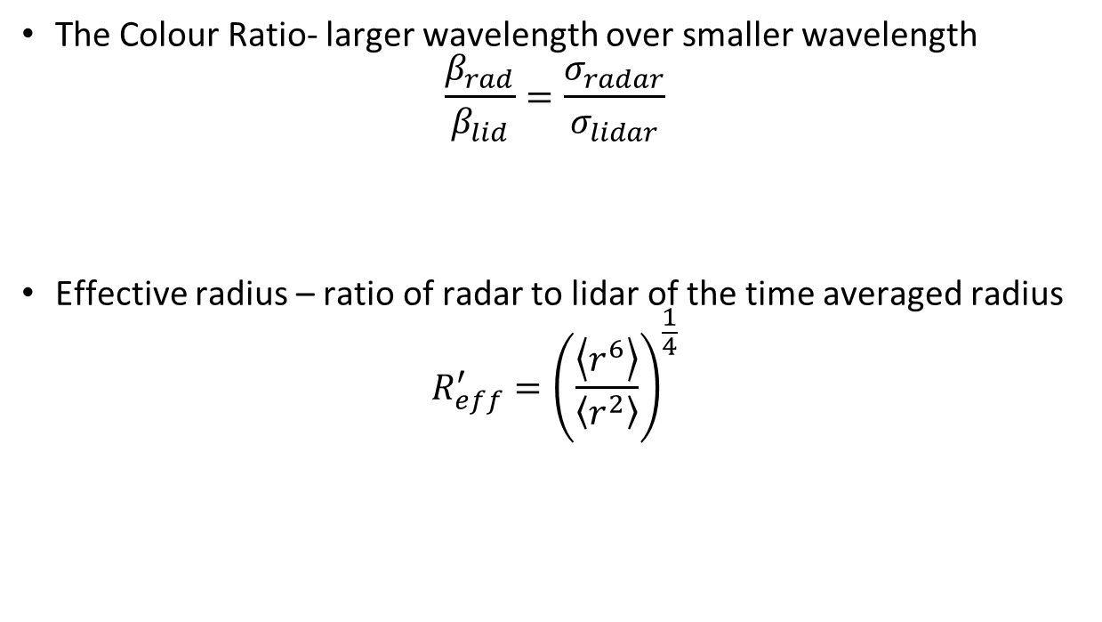
Colour Ratio
The Colour Ratio- larger wavelength over smaller wavelength
$$\frac{β_{rad}}{β_{lid}}=\frac{σ_{radar}}{σ_{lidar}}$$
Effective radius – ratio of radar to lidar of the time averaged radius
$$R_{eff}^{′}={\left(\frac{\left\langle r^{6}\right\rangle }{\left\langle r^{2}\right\rangle }\right)}^{\frac{1}{4}}$$
9
Department of Physics and Astronomy
Victoria Pinnegar, Callum Dewsnap
Notes:
[9], [20]

Slide 11
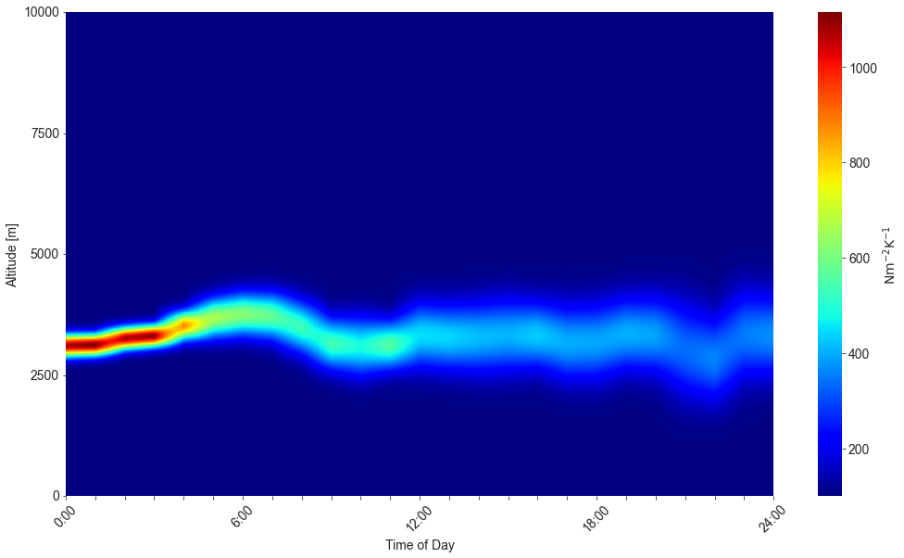
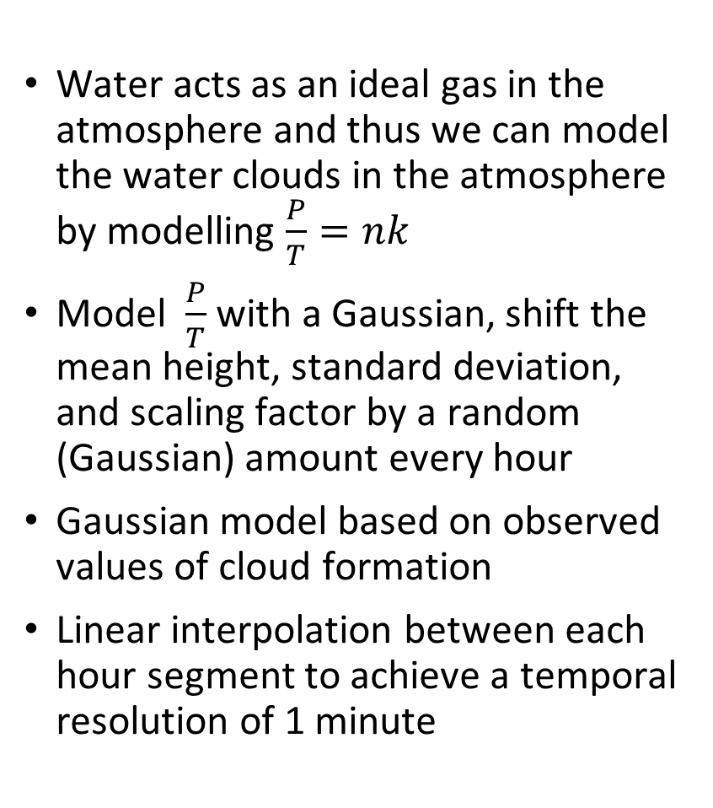
Water acts as an ideal gas in the atmosphere and thus we can model the water clouds in the atmosphere by modelling $\frac{P}{T}=nk$
Model $\frac{P}{T}$ with a Gaussian, shift the mean height, standard deviation, and scaling factor by a random (Gaussian) amount every hour
Gaussian model based on observed values of cloud formation
Linear interpolation between each hour segment to achieve a temporal resolution of 1 minute
Modelling the Atmosphere
10
Department of Physics and Astronomy
Callum Dewsnap, Victoria Pinnegar

Slide 12
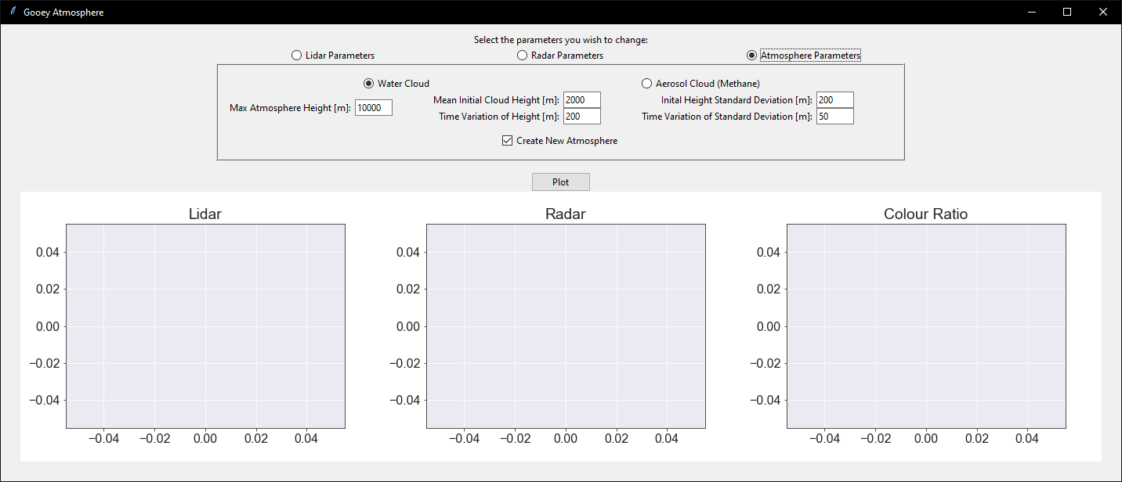
GooeyAtmosphere.py
11
Department of Physics and Astronomy
Callum Dewsnap, Victoria Pinnegar

Slide 13
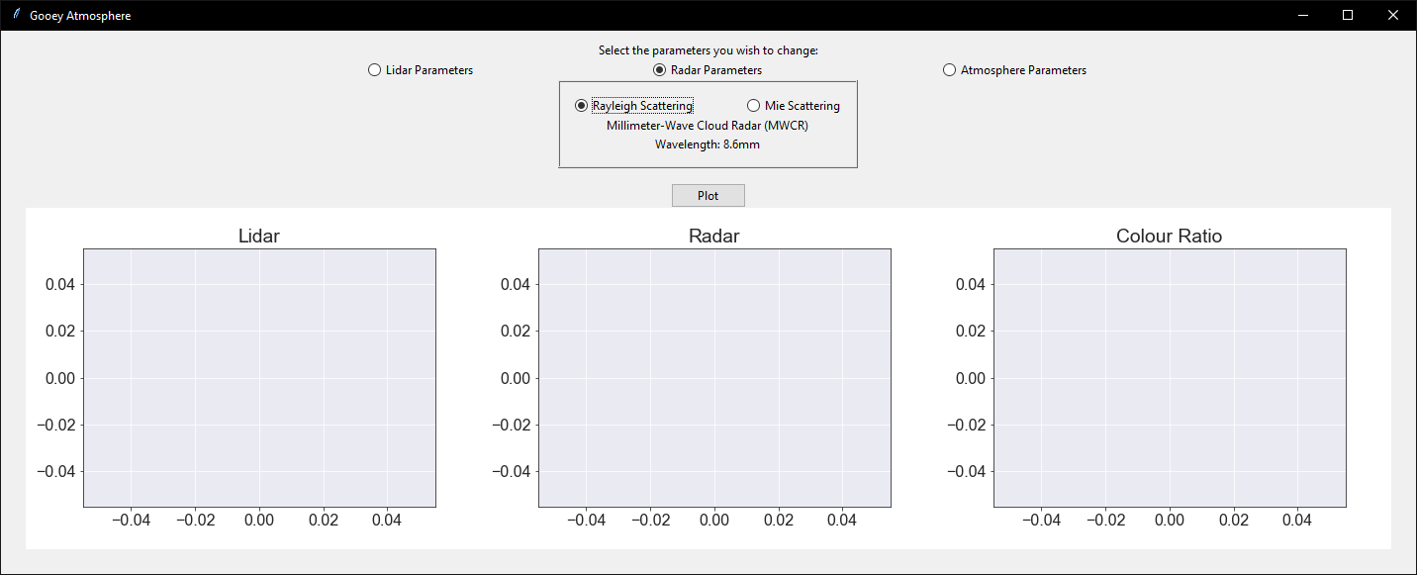
GooeyAtmosphere.py
12
Department of Physics and Astronomy
Callum Dewsnap, Victoria Pinnegar

Slide 14
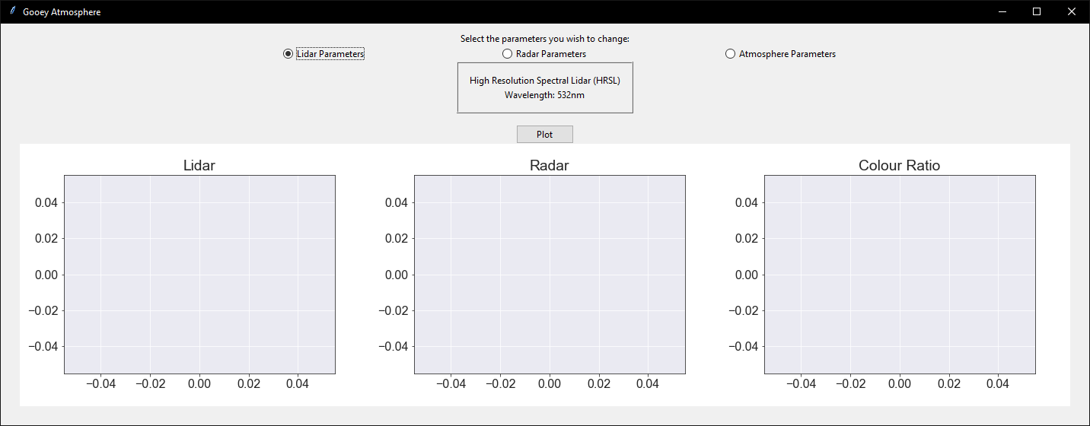
GooeyAtmosphere.py
13
Department of Physics and Astronomy
Callum Dewsnap, Victoria Pinnegar

Slide 15
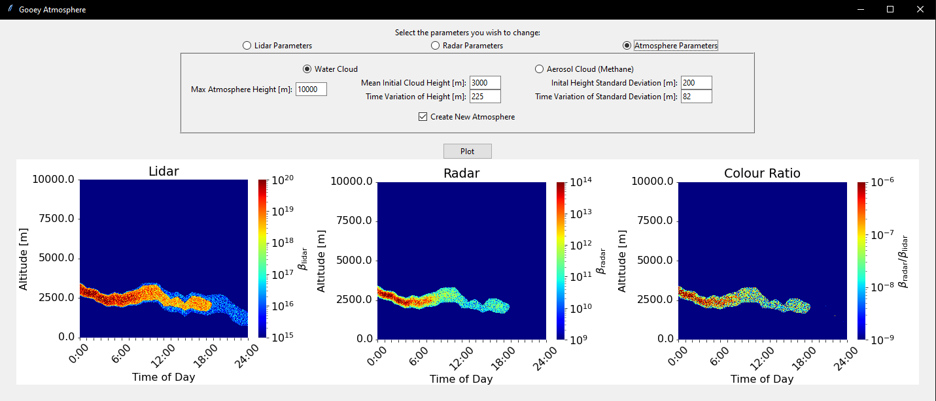
GooeyAtmosphere.py
14
Department of Physics and Astronomy
Callum Dewsnap, Victoria Pinnegar

