Slide 1
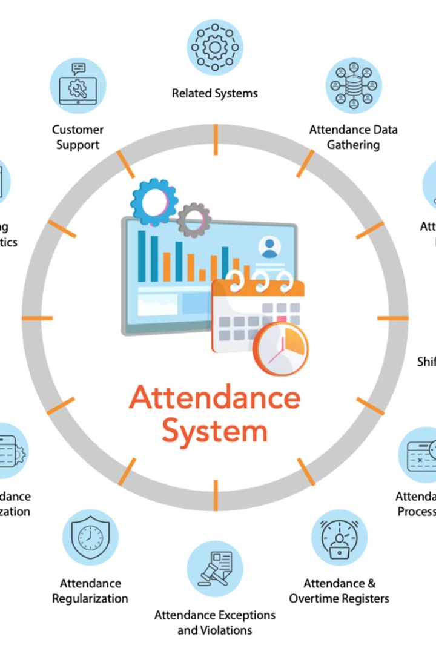
Introduction to Attendance Management System
An attendance management system is a software solution that tracks and manages the presence, absence, and lateness of employees. It provides real-time data and insightful reports to help organizations monitor and improve workforce punctuality and productivity.

Slide 2

Benefits of using an Attendance Management System
Efficiency: Streamline attendance tracking, reduce errors, and automate processes
Insights: Gain actionable data for decision making and performance evaluation
Compliance: Ensure adherence to labor laws and regulations, avoiding penalties

Slide 3
Key features of our Attendance Management System
Real-time Tracking
Automatic Leave Calculations
Monitor employee attendance instantly with real-time tracking and notifications.
Effortlessly calculate and manage leaves, vacations, and time off requests.
Data Security
Customizable Reports
Ensure sensitive attendance data is secure with robust data encryption and access controls.
Generate detailed reports tailored to specific organizational needs for analysis and decision-making.

Slide 4
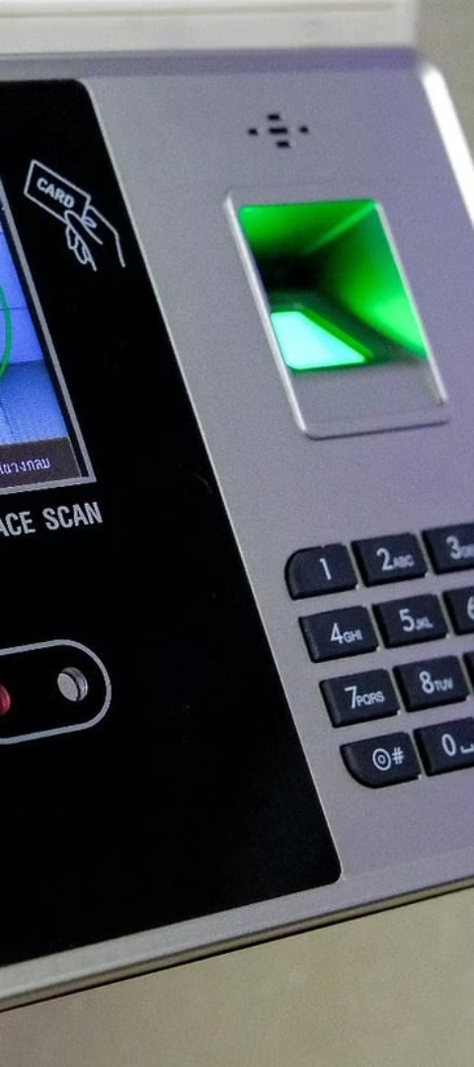
How the Attendance Management System works
1
Employee Check-in
Employees use the system to check in upon arrival at work.
2
Data Capture
The system records arrival time, departure time, and breaks, ensuring accurate attendance data.
3
Real-time Updates
Supervisors receive real-time updates on employee attendance through the system's dashboard.

Slide 5
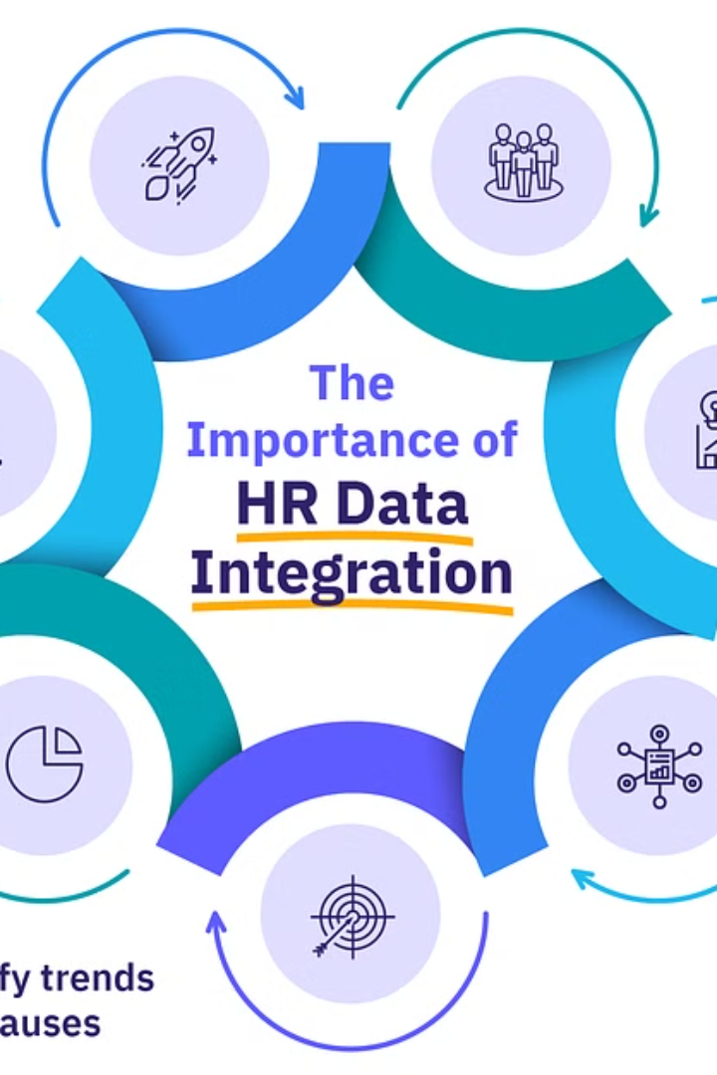
Integration with existing HR systems
Our Attendance Management System seamlessly integrates with existing HR systems, providing a unified platform for streamlined data management.
It allows for the transfer of attendance data to HR databases, ensuring accurate and efficient record-keeping and reporting.

Slide 6
Customization options for different business needs
Flexible Configurations
Modular Add-ons
Our system offers customizable settings to adapt to various business structures and requirements.
Customize the system with modular components to meet specific business needs without unnecessary complexity.

Slide 7
Reporting and analytics capabilities
Data Visualization
Customized Reports
Our system provides visually engaging charts and graphs for easy data interpretation.
Users can generate customized reports to track attendance trends and patterns.
Real-time Insights
Analytical Tools
Instant access to real-time attendance data for timely decision-making.
Utilize robust analytical tools to gain valuable insights for optimizing workforce management.

Slide 8



Compliance and Security Considerations
Data Protection
Regulatory Compliance
Security Protocols
Ensure robust encryption and access controls to safeguard sensitive information.
Adhere to industry standards and regulations to maintain legal and ethical integrity.
Implement multi-layered security measures to prevent unauthorized access and breaches.

Slide 9
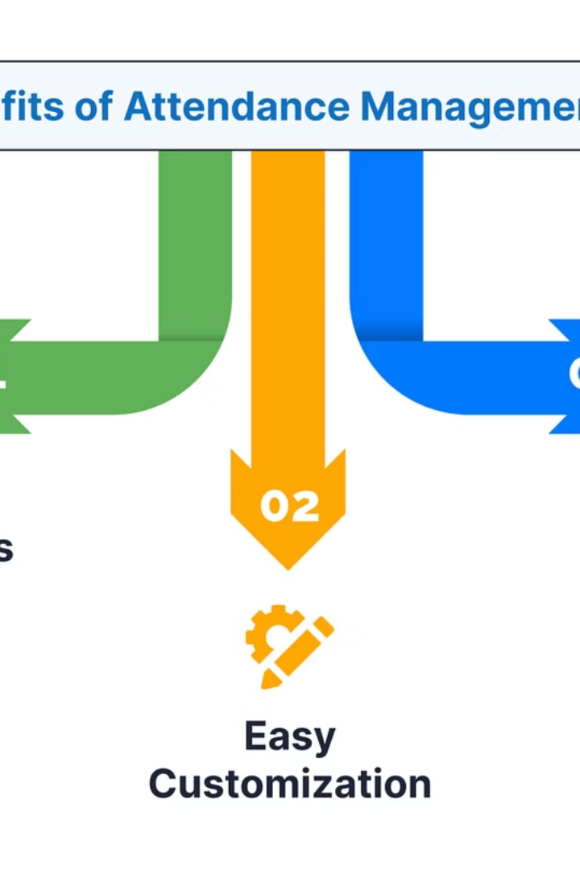
Customer Support and Training
Our comprehensive customer support includes 24/7 assistance via phone, email, and live chat. Training programs are tailored to your team's needs, with on-site workshops and video tutorials available.
Our dedicated support team ensures quick response times, resolving any issues efficiently. Training sessions cover system navigation, data management, and best practices.
We understand the importance of ongoing support and continuous learning for seamless integration into your business operations.

Slide 10

Conclusion
As we conclude, the Attendance Management System proves to be a vital tool for businesses to streamline attendance tracking and enhance workforce management. With its comprehensive features and user-friendly interface, it significantly improves operational efficiency and transparency.
Implementing our system will empower organizations to take control of attendance processes, resulting in improved productivity and compliance.

