Slide 1
RegEx
A RegEx, or Regular Expression, is a sequence of characters that forms a search pattern.
RegEx can be used to check if a string contains the specified search pattern.
RegEx Module
import re
import re
#Check if the string starts with “Today" and ends with “Good Day":
txt = “Today is a Good Day"
x = re.search("^Today.*Good Day$", txt)
if x:
print("YES! We have a match!")
else:
print("No match")

Slide 2
RegEx Functions
The re module offers a set of functions that allows us to search a string for a match:
Function | Description
findall | Returns a list containing all matches
search | Returns a Match object if there is a match anywhere in the string
split | Returns a list where the string has been split at each match
sub | Replaces one or many matches with a string

Slide 3
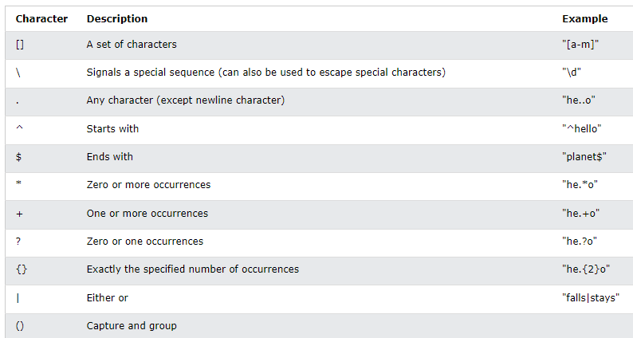
Metacharacters
Metacharacters are characters with a special meaning:

Slide 4
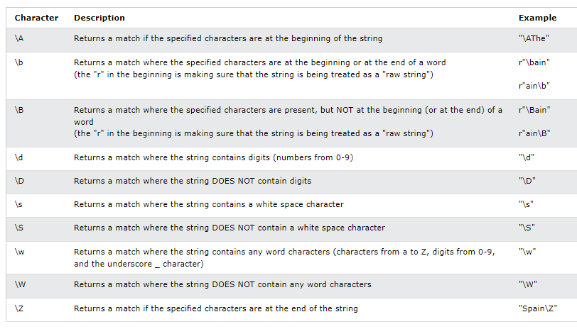
Special Sequences
A special sequence is a \ followed by one of the characters in the list below, and has a special
meaning:

Slide 5
The findall() Function
The findall() function returns a list containing all matches.
import re
#Return a list containing every occurrence of "ai":
txt = "Today is a good day"
x = re.findall("day", txt)
print(x) #['day', 'day']

