Slide 1
Session 2
Pass
Strings
Accessing Strings
Basic Operations
Formatting Strings
String slices
Tuples
Assigning Multiple Values at Once

Slide 2
Nested If
You can have if statements inside if statements, this is called nested if statements.
Example
x = 35 if x > 10: print("Above ten,") if x > 20: print("and also above 20!") else: print("but not above 20.")
The pass Statement
if statements cannot be empty, but if you for some reason have an if statement with
no content, put in the pass statement to avoid getting an error.
Example
a = 20 b = 100 if b > a: pass

Slide 3
Nested Loops
A nested loop is a loop inside a loop.
The "inner loop" will be executed one time for each iteration of the "outer loop":
Example
Print each adjective for every fruit:
adj = ["red", “big", "tasty"] fruits = ["apple", “watermelon", "cherry"] for x in adj: for y in fruits: print(x, y)
for x in [0, 1, 2]: pass

Slide 4
Strings
Strings in python are surrounded by either single quotation marks, or
double quotation marks.
'hello' is the same as "hello".
You can display a string literal with the print() function:
Example
print("Hello") print('Hello')
Assign String to a Variable
Example
a = "Hello" print(a)

Slide 5
Multiline Strings
You can assign a multiline string to a variable by using three quotes:
Example
You can use three double quotes:
str = ""“Good Morning, text written in multiline, with in quotes.""" print(str)
str = '' ‘Good Morning, text written in multiline, with in quotes.''' print(str)
Strings are Arrays
Like many other popular programming languages, strings in Python are arrays of bytes representing Unicode characters.
However, Python does not have a character data type, a single character is simply a string with a length of 1.
Square brackets can be used to access elements of the string.
Example
Get the character at position 1 (remember that the first character has the position 0):
a = "Hello, World!" print(a[1])

Slide 6
Example
Loop through the letters in the word “Morning":
for x in “Morning": print(x)
String Length
To get the length of a string, use the len() function.
Example
The len() function returns the length of a string:
a = "Hello, World!" print(len(a))
Check String
To check if a certain phrase or character is present in a string, we can use the keyword in.
Example
Check if “good" is present in the following text:
txt = “Today is a good day!" print(“good" in txt) #True

Slide 7
Example
Print only if “good" is present:
txt = “Today is a good day!" if “good" in txt: print("Yes, ‘good' is present.")
Check if NOT
To check if a certain phrase or character is NOT present in a string, we can use the
keyword not in.
Example
Check if “bad" is NOT present in the following text:
txt = “Today is a good day" print(“bad" not in txt)
Example
print only if “bad" is NOT present:
txt = “Today is a good day!" if “bad" not in txt: print("No, ‘bad' is NOT present.“)

Slide 8
Slicing
You can return a range of characters by using the slice syntax.
Specify the start index and the end index, separated by a colon, to return a part of the string.
Example
Get the characters from position 2 to position 5 (not included):
b = "Hello, World!" print(b[2:5]) #llo
Example
Get the characters from the start to position 5 (not included):
b = "Hello, World!" print(b[:5]) #Hello
Example
Get the characters from position 2, and all the way to the end:
b = "Hello, World!" print(b[2:]) #llo, World!

Slide 9
Example
Get the characters: From: "o" in "World!" (position -5) To, but not included: "d" in "World!" (position -2):
b = "Hello, World!" print(b[-5:-2])
Basic Operations
Example
The upper() method returns the string in upper case:
a = "Hello, World!" print(a.upper())
Example
The lower() method returns the string in lower case:
a = "Hello, World!" print(a.lower())
Example
The strip() method removes any whitespace from the beginning or the end:
a = " Hello, World! " print(a.strip()) # returns "Hello, World!”

Slide 10
Example
The replace() method replaces a string with another string:
a = "Hello, World!" print(a.replace("H", "J"))
Example
The split() method splits the string into substrings if it finds instances of the separator:
a = "Hello, World!" print(a.split(",")) # returns ['Hello', ' World!']
String Concatenation
Example
Merge variable a with variable b into variable c:
a = "Hello" b = "World" c = a + b print(c)
Example
To add a space between them,
add a " ":
a = "Hello" b = "World" c = a + " " + b print(c)

Slide 11
String Format
Example
age = 36 txt = "My name is John, I am " + age print(txt) //Error
The format() method takes the passed arguments, formats them, and places them in the string where the placeholders {} are:
Example
Use the format() method to insert numbers into strings:
age = 36 txt = "My name is John, and I am {}" print(txt.format(age))
Example
quantity = 3 itemno = 567 price = 49.95 myorder = "I want {} pieces of item {} for {} dollars." print(myorder.format(quantity, itemno, price))

Slide 12
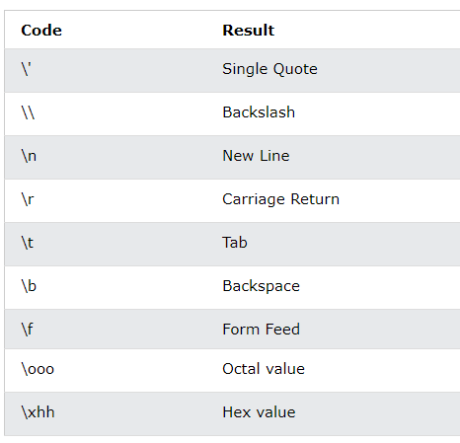
You can use index numbers {0} to be sure the arguments are placed in the correct placeholders:
Example
quantity = 3 itemno = 567 price = 49.95 myorder = "I want to pay {2} dollars for {0} pieces of item {1}." print(myorder.format(quantity, itemno, price))
Escape Character
txt = "We are the so-called "Vikings" from the north."
txt = "We are the so-called \"Vikings\" from the north."

Slide 13
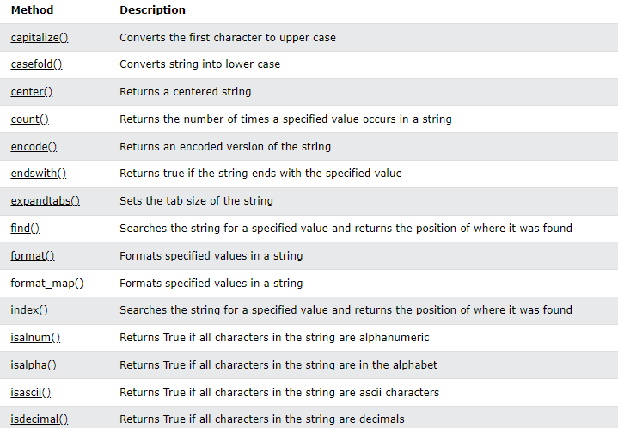

Slide 14
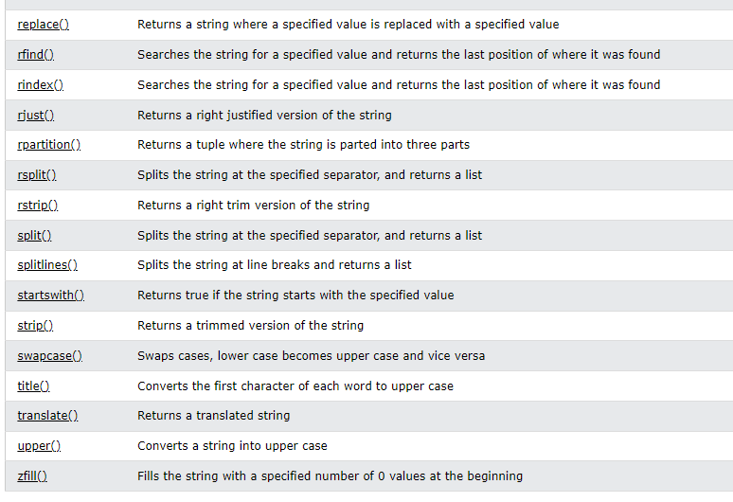
Note: All string methods return new values. They do not change the original string.

Slide 15
Tuples
mytuple = (“car", “bus", “truck")
Tuples are used to store multiple items in a single variable.
A tuple is a collection which is ordered and unchangeable.
Tuples are written with round brackets.
Example
Create a Tuple:
mytuple = (“car", “bus", “truck")
print(mytuple )
Tuple items are ordered, unchangeable, and allow duplicate values.
Tuple items are indexed, the first item has index [0], the second item has index [1] etc.
Tuples are unchangeable, meaning that we cannot change, add or remove items after the
tuple has been created.
Since tuples are indexed, they can have items with the same value
Example
Tuples allow duplicate values:
mytuple = (“car", “bus", “truck“, “bus”, “truck”)
Print(mytuple )

Slide 16
Tuple Length
To determine how many items a tuple has, use the len() function:
Example
Print the number of items in the tuple:
mytuple = (“car", “bus", “truck") print(len(mytuple))
Create Tuple With One Item
To create a tuple with only one item, you have to add a comma after the item, otherwise Python will not recognize it as a tuple.
Example
One item tuple, remember the comma:
mytuple = (“car",) print(type(mytuple)) #NOT a tuple mytuple = (“car") print(type(mytuple))
Example
String, int and boolean data types:
tuple1 = (“car", "bus", “truck") // ('apple', 'banana', 'cherry') tuple2 = (1, 5, 7, 9, 3) //(1, 5, 7, 9, 3) tuple3 = (True, False, False) // (True, False, False)
tuple4 = (1.1,2.2,3.3) //(1.1, 2.2, 3.3)

Slide 17
A tuple can contain different data types:
Example
A tuple with strings, integers and boolean values:
tuple1 = ("abc", 34, True, 40, "male")
Print(tuple1) // ('abc', 34, True, 40, 'male')
type()
From Python's perspective, tuples are defined as objects with the data type 'tuple':
<class 'tuple'>
Example
What is the data type of a tuple?
mytuple = (“car", “bus", ”truck") print(type(mytuple))
Example
Using the tuple() method to make a tuple:
mytuple = tuple((“car", “bus", “truck")) # note the double round-brackets print(mytuple)

Slide 18
Access Tuple Items
Example
Print the second item in the tuple:
mytuple = (“car", “bus", “truck") print(mytuple[1])
Note: The first item has index 0.
Negative Indexing
Negative indexing means start from the end.
-1 refers to the last item, -2 refers to the second last item etc.
Example
Print the last item of the tuple:
mytuple = (“car", “bus", “truck") print(mytuple[-1])

Slide 19
Range of Indexes
You can specify a range of indexes by specifying where to start and where to end the range.
When specifying a range, the return value will be a new tuple with the specified items.
Example
Return the third, fourth, and fifth item:
thistuple = ("apple", "banana", "cherry", "orange", "kiwi", "melon", "mango") print(thistuple[2:5])
//This will return the items from position 2 to 5.
//Remember that the first item is position 0,
//and note that the item in position 5 is NOT included
thistuple = ("apple", "banana", "cherry", "orange", "kiwi", "melon", "mango") print(thistuple[:4])
thistuple = ("apple", "banana", "cherry", "orange", "kiwi", "melon", "mango") print(thistuple[2:])
thistuple = ("apple", "banana", "cherry", "orange", "kiwi", "melon", "mango")
print(thistuple[-4:-1])
//Negative indexing means starting from the end of the tuple.
//This example returns the items from index -4 (included) to index -1 (excluded)
//Remember that the last item has the index -1,

Slide 20
Check if Item Exists
Example
Check if “car" is present in the tuple:
mytuple = (“car", “bus", “truck") if “car" in mytuple: print("Yes, ‘car' is in the vehicles tuple")
Once a tuple is created, you cannot change its values. Tuples are unchangeable, or immutable as it also is called.
But there is a workaround. You can convert the tuple into a list, change the list, and convert the list back into a tuple.
Example
Convert the tuple into a list to be able to change it:
x = ("apple", "banana", "cherry") y = list(x) y[1] = "kiwi" x = tuple(y) print(x)
Example
Convert the tuple into a list, add "orange", and convert it back into a tuple:
thistuple = ("apple", "banana", "cherry") y = list(thistuple) y.append("orange") thistuple = tuple(y)

Slide 21
Example
Create a new tuple with the value "orange", and add that tuple:
thistuple = ("apple", "banana", "cherry") y = ("orange",) thistuple += y print(thistuple)
Example
Convert the tuple into a list, remove "apple", and convert it back into a tuple:
thistuple = ("apple", "banana", "cherry") y = list(thistuple) y.remove("apple") thistuple = tuple(y)
Example
The del keyword can delete the tuple completely:
thistuple = ("apple", "banana", "cherry") del thistuple print(thistuple) #this will raise an error because the tuple no longer exists

Slide 22
Unpacking a Tuple
When we create a tuple, we normally assign values to it. This is called "packing" a tuple:
Example
Packing a tuple:
fruits = ("apple", "banana", "cherry")
But, in Python, we are also allowed to extract the values back into variables. This is called "unpacking":
Example
Unpacking a tuple:
fruits = ("apple", "banana", "cherry") (green, yellow, red) = fruits print(green) print(yellow) print(red)

Slide 23
Using Asterisk*
If the number of variables is less than the number of values, you can add an * to the variable
name and the values will be assigned to the variable as a list:
Example
Assign the rest of the values as a list called "red":
fruits = ("apple", "banana", "cherry", "strawberry", "raspberry") (green, yellow, *red) = fruits print(green) print(yellow) print(red)
apple
banana
['cherry', 'strawberry', 'raspberry']
Example
fruits = ("apple", "mango", "papaya", "pineapple", "cherry")
(green, *tropic, red) = fruits
print(green)
print(tropic)
print(red)
Apple
['mango', 'papaya', 'pineapple']
cherry

Slide 24
Loop Through a Tuple
You can loop through the tuple items by using a for loop.
Example
Iterate through the items and print the values:
thistuple = ("apple", "banana", "cherry") for x in thistuple: print(x)
Loop Through the Index Numbers
You can also loop through the tuple items by referring to their index number.
Use the range() and len() functions to create a suitable iterable.
Example
Print all items by referring to their index number:
thistuple = ("apple", "banana", "cherry") for i in range(len(thistuple)): print(thistuple[i])

Slide 25
Using a While Loop
You can loop through the tuple items by using a while loop.
Use the len() function to determine the length of the tuple, then start at 0 and loop your
way through the tuple items by referring to their indexes.
Remember to increase the index by 1 after each iteration.
Example
Print all items, using a while loop to go through all the index numbers:
thistuple = ("apple", "banana", "cherry") i = 0 while i < len(thistuple): print(thistuple[i]) i = i + 1

Slide 26
Join Two Tuples
To join two or more tuples you can use the + operator:
Example
Join two tuples:
tuple1 = ("a", "b" , "c") tuple2 = (1, 2, 3) tuple3 = tuple1 + tuple2 print(tuple3)
Example
Multiply the fruits tuple by 2:
fruits = ("apple", "banana", "cherry") mytuple = fruits * 2 print(mytuple)

Slide 27
