Slide 1
Session -1
Installing Python
Introduction to Python
Basic Syntax
Variables
Data Types
Operators
Input/output
Flow of Control (Modules, Branching)
If, If- else, Nested if-else
Looping –For, While, Nested loops
Control Structure
Uses of Break & Continue

Slide 2
Introduction to Python
Python is a popular programming language. It was created by Guido van Rossum, and released in 1991.
It is used for:
web development (server-side),
software development,
mathematics,
system scripting.
What can Python do?
Python can be used on a server to create web applications.
Python can be used alongside software to create workflows.
Python can connect to database systems. It can also read and modify files.
Python can be used to handle big data and perform complex mathematics.
Python can be used for rapid prototyping, or for production-ready software development.
Why Python?
Python works on different platforms (Windows, Mac, Linux, Raspberry Pi, etc).
Python has a simple syntax similar to the English language.
Python has syntax that allows developers to write programs with fewer lines than some other programming languages.
Python runs on an interpreter system, meaning that code can be executed as soon as it is written. This means that prototyping can be very quick.
Python can be treated in a procedural way, an object-oriented way or a functional way.

Slide 3
Python Syntax
Python syntax can be executed by writing directly in the Command Line:
>>> print("Hello, World!") Hello, World!
Or by creating a python file on the server, using the .py file extension, and running it in the Command Line:
C:\Users\Your Name>python myfile.py
Python Indentation
Indentation refers to the spaces at the beginning of a code line.
Where in other programming languages the indentation in code is for readability only, the indentation in Python is very important.
Python uses indentation to indicate a block of code.
if 4 > 2: print("Four is greater than two!")

Slide 4
Example
Syntax Error:
If 4 > 2: print("Four is greater than two!")
if 4 > 2: print(“Four is greater than two!") if 4 > 2: print(“Four is greater than two!")
Example
Syntax Error:
if4 > 2: print(“Four is greater than two!") print(“Four is greater than two!")

Slide 5
Creating a Comment
#This is a comment print("Hello, World!")
Example
print("Hello, World!") #This is a comment
Example
#print("Hello, World!") print(“Welcome!")
Multiline Comments
Example
#This is a comment # written in more than just one line print("Hello, World!")
Example
""" This is a comment written in more than just one line """ print("Hello, World!“)

Slide 6
Python Variables
Variables
Variables are containers for storing data values.
Creating Variables
Python has no command for declaring a variable.
A variable is created the moment you first assign a value to it.
Example
x = 5 y = “Ram" print(x) print(y)
Variables do not need to be declared with any particular type, and can even change type after they have been set.
Example
x = 4 # x is of type int x = “Seth" # x is now of type str print(x)

Slide 7
Casting
If you want to specify the data type of a variable, this can be done with casting.
Example
x = str(3) # x will be '3' y = int(3) # y will be 3 z = float(3) # z will be 3.0
Get the Type
You can get the data type of a variable with the type() function.
Example
x = 5 y = “Ram" print(type(x)) print(type(y))
Example
This will create two variables:
a = 4 A = “Seth" #A will not overwrite a
Example
x = “Ram" # is the same as x = Ram'

Slide 8
Example
Legal variable names:
myvar = “Ram" my_var = " Ram"
_my_var = "Ram" myVar = "Ram" MYVAR = "Ram" myvar2 = "Ram"
Many Values to Multiple Variables
Python allows you to assign values to multiple variables in one line:
Example
x, y, z = “Bat", “Hat", “Car" print(x) print(y) print(z)
One Value to Multiple Variables
And you can assign the same value to multiple variables in one line:
Example
x = y = z = "Car" print(x) print(y) print(z)

Slide 9
Unpack a Collection
If you have a collection of values in a list, tuple etc. Python allows you to extract the values into variables. This is called unpacking.
Example
Unpack a list:
fruits = [“Strawberry", “Apple", "cherry"] x, y, z = fruits print(x) print(y) print(z)
Output Variables
The Python print() function is often used to output variables.
Example
x = "Today" y = "is" z = “Friday" print(x, y, z)
Example
x = “Today" y = "is " z = “Friday" print(x + y + z)
Example
x = 10 y = 10 print(x + y)
Example
x = “Today is Friday" print(x)

Slide 10
Output Variables
In the print() function, when you try to combine a string and a number
with the + operator, Python will give you an error:
Example
x = 5 y = “Ram" print(x + y) //Error
Example
x = 5 y = “Ram" print(x, y)
Example
Create a variable outside of a function, and use it inside the function
x = “Friday" def myfunc(): print(“Today is " + x) myfunc()

Slide 11
Example
Create a variable inside a function, with the same name as the global variable
x = “Friday" def myfunc(): x = "fantastic" print(“Today is " + x) myfunc() print(“Today is " + x)
The global Keyword
Normally, when you create a variable inside a function, that variable is local,
and can only be used inside that function.
To create a global variable inside a function, you can use the global keyword.
Example
If you use the global keyword, the variable belongs to the global scope:
def myfunc(): global x x = “Friday“ myfunc() print(“Today is " + x)

Slide 12
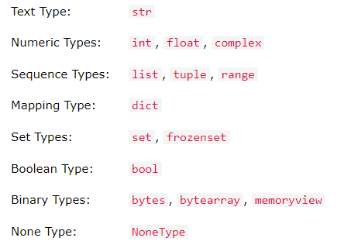
Python Data Types
Built-in Data Types
In programming, data type is an important concept.
Variables can store data of different types, and different types can do different things.
Python has the following data types built-in by default, in these categories:

Slide 13
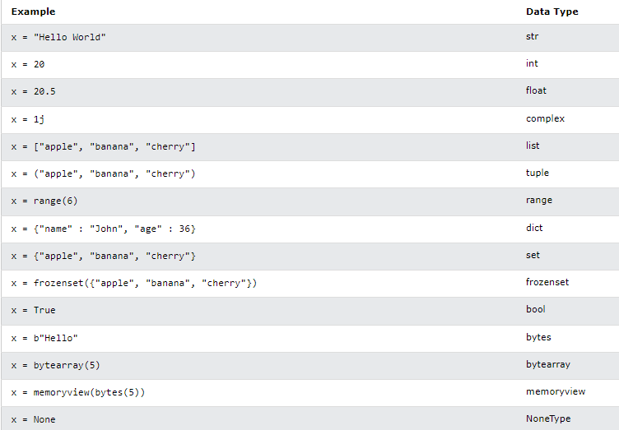

Slide 14
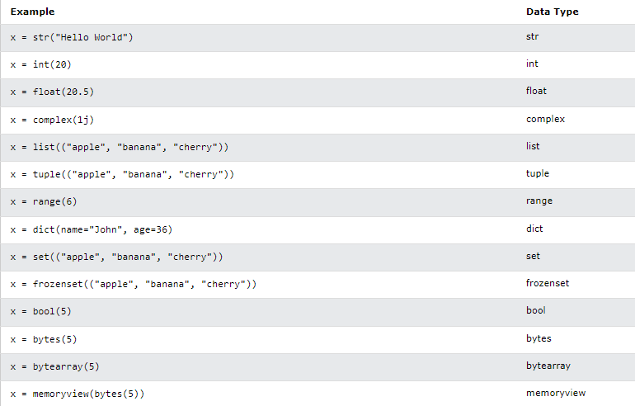

Slide 15
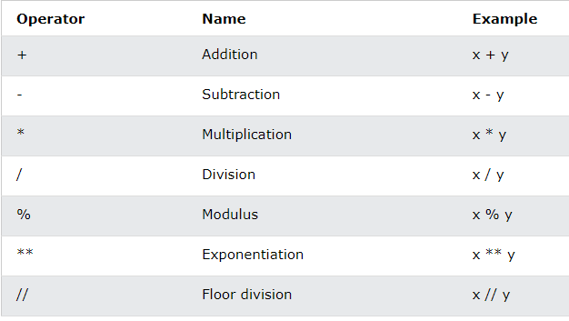
Operators
Example
print(10 + 5)
Python divides the operators in the following groups:
Arithmetic operators
Assignment operators
Comparison operators
Logical operators
Identity operators
Membership operators
Bitwise operators

Slide 16
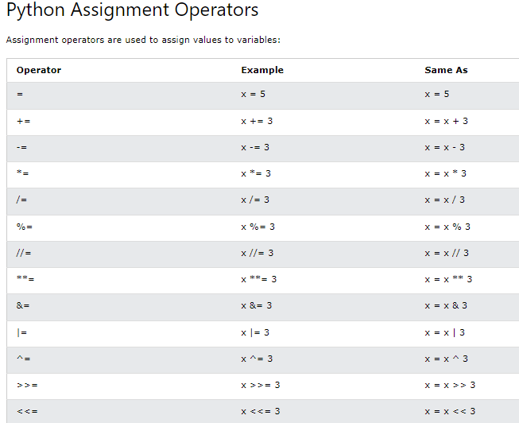

Slide 17
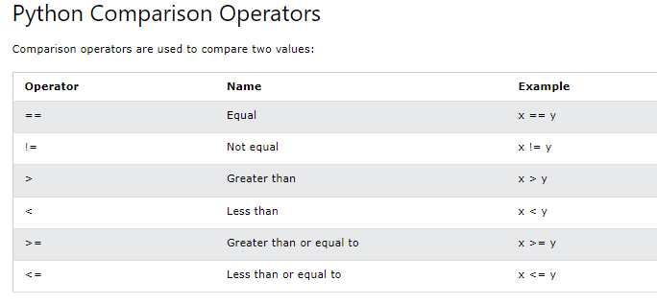
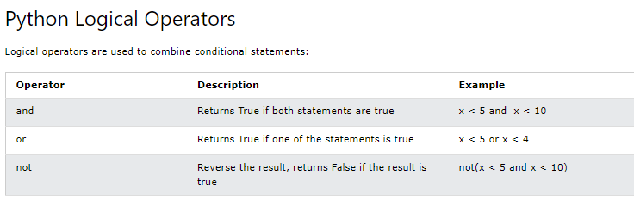

Slide 18
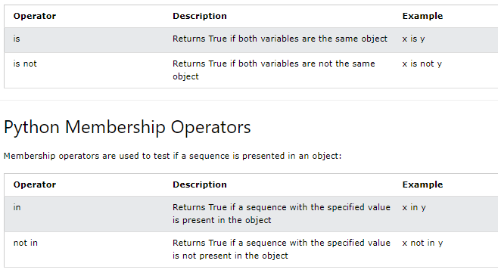
Python Identity Operators
Identity operators are used to compare the objects, not if they are equal, but if they are actually the same object, with the same memory location:

Slide 19
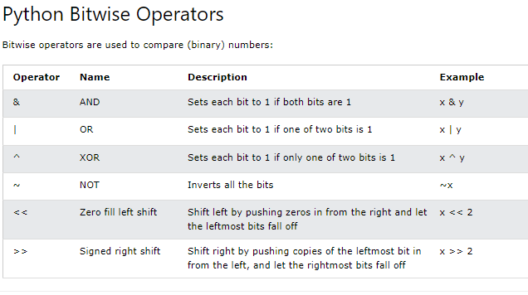

Slide 20
User Input
Python 3.6 uses the input() method.
Python 2.7 uses the raw_input() method.
Python 3.6
username = input("Enter username:") print("Username is: " + username)
Python 2.7
username = raw_input("Enter username:") print("Username is: " + username)
Flow of Control
What is a Module?
Consider a module to be the same as a code library.
A file containing a set of functions you want to include in your application.

Slide 21
To create a module just save the code you want in a file with the file extension .py:
Example
Save this code in a file named myfile.py
def message(name): print("Hello, " + name)
Example
Import the module named myfile, and call the message function:
import myfile mymodule.message(“All")
Example
File myfile.py
person1 = { "name": “Ram", "age": 36, "country": “India" }
Example
Import the module named myfile, and access the person1 dictionary:
import myfile a = myfile.person1["age"] print(a)

Slide 22
Example
Create an alias for myfile called mf:
import myfile as mf a = mf.person1["age"] print(a)
Built-in Modules
import platform x = platform.system() print(x)
Example
def msg(name): print("Hello, " + name) person1 = { "name": “Ram", "age": 36, "country": “India" }
Example
Import only the person1 dictionary from the module:
from myfile import person1 print (person1["age"])
Note: When importing using the from keyword, do not use the module name
when referring to elements in the module.
Example: person1["age"], not mymodule.person1["age"]

Slide 23
If-else
Python supports the usual logical conditions from mathematics:
Equals: a == b
Not Equals: a != b
Less than: a < b
Less than or equal to: a <= b
Greater than: a > b
Greater than or equal to: a >= b
These conditions can be used in several ways, most commonly in "if statements" and loops.
An "if statement" is written by using the if keyword.
Example
If statement:
a = 20 b = 100 if b > a: print("b is greater than a")

Slide 24
Indentation
Python relies on indentation
Example
If statement, without indentation (will raise an error):
a = 20 b = 100 if b > a: print("b is greater than a") # you will get an error
Elif
The elif keyword is Python's way of saying "if the previous conditions were not true, then try this condition".
Example
a = 20 b = 20 if b > a: print("b is greater than a") elif a == b: print("a and b are equal")

Slide 25
Else
The else keyword catches anything which isn't caught by the preceding conditions.
Example
a = 100 b = 20 if b > a: print("b is greater than a") elif a == b: print("a and b are equal") else: print("a is greater than b")
You can also have an else without the elif:
Example
a = 100 b = 20 if b > a: print("b is greater than a") else: print("b is not greater than a")

Slide 26
Example
One line if statement:
if a > b: print("a is greater than b")
Example
One line if else statement:
a = 20 b = 100 print("A") if a > b else print("B")
Example
One line if else statement, with 3 conditions:
a = 100 b = 100 print("A") if a > b else print("=") if a == b else print("B")
And
The and keyword is a logical operator, and is used to combine conditional statements:
Example
Test if a is greater than b, AND if c is greater than a:
a = 100 b = 20 c = 200 if a > b and c > a: print("Both conditions are True")

Slide 27
Or
The or keyword is a logical operator, and is used to combine conditional statements:
Example
Test if a is greater than b, OR if a is greater than c:
a = 100 b = 20 c = 200 if a > b or a > c: print("At least one of the conditions is True")
Not
The not keyword is a logical operator, and is used to reverse the result of
the conditional statement:
Example
Test if a is NOT greater than b:
a = 20 b = 100 if not a > b: print("a is NOT greater than b")

Slide 28
Nested If
You can have if statements inside if statements, this is called nested if statements.
Example
x = 35 if x > 10: print("Above ten,") if x > 20: print("and also above 20!") else: print("but not above 20.")
The pass Statement
if statements cannot be empty, but if you for some reason have an if statement with
no content, put in the pass statement to avoid getting an error.
Example
a = 20 b = 100 if b > a: pass

Slide 29
Looping in Python
For Loops
A for loop is used for iterating over a sequence (that is either a list, a tuple, a dictionary, a set, or a string).
This is less like the for keyword in other programming languages, and works more like an iterator method as found in other object-orientated programming languages.
With the for loop we can execute a set of statements, once for each item in a list, tuple, set etc.
Example
Print each fruit in a fruit list:
fruits = ["apple", "banana", "cherry"] for x in fruits: print(x)
Example
Loop through the letters in the word "banana":
for x in "banana": print(x)

Slide 30
The break Statement
With the break statement we can stop the loop before it has looped through all the items:
Example
Exit the loop when x is "banana":
fruits = ["apple", "banana", "cherry"] for x in fruits: print(x) if x == "banana": break
Example
Exit the loop when x is "banana", but this time the break comes before the print:
fruits = ["apple", "banana", "cherry"] for x in fruits: if x == "banana": break print(x)

Slide 31
The continue Statement
With the continue statement we can stop the current iteration of the loop, and continue with the next:
Example
Do not print banana:
fruits = ["apple", "banana", "cherry"] for x in fruits: if x == "banana": continue print(x)
The range() Function
Example
Using the range() function:
for x in range(6): print(x)
Example
Using the start parameter:
for x in range(2, 6): print(x)
Example
Increment the sequence with 3 (default is 1):
for x in range(2, 30, 3): print(x)

Slide 32
Else in For Loop
The else keyword in a for loop specifies a block of code to be executed
when the loop is finished:
Example
Print all numbers from 0 to 5, and print a message when the loop has ended:
for x in range(6): print(x) else: print("Finally finished!")
for x in range(6): if x == 3: break print(x) else: print("Finally finished!")

Slide 33
Nested Loops
A nested loop is a loop inside a loop.
The "inner loop" will be executed one time for each iteration of the "outer loop":
Example
Print each adjective for every fruit:
adj = ["red", "big", "tasty"] fruits = ["apple", "banana", "cherry"] for x in adj: for y in fruits: print(x, y)
for x in [0, 1, 2]: pass

Slide 34
The while Loop
Example
Print i as long as i is less than 6:
i = 1 while i < 6: print(i) i += 1
The break Statement
With the break statement we can stop the loop even if the while condition is true:
Example
Exit the loop when i is 3:
i = 1 while i < 6: print(i) if i == 3: break i += 1

Slide 35
The continue Statement
With the continue statement we can stop the current iteration, and continue with the next:
Example
Continue to the next iteration if i is 3:
i = 0 while i < 6: i += 1 if i == 3: continue print(i)
The else Statement
With the else statement we can run a block of code once when the condition no longer is true:
Example
Print a message once the condition is false:
i = 1 while i < 6: print(i) i += 1 else: print("i is no longer less than 6")

