Slide 1
Presentation for Internship Project Review
Robotic Process Automation (RPA) using Blue Prism
By Vaibhav Ranashoor

Slide 2
Table of Contents:
Assignment No. | Assignment Title | Slides
1 | Automating excel file and folder creation. | 4-10
2 | Sending email when a file is missing. | 11-12
3 | Combining excel data and filtering unique and duplicate records. | 13-17
4 | Updating excel sheet when new files are created in “Opened” folder. | 18
5 | Browser automation for finding values of different currencies using currency converter Webapp (xe.com). | 19-20

Slide 3
What are the benefits of using RPA vs Traditional Automation?
Increased Efficiency
No major modifications required in existing systems
Can update business flow easily due to its simplicity
Easier and faster implementation
Employees can focus on other important work and not on mundane tasks
Easy to scale up
Decrease in overall cost to company in the long run

Slide 4
Assignment 1: Automating excel file and folder creation.
In this assignment we create a Blue Prism process which can automatically create folders, subfolders and excel files as well as write some data into the newly created excel sheet.
For creating folder we use “Utility - File Management” VBO which makes the tasks of creating folders and subfolders extremely easy.
For creating and writing and excel file we use “MS Excel” VBO.

Slide 5
In this assignment a folder called “Assignment_1” is created in “C:\” drive and this folder will contain a subfolder with current month and that in turn contains subfolders for each date of that month.
Inside the folder with today’s date there should be 2 folders named “Opened” and “Completed”, inside the “Opened” folder we will create a file called “completed.xlsx” and write “completed” into cells “A1” and “B1” of this file.
After that, file is moved into “”Completed” folder and process ends.

Slide 6
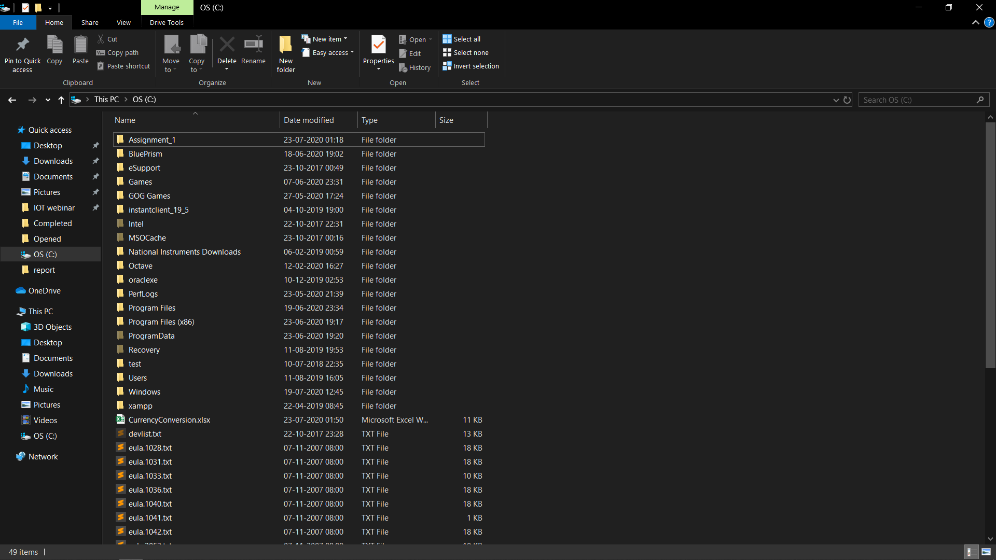
Screenshots:

Slide 7
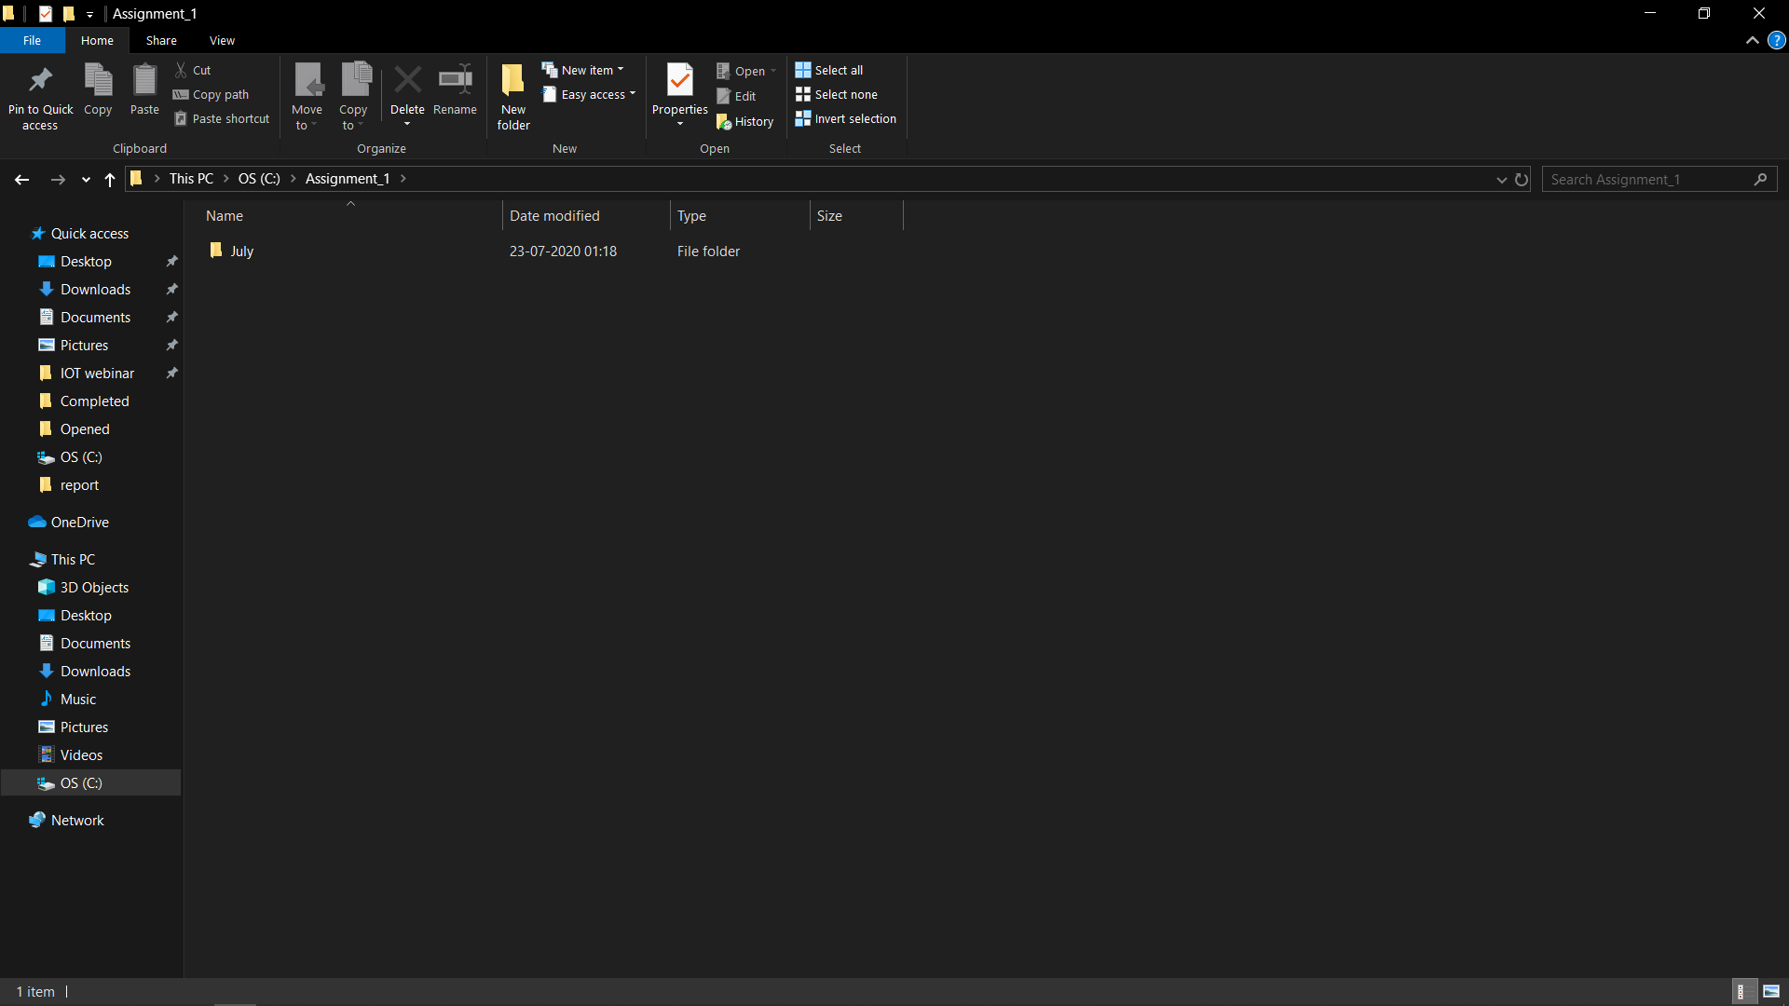
Inside “Assignment_1” folder

Slide 8
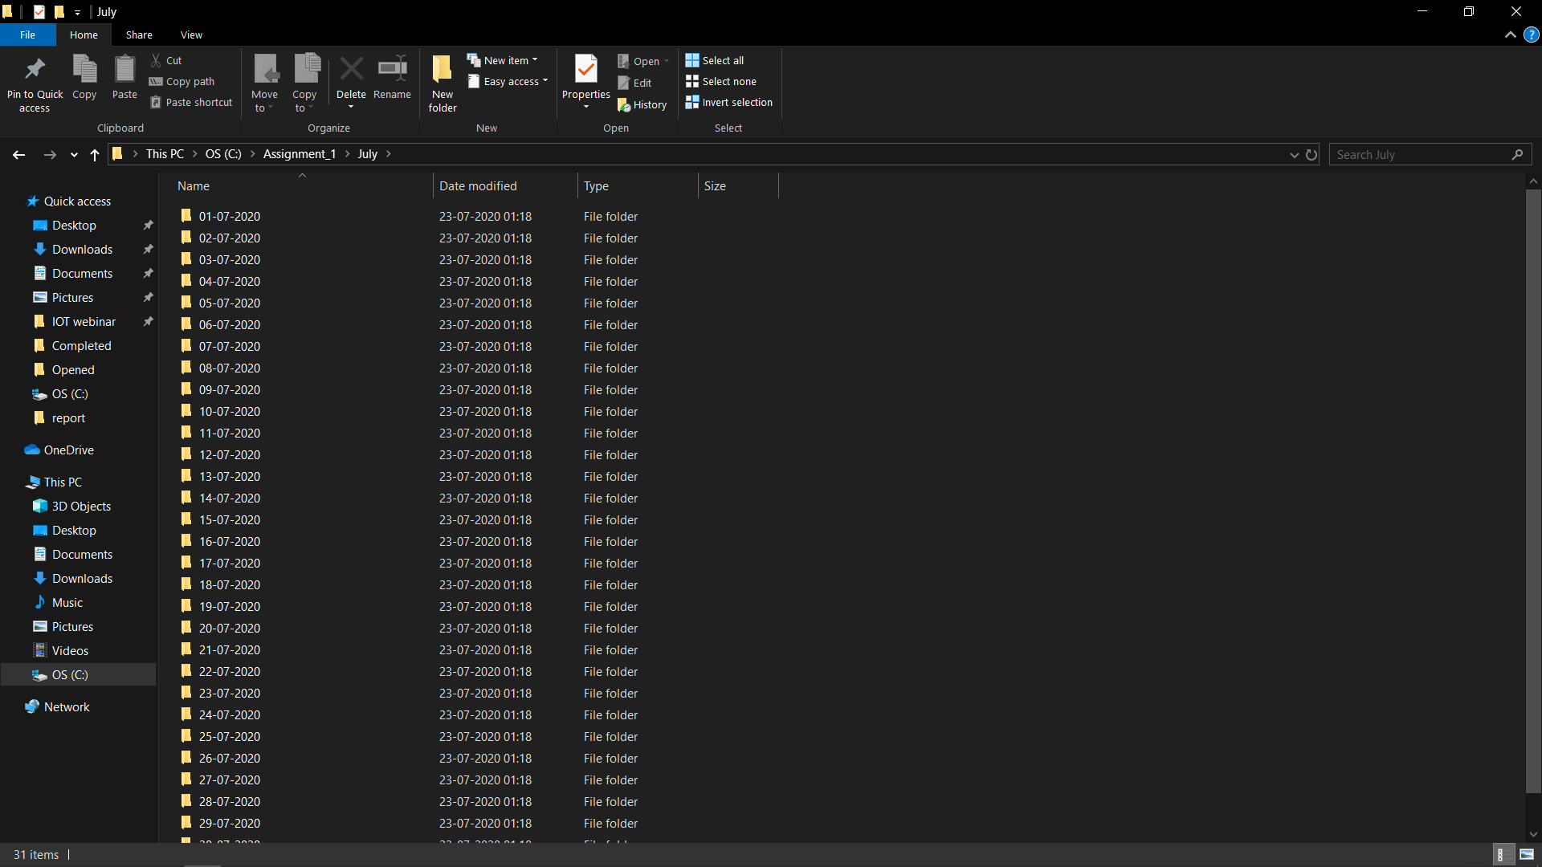
Inside today’s month folder

Slide 9
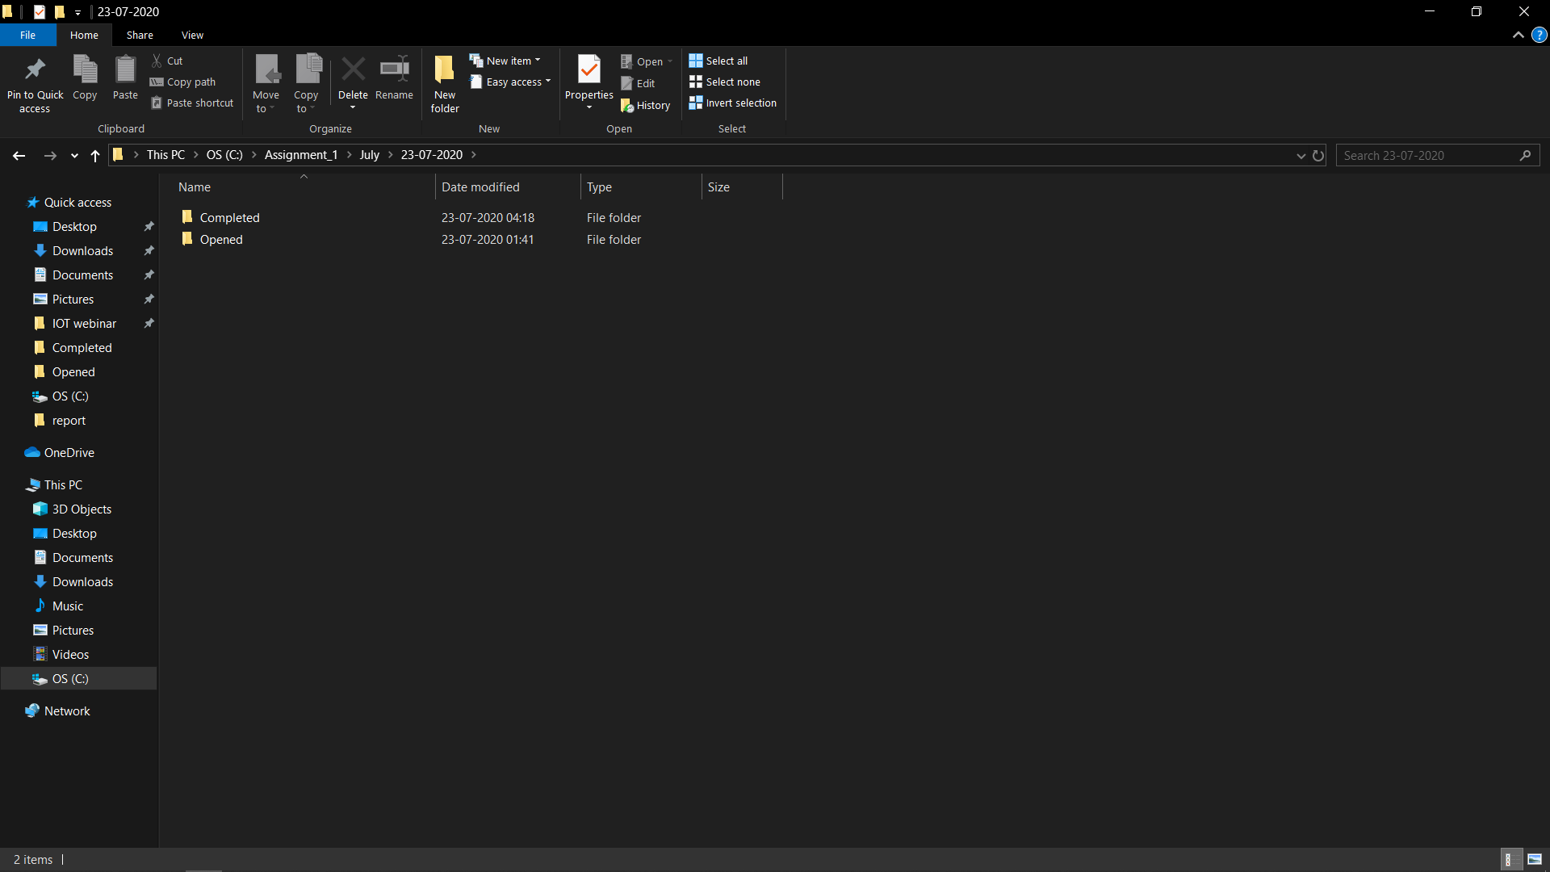
Inside today’s date folder

Slide 10
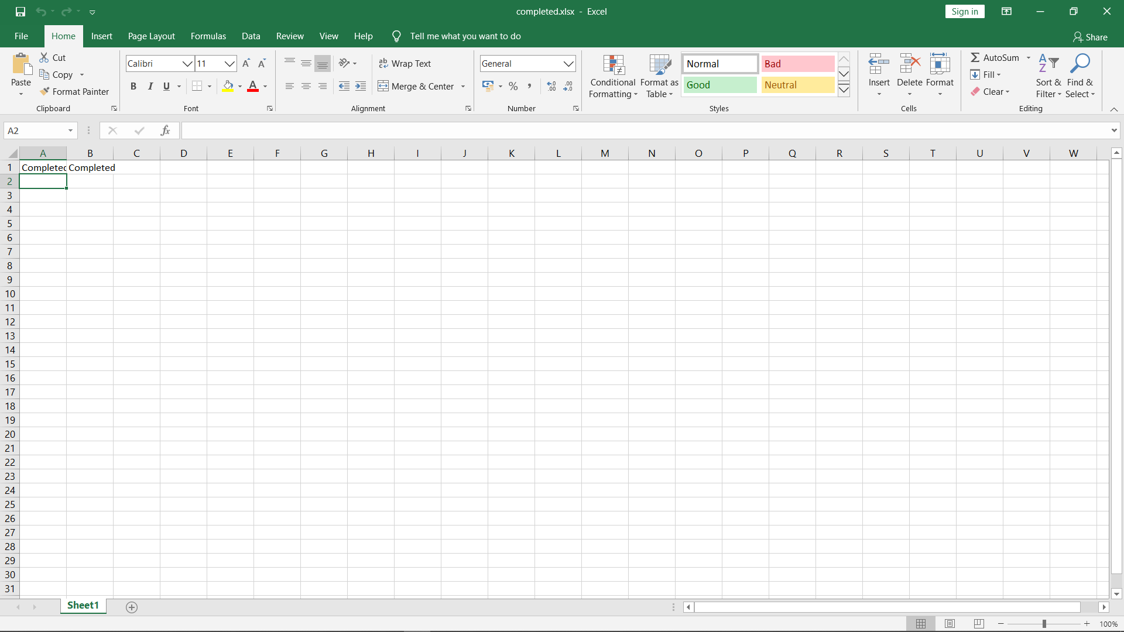
Inside newly created “completed.xlsx” excel file which is now moved to “Completed” folder

Slide 11
Assignment 2: Sending an email when a file is missing
In this assignment we will search for “completed.xlsx” file in “Completed” folder.
If file is present then process will end without any problems.
If file is absent then process will send a email to a predetermined email id using “Email - POP3/SMTP” VBO.

Slide 12
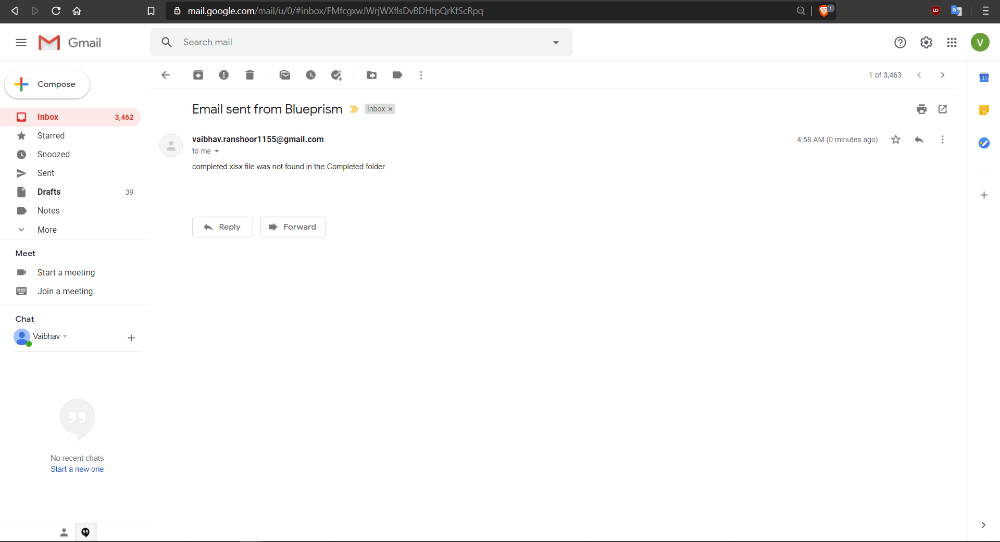
Screenshot of email received if file is absent.

Slide 13
Assignment 3: Combining excel data and filtering unique and duplicate records.
This assignment requires use of LINQ in order to filter unique records and duplicate records from a collection all of which will be stored in 5 files.
Filtered records and duplicate records will be stored in another file called “final.xlsx” in “report folder” inside ”Completed” folder
In this assignment, it is observed that use LINQ substantially decreases the time taken to filter the collections in Blue Prism.
Thus filtering collection data using LINQ is preferred if a predetermined action from a VBO is unavailable for a certain operation involving a collection.

Slide 14
Note that we will also include source file name when records are copied into “final.xlsx”.
After data from source files is copied and filtered into “final.xlsx” these 5 source files are moved into “added” folder inside “Opened” folder.
We will have 3 sheets in “final.xlsx” which contain “All Data”, “Unique” records and “Duplicate” records.

Slide 15
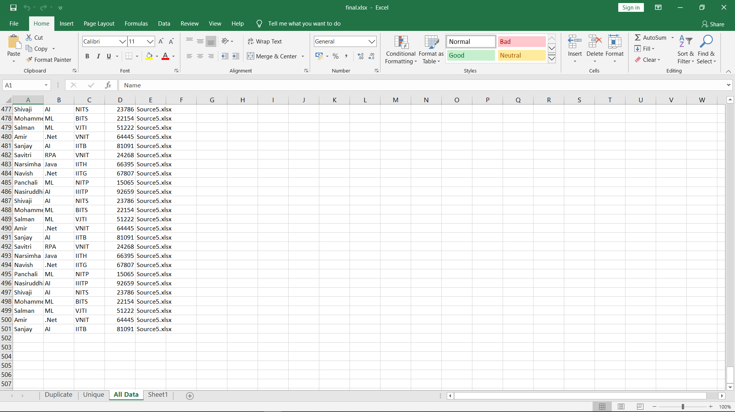
All Data (Including Unique and Duplicate records = 500)

Slide 16
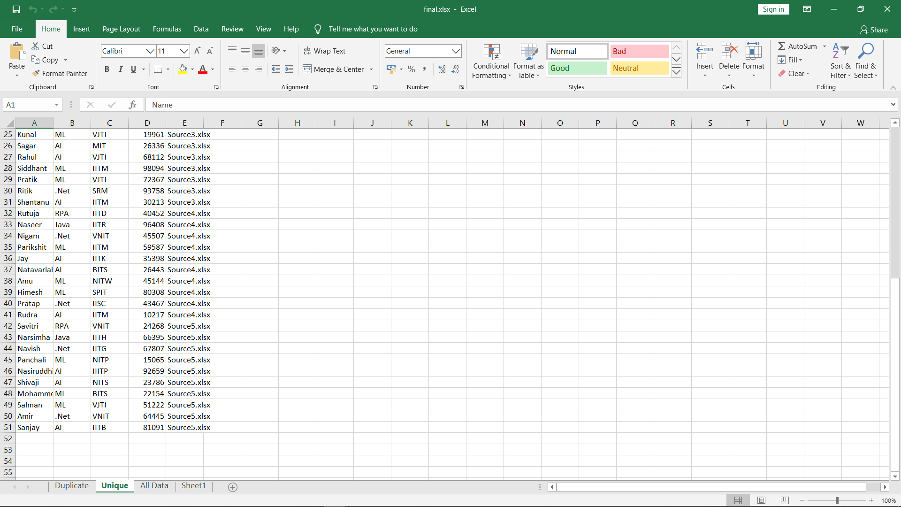
Unique Records (50 in total)

Slide 17
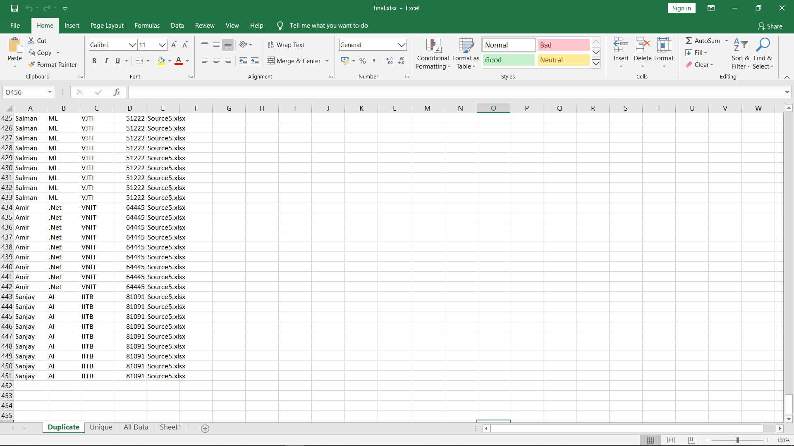
Duplicate records (450 in total)

Slide 18
Assignment 4: Updating excel sheet when new files are created in “Opened” folder.
In this assignment a process is created which updates the “final.xlsx” if new files are created in “Opened” folder.
Here we use the same VBOs as we have used in previous assignment.
Any number of files created will be updated into the “final.xlsx” file as before and the original files will be moved to added folder.

Slide 19
Assignment 5: Browser automation for finding values of different currencies using currency converter Webapp (xe.com).
This assignment involves Browser automation, we will use Internet Explorer for this purpose.
We make sure the web url is entered properly and all elements which are necessary to provide input and obtain result into the webapp are spied using application modeller.

Slide 20
In case certain input elements are hidden we can use inspect element to spy them and then make necessary modifications in element properties.
We read an excel file called “CurrencyConversion.xlsx” which provides us with as follows:
Currency code of currency to be converted
Amount of Currency to be converted
Currency code of currency to convert to
Results of this conversion will be stored in same excel file and the browser will close automatically as soon as all currency data has been converted.

Slide 21
Conclusion and future scope:
As we have seen, through these assignments Blue Prism RPA can be used to automate many mundane and repetitive tasks like filtering excel sheet data, creating folders, moving files, sending emails in case of missing files and foreign currency conversion using web application.
Use of this tool can be further utilised in accessing SQL databases and automating data entry tasks which are repetitive in nature.
Utilization of this tool greatly increases the productivity and efficiency of organization and it proves to be cost effective in long run.

Slide 22
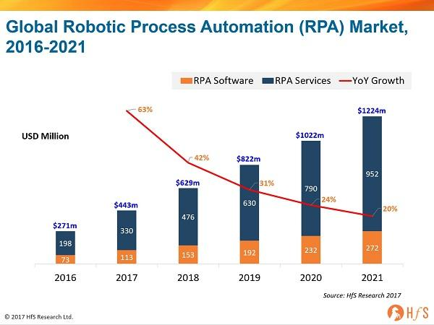
Future scope of RPA:
The future scope of RPA is relatively very high. There are various human jobs which can be easily automated using RPA tools and technology. The future scope of RPA can be observed in the field of data entry and data rekeying jobs. These tasks could be easily automated with RPA. The various repetitive tasks such as formatting, data assembling or anything which requires a series of steps are easily carried out with the help of RPA. The other computer-supported processes which utilize a set of procedures are also performed through RPA.During the upcoming year, a tremendous growth is observed in the field of RPA and therefore it will deliver higher technological abilities towards significantly reducing the risk of incorrectly regulatory reporting, including the improved data analytics and higher data accuracy. The RPA in the market is progressing rapidly and acceptance of this robotic automated technique could help to restructure the business process management marketplace in IT Industry.

Slide 23
That's all for now!
Any Questions?

