Slide 1




SMART INDIA HACKATHON 2026
TITLE PAGE
Problem Statement ID – 26158
Problem Statement Title-Single-Pass Drone Video to Accurate 3D Model Generation System
Theme- Robotics and Drones
PS Category- Software
Team ID-51
Team Name: Pixel Error

Slide 2
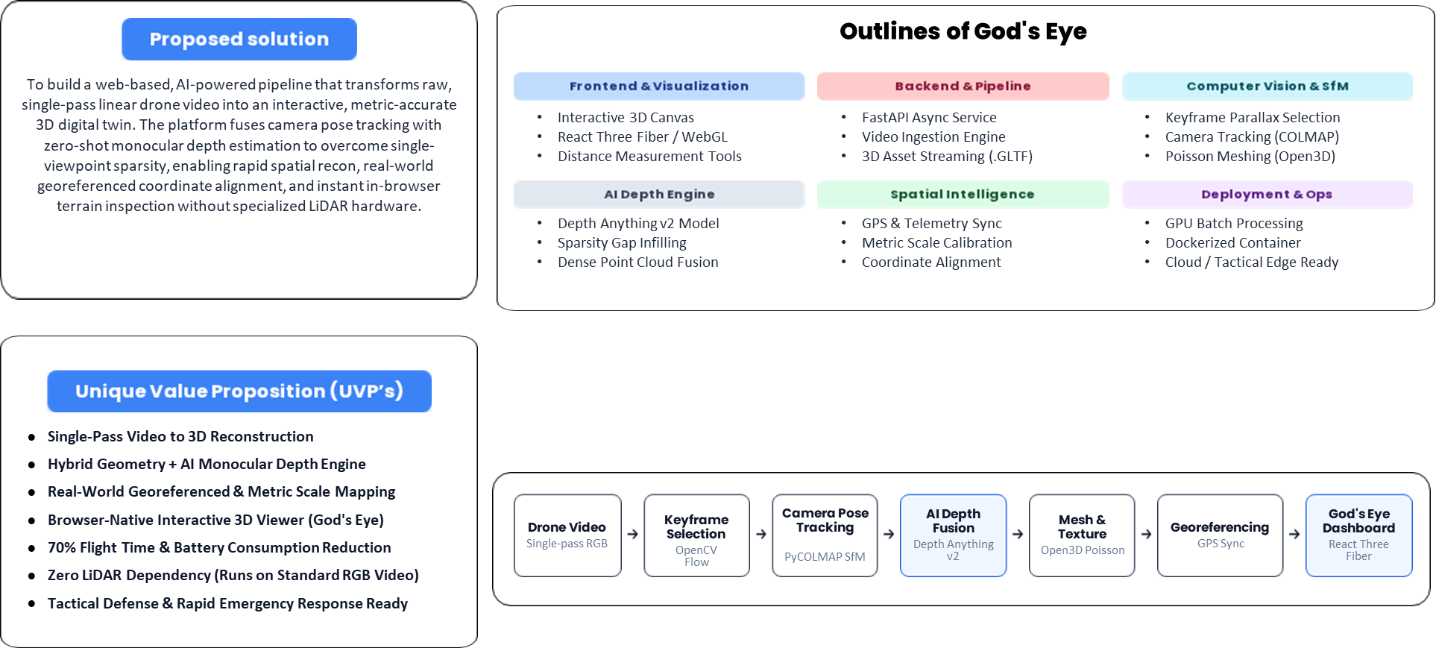
AI-Powered Single-Pass 3D Drone Reconstruction :- God's Eye
Pixel Error
@SIH Idea submission- Template
2
Notes:
2

Slide 3
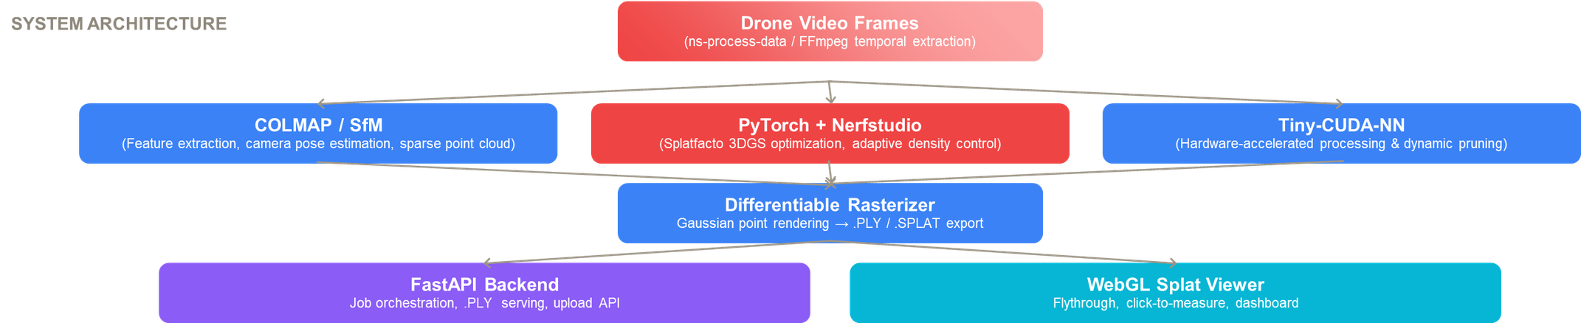
TECHNICAL APPROACH
Pixel Error
Notes:
3

Slide 4
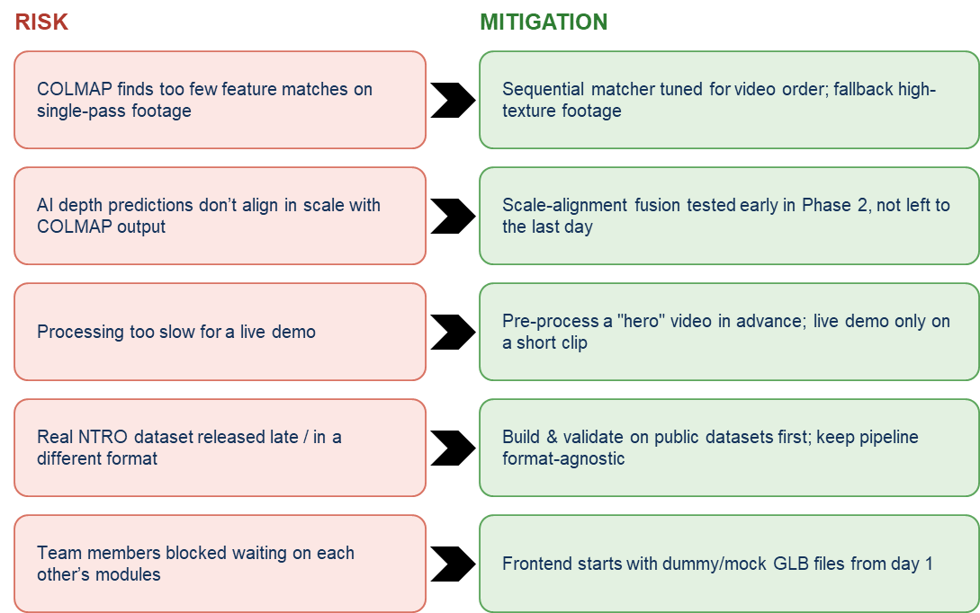
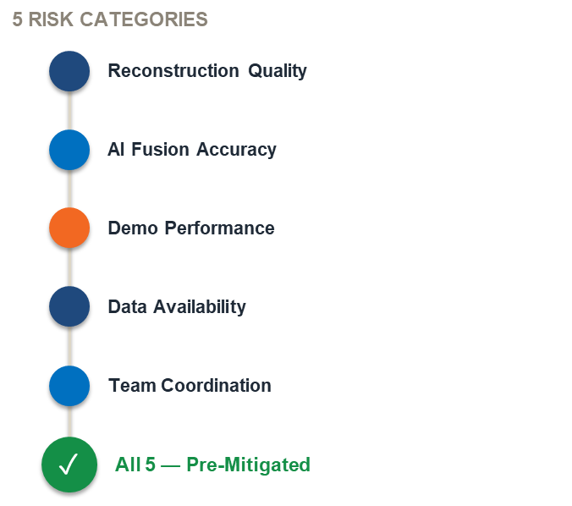
FEASIBILITY AND VIABILITY
Pixel Error
@SIH Idea submission- Template
4
Notes:
4

Slide 5




IMPACT AND BENEFITS
Pixel Error
God’ s Eye Single-Pass workflow
Traditional Multi-Pass survey
One drone flyover video
Plan overlapping flight grid
AI depth fusion
(single pass)
Fly 3-5+ passes
(heavy battery/time)
How will God’s Eye change this ? same terrain - ONE flight instead of five
Automated mesh +
texture pipeline
Manually switch in desktop software
Model ready
in hours
Waiting days for terrain model
Georeferenced &
metrically accurate
Miss the critical response window
Output: a georeferenced, metrically accurate 3D model — fewer flights · faster turnaround · lower cost · usable in disaster response, defense recon & infrastructure survey
@SIH Idea submission- Template
5
Notes:
5

Slide 6
RESEARCH AND REFERENCES
Pixel Error
Structure-from-Motion & Multi-View Stereo
AI Monocular Depth Estimation
Meshing, Texturing & Neural Rendering
COLMAP — general-purpose SfM & MVS pipeline
https://colmap.github.io/
Depth Anything V2 — fast, accurate monocular depth
https://github.com/DepthAnything/Depth-Anything-V2
Open3D — point cloud processing & Poisson meshing
https://www.open3d.org/
MiDaS — robust monocular depth baseline
https://github.com/isl-org/MiDaS
3D Gaussian Splatting — alternative dense-scene representation
https://repo-sam.inria.fr/fungraph/3d-gaussian-splatting/
pycolmap — Python bindings for COLMAP
https://github.com/colmap/pycolmap
@SIH Idea submission- Template
6
Notes:
6

