Slide 1
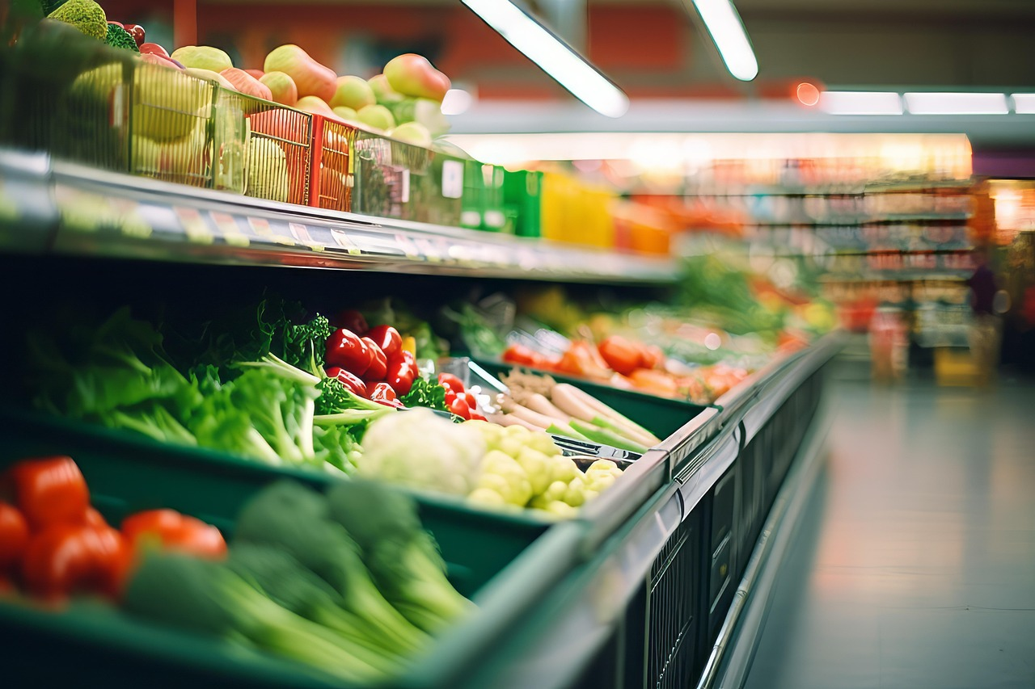
Grocery Store Management System
By Vraj Gajera

Slide 2
INTRODUCTION
Online Grocery System is a web application.
It helps users buy grocery products online.
Customers can view products and place orders.
Admin can manage products and orders.
It saves time and makes shopping easy.

Slide 3
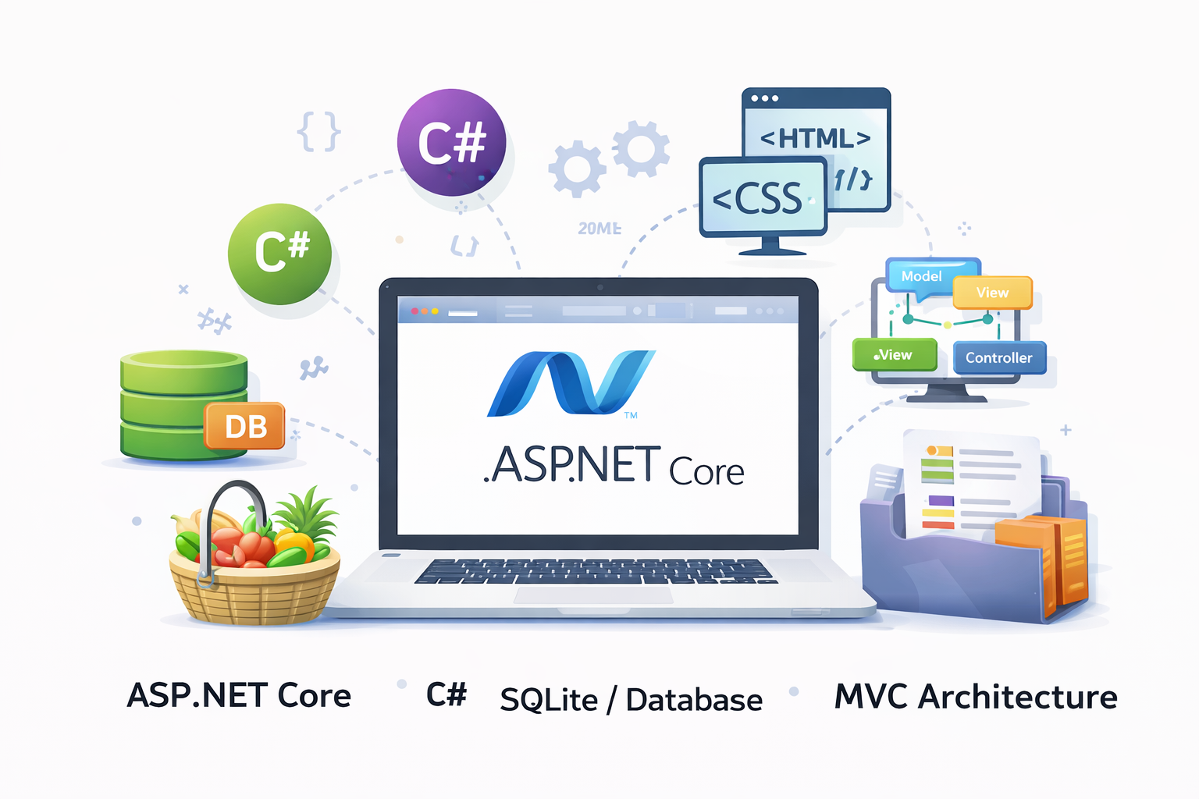
TECHNOLOGIES USED
ASP.NET Core – Web application framework
C# – Programming language
SQLite / Database – Store data
HTML, CSS – Design the website
MVC Architecture – Structure of the project

Slide 4
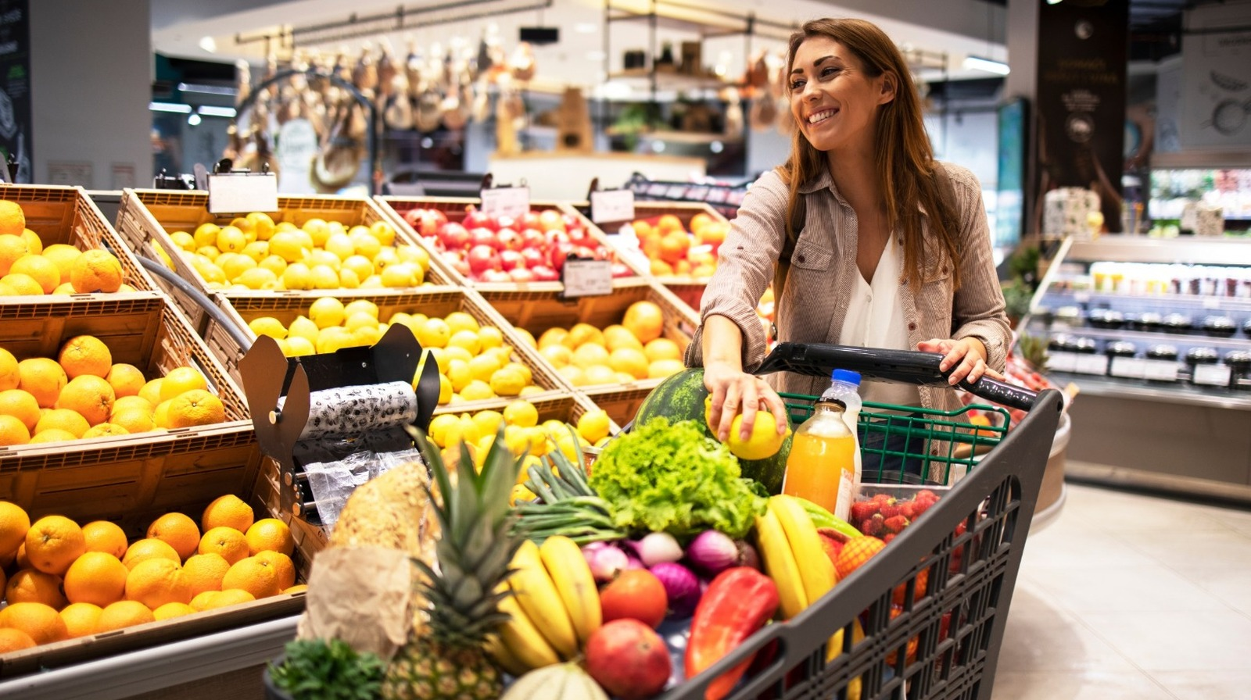
USER FEATURES
User registration and login
View product list
Add products to cart
Checkout and place order
Order Cancel

Slide 5

ADMIN FEATURES
Add new products
Edit or delete products
View customer orders
Manage Orders
Quantity Manage

Slide 6
CONCLUSION
Online Grocery System makes shopping easier.
Users can order groceries from home.
Admin can manage products and orders easily.
It is a simple and useful web application.

Slide 7
Thank you

