Slide 1






HAD PROJECT – 6 TEAM - 12
ADMIN
State Level
Supervisor - 1
District - 1
Supervisor - 2
District - 2
Supervisor - 3
District - 3
Doctor – 1.1
District - 1
Doctor – 1.2
District - 1
Doctor – 2.1
District - 2
Doctor – 3.1
District - 3
Doctor – 3.2
District - 3
FHW – 2.1
Local area – 1.1
FHW – 2.1
Local area – 2.1
FHW – 3.1
Local area – 3.1
FHW – 2.1
Local area – 1.2
FHW – 3.2
Local area - 3.2
FHW – 2.1
Local area – 2.2
FHW – 2.1
Local area – 1.3
FHW – 3.3
Local area – 3.3

Slide 2
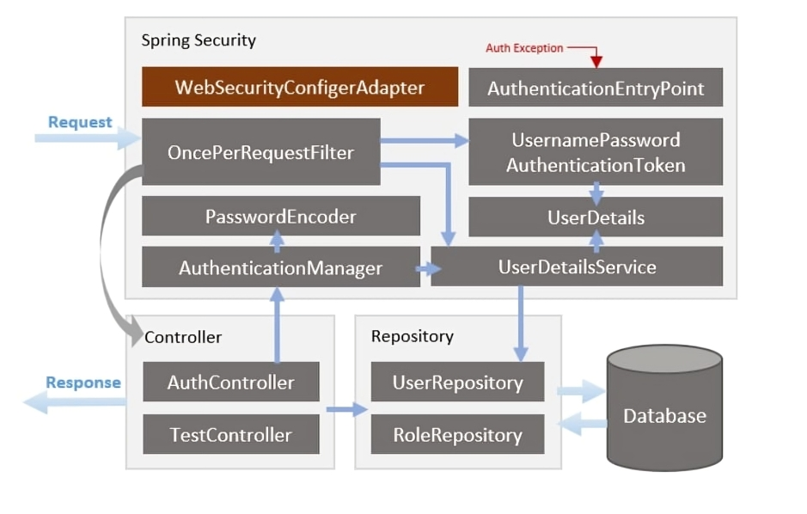

Slide 3
