Slide 1
AWS - ML INTRODUCTION
Vraj Suratwala

Slide 2
Trends in Cloud Computing
Introduction
Cloud computing is always changing, and AWS is always innovating. AWS is regularly introducing new services and features and making improvements, such as lower costs, more granular billing options, higher quotas, new Regions, and faster performance.
Because of these changes, it is vital to stay up to date on what is happening.

Slide 3
Latest Advancement
Generative AI is changing the way that organizations do work. AWS has infrastructure, tools, and applications to help customers use generative AI in their business. Here are some of the generative AI services that AWS has announced:
Amazon Bedrock
Amazom Q

Slide 4
Amazon Bedrock
Amazon Bedrock is a fully managed service that offers a choice of high-performing foundation models (FMs) along with a broad set of capabilities that you need to build generative AI applications.
Amazon Bedrock simplifies development with security, privacy, and responsible AI.

Slide 5
Amazon Q
Amazon Q is a generative AI-powered assistant for work that is designed to be secure and private by default. Amazon Q is integrated into many AWS products. Two of the primary Amazon Q products are the following:
1. Amazon Q Business
2. Amazon Q Developer

Slide 6
I) Amazon Q Business
It is a generative AI-powered assistant that can answer questions, provide summaries, generate content, and securely complete tasks. You can tailor Amazon Q Business to do any of those tasks based on data and information in your enterprise systems.

Slide 7
ii) Amazon Q Developer
It is a coding assistant that can accelerate development time for developers of all skills levels and for many tasks across the software development lifecycle.
Amazon Q Developer can chat about code, provide in-line code completions, generate new code, and scan your code for security vulnerabilities.
It can also make code upgrades and improvements, such as language updates, debugging, and optimizations.
With Amazon Q Developer, you can describe the application you want to create in natural language, and Amazon Q Developer will generate and suggest code for the application.

Slide 8
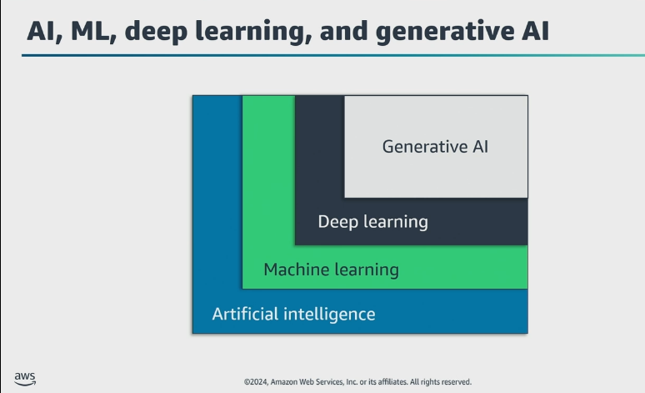
Where ML is Placed ?

Slide 9
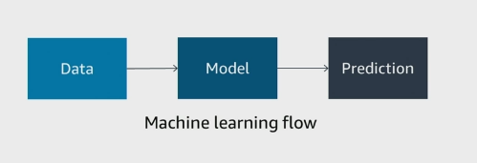
Definition of ML - Understanding of ML
ML is a Scientific study of stastical and algorithm based models which is going to perform specific task using interface rather then instruction.

Slide 10
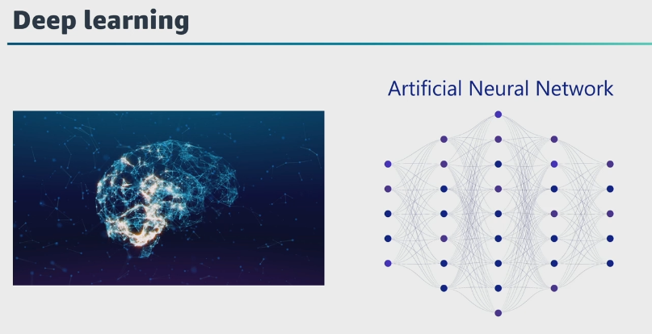
DL - Deep Learning - Process

Slide 11
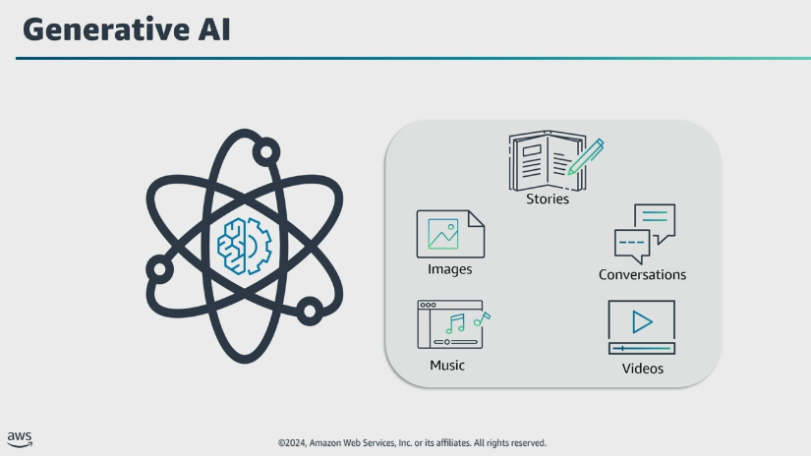
GAN AI - Generative AI

Slide 12
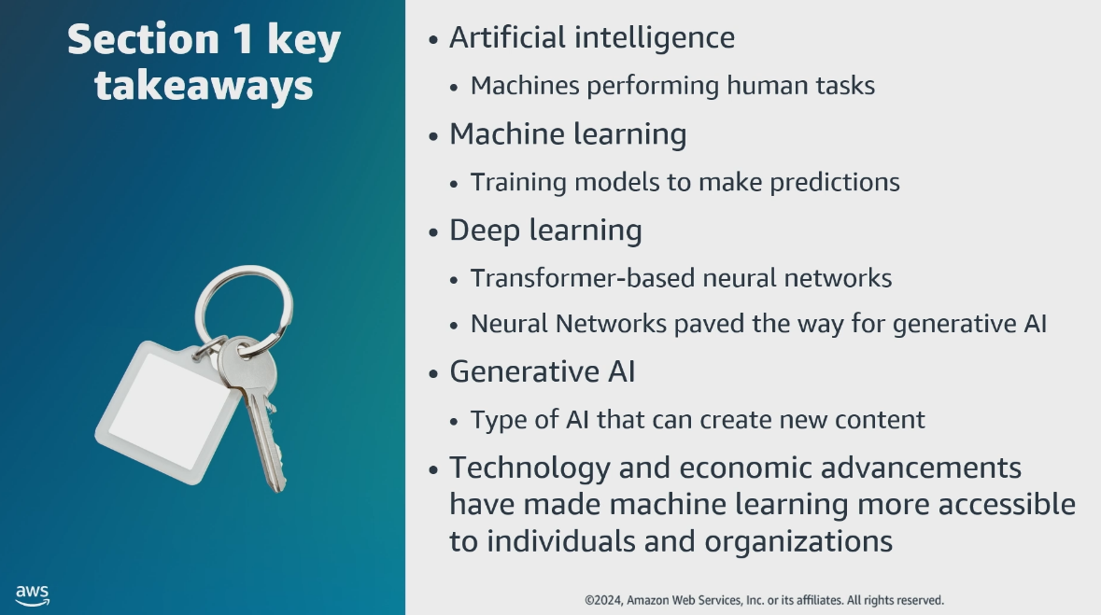
Summary till here

Slide 13
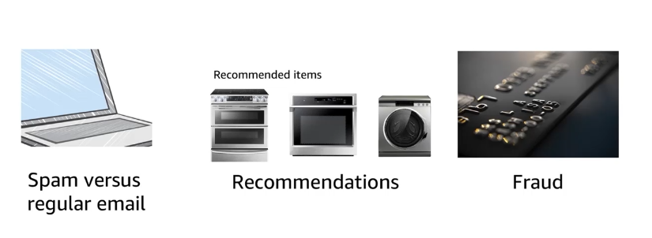
Business Probelms that can be solved by ML

Slide 14
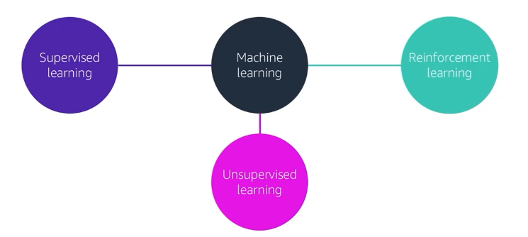
Types of ML

Slide 15
1. Supervised Learning
working for labeled data. (which is refers to input and output both for training).
two types for the Supervised Learning.
1. Regression - works for numerical data
  Example : Image Recognition
2. Classification - works for categorial data.
  Example : Market Forcasting

Slide 16
2. UnSupervised ML
without labels.
Common Methods of Unsupervised ML.
  Clustering
    Product recommandations
  Dimensional Reduction
    Visulaization

Slide 17
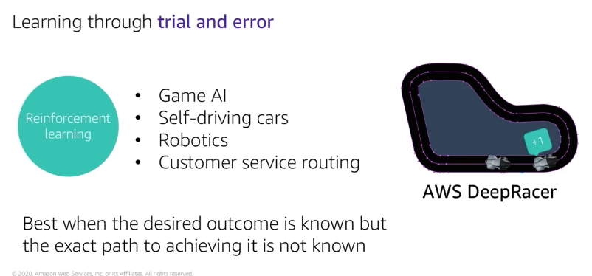
3. Reinforcement Learning

Slide 18
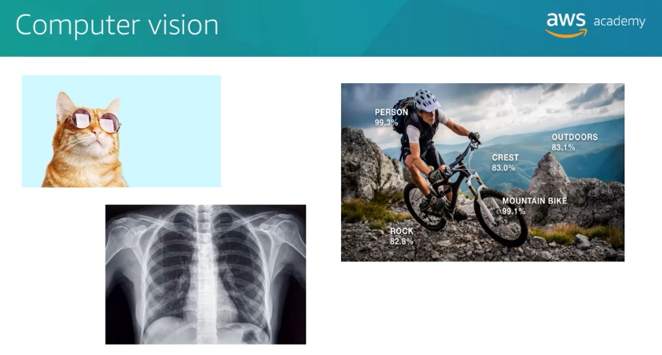
Computer Vision

Slide 19
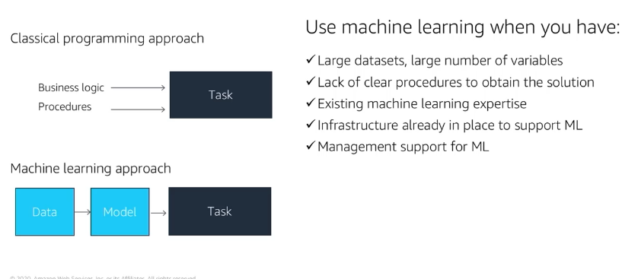
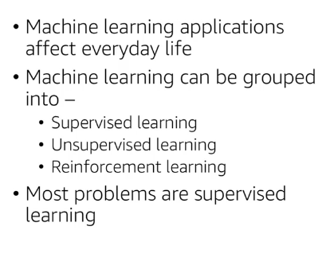
Traditional vs ML Programming
Summary till here

Slide 20
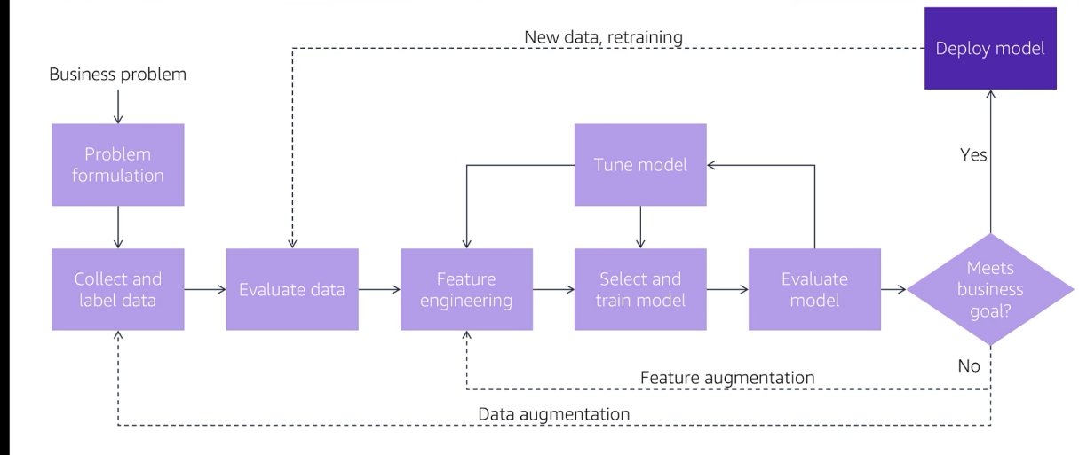
ML Process

Slide 21
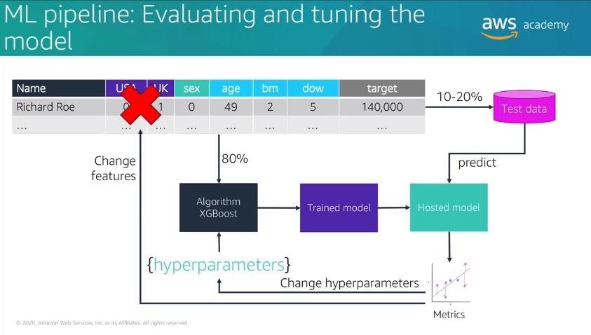
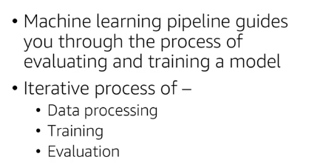

Slide 22
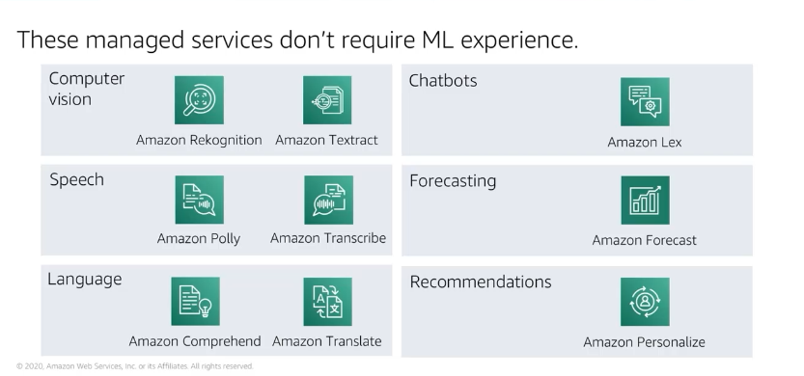
ML Services by AWS

Slide 23
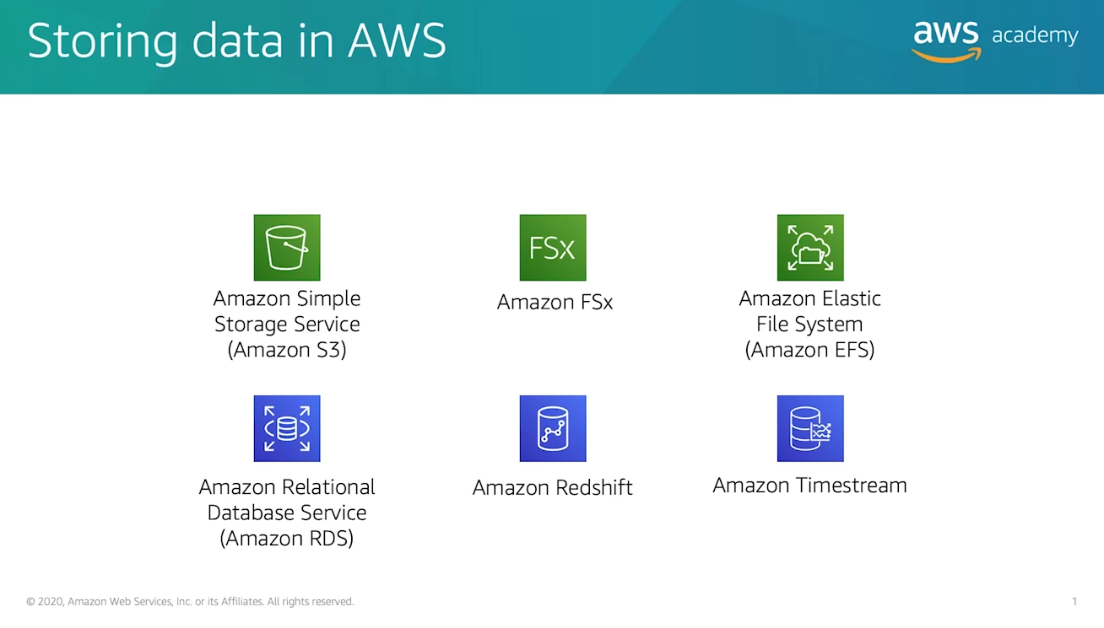
Storing Data in an AWS

Slide 24
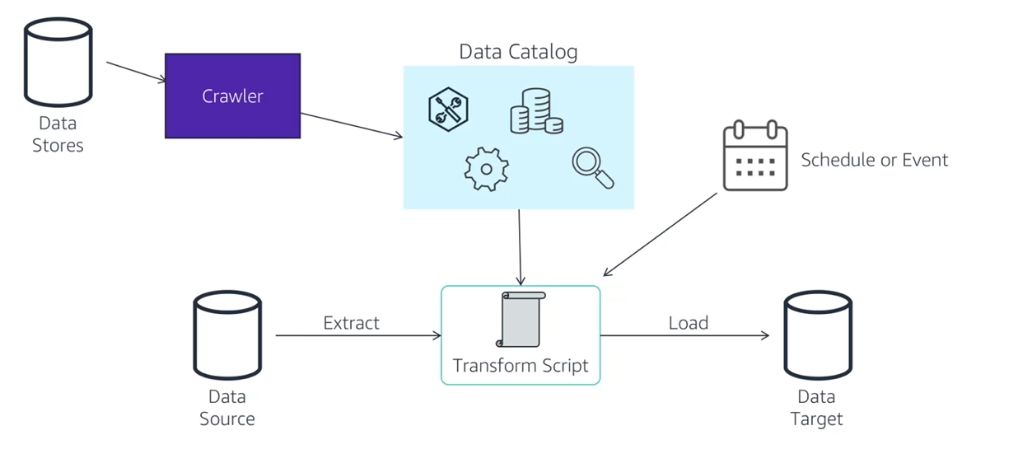
Storage Processing in AWS with Glue

Slide 25
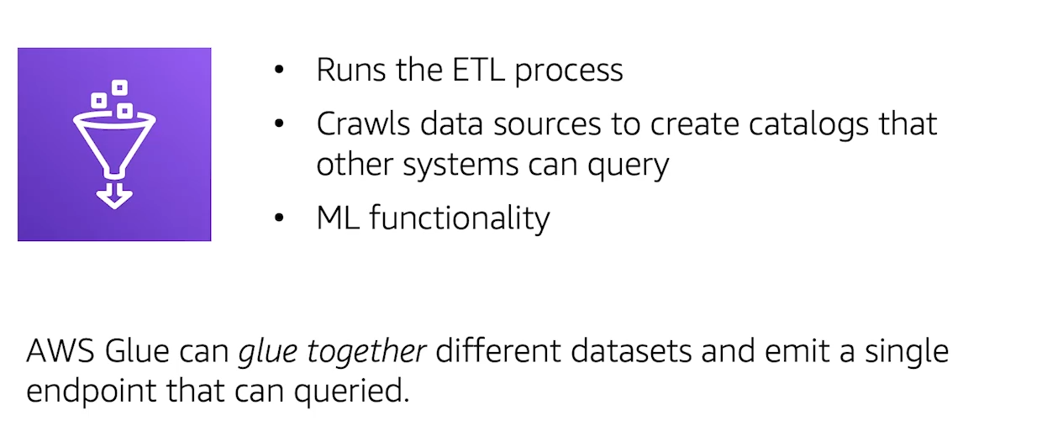
Storage Processing in AWS with Glue

Slide 26
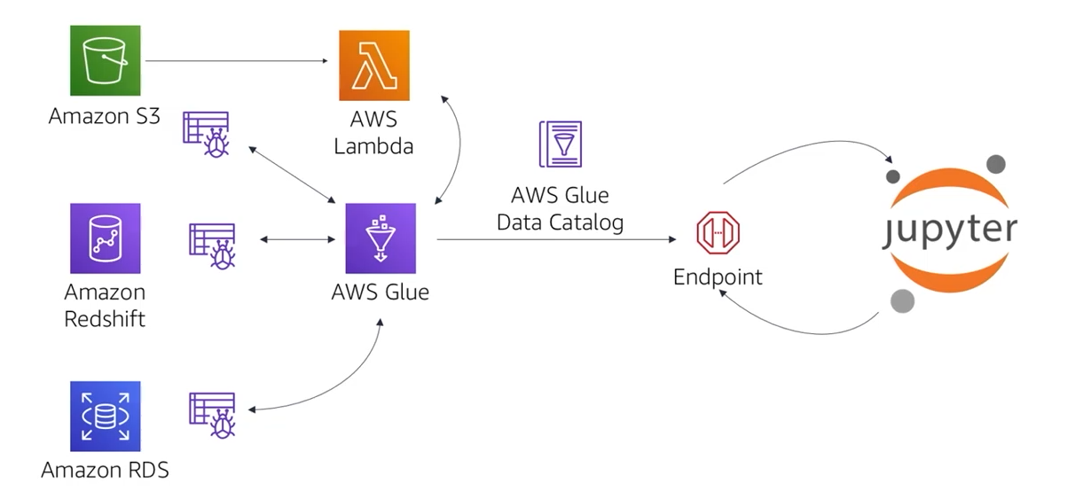
Storage Processing in AWS with Glue

Slide 27
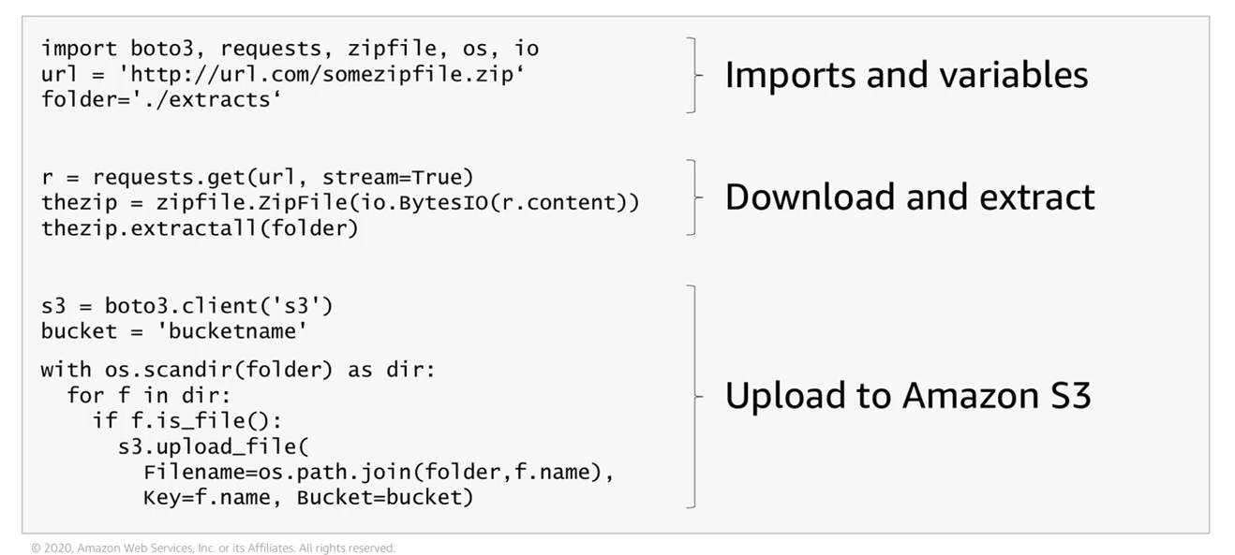
ETL with Python

Slide 28
Feature Extraction vs Selection
Difference Between Them.

Slide 29
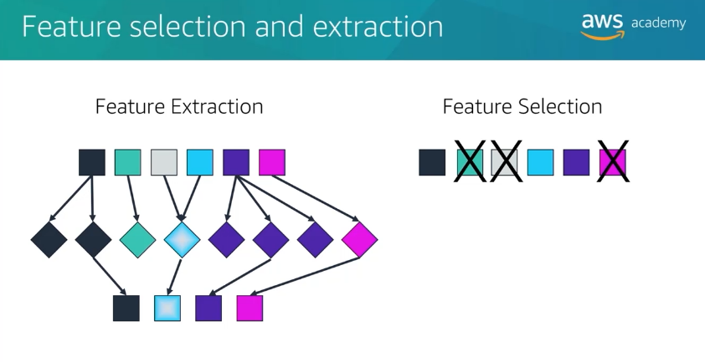
Difference Between Both

Slide 30
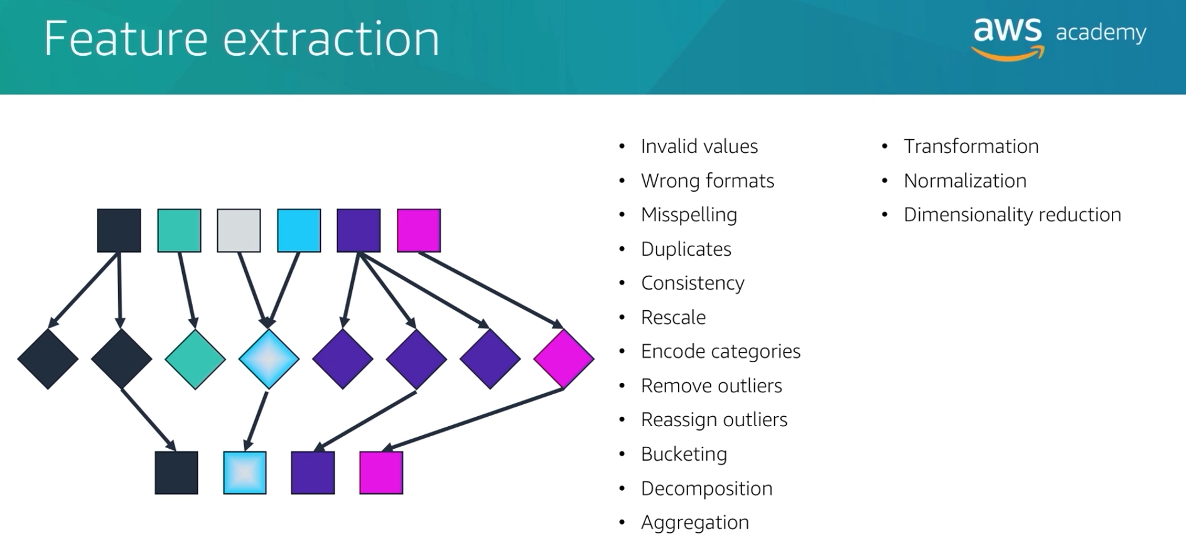
Feature Extraction Includes various activities.

Slide 31
Cleaning Data

Slide 32
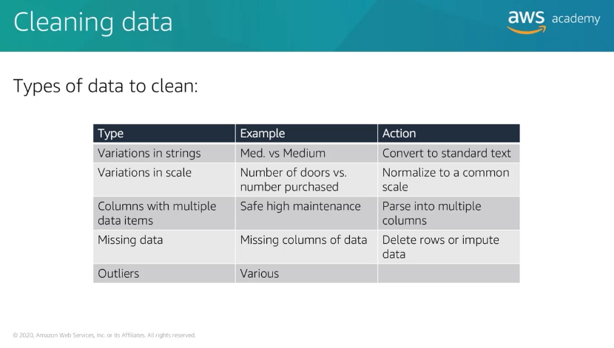
Types of Data to Clean

Slide 33
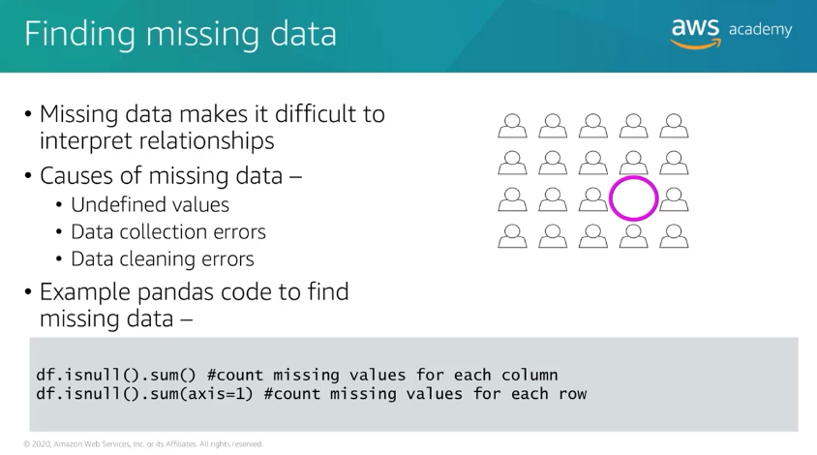
Handling Missing Data

Slide 34
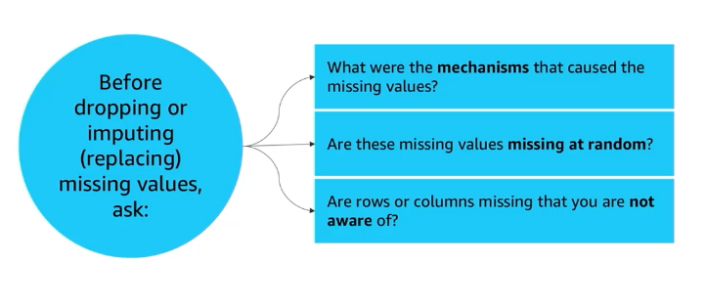
Missing Values analysis based on ...

Slide 35
Solution
1. Removing Missing Values
2. Impute Missing Values

Slide 36
How to Work with outliers ?
Types of Outliers
1.Univariate : Abnormal values for a single variables.
2. Multivariate : Abnormal values for two or more variables.

Slide 37
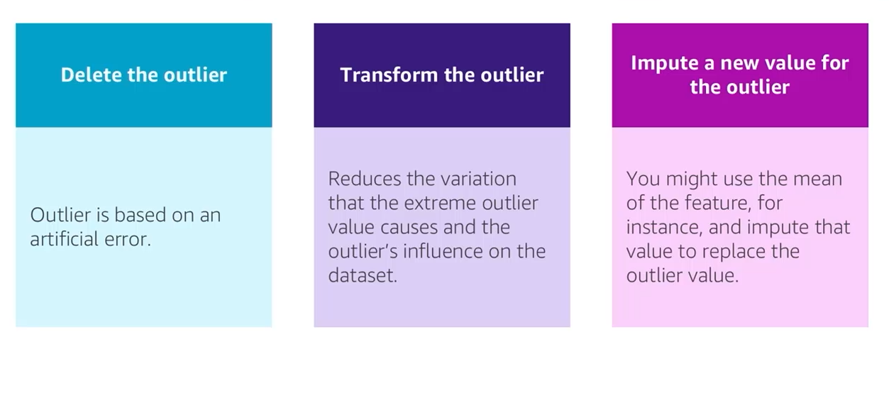
Handling Outliers

Slide 38
Training
How to Train your models ?

Slide 39
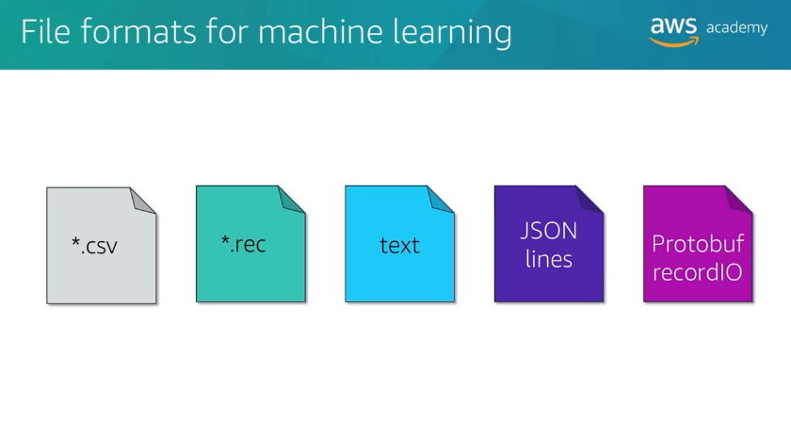
The File Extension which are supported by ml.

Slide 40
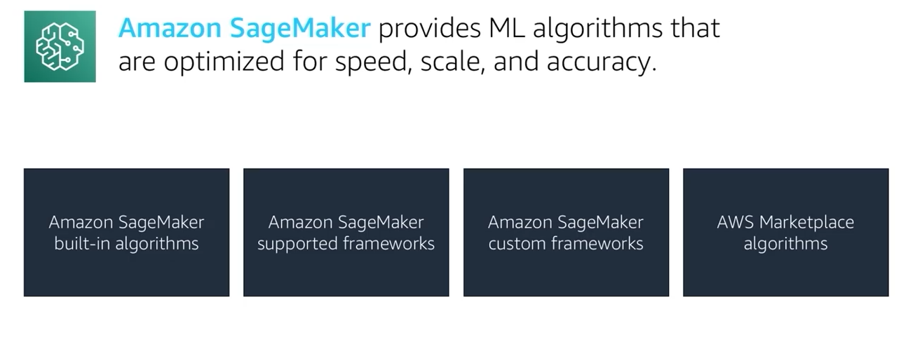
Amazon SageMaker - ML algorithms

