Slide 1
BI : Data Fabric
Vraj Suratwala
Department of ICT, VNSGU

Slide 2
Basic Understadning
In today's organizations, data is no longer stored in just one database. It can exist in cloud platforms, databases, applications, IoT devices and data lakes. Managing all this distributed data creates a major challenge. Data Fabric is one approach designed to solve this problem."

Slide 3
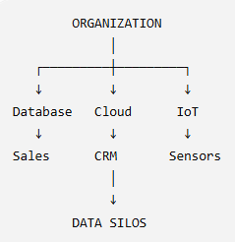
Why Do We Need Data Fabric?
"The problem is not that we don't have enough data. The problem is that our data is scattered across different systems."
Main problems:
Data duplication
Difficult integration
Inconsistent information
Poor data visibility
Governance problems
Slow analytics

Slide 4
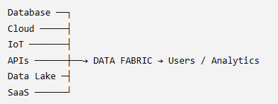
What is Data Fabric?
Data Fabric is an architectural approach that connects, integrates, manages, governs and provides access to data across distributed environments.
Data Fabric = A connected layer over distributed data

Slide 5
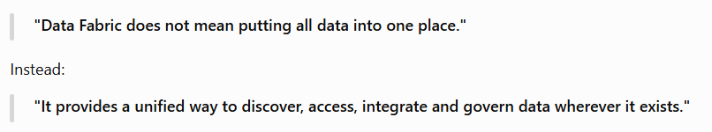
Again...Clear the Concept of Data Fabric

Slide 6
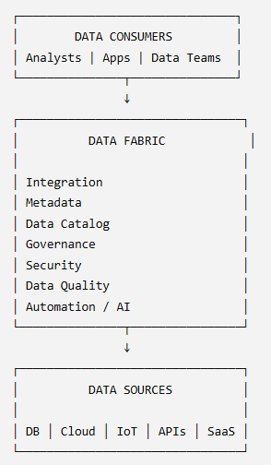
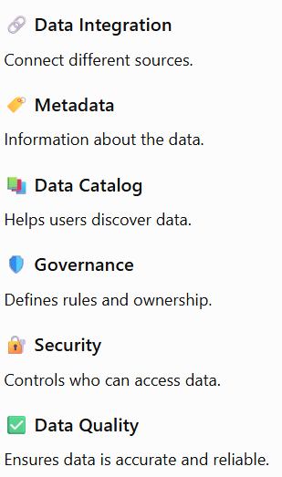
Vague Architecture of Data Fabric - Only For Understanding
Understading from Bottom..
1. Data Sources
2. Data Fabric
3. Data Consumers

Slide 7
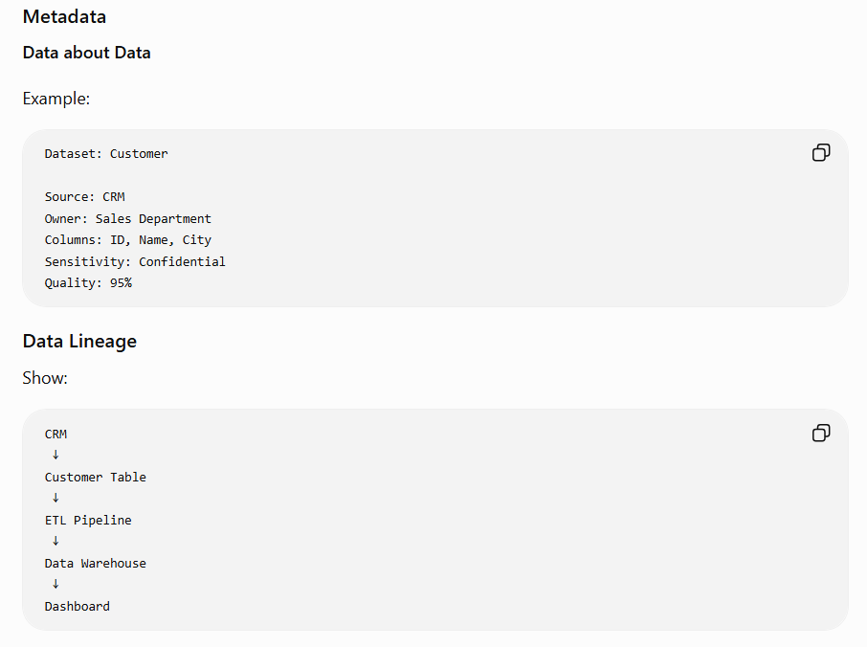
IMP. Component from these 6 Component : METADATA

Slide 8
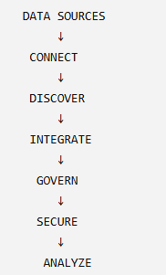
Overall working of Data Fabric
1. Connect : Connect different data sources.
2. Discover : Identify available datasets.
3. Integrate : Combine or access information across sources.
4. Govern : Apply policies.
5. Secure : Control access.
6. Analyze : Make the data available for analytics and decision-making.

Slide 9
Let’s Explore Practical Aspect also
where Study and It’s Implementations got meet...

Slide 10
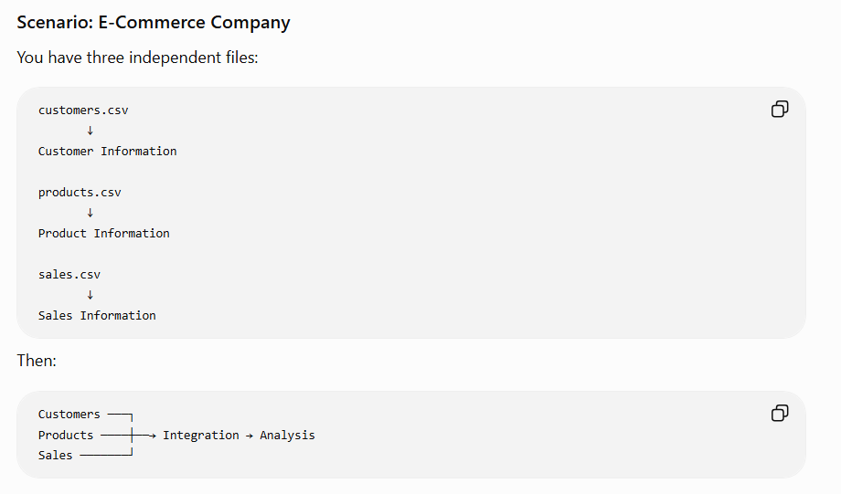

Slide 11
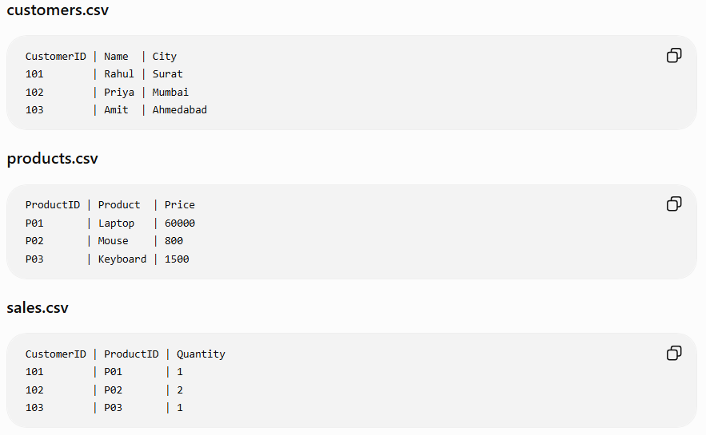

Slide 12
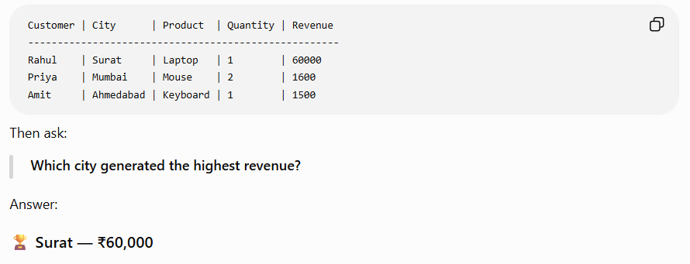
After integration:

Slide 13
Pros & Cons
PROS
Unified data access
Better data discovery
Improved governance
Better data quality
Faster analytics
Automation
Works across distributed environments
CONS
Complex implementation
Cost
Security requirements
Metadata management
Requires skilled professionals

Slide 14
Conclusion
DATA SOURCES
↓
DATA FABRIC
↓
TRUSTED DATA
↓
BETTER INSIGHTS
↓
BETTER DECISIONS

Slide 15
References
[1] A. Author et al., “Paper title,” IEEE Access, vol. XX, no. XX, pp. XX–XX, year.
The important part is that every technical claim taken from a source gets a numbered citation, e.g. [1], [2], [3].
Many LLM - ChatGPT, Gemini AI, Perplexity. (For Content generation from this Papers and Content Evaluation.)

Slide 16
Thank you
Vraj Suratwala
Roll Call : 112
MSC IT - 9
Department of ICT, VNSGU

