Slide 1
CNN - Convolutional Nueral Network- More
Vraj Suratwala
Department of ICT, VNSGU

Slide 2
Fully Connected Neural Network vs CNN
Basis | Fully Connected Neural Network (FCNN) | Convolutional Neural Network (CNN)
Basic idea | Every neuron in one layer is connected to every neuron in the next layer. | Uses convolutional filters to process local regions of the input.
Connections | Fully connected. | Local/receptive-field connections in convolution layers.
Input | Usually requires input to be represented as a vector. | Can directly process structured grid-like data such as images.
Spatial information | Spatial relationships can be lost when an image is flattened. | Preserves and exploits spatial relationships.
Feature extraction | Usually learns features through fully connected transformations. | Automatically learns local features such as edges, textures, and shapes.
Parameters | Generally very large for high-dimensional inputs. | Usually fewer parameters due to local connectivity and weight sharing.

Slide 3
Weight sharing | No weight sharing between different connections. | Same filter weights are applied across different spatial locations.
Image processing | Less efficient for large images. | Particularly suitable for image-related tasks.
Main layers | Fully connected/dense layers. | Convolution, activation, pooling, and often fully connected layers.
Computational efficiency for images | Can require many parameters. | More parameter-efficient for image data.
Common applications | Tabular data, classification, regression, general prediction. | Image classification, object detection, image segmentation, medical image analysis.
Example | MLP | LeNet, AlexNet, VGG, ResNet

Slide 4
Variants of Basic Convolutional Function
fundamental operation in a Convolutional Neural Network (CNN)

Slide 5
Variants of Basic Convolutional Function
A convolutional function is the fundamental operation in a Convolutional Neural Network (CNN). It applies a small filter/kernel over the input and calculates weighted sums to extract features such as edges, textures, and shapes.
There are several important variants of the basic convolution operation.

Slide 6
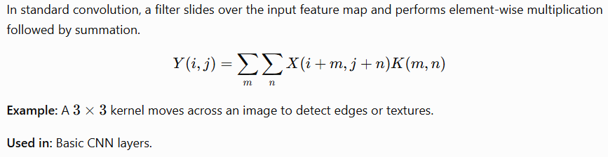
1. Standard Convolution

Slide 7
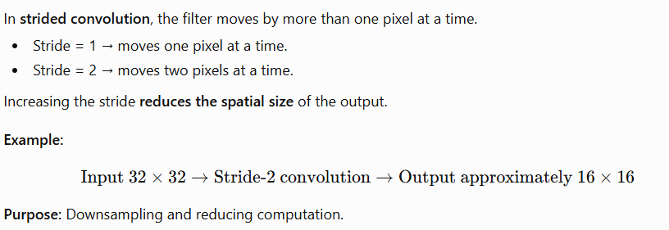
2. Strided Convolution

Slide 8
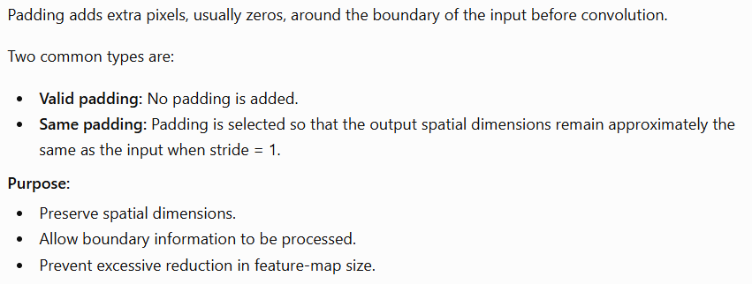
3. Padded Convolution

Slide 9
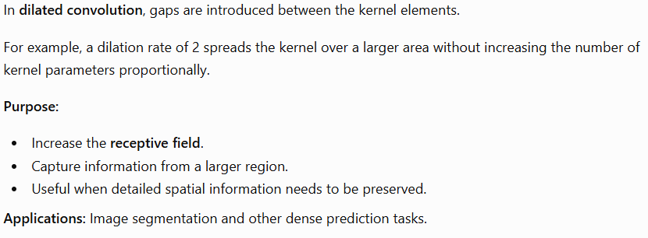
4. Dilated (Atrous) Convolution

Slide 10
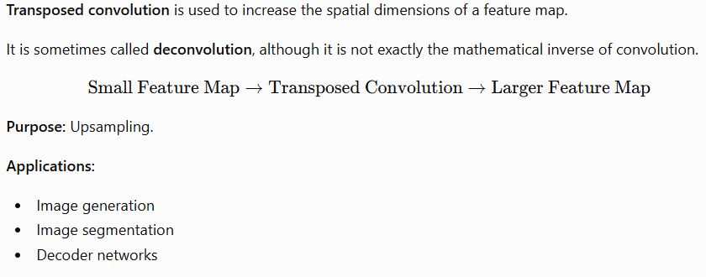
5. Transposed Convolution

Slide 11
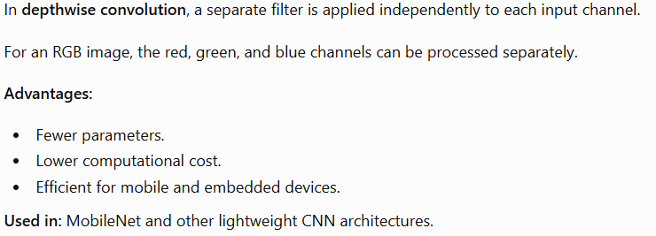
6. Depthwise Convolution

Slide 12
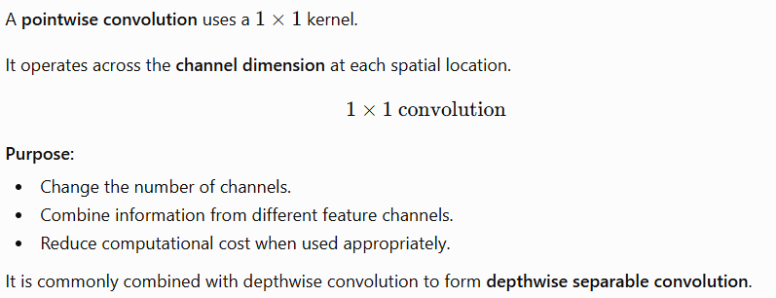
7. Pointwise Convolution

Slide 13
Thank You
Suratwala Vraj
Department of ICT, VNSGU

