Slide 1
IoS - iphone Operating System
Basics of Ios

Slide 2
What is an Ios ?
Swift is general purpose, object and protocol oriented programming language which is developed by Apple Inc. for iPad, iPhone, macOS, WatchOS, tvOS and etc. to build Apple products.
designed to work with Apple’s Coca and Coca Touch frameworks and it supports the fundamental concepts of Objective C like multithreading, optional chaining, late binding and some more features.
In swift, Apple Added New Features like autometic memory management, protocols and introduced the protocol oriented language.

Slide 3
Features of Swift
Easy Syntax
No Need to Give a Semicolon
Automatic Memory Management
Real Time Output Swift Programming Language include the playground feature which will help you to write the code and don’t need to run the code separately, automatically it will compile the code and shows the result.
Similar with the Scripting Language.
Also supports the extension, protocols and methods.

Slide 4
What is the Meaning of Type-Safety in ios ?
Swift is a type-safe programming language means, it will help you to identify what type of values required to work with the code.
let say for an instance, we are passing an ‘int’ value and code needs the data in ‘string’ format, in this kind of cases swift will prevent us to send this kind of invalid data with invalid datatype.
Let’s think, where to write this code now ? so let’s understand that......

Slide 5
Playground
Playground contains main five components.
  1. Activity Viewer.
  2. Panel Control
  3. Result Bar
  4. Source Editor
  5. Execution Control

Slide 6
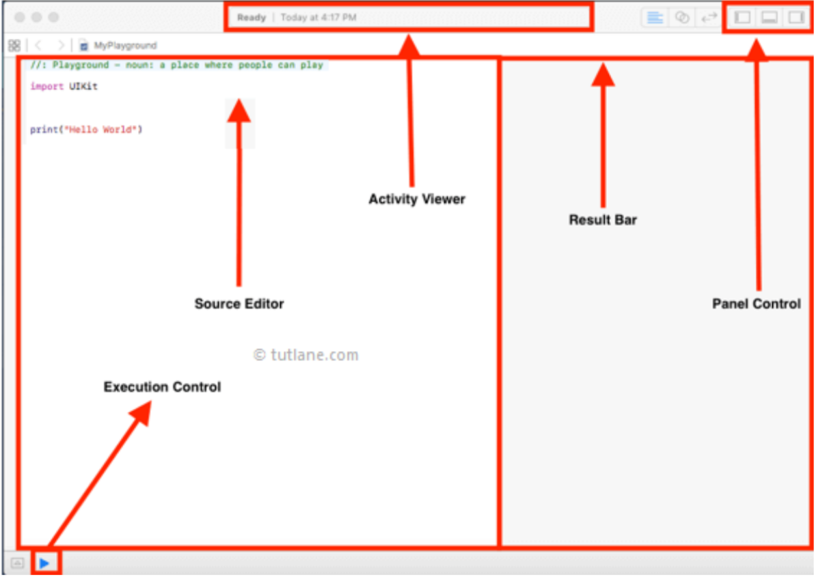
Playground - Visual Components

Slide 7
Playground
Activity Viewer
  Displays the current activity or process. It helps track what’s happening in real time.
Panel Control
  Provides options to configure or adjust settings. Think of it as the control hub for toggling features or layouts.
Result Bar
  Shows the output or feedback from execution. This is where you see results, logs, or status updates.
Source Editor
  The main coding area where you write and edit source code. It’s the core workspace for developers.
Execution Control
  Manages how and when the code runs. Includes buttons or commands like Run, Pause, Stop, and sometimes debugging tools.

Slide 8
Comments in Swift
Single-line comment
  // SINGLE LINE COMMENT
Multi-line comment
  /* Playground - noun: a
  place where
  people can play */

Slide 9
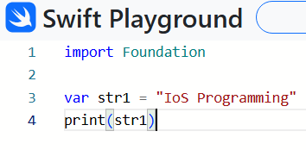
Swift Variables
In swift variables are used to store value in memory and we can manipulate or change the
value of variables by applying different operations based on our requirements.
We use keyword called “var” to define variables in swift.
Syntax :
  var <Variable_Name> = <Value>

Slide 10
Swift Data-Types
1. Integer - int,Uint (int32, int64, UInt32, UInt64)
  Unsigned will only allow positive values.
2. Float
  Small Decimal Numbers
3. Double
  Double is more precise then Float and it can storelarge decimal Numbers.
4. Bool
  True or False
5. String
  is a combination of a charatcers
6. Character
7. Optional
  Can Hold value oor no Value

Slide 11
Swift Constants
Constant means it refers fixed value it means when we declare variable as constant then it’s not possible for us to change or override.
Syntax :
  let <ConstantName> = <Value>
Example :
  let str1 = “IOS Programming”
  print(str1)

Slide 12
String Concatenation and Interpolation
to combining two variables or string swift provide two ways:
  1. Concatenation
  2. Interpolation

Slide 13
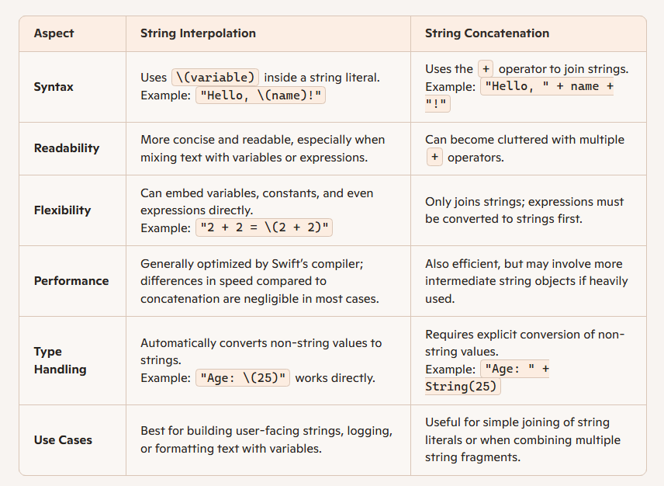
Explanation of Both

Slide 14
Swift Optionals
optionals is a type which is used to hold the value or absence of value means nil values which is representing the absence of value.
Example :
  var firstname : String = “IOS Programming”
  var lastname : String // Compile time error
  var uname : String = nil // throw compile time error
  Here nil means no value is present.
  because lastname is not having any value it will throw an error.
  uname will also throw an error because String is not able to store the nil value.
  So let’s see the solution !!

Slide 15
Optionals : One Solution to us
basically we have to use ‘?’ symbol to declare the variable optional. (after the datatype)
Syntax :
  var variable_name : DataType ?
Example :
  var firstname : String ?
  print(firstname)
  // O/P -> nil

Slide 16
Problem with nil concept
If you try to directly use name without checking, Swift won’t allow it because it could be nil.
This prevents runtime crashes that are common in other languages when dereferencing null.
When we create an optional variable (?), swift stores the values like this,
  Optional(“Bharat”)
  so what is the solution for this problem ? - unwrapping the variable’s value

Slide 17
Force Unwrapping and Autometic Unwrapping
using an exclamation mark(!) we can unwrapp the value which is nil and solve the above problem.
Example without unwrapping
  var firstname : String?
  firstname = “Vivan”
  if firstname!=nil{
    print(“firstname is \(firstname)”)
  }
  // o/p -> firstname is Optional(“Vivan”)

Slide 18
Solving that...
  var firstname : String?
  firstname = “Vivan”
  if firstname!=nil{
    print(“firstname is \(firstname!)”)
  }
  // o/p -> firstname is Vivan

Slide 19
Important Notes
Force unwrapping is called “force” because if the value is nil value and we use an exclamation mark (!) the program will crash.
var name : String?
print(name!) // Crash
so always check like this,
  if name!=nil{
    print(name!)
  }

Slide 20
Autometic Unwrapping (Implicit Unwrapped Optional)
instead of ? we will use !.
var name : String!
Example :
  var name : String!
  name = “Vivan”
  if name!=nil{
    print(name)
  }

Slide 21
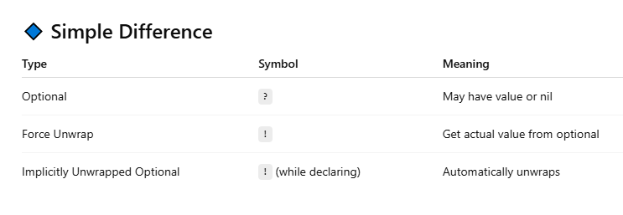
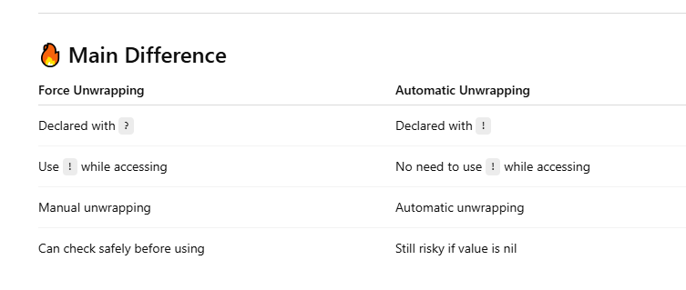
Difference - From ChatGPT

Slide 22
If-else
Syntax :
  if condition {
    //code
  }else {
    //code
  }

Slide 23
Tuples in Swift
In swift, tuples are used to group multiple values together into single compound value. The values whatever we will define in tuple can be of any type and there is no restriction to use same type of values.
In swift we have two types of tuples are available those are unnamed tuples and named tuples.

Slide 24
1. Unnamed Tuples
In swift, unnamed tuples are used to group multiple values into single by using parentheses and those are need to be separated by commas.
Following is the simple example of defining unnamed tuples in swift programming language.
let userInfo = ("Bharat Patel", 200)
Or
var userinfo:(String, Int) = ("Bharat Patel", 200)

Slide 25
1. Unnamed Tuples
If you observe above unnamed tuple values we are grouping string and integer values into single compound value and we are using immutable let or mutable var based on our requirements.

Slide 26
2. Named Tuples
In swift, named tuples are used to group multiple values into single by using parentheses and need to define those values with named variables and those are separated by commas.
Following is the simple example of defining named tuples in swift programming language.
let userinfo = (name: "Bharat Patel", id: 200)
Or
var userinfo:(name:String, id:Int) = ("Bharat Patel", 200)
As we discussed in tuple we can use any type of values within the tuple and it’s restricted to use same type like arrays.

Slide 27
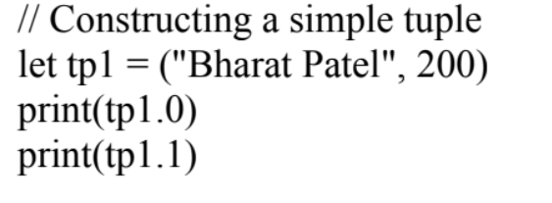
2. Named Tuples
If you observe above tuple example we defined values with variable names and we are grouping String and Integer type values into single tuple value.

Slide 28
Loops in Swift
In swift, for-in loop is used to iterate over a sequence of items, such as items in an array list, characters in string or collection of items to execute specified statements repeatedly based on the defined conditions.
If we get requirement like need to execute set of statements repeatedly based on the items in list or array then by using for-in loop we can easily achieve this functionality in swift programming language.
syntax:
for item_name in list_name {
// your statements
}
Item_name – By using this we can access each item in defined list.
list_name – It’s name of the list which we need to access the items.

Slide 29
Iterating on Collection
var lstNames: [String] = ["Bharat","Khawar"]
for index in lstNames {
print( "Name of Developer is \(index)")
}

Slide 30
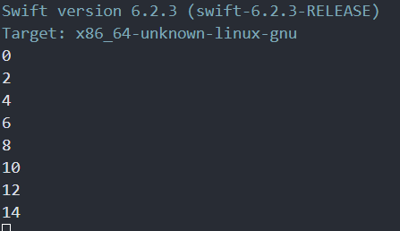
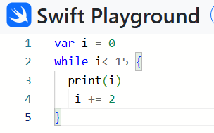
While Loop
Syntax :
  while(condition) {
    //Statements
  }

Slide 31
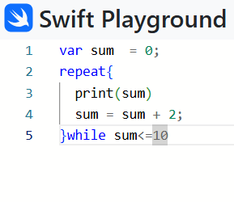
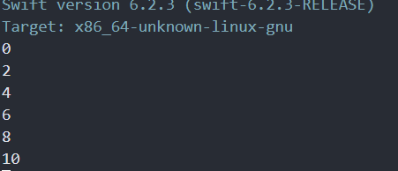
repeat While Loop
Syntax :
  repeat{
    //Statement
  }while <Condition>

Slide 32
Collections in IOS
Collection refers to group of one or different data type to manage large bundle of data.
we will cover three collection which is widly used in theee Swift Programming.
1. Swift Array
2. Swift Set
3. Swift Dictionary

Slide 33
1. Swift Array
In swift, arrays are used to store same data type of multiple values in ordered manner.In array we can store same value in multiple times at different positions based on our requirements.
In swift arrays we can store any kind of elements like either strings or integers or other element types based on our requirements.
We can use arrays in swift programming language whenever we want to hold multiple values of single data type in one variable.
By using index we can access arrays elements and perform update or delete operations on array elements based on our requirements in swift programming language.
In swift we can create arrays by surround a list of comma separated values with square brackets.

Slide 34
Declaration of an Array
var numbers = [1,2,3,4]
or
var nums : Array<Int> = [1,2,3] // For Specific DataType
//Declaration without Assigning the values.
var intervals = Array<Int>()
var intervals = [Int]()

Slide 35
Operation on an Array
Access : the by default index of an array is starting from 0.basically access an array is as simple as you were doing in C and other programming!
Check Array Empty or not: isEmpty property
Get Array Element Count : count property
Adding an Element in an Array : append() or += or index()
Remove Array Element : removeLast() or removeAtIndex()
Update an Element in Array : by assigning new value to specific position.
Iteration : using any loop

Slide 36
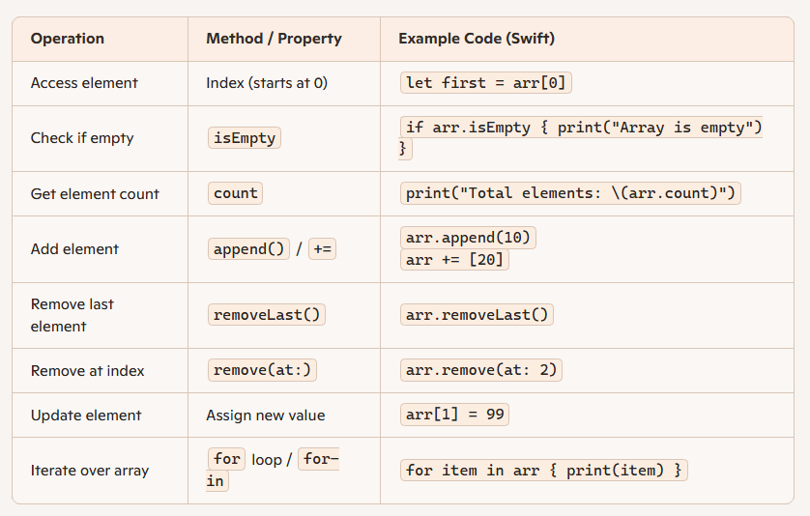
Example : Operation of an Array

Slide 37
2. Swift Dictionary
swift, dictionaries are used to store values with key-value pair association in unordered manner. In dictionaries we can store same type of keys and same type of values with no defined order. The keys in dictionaries must be unique and those will act as identifiers for
the values in dictionaries.
We can use dictionaries in swift programming language whenever we want to get values based on key value.
Syntax :
  Dictionary<Key, Value>()
  Or
  [Key: Value]()

Slide 38
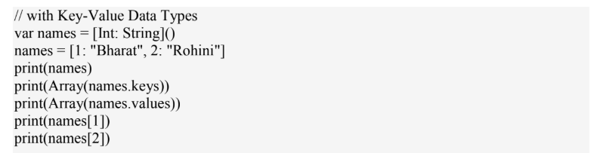
Creating the Dictionary
// using Dictionary
  let nums = Dictionary<Int, String>()
  print(nums.count)
  // It prints 0
// without dictionary
  let nums = [Int: String]()
  print(nums.count)
  // It prints 0

Slide 39
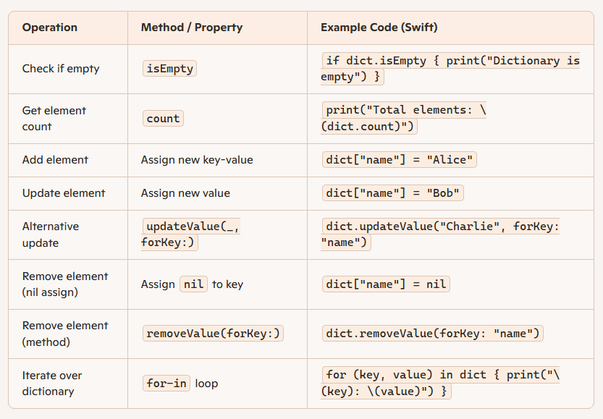
Operation on Dictionary

Slide 40
3. Swift Sets
sets are used to store same type of distinct values in unordered manner. We can use sets instead of arrays in case if we want to store only distinct values and we are not concerned about the order of items.
Syntax:
  Set<ElementType>
Example:
  var numbers : Set<Int> = [1,2,3]

Slide 41
Creating a Set in Swift
var numbers : Set = [10,20,30,40,50]
or
var names : Set = [“ABC”,”BCD”,”CDE”]
//We can also specify the DataType.
var numvers : Set<Int> = [10,20,30,40,50]

Slide 42
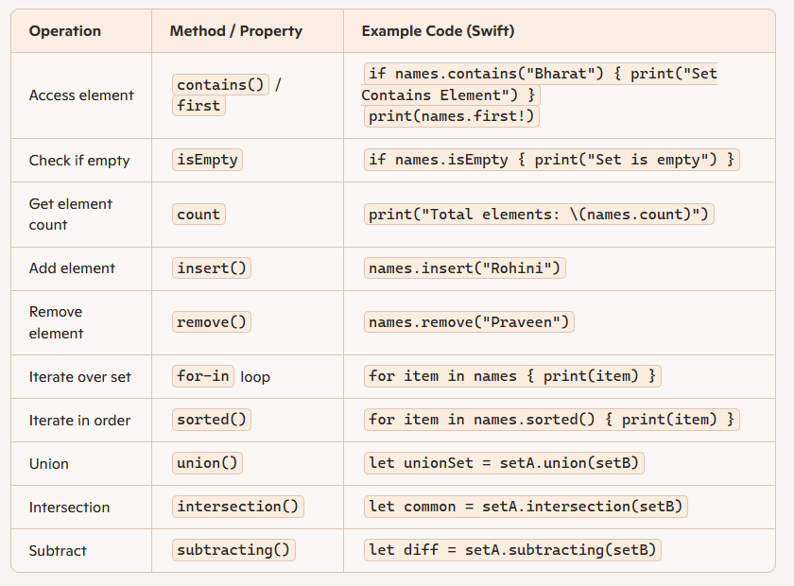
Operation on Swift

Slide 43
Functions in Swift
functions are the block of statements to perform specified tasks and return values based on our defined conditions.
In swift we can send data to functions by using input parameters and functions is having return types to return data as result.
Provides Reusability.
* Syntax:
  func function_name(parameters) -> ReturnType {
    // Statements
    return parameters
  }

Slide 44
Swift Funtion without Parameter
Example :
func show(){
  print(“IOS Programming”)
}
show()

Slide 45
Swift Funtion with multiple parameters
func addition(a : Int){
  print(“\(a) + 50 = ” + (a +50))
}
addition(120)
O/P -> 120 + 50 = 170

Slide 46
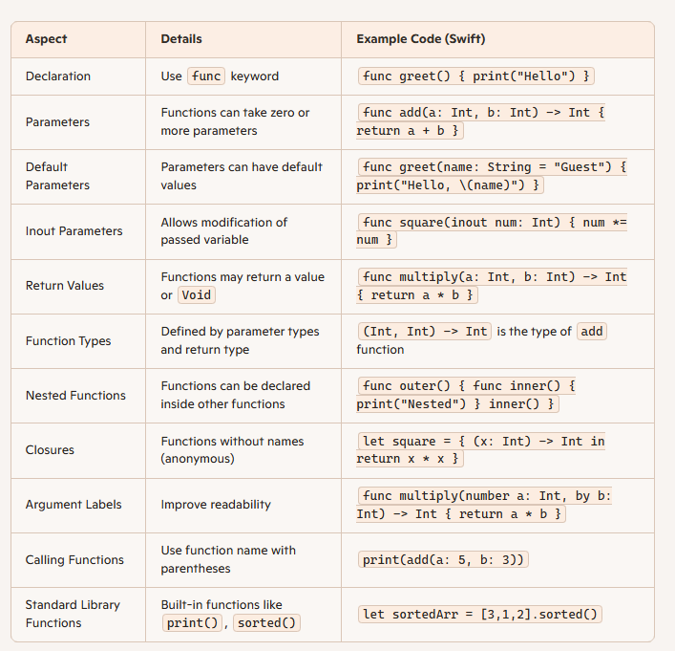
Summarry

Slide 47
Thank you
Vraj Suratwala, Department of ICT, VNSGU

