Slide 1
Object - Oriented Programming in Swift
Vraj Suratwala
Module_1

Slide 2
What is Object Oriented Programming in Swift ?
it is a way of programming that put code around the objects which are instances or blueprint implementation of classes!
basically, it is having five pillers
  1. Object and Classes
  2. Inheritance
  3. Encapsulation
  4. Abstraction
  5. Polymorphism
  so let’s Explore each one !!

Slide 3
Classes and Objects in Swift
A class is a blueprint or template for creating objects. A class defines the properties and methods that are common to all objects of that type.
Properties of a Class : Properties refers to the variables or constant in a class which can be either normal properties or computed properties.
Methods of a Class : Refers to Fucntions in class.

Slide 4
Declaration and Syntax of Class
Syntax :
  Class Class_Name {
    // Class Definition goes here
  }
Example :
  Class Animal {
    var Name : String = “”
    var Age : Int = 0
    func display(){
      print(Name)
      print(Age)
    }
  }

Slide 5
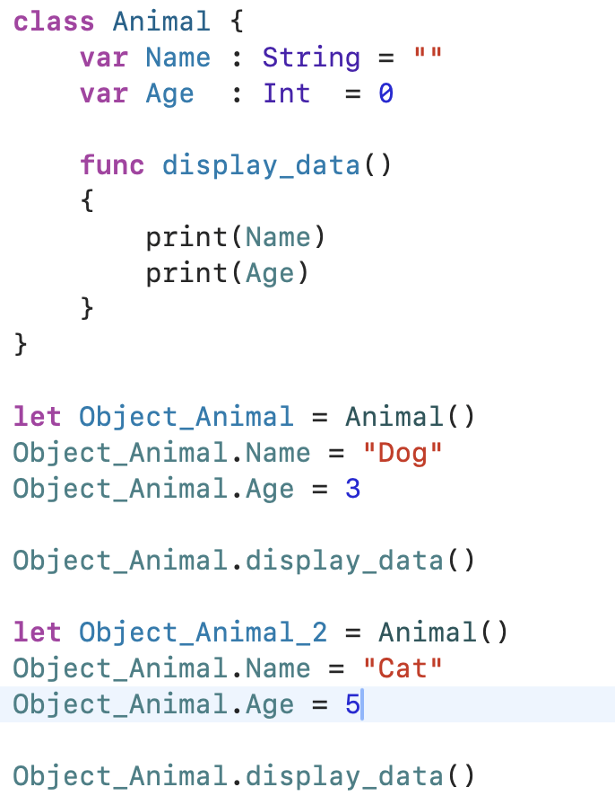
Practiced Example

Slide 6
Components of Swift Classes
1. Properties : variables of constants to store values for an object in class.
2. Methods : refers to functions which performs specific task.
3.Intializaers : Special Methods (Constructors) which called when object is getting created.
4.Subscripts : special methods that allow access to the values of the object using subscript syntax, such as object[index].
5.Extensions : Block of code which extending the class functionlity without affecting original class code.
6. Protocols : Interfaces that declaring common methods and properties which will be implemented by class or extending interfaces.

Slide 7
Key Points about Classes
Classes are the pointers towards the “Objects”.
Classes allow us to declare properties, methods, subscript.
Classes allow to inherit the protocols.
Classes must have intializers and DE Intializers.
Classes can inherit from another class.

Slide 8
What is an Object ?
Object is an instance of a class which can use the all public methods and properties of it’s class.
Declaration of class :
  Syntax : var/let object_name = ClassName(Paramater_List)
  Example : var Object_Animal = Animal()

Slide 9
Ways to Create an Object
using class name and parentheses :
  var/let object_name = classname()
using class name with arguments :
  var/let object_name = classname(arguments)
using new keyword
  var/let classname = new classname()
using a factory method: a static or class method that returns an object of the class.
  For example, var objectName = ClassName.create()
copy constructor
  var object_name = ClassName(another_object)

Slide 10
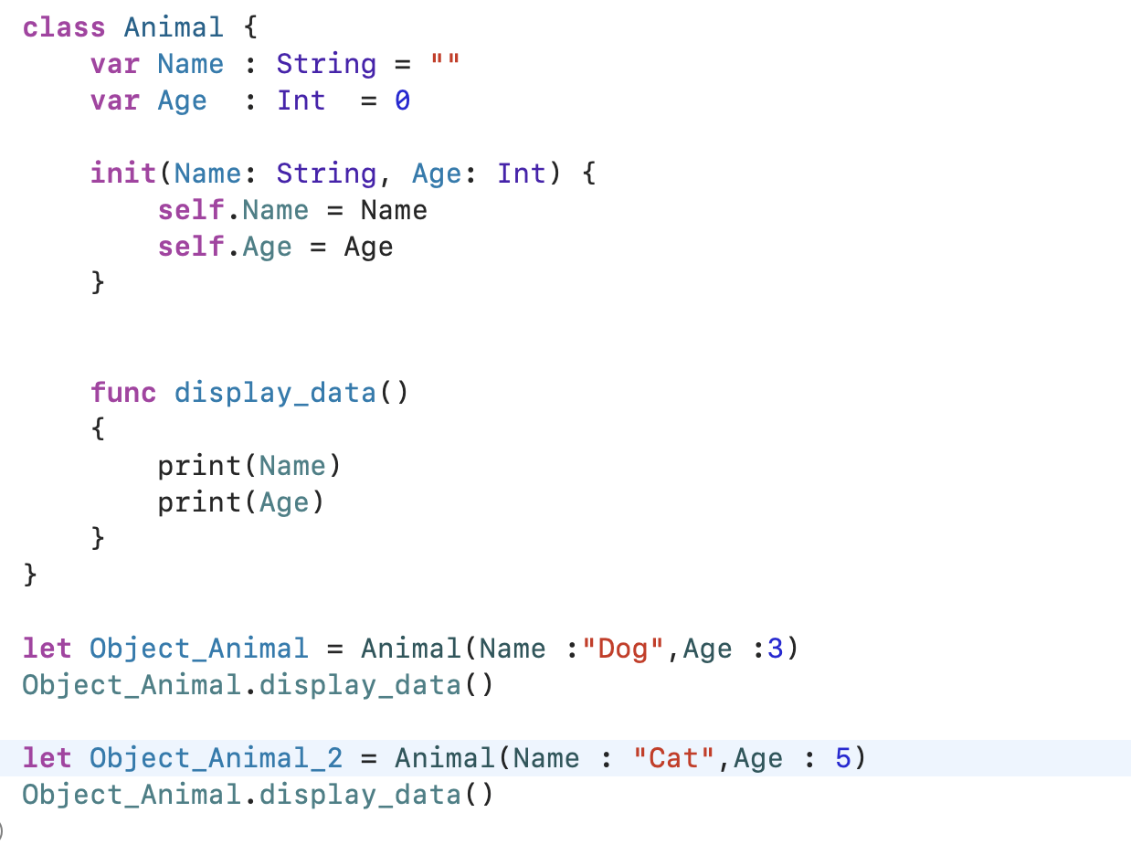
Example : Intializers in Class

Slide 11
Question Arise : What is Self which we are using in init() method !
‘self’ Keyword in swift : -
  Self refer to current instance or instance right here.
  usage of self :
    Accessing own properties or methods
    calling own methods
    inside closures
    in structures
    refer current instance
  We understood the self keyword, right ! so let’s explore one more keyword ... ready ? - but we will se that after one concept which is Inheritance...

Slide 12
Inheritance in Swift
Definition : Inheritance refers to acquire the properties, methods and intializaers of one class to anthor class.
the class from which another is acquiring these things that is knows as Super class and the class who is aquiring that is known as Child or Sub Class.
this acquiring process is known as Inheritance.

Slide 13
Swift Base Class
the class which the class that does not inherit properties, methods or function from any other class is called as Base Class.
it is also known as Super and Master Class.

Slide 14
Swift Sub Class
in swift, a class which inherting properties or methods from other existing class is called as a sub class.
we can also achive an overrding. (we can override proerties, methods and init’s as well!)
Syntax :
  class subclass_name : super_class_name {
    // subclass implementation goes here.
  }
  Note : using ‘:’ , we can inherit the super class.

Slide 15
Swift Overrding
Overrding is the process in which subclass is fully responsible to change or reimplementation the instance method , instance property and type property which is define in parent class or superclass.
a subclass provides fully custom implementation for any type including instance method or property of super class based on requirements.
Keyword : override - which will tells the compiler to check the overriding method or property definition matches with the base class or not.

Slide 16
Syntax of Overriding
class Sample_1 {
  // Implementation goes here
  func display()
  {
    // Code goes here
  }
}
class Sample_2 : Sample_1{
  override func display(){
    // New code can go here
  }
}

Slide 17
Example
class Base{
var Name : String = ""
init(Name : String){
self.Name = Name
}
func display()
{
print(Name)
}
}
class Child : Base {
override func display() {
print("an Extra Display Definition can go here")
super.display()
}
}
let obj_1 = Child(Name: "Suratwala")
obj_1.display()
OUTPUT
an Extra Display Definition can go here
Suratwala

Slide 18
‘Super’ Keyword in Swift
We can access super class members using the super keyword in Swift.
To access a super class variable, we can use super.(variablename)
To access a super class method, we can use super.(methodname())
To access a super class constructor, we can use convenience initializer in subclass constructor.

Slide 19
Swift Protocols
Protocols are used to define a skeleton of classes, structues and methods that would require other types to implement a defined classes, methods and properties.
the defined protocol adopted by other classes or methods to provide an actual implementation of defined properties and methods.
If we worked on other programming languages the term protocol is similar to interfaces in java and C#.
Keyword : protocol to define the protocol.

Slide 20
Syntax : Protocol
protocol protocol_name {
  // Definition foes here
}
// Inheriting protocol (Single)
struct full_name_of_structure : First_Name_Protocol{
  // Body Goes here
}

Slide 21
Syntax : Protocol
// Inheriting Multiple Protocol
struct full_name_of_Structure : Protocol1_Name , Protocol2_Name {
  // body goes here
}
// Note : the symbol ‘:’ is indicating that this type is going to inherit this protocol or class.

Slide 22
Implementing Protocol to Protocol
Swift also provide the functionlity to implement protocol to another protocol.
Syntax : Similar to Extending a Protocol to Class.
protocol A {
  // Definition goes here
}
protocol B : A{
  // definition goes here
}

Slide 23
Multiple Protocol Inheritance
protocol A {
func a()
}
protocol B {
func b()
}
protocol C: A, B {
func c()
}

Slide 24
Swift Extensions
In swift, Extension is the process of extending the functionality of an existing classes, structures, enumerations or protocol types by adding a new functionalities.By using extensions we can extend the functionality of types which we don’t have access to
the original source code. In swift, extensions can provide the following functionalities.
• It can add a computed type instance properties
• It can define an instance and type methods
• Define a new nested types and subscripts.
Keyword : extension

Slide 25
Syntax : Extension in Swift
extension Name_of_Type {
  // New Functionlity and types
}
// Implementing or Extending to an Extension
extension Name_of_Type : Protocol_1, Protocol_2{
  // Implementation goes here
}

Slide 26
Swift Extend Computed Properties
Computed properties are those properties which are calculated each and evry time in out code but i will not able to store the values.
It can be use in a Class, Structures and enumerations.
Extension allow user to add computed properties and computed type proeprties in the class.

Slide 27
Example : Extension in Swift
extension String {
func shout() -> String {
return self.uppercased()
}
}
// USAGE
let text = "hello"
print(text.shout())

Slide 28
Swift Intialization
Intialization is a Special type of method in a class , stucture or enum and it is responsible for making sure a newly created instance of class , stucture or enum is fullt intializaed and perform other tasks that is required new instance is ready for use in out application.
Syntax :
  init(){
  // Intialization must go here
  }

Slide 29
Types of Intialization
1. Default parameter
2. init() with no parameter
3. init() with single parameter
4. init() with multiple parameter

Slide 30
1. Default Parameter
struct User {
var name: String
var age: Int
init(name: String = "Guest", age: Int = 18) {
self.name = name
self.age = age
}
}

Slide 31
2. init() without Parameter
struct User {
var name: String
var age: Int
init() {
self.name = "Guest"
self.age = 18
}
}

Slide 32
3. init() with single parameter
struct User {
var name: String
var age: Int
init(name: String) {
self.name = name
self.age = 18
}
}
User(name: "Ruta")

Slide 33
4. init() with multiple parameter
struct User {
var name: String
var age: Int
init(name: String, age: Int) {
self.name = name
self.age = age
}
}
User(name: "Ruta", age: 21)

Slide 34
Swift Enumeration
Enum is a datatype which consist a set of related values and it allows us to use those defined values in our code in a type-safe manner.
Syntax :
  enum enumname {
    //case A
    //case B
    // Case N
  }

Slide 35
Basic Example of ENUM
enum TrafficLight {
case red
case yellow
case green
}
var signal = TrafficLight.red
signal = .green
Swift already knows type, so no need to write full name

Slide 36
Using enum with switch case - from ChatGPT
switch signal {
case .red:
print("Stop 🚫")
case .yellow:
print("Slow down ⚠️")
case .green:
print("Go 🚀")
}

Slide 37
Enum with Raw Values
enum Weekday: String {
case mon = "Monday"
case tue = "Tuesday"
case wed = "Wednesday"
}
let day = Weekday.mon
print(day.rawValue)

Slide 38
ENUM with Associated values
enum Result {
case success(String)
case failure(String)
}
let response = Result.success("Data loaded")
switch response {
case .success(let message):
print(message)
case .failure(let error):
print(error)
}

Slide 39
ENUM with Methods
enum Direction {
case north, south, east, west
func move() {
print("Moving \(self)")
}
}
Direction.north.move()

Slide 40
Structures in Swift
structures are used to construct building blocks of out programming code and we can extend functionlity of structures by defining different type of properties and methods.
Keyword : struct
Structure can also define the constants , variables adn functions.
Structure is value type whereas Class is Reference type.

Slide 41
Similarities between structure and classes
Defining properties to hold values
Defining methods to implement required functionlity
Defining intializaers
Defining type methods
Defining Subscripts, Protocols, Extensions

Slide 42
Facts about Structure
In swift, stuctures are always copied when they are passed around in our code because when we assign same structure to multiple variables and if we modify one, only that value alone will change, not others because each new variable was a copy of the original , not a reference.
Unlike other programming languages we do not need to create any separate interface or implementation files for structures.
In swift when we create a structures in a single file automatically that class file will be available for other code blcoks to use that functionality in applications.

Slide 43
Syntax : Structure in Swift
struct Structure_Name {
  // Variables
  // Methods
  // Properties
}
//Instances of Structure
var/let object_name = structure_name()

Slide 44
Example : Structure in Swift
struct User {
var name: String
var age: Int
func greet() {
print("Hi, I'm \(name)")
}
}
let user1 = User(name: "Ruta", age: 21)
print(user1.name)
print(user1.age)

Slide 45
Key Points about Structure : Need to Remember - IMP
Structure are value type. hence when are are passing the value to variables the originaal value will remain same.
by using ‘.’, we can access all the named types which is declared in the Structure. (like Properties, methods...)
Structure are having default init() but we can also define the custom init() method.
At init() level, it is mendatory to intialized defined properties with values.

Slide 46
Difference Between Class and Structure - chatGPT
Feature | Structure (struct) | Class
Type | Value type 📋 | Reference type 🔗
Memory behavior | Copies data | Shares same object
Speed | Faster ⚡ | Slightly slower
Inheritance | ❌ Not allowed | ✅ Allowed
Multiple objects | Independent copies | Same reference
let behavior | Fully immutable | Only reference fixed
Deinitializer (deinit) | ❌ No | ✅ Yes
ARC (memory mgmt) | ❌ No | ✅ Yes
Mutating methods needed | ✅ Yes | ❌ No
Best for | Simple data | Complex logic

Slide 47
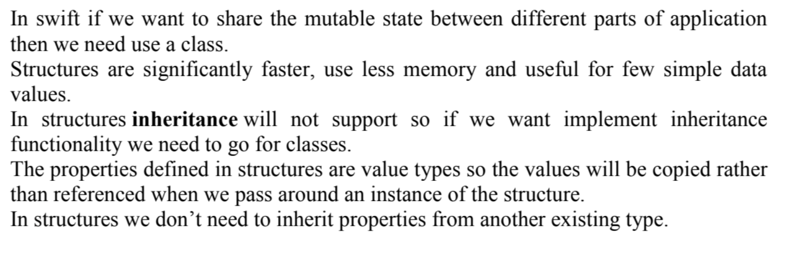
When to Use Classes and Structure ?

Slide 48
Thank you
Vraj Suratwala, Department of ICT, VNSGU
Module_2 will cover remaining topics....

