Slide 1
LoRa , LPWAN & LoRaWAN
Vraj Suratwala
Department of ICT, VNSGU

Slide 2
What is LoRa ?
LoRa® is a wireless modulation technology used for long-range communication.
Traditional wireless systems often use FSK (Frequency Shift Keying) because it provides low power consumption. LoRa® uses Chirp Spread Spectrum (CSS) modulation.
LoRa® provides low power consumption like FSK, but offers a much longer communication range. Chirp Spread Spectrum is also resistant to interference and has been used for many years in military and space communication.
In simple words:
LoRa = Low Power + Long Range + High Resistance to Interference
LoRa® made this long-range, interference-resistant technology low-cost and suitable for commercial IoT applications.

Slide 3
LoRa
The main advantage of LoRa® is its very long communication range.
A single gateway or base station can cover an entire city or even hundreds of square kilometers.
However, the actual range depends on the environment and obstacles in the area. LoRa® and LoRaWAN™ have a very high link budget, which helps them achieve greater communication distances.
Link budget is usually measured in decibels (dB) and is an important factor in determining how far a wireless signal can travel.
Because LoRa® provides such a long range, large areas or even entire countries can be covered using relatively few gateways.
In simple words:
LoRa® → Very Long Range + Few Gateways + Large Area Coverage

Slide 4
Where Does LPWAN Fit?
LPWAN (Low Power Wide Area Network) is a wireless communication technology designed for IoT applications that need to send small amounts of data over long distances while consuming very little power.
No single wireless technology is suitable for every IoT application. Different technologies are used according to the range, data requirements and power availability of the application.

Slide 5
Technology Best Suited For Main Characteristic
Wi-Fi Personal devices Widely adopted for personal connectivity
and local networks
Bluetooth Low Personal devices and Low-power personal-device communication
Energy (BTLE) short-range communi
cation
Cellular Applications requiring
high data throughput Suitable when a power source is available
LPWAN Long-range IoT
sensors Low power, long range and small data transmission

Slide 6
Why LPWAN is Important
  LPWAN is designed for sensors and IoT applications that:
  Need long communication distances
  Send small amounts of data
  Transmit data a few times per hour
  Require multi-year battery life
  Operate in different environments
Simple Example
  Imagine a smart agriculture system with sensors placed across a large farm.
  The sensors may send temperature or soil-moisture readings only a few times per hour. They do not need to transmit large amounts of data, but they need to communicate over long distances while running on batteries.

Slide 7
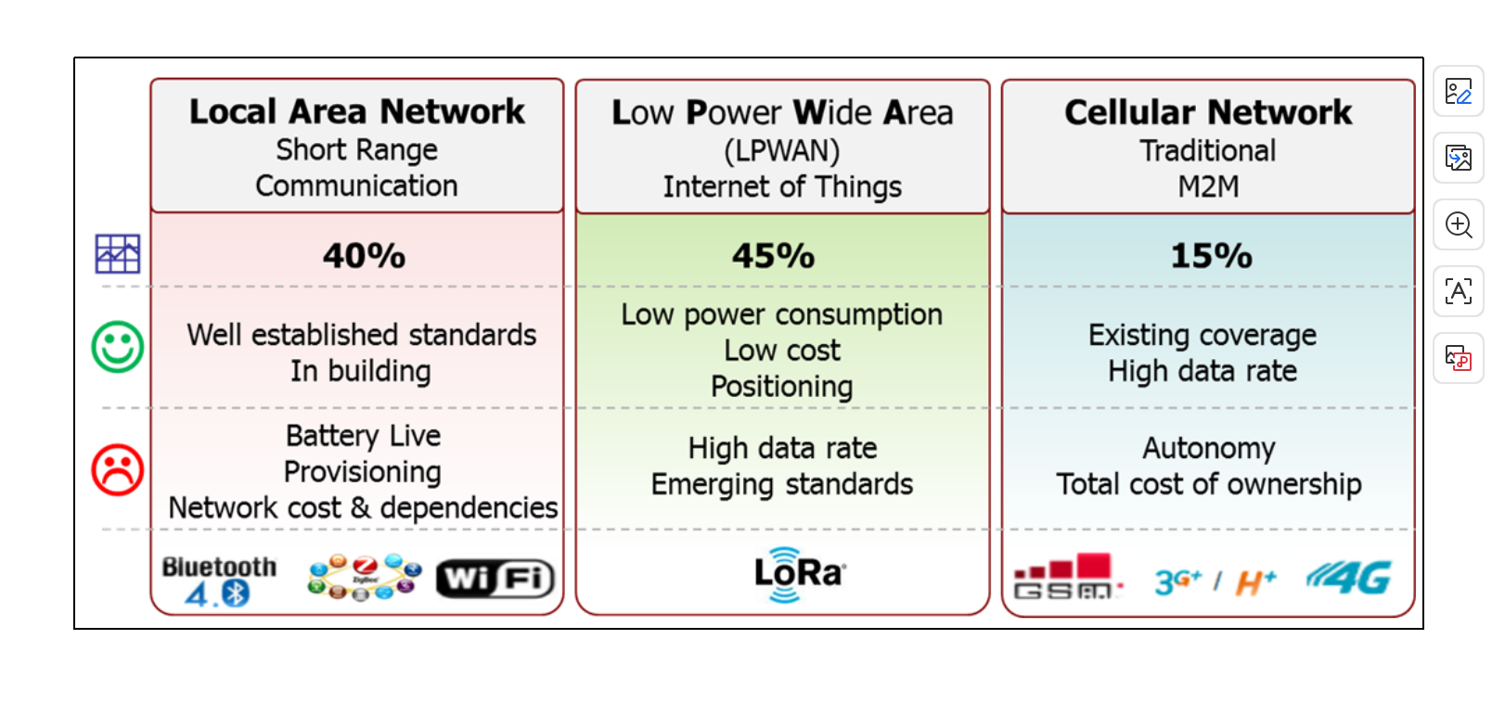
Basic Understanding Diagram

Slide 8
The most critical factors in a LPWAN are:
• Network architecture
• Communication range
• Battery lifetime or low power
• Robustness to interference
• Network capacity (maximum number of nodes in a network)
• Network security
• One-way vs two-way communication
• Variety of applications served

Slide 9
WHAT IS LoRaWAN ?
LoRaWAN™ defines the communication protocol and system architecture for the
network while the LoRa® physical layer enables the long-range communication link.
The protocol and network architecture have the most influence in determining the
battery lifetime of a node, the network capacity, the quality of service, the security,
and the variety of applications served by the network.

Slide 10
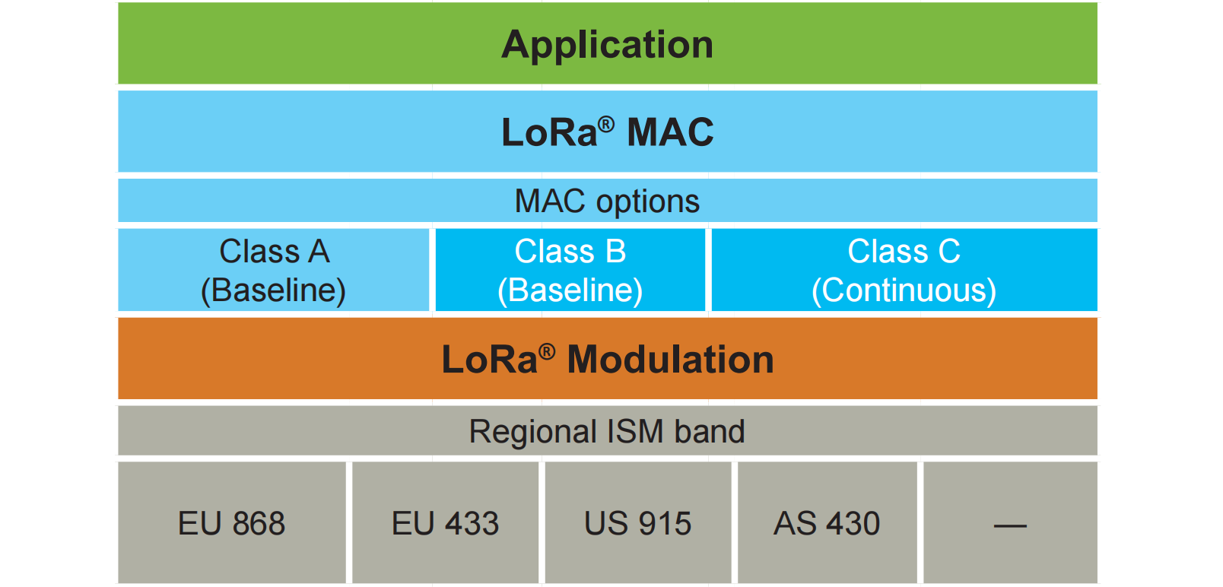
Architecture

Slide 11
Network Architecture
Many existing deployed networks utilize a mesh network architecture. In a mesh
network, the individual end-nodes forward the information of other nodes to
increase the communication range and cell size of the network. While this increases
the range, it also adds complexity, reduces network capacity, and reduces battery
lifetime as nodes receive and forward information from other nodes that is likely
irrelevant for them. Long range star architecture makes the most sense for preserving
battery lifetime when long-range connectivity can be achieved.

Slide 12
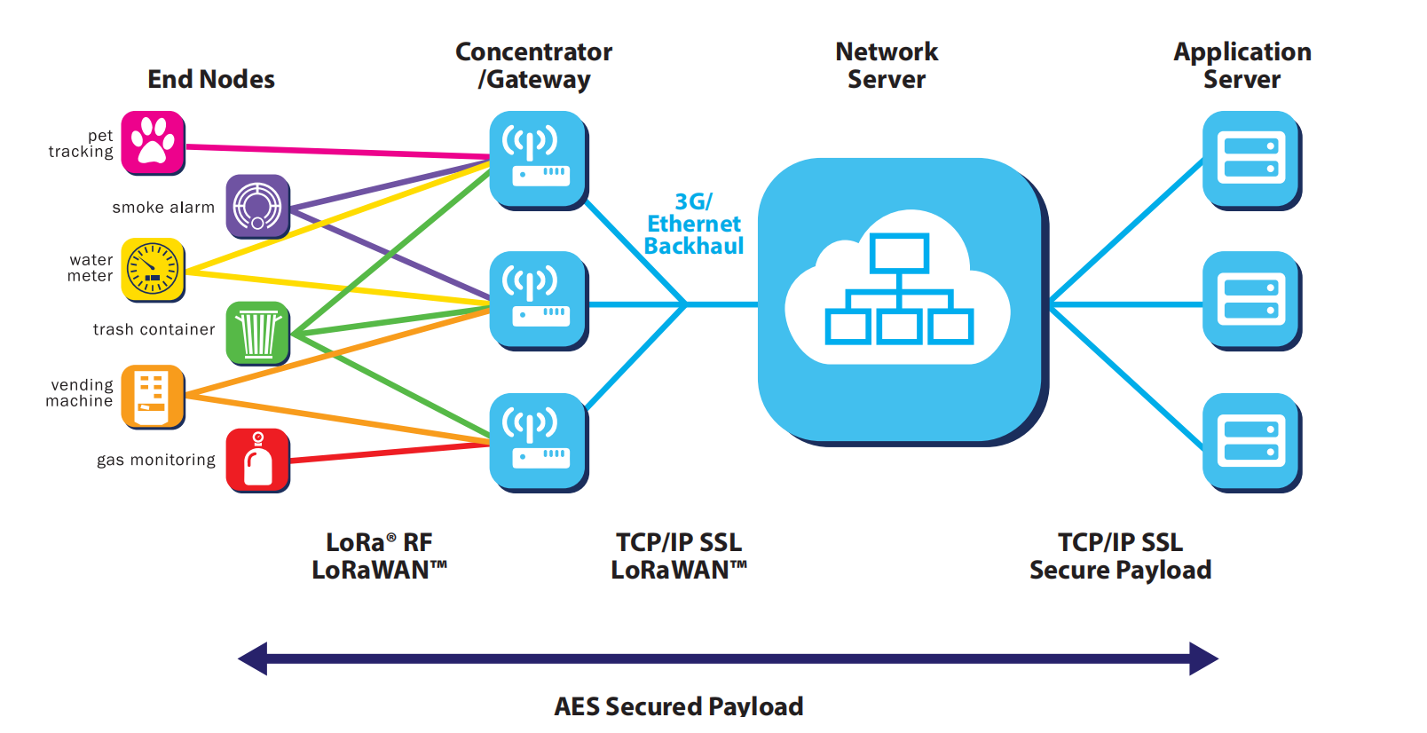
Networked Architecture

Slide 13
Important Features
1. Network Architecture
  In LoRaWAN, a node is not connected to one specific gateway. Its data can be received by multiple gateways. The gateways forward the data to a cloud-based network server, which:
  Removes duplicate packets
  Performs security checks
  Selects the suitable gateway for acknowledgements
  Manages adaptive data rate
For mobile nodes, gateway-to-gateway handover is not required, making LoRaWAN suitable for asset tracking

Slide 14
2. Battery Lifetime
LoRaWAN uses an asynchronous ALOHA-type communication method. Devices transmit only when they have data instead of continuously waking up to synchronize with the network.
This significantly reduces power consumption and provides long battery life.
  LoRaWAN → Low synchronization → Low power → Long battery life
3. Network Capacity
LoRaWAN can support a large number of nodes.
It uses:
  Adaptive Data Rate (ADR)
  Multiple channels
  Multi-modem gateways
  Different spreading factors
  ADR allows nearby devices with good connectivity to use a higher data rate, reducing transmission time and leaving more capacity for other devices.
Therefore, LoRaWAN networks are scalable—additional gateways can be added when more capacity is required.

Slide 15
4. Device Classes
LoRaWAN has three device classes based on the trade-off between battery life and downlink latency:
Class Main Feature Battery
Class A Downlink only after uplink transmission Highest efficiency
Class B Scheduled receive windows using gateway beacon Moderate
Class C Almost continuously listening Highest power consumption
5. Security
LoRaWAN provides two layers of security:
  Network security → Ensures the authenticity of the device/node.
  Application security → Protects application data from unauthorized access by the network operator.
It uses AES encryption for security.

Slide 16
Thank You
Vraj Suratwala
Department of ICT, VNSGU

