Slide 1
Introduction to Open-Source Tools Supported by Raspberry Pi for IoT
Vraj Suratwala
Department of ICT, VNSGU

Slide 2
Introduction
Raspberry Pi Foundation's Raspberry Pi is a low-cost, small-sized single-board computer (SBC) that is widely used for IoT (Internet of Things) applications.
Raspberry Pi supports many open-source tools, operating systems, programming languages, libraries, frameworks, and IoT platforms. These tools allow developers to connect sensors and actuators, collect data, process information, communicate with other devices, and build IoT applications.

Slide 3
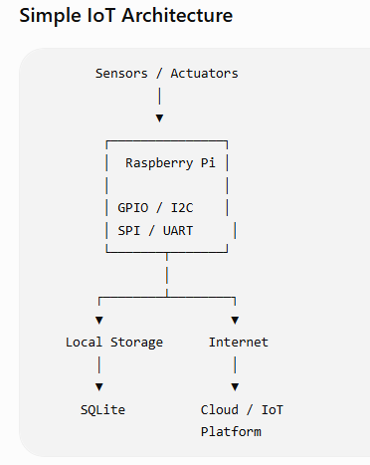
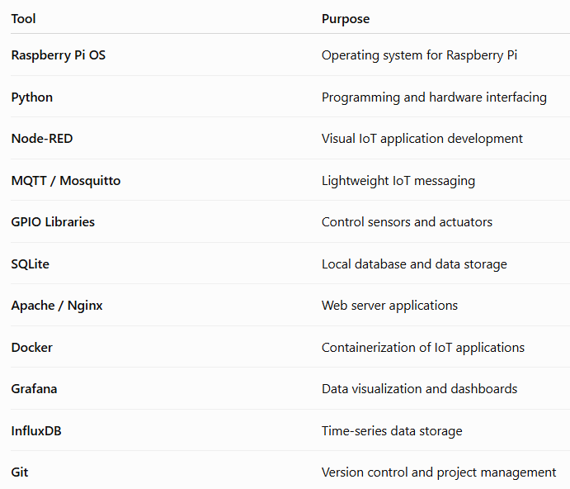
Simple IoT Architecture

Slide 4
Raspberry Pi OS
Raspberry Pi OS is the official operating system designed for Raspberry Pi computers. It is based on Debian Linux and provides a complete environment for developing and running IoT applications.
Features
  Linux-based open-source environment
  Supports Python and other programming languages
  Provides command-line and graphical interfaces
  Supports GPIO and hardware interfaces
  Supports networking and Internet connectivity
  Suitable for IoT and embedded applications
Example
A user can install Python packages and run an IoT program directly on Raspberry Pi OS.

Slide 5
Python
Python is one of the most commonly used programming languages for Raspberry Pi IoT development.
It can be used to:
  Read sensor values
  Control LEDs and motors
  Communicate with IoT devices
  Process sensor data
  Connect to databases
  Send data to cloud platforms
Example
  print("IoT Application Running")

Slide 6
Node-RED
Node-RED is an open-source, flow-based programming tool that is particularly useful for IoT applications.
Instead of writing large amounts of code, developers can create applications by connecting nodes in a visual flow.
Sensor
↓
[Input Node]
↓
[Process Node]
↓
[MQTT Node]
↓
Cloud / Database
Applications
Sensor monitoring
MQTT communication
Data processing
Automation
IoT dashboards
Home automation

Slide 7
MQTT and Mosquitto
MQTT (Message Queuing Telemetry Transport) is a lightweight messaging protocol designed for devices with limited resources and unreliable networks.
It uses a Publisher–Subscriber model.
MQTT Broker
/ | \
/ | \
Sensor Mobile Dashboard
Publisher Subscriber Subscriber

Slide 8
Mosquitto
Eclipse Mosquitto is an open-source MQTT broker that can run on Raspberry Pi.
For example:
  Temperature Sensor
  ↓
  MQTT Publish
  ↓
  Raspberry Pi
  Mosquitto Broker
  ↓
  MQTT Subscribe
  ↓
  IoT Dashboard

Slide 9
GPIO Libraries
Raspberry Pi provides GPIO (General Purpose Input/Output) pins that allow it to communicate with electronic components.
Python libraries can be used to control these pins.
For example:
Raspberry Pi
│
├── LED
├── Temperature Sensor
├── Relay
├── Motor
└── Button

Slide 10
GPIO Libraries
GPIO can therefore be used to:
  Read digital sensors
  Control LEDs
  Control relays
  Interface with actuators

Slide 11
Grafana and InfluxDB
InfluxDB
InfluxDB is a database designed particularly for time-series data, making it useful for continuously changing IoT sensor readings.
Example:
10:00 → 28°C
10:05 → 28.5°C
10:10 → 29°C
10:15 → 29.5°C
Grafana
Grafana can be used to create dashboards and visualize sensor data in graphs and charts.
Sensor
↓
InfluxDB
↓
Grafana
↓

Slide 12
Docker
Docker is an open-source containerization platform.
On Raspberry Pi, Docker can be used to run IoT services in separate containers.
For example:
  Raspberry Pi
  │
  ├── MQTT Container
  ├── Node-RED Container
  ├── Database Container
  └── Grafana Container
This makes IoT applications easier to deploy and manage.

Slide 13
Advantages of Open-Source Tools in Raspberry Pi IoT
Low cost — Most tools are freely available.
Customizable — Source code can be modified according to requirements.
Large community support — Many tutorials and libraries are available.
Easy integration — Tools can work together.
Cross-platform support — Many tools run on Linux and other platforms.
Rapid development — Ready-made libraries and frameworks reduce development time.
Suitable for prototyping — Excellent for experimenting with IoT ideas.

Slide 14
Thank You
Vraj Suratwala
Department of ICT, VNSGU

