Slide 1
Actuator
An actuator is a machine part that receives feedback from a control signal and then begins movement. The actuator makes distinct motions depending on the machine’s purpose once it receives electricity.

Slide 2
At least one actuator can be found in any portion of a piece of equipment or appliance that converts electrical energy into motion,
such as ventilation fans, blenders, or refrigerators. Actuators are also used in electric vehicles.
Stepper motors are a type of actuator that receives digital pulses and converts them into mechanical motion. Robots, smart tools, and automated cutting equipment all use stepper motors.
Hydraulic cylinders are linear motion devices that use a tube, piston, and rod to function. Bulldozers, backhoes, and excavators are examples of vehicles that use hydraulic action.
Source: https://www.linquip.com/blog/types-of-actuators/

Slide 3
ACTUATORS
Actuators are the devices which provide the actual motive force for the robot joints.
Actuators are the muscles of robots. If you imagine that the links and the joints are the skeleton of the robot, the actuators act as muscles, which moves or rotate the links to change the configuration of robots. The actuators must have enough power to accelerate and decelerate the links and to carry the loads, yet be light, economical, accurate, responsive, reliable and easy to maintain.
Actuators in robotic system basically consists of :
A power supply.
A power amplifier.
A servomotor.
A transmission system.

Slide 4
Actuator system
Pp : Primary source of power (Electric, Press.fluid, compress. Air)
Pc : Input control power usually electric .
Pa : Input power to motor Electric, Hydraulic, or Pneumatic.
Pm: Power output from motor.
Pu : mechanical power required
POWER
SUPPLIES
PP
POWER
AMPLIFIER
Pa
MOTOR
OR
SERVO MOTOR
Pm
TRANSMISSION
Pu
Pc
Pda
Pds
Pdt
Pds, Pdt , Pda : Powers lost in dissipation for the conversion performed by the Amplifier, Motor, Transmission

Slide 5
ISSUES/CHARACTERISTICS OF AN ACTUATOR
Load (e.g. torque to overcome own inertia)
Speed (fast enough but not too fast)
Accuracy (will it move to where you want?)
Resolution (can you specify exactly where?)
Repeatability (will it do this every time?)
Reliability (mean time between failures)
Power consumption (how to feed it)
Energy supply & its weight.

Slide 6
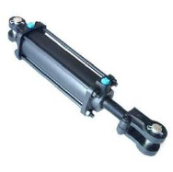
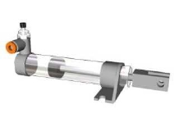
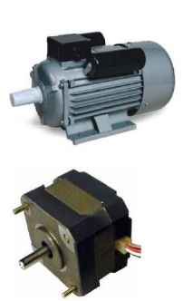
TYPES OF ACTUATORS
Based on the source of Input Power actuators are classified in to three groups :
Pneumatic Actuators.
These utilize pneumatic energy provided by the compressor and transforms it into mechanical energy by means of pistons or turbines.
Hydraulic Actuators.
These Transform the energy stored in reservoir into mechanical energy by means of suitable pumps.
Electric Actuators.
Electric actuators are simply electro-mechanical devices which allow movement through the use of an electrically controlled systems of gears

Slide 7
Pneumatic and Hydraulic Actuators
Both these actuators are powered by moving fluids.
In the first case, the fluid is compressed air and
In the second case, the fluid is pressurized oil.
Pneumatic systems typically operate at about 100lb/in2
Hydraulic systems at 1000 to 3000 lb/in2.
Both Hydraulic and Pneumatic actuators are classified as
linear Actuators (Cylinders).
Rotary Actuators (Motors).

Slide 8
Pneumatic and Hydraulic Actuators
linear Actuators

Slide 9
Pneumatic and Hydraulic Actuators
linear Actuators
The simplest power device could be used to actuate a linear joint by means of a moving piston.
There are two relationships of particular interest when discussing actuators:
The velocity of the actuator with respect to input power and
Force of the actuator with respect to the input power.

Slide 10
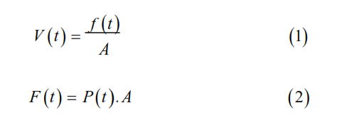
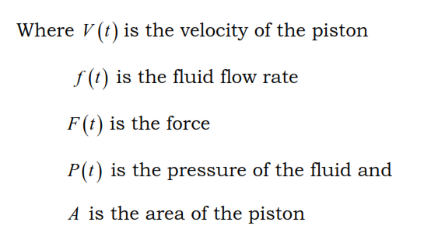
Pneumatic and Hydraulic Actuators
linear Actuators

Slide 11
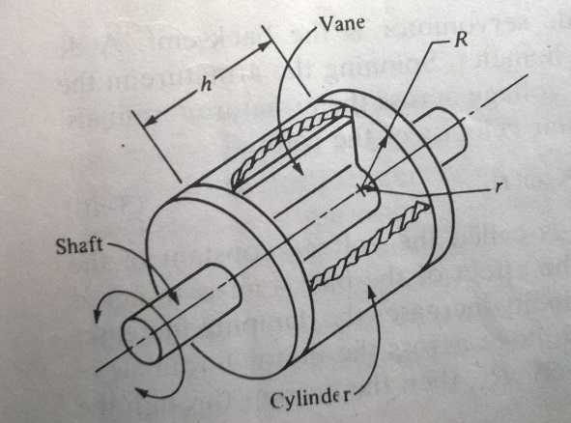
Pneumatic and Hydraulic Actuators
Rotary Actuators

Slide 12
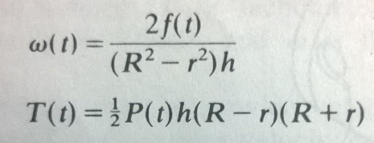
Pneumatic and Hydraulic Actuators
Rotary Actuators
There is a relationship of particular interest when discussing Rotary actuator:
The angular velocity, ω, and Torque, T.
R, outer radius of the vane., r, inner radius., h, thickness of the vane., ω, angular velocity., T, torque.

Slide 13
Advantages and limitations of Pneumatic actuators
ADVANTAGES
LIMITATIONS
It is cheapest form of all actuators. Components are readily available and compressed air normally is an readily available facility in factories.
Compressed air can be stored and conveyed easily over long distances.
They have few moving parts making them inherently reliable and reducing maintenance costs.
They have quick action and response time thus allowing for fast work cycles.
No mechanical transmission is usually required.
These systems are usually compact thus the control is simple e.g: mechanical stops are often used.
Since air is compressible, precise control of speed and position is not easily obtainable unless much more complex electro mechanical devices are incorporated in to system.
If mechanical stops are used resetting the system can be slow.
If moisture penetrates the units and ferrous metals have been used then damage to individual components may happen.

Slide 14
Advantages and limitations of Hydraulic actuators
ADVANTAGES
LIMITATIONS
High efficiency and high power to size ratio.
Complete and accurate control over speed position and direction of actuators are possible.
No mechanical linkage is required i.e., a direct drive is obtained with mechanical simplicity.
They generally have a greater load carrying capacity than electric and pneumatic actuators.
Self lubricating and non corrosive.
Hydraulic robots are more capable of with standing shock loads than electric robots.
Leakages can occur causing a loss in performance and general contamination of the work area. There is also a higher fire risk.
The power pack can be noisy typically about 70 decibel or louder if not protected by an acoustic muffler.
Changes in temp alter the viscosity of hydraulic fluid. Thus at low temperatures fluid viscosity will increase possibly causing sluggish movement of the robot.

Slide 15
Comparison of actuating systems
Hydraulic
+ Good for large robots and heavy payload
+Highest Power/Weight Ratio
+Stiff system, High accuracy, better response
+No reduction gear needed
+Can work in wide range of speeds without difficulty
+Can be left in position without any damage
Electric
+ Good for all size of Robots
+Better control, good for high precision robots
+Higher Compliance that Hydraulics
+Reduction gears used reduce inertia on the motor
+does not leak, good for clean room
+Reliable, low maintenance
Pneumatic
+ Many components are usually off-the-shelf
+Reliable components.
+No leaks or sparks
+Inexpensive and simple
+Low pressure compared to hydraulics
+ Good for on-off applications and for pick and place

Slide 16
Comparison of actuating systems
Hydraulic
- May leak. Not fit for clean room application
-Requires pump, reservoir, motor, hoses etc.
-Can be expensive and noisy, requires maintenance.
-Viscosity of oil changes with temperature
-Very susceptible to dirt and other foreign material in oil
-Low compliance
-High torque, High pressure, large inertia on the actuator.
Electric
+Can be spark-free. Good for explosive environment.
-Low stiffness
-Needs reduction gears, increased backlash, cost, weight, etc.
-Motor needs braking device when not powered. Otherwise, the arm will fail.
-
-
-
Pneumatic
+Complaint systems.
-Noisy systems.
- Require air pressure, filter, etc.
-Difficult to control their linear position
-Deform under load constantly
-Very low stiffness. Inaccurate response.
-Lowest power to weight ratio

