Slide 1
Sensors & Actuators
IoT
Vraj Suratwala

Slide 2
Introduction to Sensors
A sensor is a device that detects changes in the physical environment and converts them into signals that electronic systems can process.
1. Detection
2. Conversion
3. Transmission

Slide 3
Ultrasonic Sensors
An ultrasonic sensor is a device used to measure the distance between the sensor and an object using ultrasonic sound waves.
It sends a sound wave at a specific frequency toward an object. When the wave hits the object, it reflects back (echoes) to the sensor. The distance is calculated using the time taken by the sound wave to return.
The ultrasonic sensor works on the Echo / Time-of-Flight principle.
Basic principle:
Transmit → Sound travels → Hits object → Reflects → Echo received → Time measured → Distance calculated
The sensor emits an ultrasonic wave, typically around 40,000 Hz (40 kHz). If an obstacle is present in its path, the wave is reflected back toward the sensor. The sensor measures the travel time of this reflected wave

Slide 4
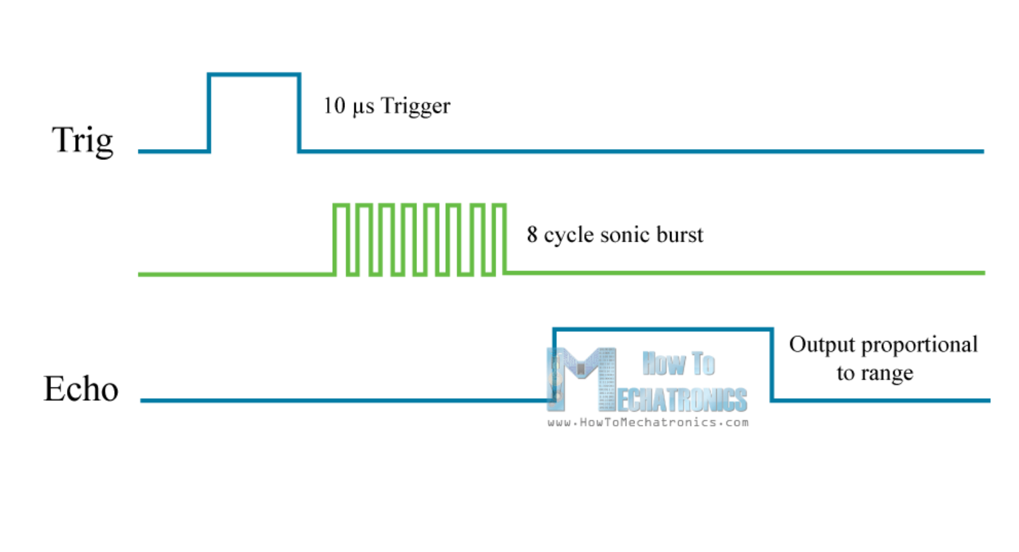
Diagram

Slide 5
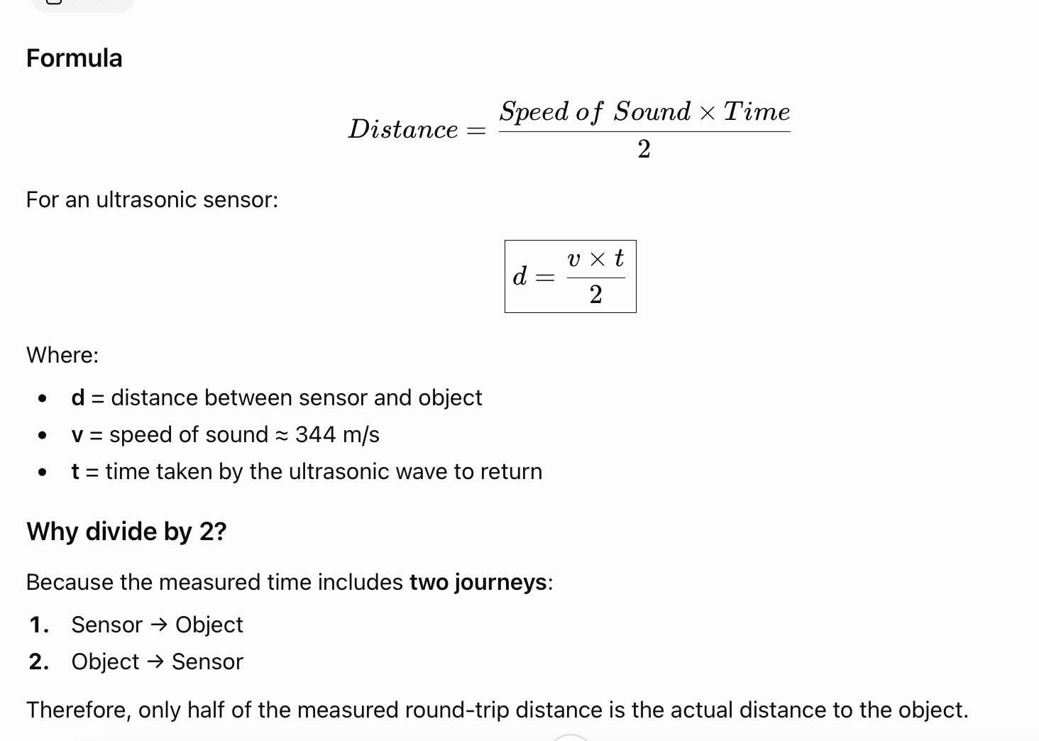
Distance Calculation

Slide 6
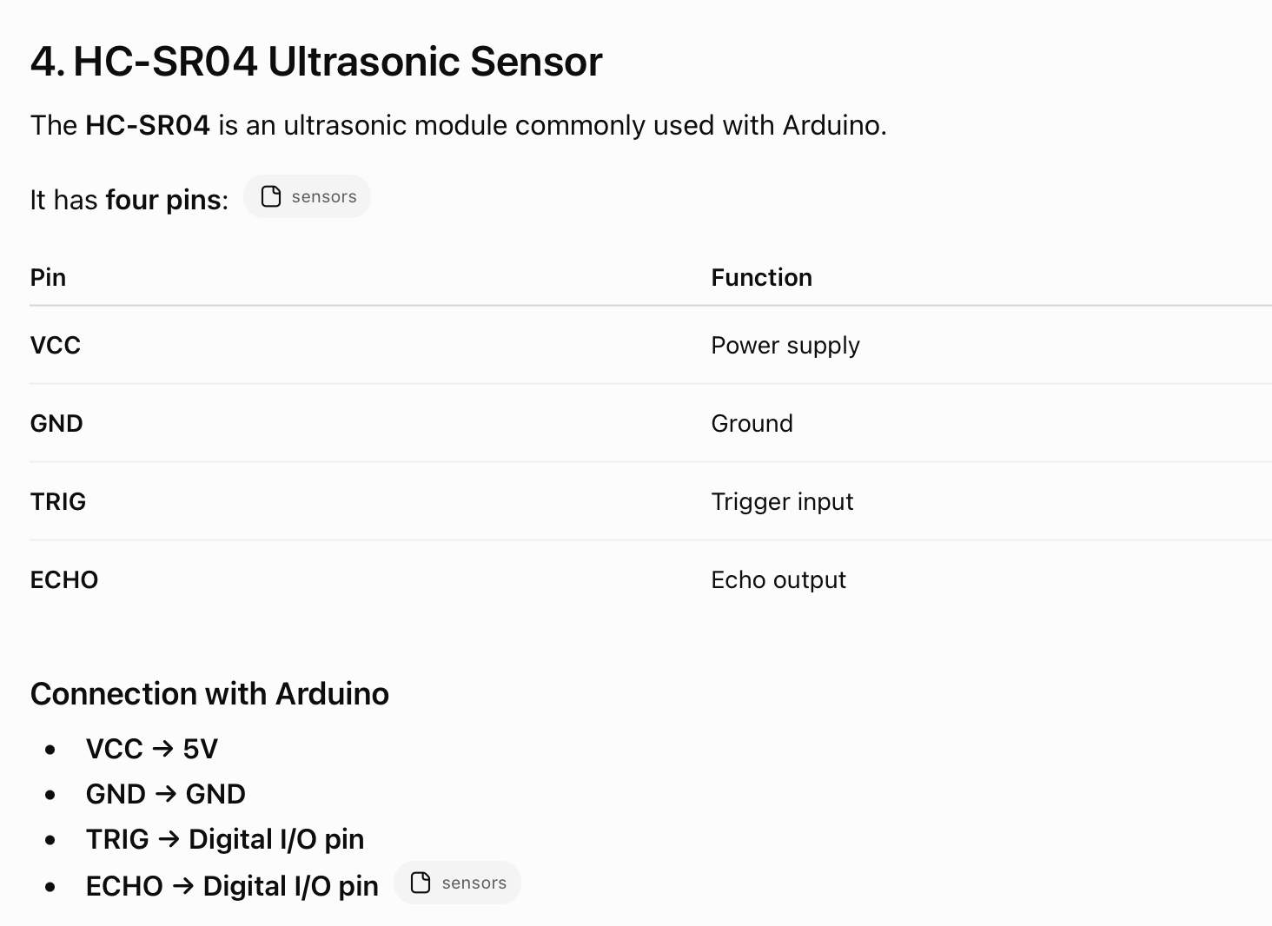
Configuration

Slide 7
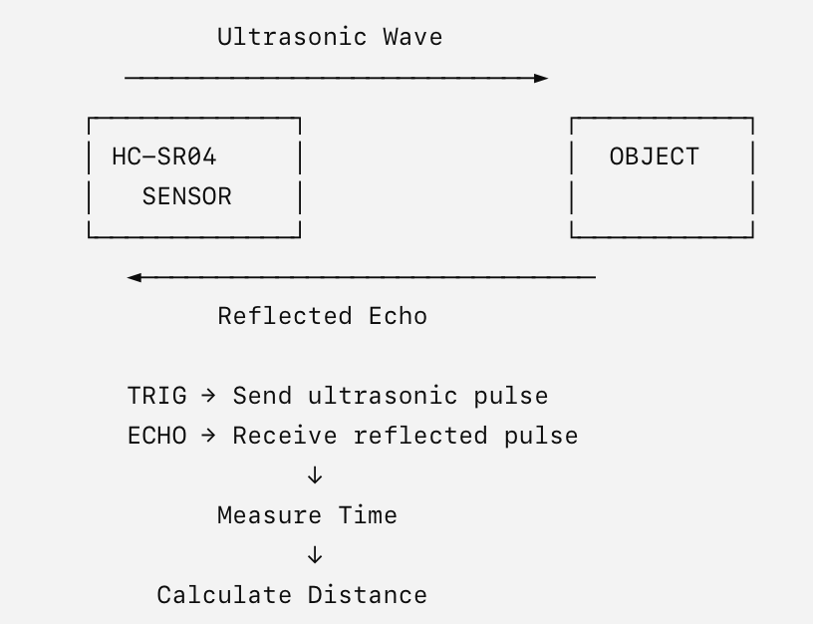
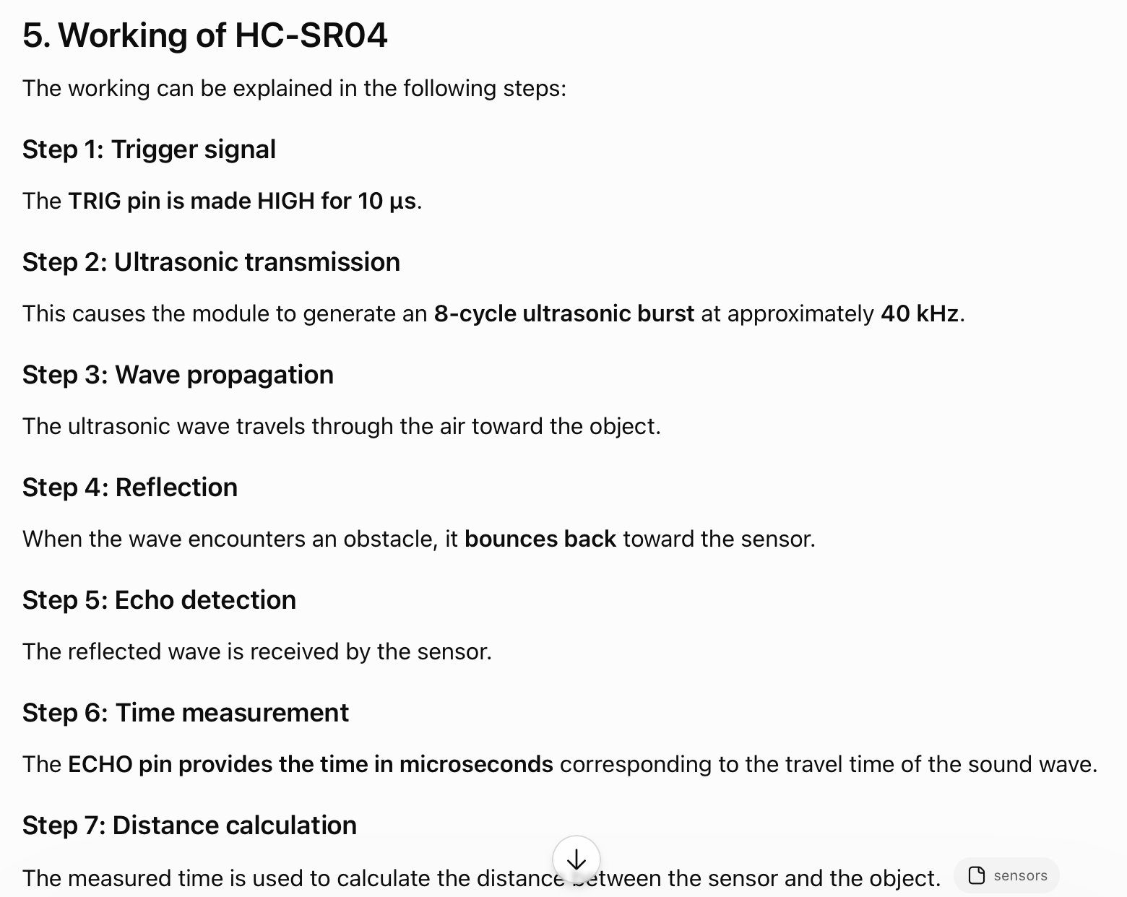

Slide 8
Advantages
It can measure the distance to an object without physical contact.
It uses sound waves rather than visible light.
It can detect objects/obstacles in its path.
The distance can be calculated from the measured echo time.

Slide 9
LDR (Light Dependent Resistor)
LDR (Light Dependent Resistor) is a light-sensitive resistor whose resistance changes according to the intensity of light falling on it.
For the most common type of LDR:
More light → Lower resistance
Less light / darkness → Higher resistance
Therefore, LDRs are used in light-sensing circuits.

Slide 10
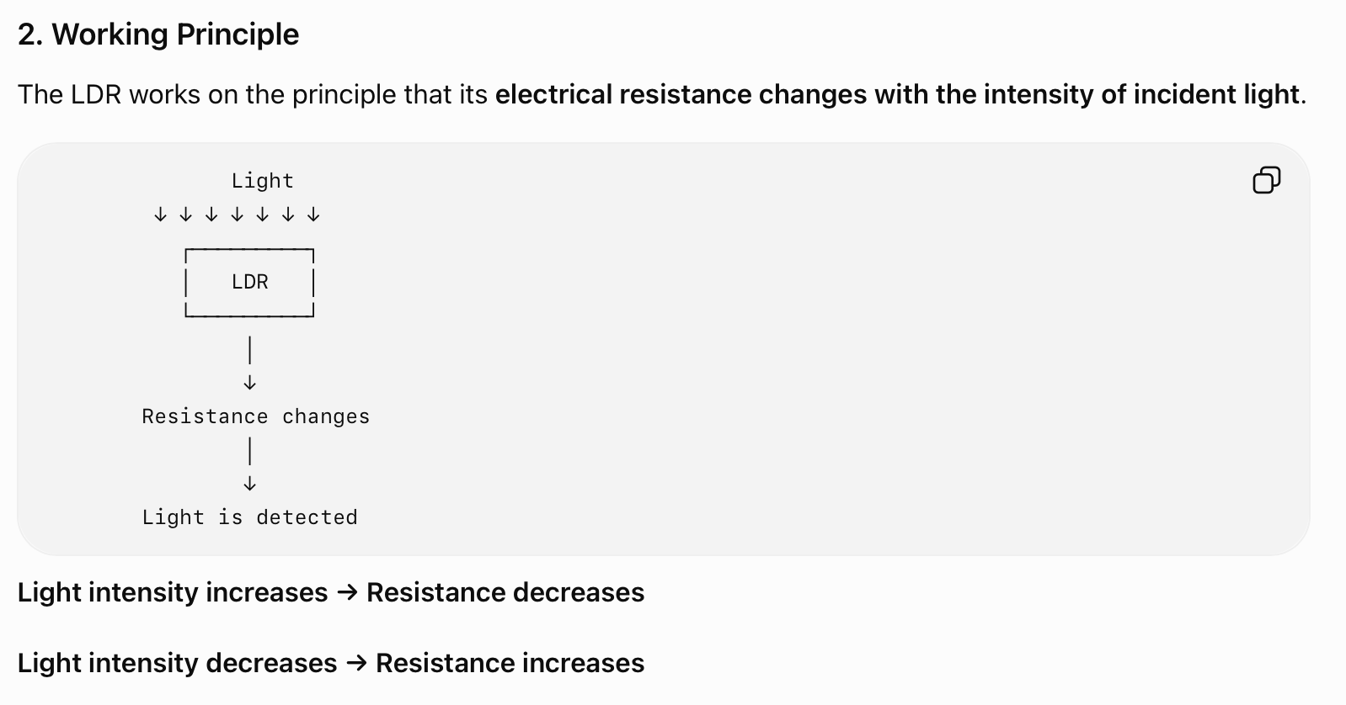
Working

Slide 11
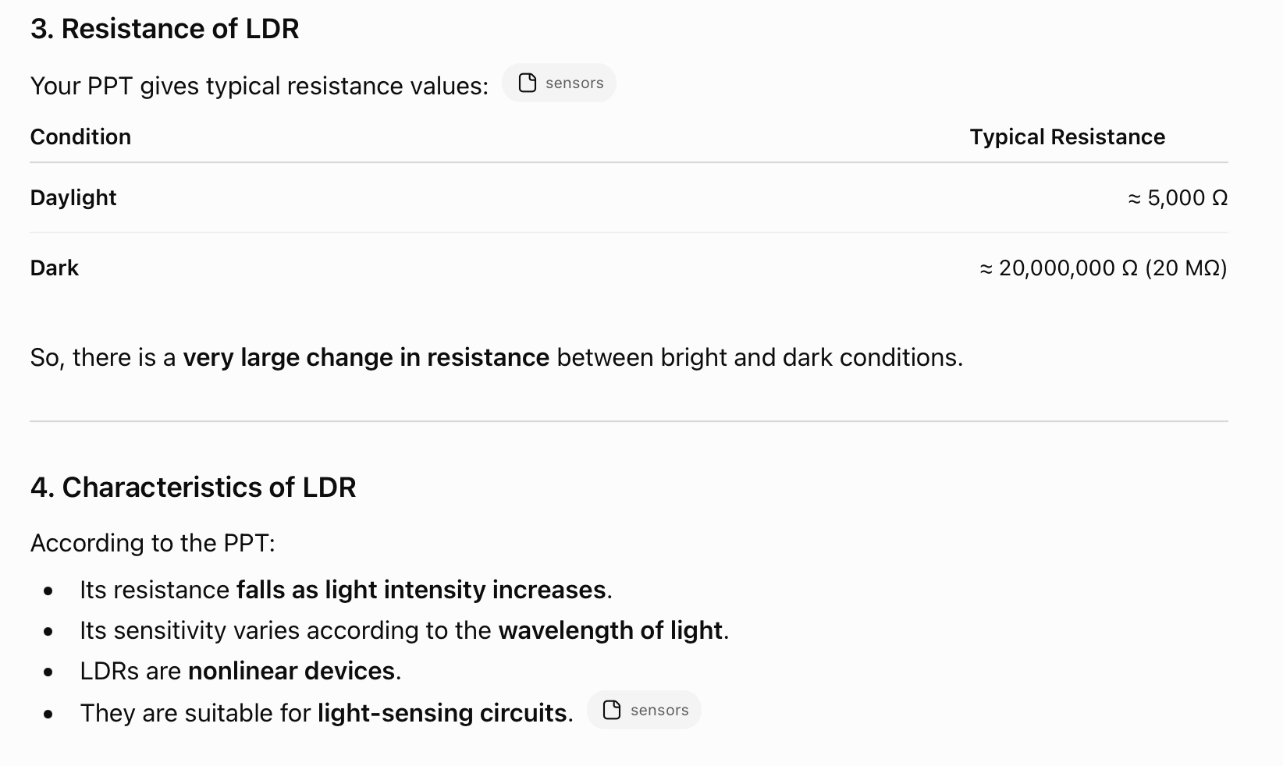

Slide 12
Construction
The PPT describes the manufacture of a cadmium sulfide (CdS) LDR.
Highly purified cadmium sulfide powder is mixed with inert binding materials.
The mixture is pressed and sintered.
Electrodes are vacuum evaporated onto the surface.
The electrodes form interleaving comb-like structures.
Connection leads are attached.
The disc is mounted inside a glass envelope or encapsulated in transparent plastic to prevent surface contamination.
The spectral response of CdS matches that of the human eye.

Slide 13
Application
The PPT specifically states that LDRs are used in light-sensing circuits.
Examples of light-sensing applications include:
Automatic light control
Light/dark detection
Automatic street-light systems
Light intensity sensing

Slide 14
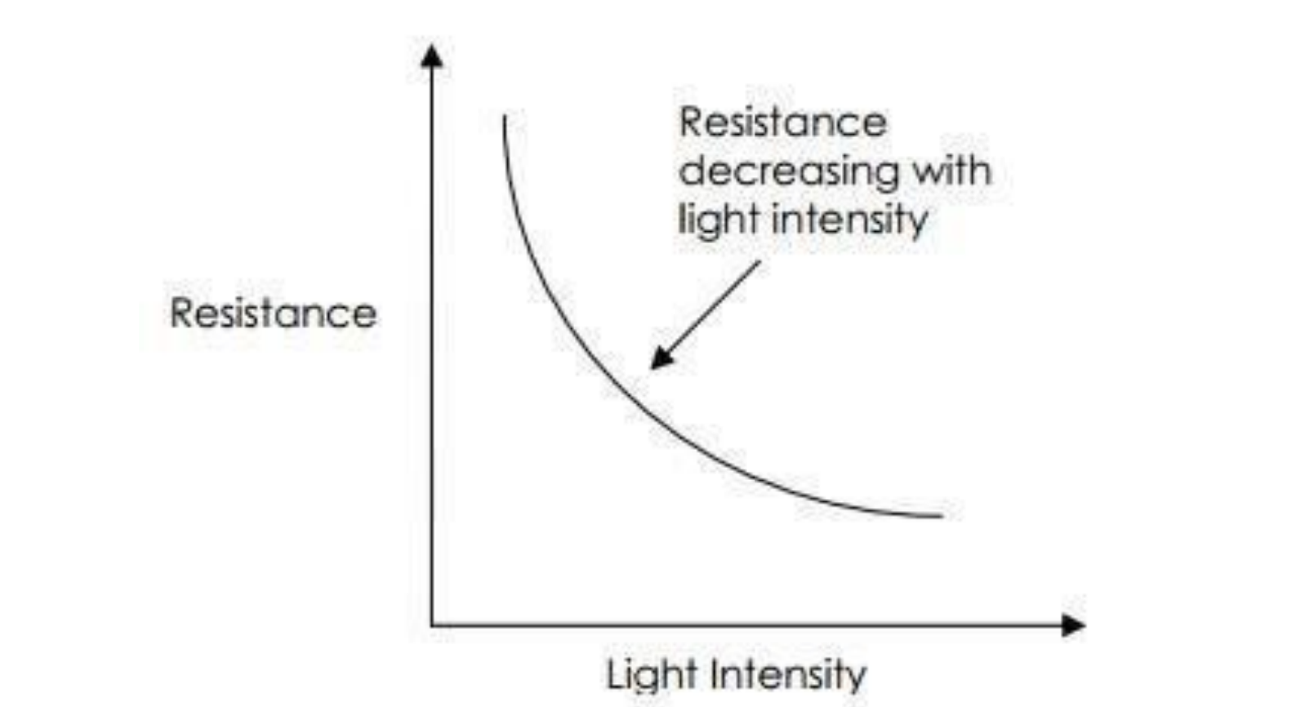
Graph

Slide 15
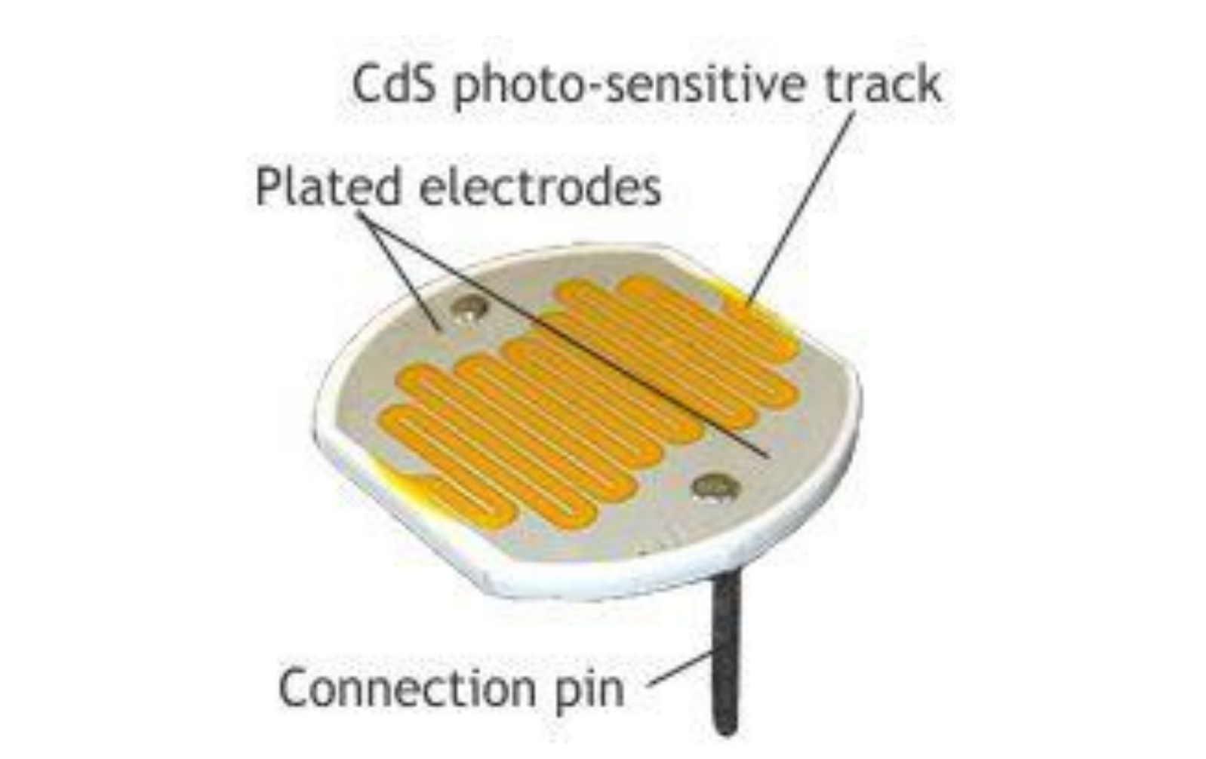
Diagram

Slide 16
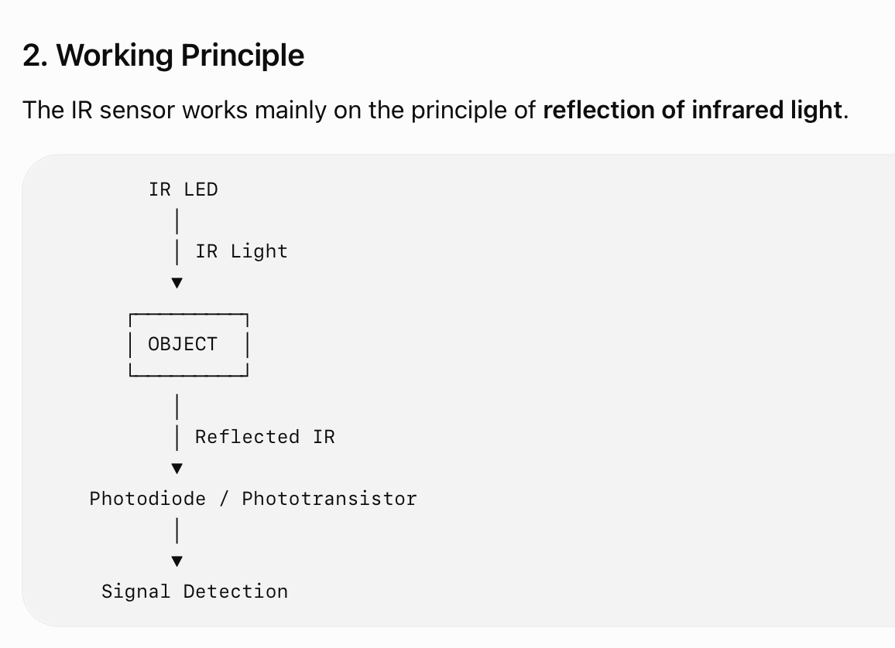
Infrared (IR) Sensor
An Infrared (IR) sensor is a sensor that uses infrared light to detect objects. It uses a light source, typically an IR LED, and a light-sensitive device such as a photodiode or phototransistor to detect the reflected IR ligh

Slide 17
Working Steps
1. IR emission:
An IR LED emits infrared light at a particular wavelength.
2. Light falls on object:
The emitted IR light travels toward the object.
3. Reflection:
If an object is close to the sensor, the IR light bounces/refects from the object.
4. Light detection:
The reflected light reaches the photodiode or phototransistor.
5. Intensity change:
The received light intensity increases significantly.
6. Object detection:
This change can be detected using a threshold, allowing the system to determine whether an object is present.

Slide 18
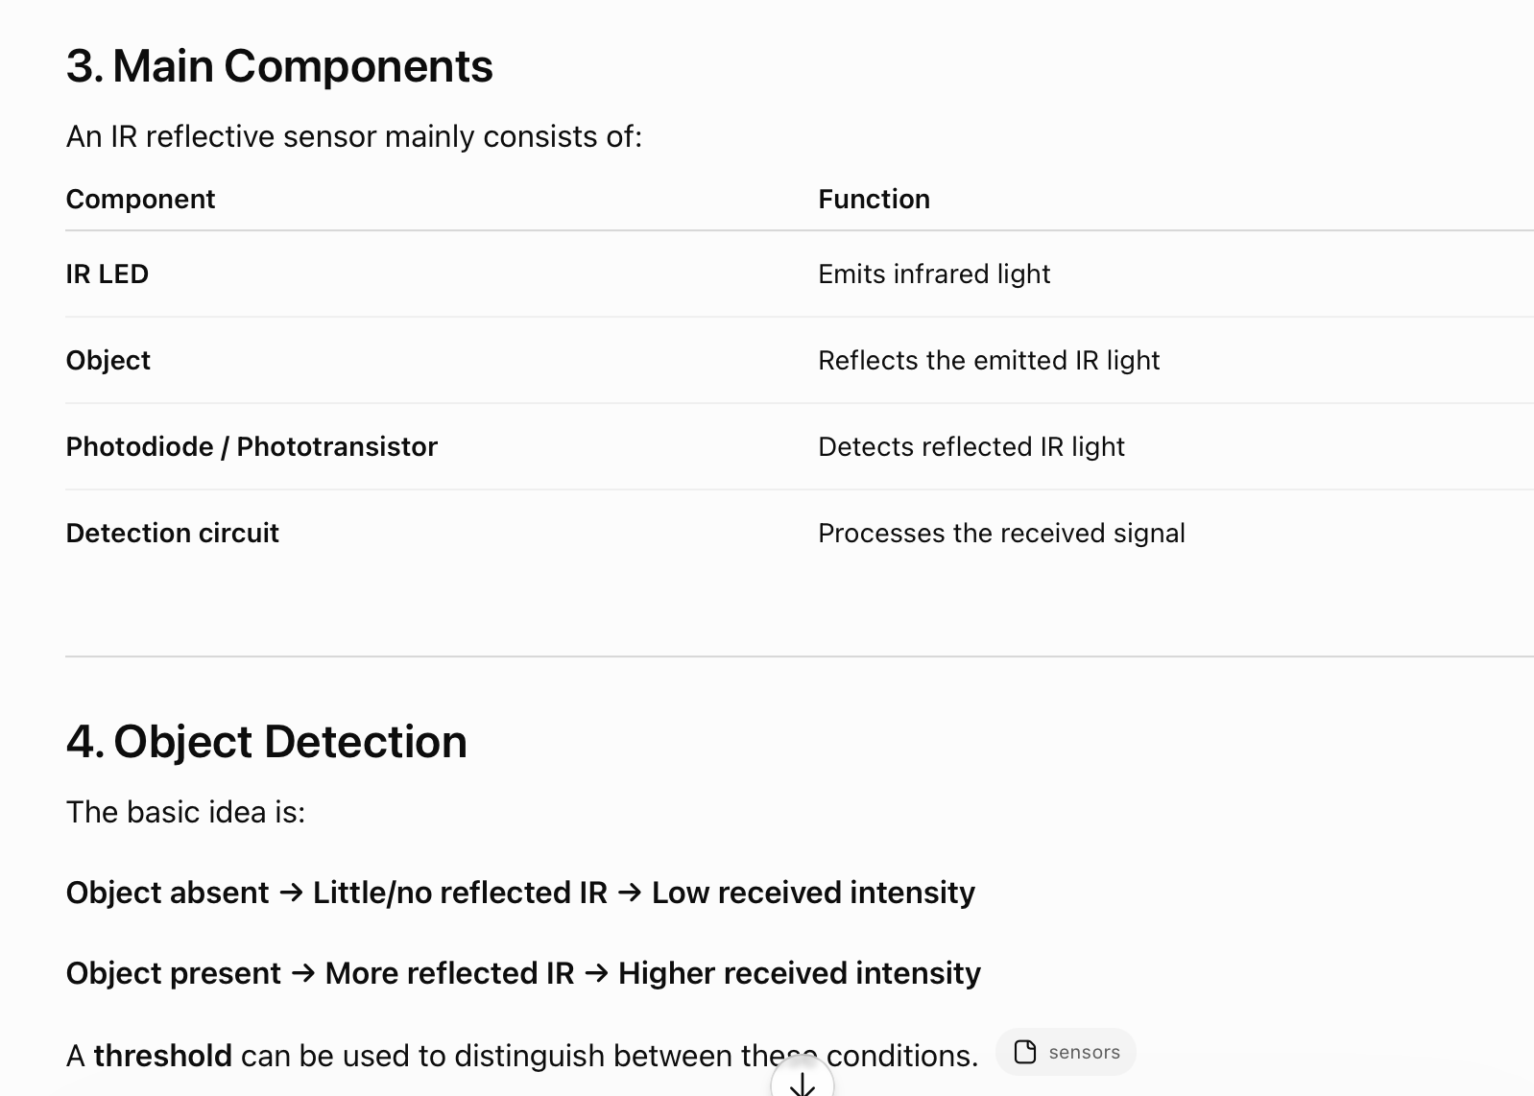

Slide 19
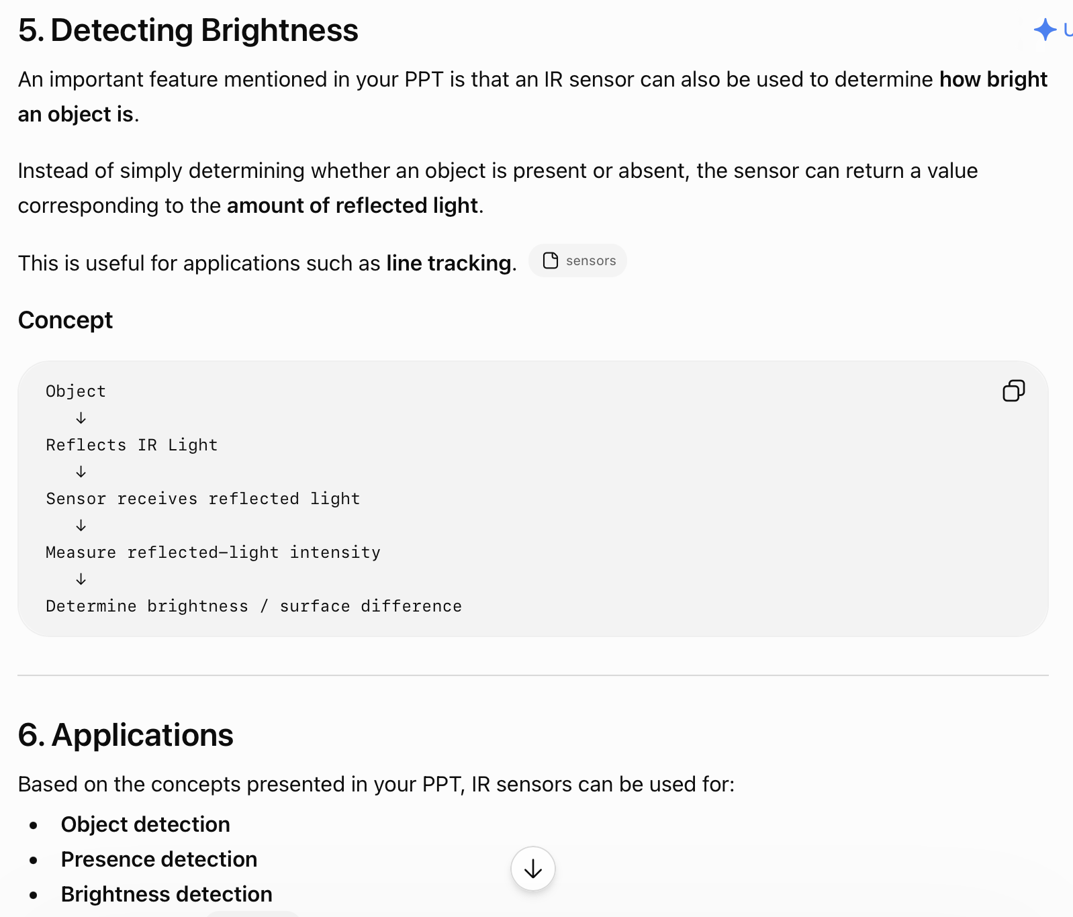

Slide 20
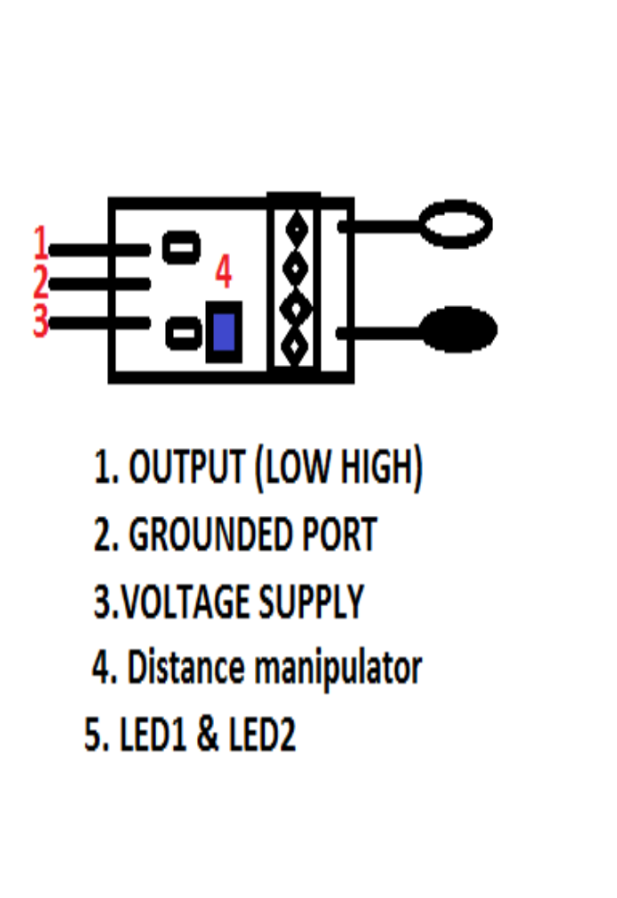
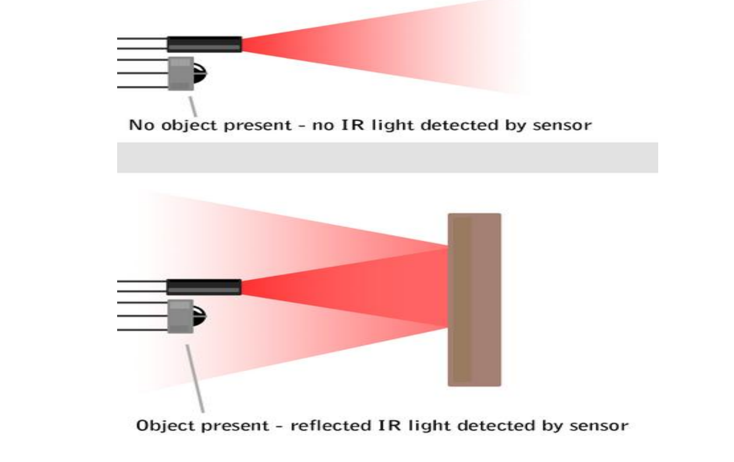
Working

Slide 21
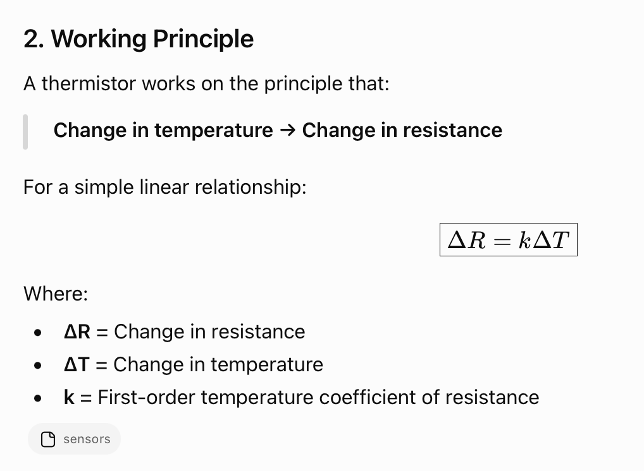
Thermistors
A thermistor is a type of resistor used to measure temperature changes. Its resistance changes when the temperature changes.
THERMal + resISTOR = THERMISTOR

Slide 22
Types of Thermistor
1. PTC – Positive Temperature Coefficient
For a PTC thermistor:
Temperature ↑ → Resistance ↑
If k is positive, resistance increases as temperature increases.
It is also called a Posistor.
2. NTC – Negative Temperature Coefficient
For an NTC thermistor:
Temperature ↑ → Resistance ↓
If k is negative, resistance decreases as temperature increases.

Slide 23
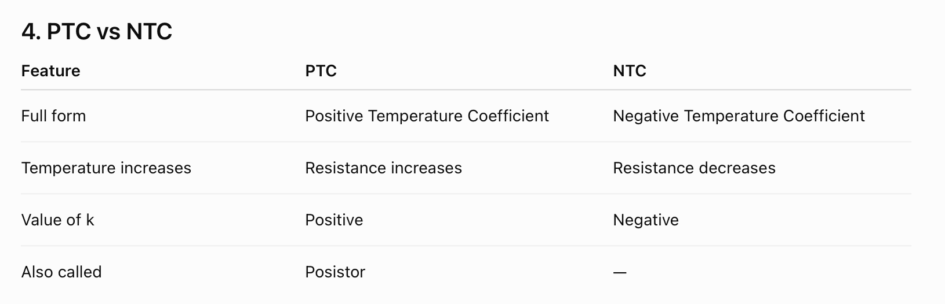
Comparision

Slide 24
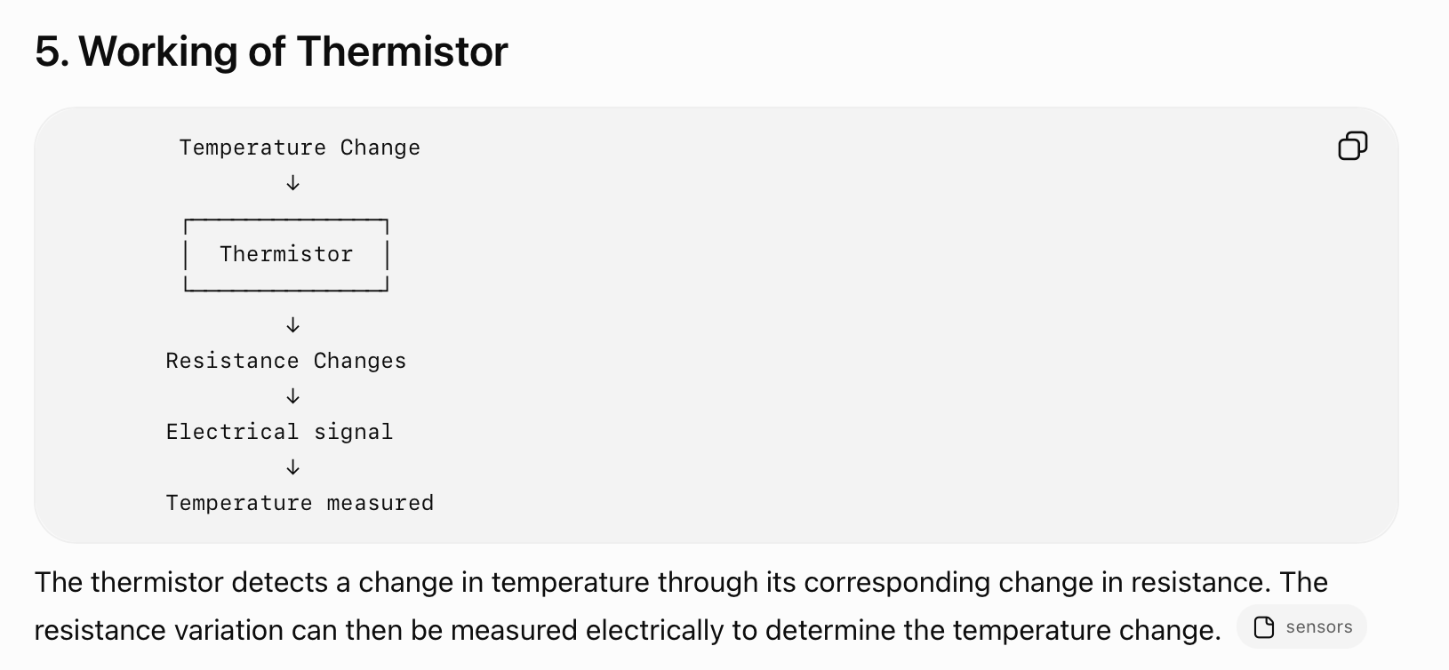
Explaination

Slide 25
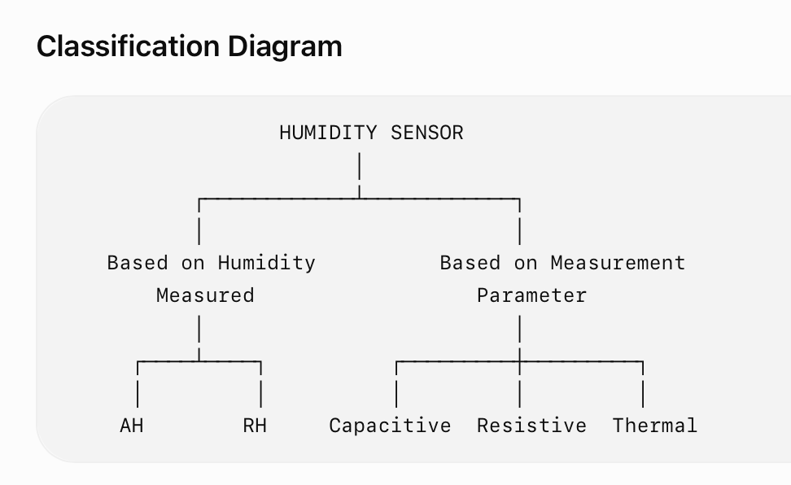
Humidity Sensor
A humidity sensor, also called a hygrometer, is a device used to sense, measure, and report the relative humidity of air.
Humidity represents the amount of moisture present in the air. Relative humidity is the ratio of the actual moisture in the air to the maximum amount of moisture that the air can hold at that temperature.
Classification of Humidity Sensors
A. Based on type of humidity measuredNAbsolute Humidity (AH) Sensor
Relative Humidity (RH) Sensor
B. Based on the parameter used for measurement
Capacitive Humidity Sensor
Electrical Conductivity / Resistive Humidity Sensor
Thermal Conductivity Humidity Sensor

Slide 26
Relative Humidity
Relative Humidity (RH) indicates how much moisture is present in the air compared with the maximum moisture that the air can hold at that temperature.
It is commonly expressed as a percentage (%).
For example:
50% RH means the air contains approximately half of the moisture it could hold at that temperature.

Slide 27
Capasitive Humidity Sensor
A capacitive humidity sensor is a type of humidity sensor that works using the capacitive effect.
In a capacitive RH sensor, the electrical permittivity of the dielectric material changes when humidity changes.
Key Point
Humidity changes → Dielectric permittivity changes → Capacitance changes → Humidity detected

Slide 28
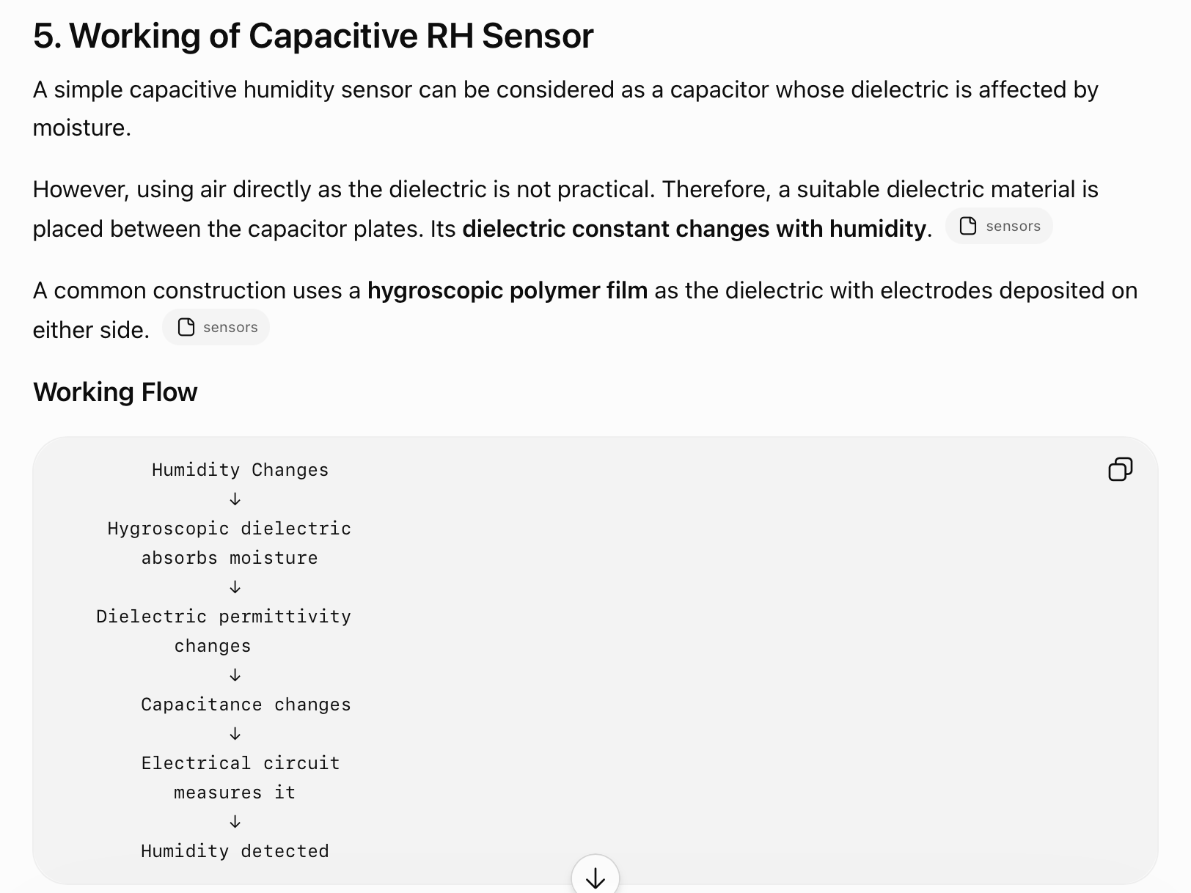

Slide 29
Construction
Two metal electrodes are deposited on the substrate.
The electrodes can be made from aluminium, platinum, or chromium.
The electrodes form an interdigitized pattern.
A dielectric layer is deposited over the electrodes.
Two temperature-sensitive resistors may also be placed on the same substrate for temperature compensation
Advantages of Capacitive Humidity Sensors
According to the PPT, capacitive humidity sensors are useful when factors such as:
Cost
Rigidity
Size

Slide 30
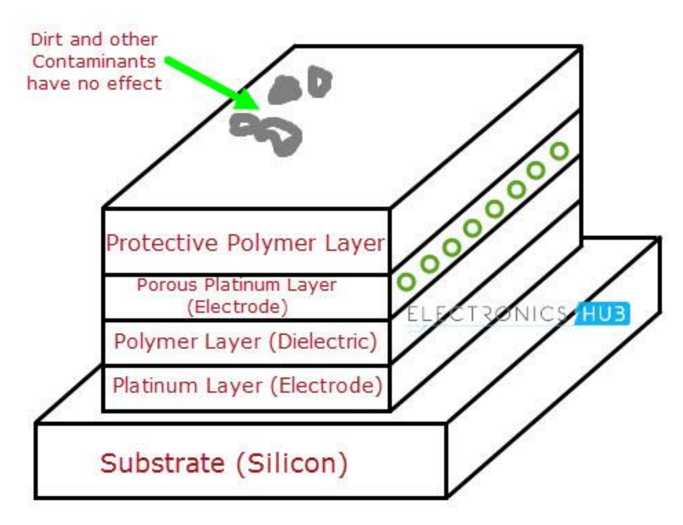
Diargarm

Slide 31
DHT11 / DHT22 Temperature & Humidity Sensor
DHT11 is a basic, low-cost digital temperature and humidity sensor.
It uses:
A capacitive humidity sensor to measure humidity
A thermistor to measure temperature
An internal IC to process the measurements
The output is provided as a digital signal, so an analog input pin is not required.

Slide 32
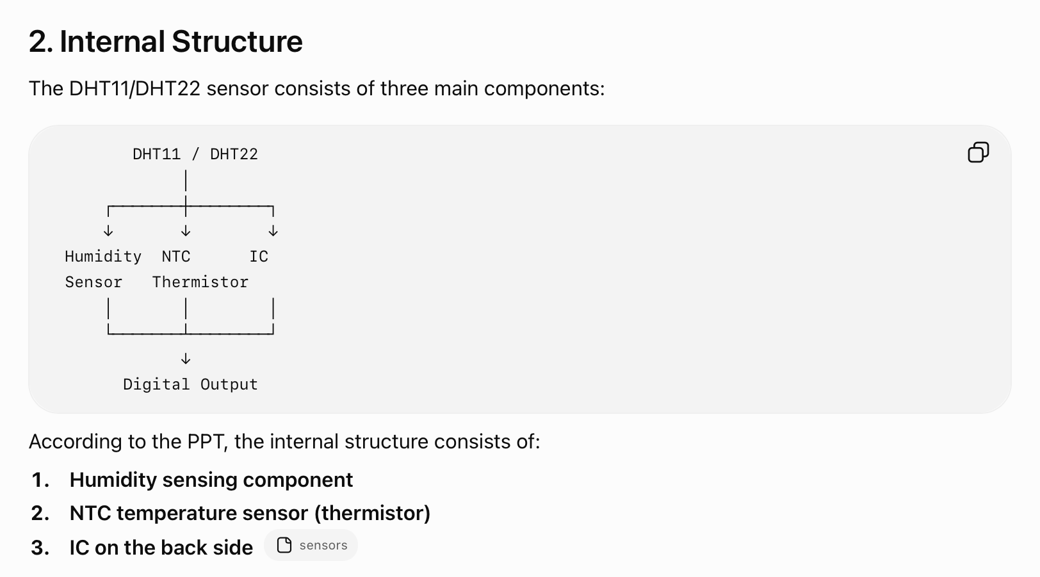

Slide 33
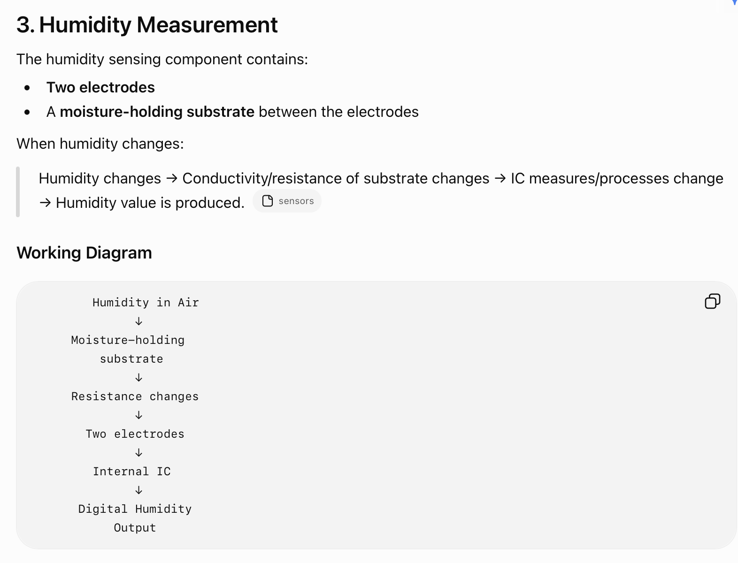

Slide 34
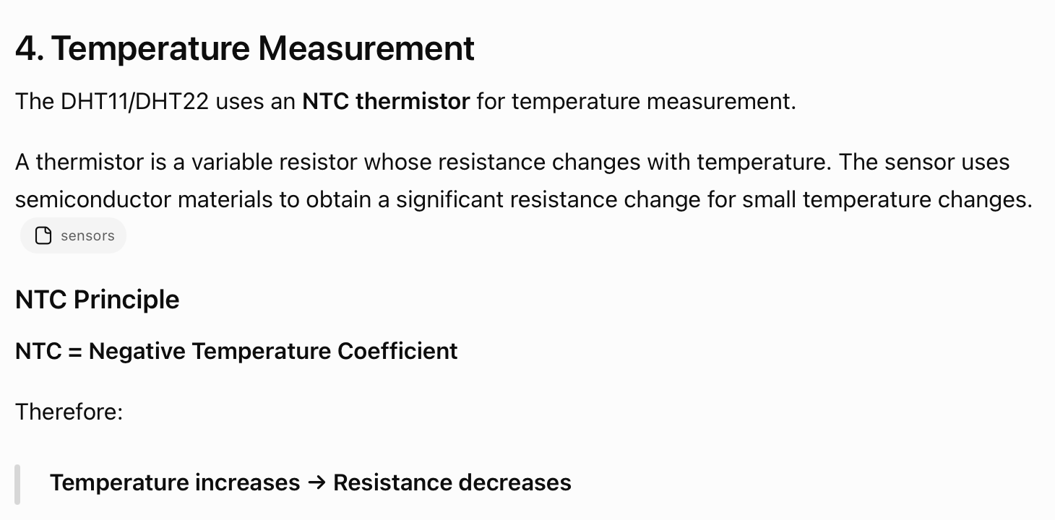
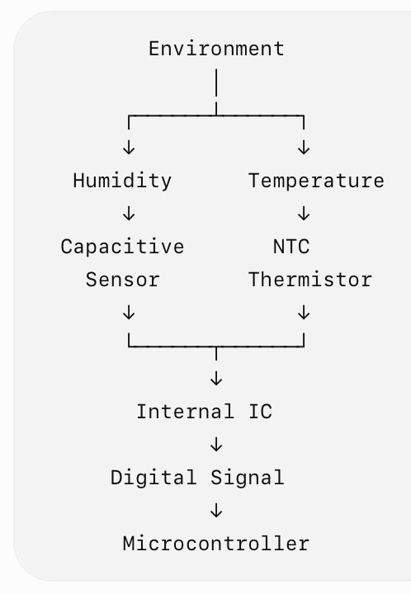

Slide 35
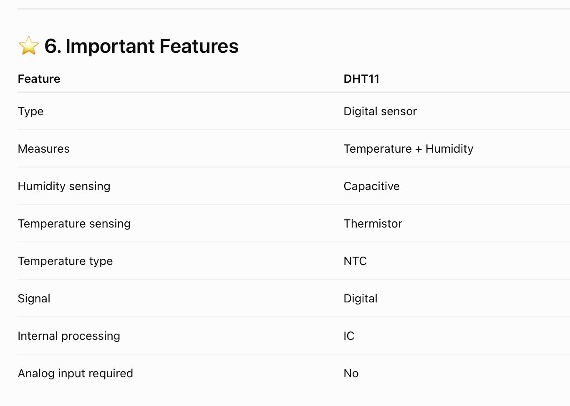
IMP

Slide 36
Thank you
Vraj Suratwala
Department of ICT, VNSGU

