Slide 1
JPA - Java Persistence API
Vraj Suratwala
Department of ICT, VNSGU

Slide 2
Definition : JPA
JPA refers to Java Persistance API is a specification used to manage relational data in java applications using object-relational mapping (ORM).
in simple words,
JPA converts Java Object -> Database tables automatically.

Slide 3
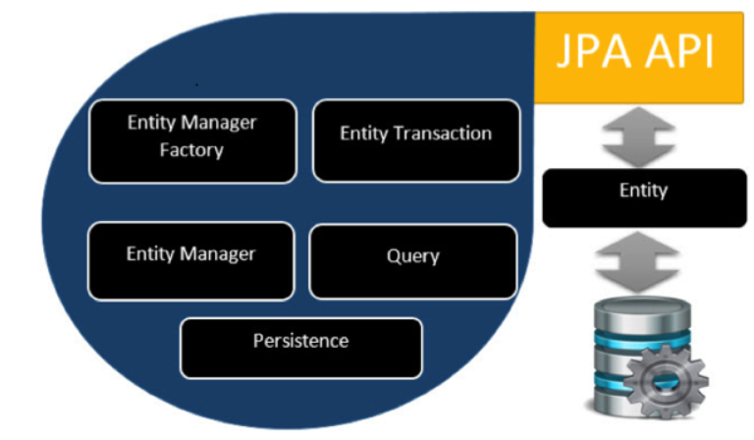
JPA Architecture

Slide 4
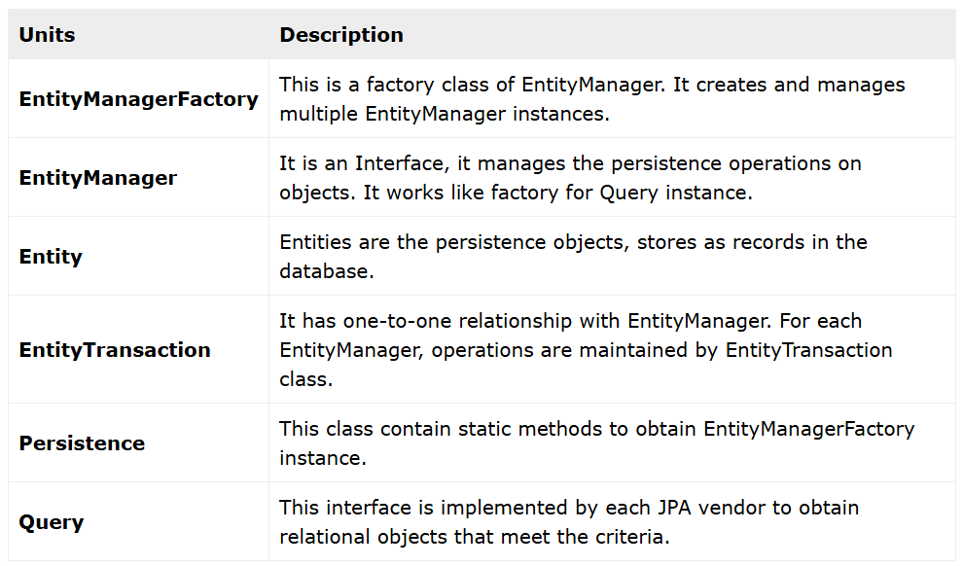
Description Table

Slide 5
Main components of JPA
1. Entity
2. Entity Manager
3. Persistence Unit
4. Persistence Context
5. JPA Provider
6. Database

Slide 6
1. Entity
java class mapped to database table.
Example :
@Entity
public class User {
@Id
private int id;
private String name;
}

Slide 7
2. EntityManager - Operation on an Entity
main interface of JPA.
used to :
persist()
find()
merge()
remove()
Example :
@PersistenceContext
EntityManager em;

Slide 8
3. Persistence Unit
Defined in persistence.xml
it contains :
Database config
provider info
entities list
<persistence-unit name="myPU"> <provider>
org.hibernate.jpa.HibernatePersistenceProvider
</provide>
</persistence-unit>

Slide 9
4. Persistence Context
set of managed entity objects.
it tacks :
new objects
updated objects
removed objects

Slide 10
5. JPA Provider
implementation of JPA Specification.
popular ones :
Hibernate
EclipseLink
OpenJPA
Converts Java Operations -> SQL

Slide 11
6. Database
Which final strong Layer :
MySQL
Oracle
PostgreSQL

Slide 12
Entity Lifecyle
States of Entity :
New
Managed
Detached
Removed
Example :
em.persist(user); //managed
em.remove(user); //removed

Slide 13
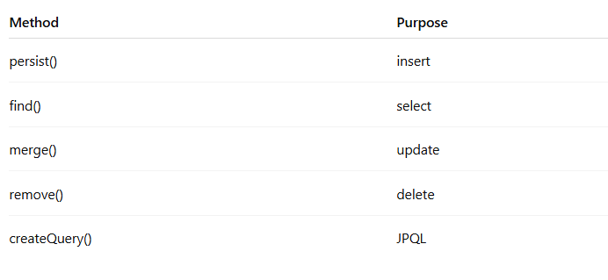
EntityManager Methods

Slide 14
JPQL - Java Persistence Query Language
similar to SQL but works on objects.
Example :
SELECT u FROM User u
Not :
SELECT * FROM USER

Slide 15
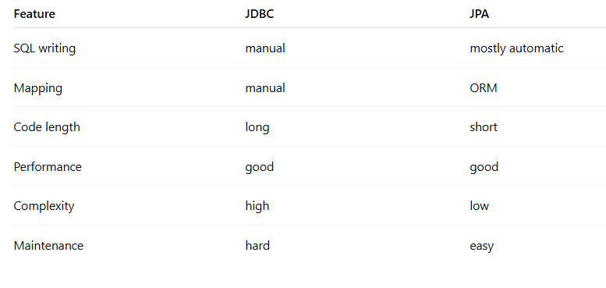
JDBC vs JPA

Slide 16
JPA in EJB
@Stateless
public class UserServcie{
@PersistenceContext
EntityManager em;
}
Note : Container injects EntityManager Automatically.

Slide 17
Advantages : JPA
no manual SQL
automatic mapping
cleaner code
portable
database independent
caching support
transaction support

Slide 18
Disadvantages : JPA
learning curve is complex
hidden SQL sometimes confusing
complex joins harder

Slide 19
ORM with an Entites
JAVA

Slide 20
Definition : ORM
ORM refers to Object relational Mapping is a technique used to map Java Objects (Entities) to database tables automatically using JPA.
an Entity is a Java class annotated with : @Entity
Let’s see an example...

Slide 21
Basic Entity Example
import javax.persistence.*;
@Entity
@Table(name = “users”)
public class User{
@Id
private int id;
@column(name = “username”)
private String name;
private String email;
//getters and setters
}

Slide 22
Mapping Extension
@Entity -> Table
@Id -> Primary Key
@Feild -> Column
@Object -> Row

Slide 23
Important JPA Mapping Annotations
@Entity : Makrs class as database entity.
@Table : Specifies table name
@Table(name = “users”)
@Id : primary key
@GeneratedValue : Auto increment ID
@generatedValue(startegy - GenerationType.IDENTITY)
@Column : custom column mapping.
@Column(nullable = false, unique = true)

Slide 24
Relationship Mapping
1. One to One
@OneToOne
@JoinColumn(name = “profile_Id”)
private Profile profile
One user -> One profile.
2. One to Many
@OneToMany(mappedBy = “user”)
private List<Order> orders;
One user -> Many Orders

Slide 25
Relationship Mapping
3. Many to One
@ManyToOne
@JoinColumn(name = “user_id”)
private User user;
Many orders -> One user
4. Many to Many
@ManyToMany
@JoinTable(name = “user_role”)
Many users <---> Many roles

Slide 26
Named Queries
JAVA

Slide 27
Definition : Named Queries
A Named Query is a pre-defined, static JPQL query defined using annotations or XML and indentified by a unique name.
which provides :
Defined ones
call by name
clean
reusable

Slide 28
Flow : Where Named Queries Resides ?
Entity
Named Query Defined
EntityManager calls by name
Provider (like Hibernate)
Database
How to is defining ?
@NamedQuery

Slide 29
Basic Example
@Entity
@NamedQuery( name = "User.findAll",
query = "SELECT u FROM User u" )
public class User {
@Id
private int id;
private String name;
}
List<User> list =
em.createNamedQuery("User.findAll", User.class)
.getResultList();

Slide 30
Named Query with Parameters
@NamedQuery(
name = "User.findByName",
query = "SELECT u FROM User u WHERE u.name = :name"
)
//Calling it
User user = em.createNamedQuery("User.findByName", User.class)
.setParameter("name", "Ruta")
.getSingleResult();

Slide 31
Multiple Named Query
@NamedQueries({
@NamedQuery(name="User.findAll",
query="SELECT u FROM User u"),
@NamedQuery(name="User.findByEmail",
query="SELECT u FROM User u WHERE u.email = :email")
})

Slide 32
Types of Named Queries
1. Named Query (JPQL)
work on entites
SELECT u FROM User u
2. Named Native Queies
uses native SQL
@NamedNativeQuery(
name="User.nativeQuery",
query="SELECT * FROM users",
resultClass=User.class
)

Slide 33
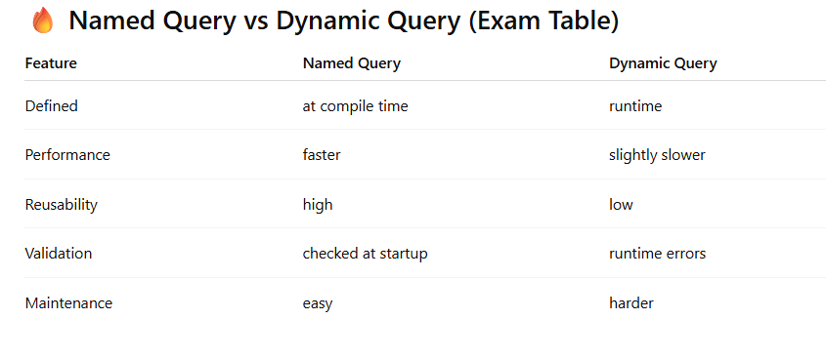

Slide 34
Dynamic and Native Queries
JAVA

Slide 35
Introduction
In Java Persistence API (JPA), data is retrieved from the database using queries. There are mainly two advanced query types:
Dynamic Queries
Native Queries
These help in fetching data based on different runtime conditions and complex database requirements.

Slide 36
Dynamic Queries in JPA
Dynamic queries are queries that are built at runtime based on conditions provided by the user.
They are useful when:
Search filters change dynamically
Conditions are optional
Query structure depends on input
How It Is Created
Dynamic queries are usually created using:
JPQL (Java Persistence Query Language)
Criteria API

Slide 37
Example : JPQL
String jpql = "SELECT s FROM Student s WHERE s.age > :age";
TypedQuery<Student> query = entityManager.createQuery(jpql, Student.class);
query.setParameter("age", 20);
List<Student> students = query.getResultList();
Here, :age is a parameter passed dynamically.

Slide 38
Example using Criteria API
CriteriaBuilder cb = entityManager.getCriteriaBuilder();
CriteriaQuery<Student> cq = cb.createQuery(Student.class);
Root<Student> root = cq.from(Student.class);
cq.select(root).where(cb.greaterThan(root.get("age"), 20));
List<Student> result = entityManager.createQuery(cq).getResultList();

Slide 39
Advantages of Dynamic Queries
Flexible
Type - Safe (Especially Criteria API)
Databaase Independent
Safe from SQL Injection (when parameters used properly)

Slide 40
Native Queries in JPA
Native queries are direct SQL queries written in database-specific SQL syntax.
They are used when:
Complex joins are required
Stored procedures are used
Database-specific functions are needed
Performance optimization is required

Slide 41
Example
Query query = entityManager.createNativeQuery(
"SELECT * FROM student WHERE age > ?",
Student.class
);
query.setParameter(1, 20);
List<Student> students = query.getResultList();

Slide 42
Advantages of Native Queries
Full control over SQL
Supports complex queries
Can use database-specific features

Slide 43
Disadvantages
Not database independent
Less portable
Can lead to SQL injection if not handled carefully

Slide 44
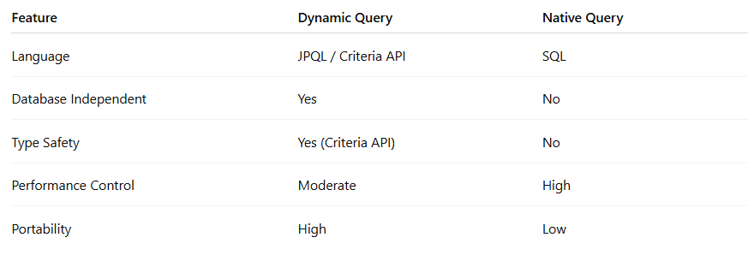
Difference between Dynamic and Native Queries

Slide 45
Roles in REST API
In REST APIs:
Dynamic queries are used for filtering data based on request parameters
Example: /students?age=20
Native queries are used when:
Reporting APIs
Complex joins
Optimized database operations
The REST controller calls the repository/service layer, which executes dynamic or native queries and returns JSON response.

Slide 46
REST Services with JAX-RS
Java

Slide 47
REST Services with JAX-RS
JAX-RS (Java API for RESTful Web Services) is a Java specification used to develop RESTful web services.
It simplifies REST development using annotations.
Popular implementation:
Jersey (Reference Implementation of JAX-RS)

Slide 48
Key Features of JAX-RS
Annotation based configuration
Supports JSON and XML
Lightweight
Easy Integration with Java EE / Spring

Slide 49
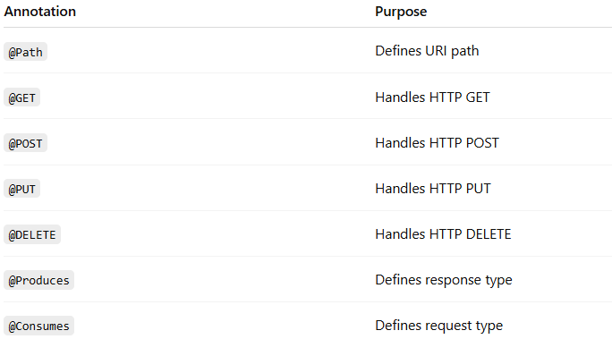
Important Annotations

Slide 50
Simple REST Service
@Path("/students")
public class StudentService {
@GET
@Produces(MediaType.APPLICATION_JSON)
public List<Student> getStudents() {
return studentList;
}
@POST
@Consumes(MediaType.APPLICATION_JSON)
public Response addStudent(Student s) {
studentList.add(s);
return Response.status(201).build();
}
}

Slide 51
Advantages
Clean Structure
Standard API
Platform Independent
Supprots REST Principals

Slide 52
Using HTTP Methods in REST
Java

Slide 53
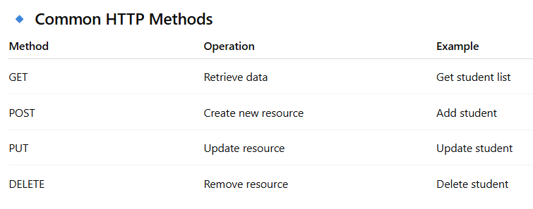
REST works completely on HTTP protocol. Each HTTP method represents an operation on a resource.
IMPORTANCE :
Standard
Predictable
Easy to integrate
Follows REST architecture
GET /students
GET /students/101
POST /students
PUT /students/101
DELETE /students/101
GET → Safe, does not modify data
POST → Creates new record
PUT → Updates existing record
DELETE → Deletes record
Each method returns:
Status codes (200, 201, 404, 500 etc.)
JSON/XML response

Slide 54
JERSEY Client for REST Services
JAVA

Slide 55
Introduction
Jersey is not only used to create REST services but also to consume REST APIs using Jersey Client API.
It allows Java applications to call REST APIs easily.
Steps to Use Jersey Client :
Create Client
Create WebTarget
Send Request
Get Response

Slide 56
Example Code
Client client = ClientBuilder.newClient();
WebTarget target = client.target("http://localhost:8080/students");
String response = target
.request(MediaType.APPLICATION_JSON)
.get(String.class);
System.out.println(response);

Slide 57
POST Request Example
Response response = target
.request()
.post(Entity.json(studentObject));

Slide 58
Advantages
Easy REST consumption
Supports JSON/XML
Asynchronous calls possible
Lightweight

Slide 59
Final Summary of Last Three Topics
JAX-RS → Used to develop RESTful services in Java
HTTP Methods → Define CRUD operations
Jersey Client → Used to consume REST APIs
Together, they form the backbone of REST-based Java applications.

Slide 60
Thank you
Vraj Suratwala
Department of ICT, VNSGU

