Slide 1
Express-Session and Express-Cookie
Theory - The Session and Cookie in an Express.js
Vraj Suratwala
Department of ICT-VNSGU

Slide 2
Express-Sessions
a session in an express.js is mechanism used to store the user data and maintain stateful information across the website.
since HTTP is a stateless protocol, we can maintain one state using session.
for an instance we can give the login at once and it will maintain state for user in whole website.
in an express this functionality can be achived using ‘express-session’ module, it will create unique SessionID for each unique user which will store in clints browser as a cookie and actual data will be stored on the Server.

Slide 3
Working of Session
The client sends request to a server.
server will create session and assign unique sessionID.
the sessionID is sent to the client as a cookie.
client will include this ID in an every subsequent request.
the server will retrive the data using this ID.

Slide 4
Example :
//Session Configuration!!
sessionapp.use(express_session({
secret : 'enc-type',
saveUninitialized : false,
resave : false
}));
//in post method : example
req.session.Password = data.Password;

Slide 5
Options in Session
secret: Used to sign and secure the session ID cookie.
store: Defines where session data is stored (Memory, Redis, MongoDB).
cookie: Configures cookie behavior (expiry, path, security).
resave: Forces session to be saved even if unmodified.
saveUninitialized: Saves a new but unmodified session.

Slide 6
Req.Session Methods
1) session.regenerate(callback)
To regenerate the session simply invoke the method. Once complete, a new SID and
Session instance will be initialized at req.session and the callback will be invoked.
req.session.regenerate(function(err) {
// will have a new session here
})
2) Session.destroy(callback)
Destroys the session and will unset the req.session property. Once complete, the
callback will be invoked.
req.session.destroy(function(err) {
// cannot access session here
})

Slide 7
Req.Session Methods
3) Session.reload(callback)
Reloads the session data from the store and re-populates the req.session object.
Once complete, the callback will be invoked.
req.session.reload(function(err) {
// session updated
})
4) Session.save(callback)
Save the session back to the store, replacing the contents on the store with the contents in memory

Slide 8
What is Session Store ?
In web development, a session is like a temporary locker where the server stores user data (like login info or cart items) while they browse your site.
Now — that locker has to be kept somewhere, right?
That’s exactly what a Session Store is.
It’s the place where session data is saved — so that it doesn’t vanish when your app restarts or runs on multiple servers.

Slide 9
Which is The By-Default Session-Store!
In Express (Node.js), if you’re using express-session, the default session store is MemoryStore — it saves all sessions in your app’s memory. AND...
memory gets wiped out when:
the server restarts
or your app scales across multiple instances

Slide 10
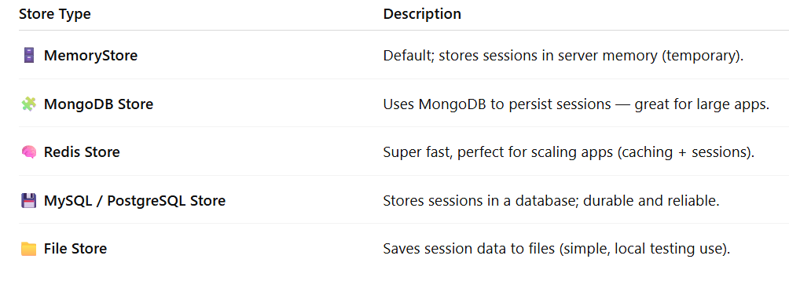
Real-world Session Stores

Slide 11
Redis-Session Store
Redis
Open source NoSQL database technology
Uses key-value pairs which are stored in memory.
Store complex data structures like lists and sets, among others.
And since it runs from memory, it is very fast.
It is perfect for storing and retrieving application session data.
Installation
  npm install express express-session connect-redis redis

Slide 12
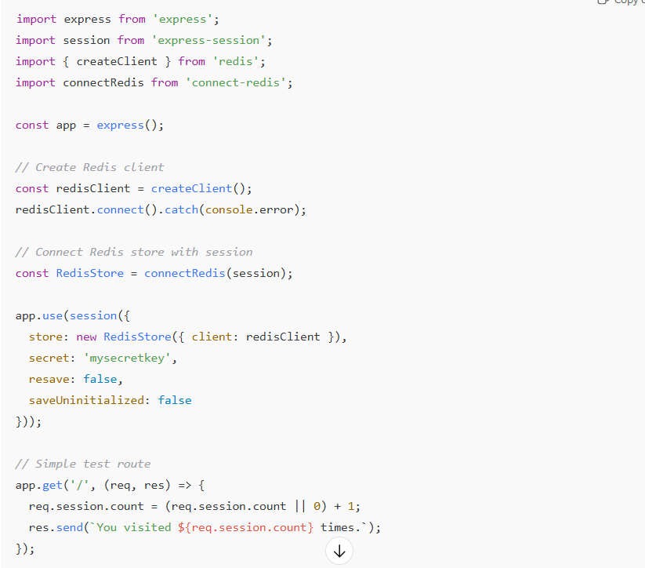
Example :
ChatGPT

Slide 13
Express-Cookie
A cookie is a small piece of data stored on the client side (browser) and sent with every HTTP request to the server.
Cookies help websites remember users and store small pieces of information such as usernames, preferences, and session identifiers.

Slide 14
Working
The server sends a small text file (cookie) to the client’s browser.
The browser stores this file locally.
With every subsequent request, the browser sends the cookie back to the server.
The server uses this data to identify the user or retrieve saved preferences.

Slide 15
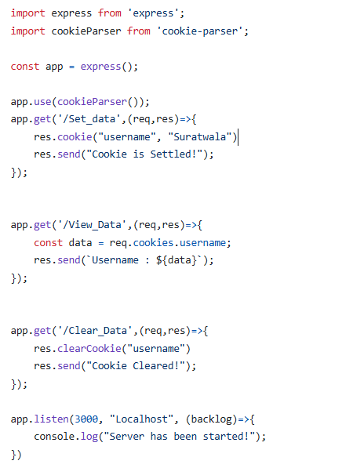
Example : Cookie-Parser

Slide 16
Thank You
Vraj Suratwala

