Slide 1
Unit - 1
Introduction to AI - Artificial Intelligennce

Slide 2
1.1 AI and It’s Applications
What is AI ?
  Artificial Intelligence (AI) is the branch of computer science that builds systems capable of performing tasks that normally require human intelligence — such as learning, reasoning, perception, and language understanding.
The ultimate goal is to create machines that can act autonomously and adaptively to achieve given objectives in complex, uncertain environments.

Slide 3
Major Pattern & Techniques
Good Old-Fashioned AI : Logic, rules, knowledge bases, planning. Strong at explicit reasoning and explanation.
Statistical / Machine Learning: Learn patterns from data — supervised, unsupervised, reinforcement learning.
Deep Learning: Neural networks with many layers (CNNs for vision, RNN/LSTM for sequences, Transformers for language).
Hybrid approaches: Symbolic + statistical (neuro-symbolic) to combine reasoning and learning.

Slide 4
Core components of AI
Data
Model
Learning Algorithm
Sensors and Actuators
Evalueation Matric
Performance Matric

Slide 5
Representative Algorithms & Models
Decision trees, k-NN
Neural networks, CNNs, RNNs, Transformers (deep learning)
Search algorithms
Bayesian networks (probabilistic reasoning)

Slide 6
Applications
Helthcare applications
Automatic Vahicles
Finance
NLP - Natural Language Processing
Robotics
Recommandation System

Slide 7
1.2 Introduction to Knowledge Representations
Artificial intelligence systems operate on data. However, raw data alone does not lead to intelligence. AI must transform data into structured knowledge.
KR achieves this by defining formats and methods for organizing information. With clear representations, AI systems solve problems, make decisions, and learn from new experiences.

Slide 8
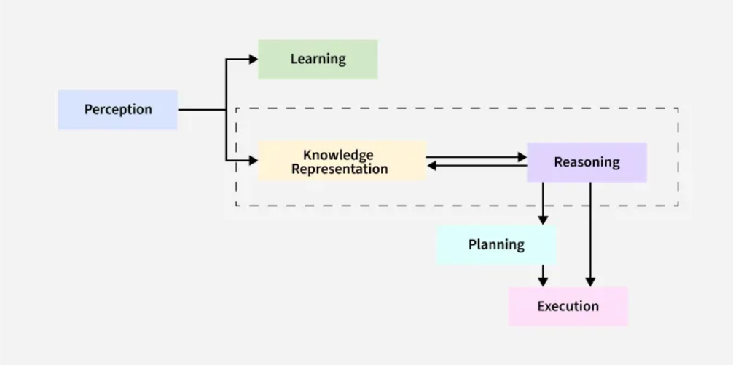
Diagram

Slide 9
Synergy of KR.
Knowledge as a Foundation: Knowledge provides facts, rules, and data (e.g., traffic laws for self-driving cars). Without it, intelligence lacks the raw material to act.
Intelligence as Application: Intelligence applies knowledge to solve problems (e.g., a robot using physics principles to navigate terrain).
Interdependence: Static knowledge becomes obsolete without adaptive intelligence. Conversely, intelligence without knowledge cannot reason or learn (e.g., an AI with no medical database cannot diagnose diseases).
Synergy: Effective AI systems merge robust knowledge bases (the what) with reasoning algorithms (the how). For example, ChatGPT combines vast language data (knowledge) with transformer models (intelligence) to generate coherent text.

Slide 10
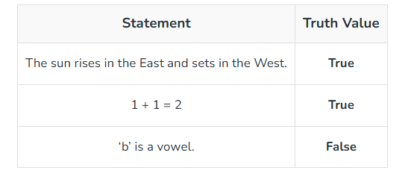
Core Methods of KR
1. Logic-Based Systems
Logic-based methods use formal rules to model knowledge. These systems prioritize precision and are ideal for deterministic environments.
A) Propositional Logic : Represents knowledge as declarative statements (propositions) linked by logical operators like AND, OR, and NOT.

Slide 11
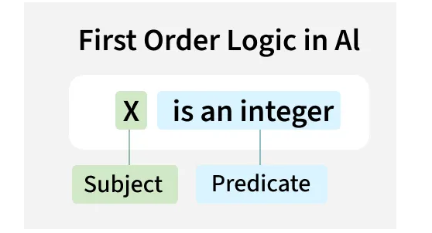
Core Methods of KR
B) First-Order Logic (FOL) : Extends propositional logic by introducing variables, quantifiers, and predicates.

Slide 12
Core Methods of KR
2. Structured Representations.
These methods organize knowledge hierarchically or through networks, mimicking how humans categorize information.
A) Semantic Networks : Represent knowledge as nodes (concepts) and edges (relationships).
Example : For example, "Dog" links to "Animal" via an "Is-A" connection. They simplify inheritance reasoning but lack formal semantics.

Slide 13
Core Methods of KR
B) Frames
Group related attributes into structured "frames." A "Vehicle" frame may include slots like wheels, engine type, and fuel. Frames excel in default reasoning but struggle with exceptions.
C) Ontologies
Define concepts, hierarchies, and relationships within a domain using standards like OWL (Web Ontology Language). Ontologies power semantic search engines and healthcare diagnostics by standardizing terminology.

Slide 14
Core Methods of KR
3. Probabilistic Models
A) Bayesian Networks
Bayesian Belief Network (BBN) is a graphical model that represents the probabilistic relationships among variables. It is used to handle uncertainty and make predictions or decisions based on probabilities.
Types :
  i) Graphical
  ii) Conditional
  iii) Probabilistic

Slide 15
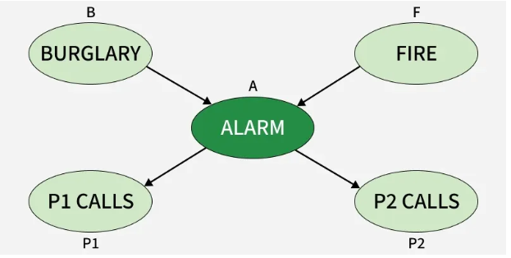
Core Methods of KR

Slide 16
Core Methods of KR
B) Markov Decision Processes (MDPs)
Model sequential decision-making in dynamic environments. MDPs help robotics systems navigate obstacles by evaluating potential actions and rewards.

Slide 17
Core Methods of KR
4. Distributed Representations
Modern AI leverages neural networks to encode knowledge as numerical vectors, capturing latent patterns in data.
A) Embeddings
Convert words, images, or entities into dense vectors. Word embeddings like Word2Vec map synonyms to nearby vectors, enabling semantic analysis.
B)Knowledge Graphs
Combine graph structures with embeddings to represent entities (e.g., people, places) and their relationships. Google’s Knowledge Graph enhances search results by linking related concepts.

Slide 18
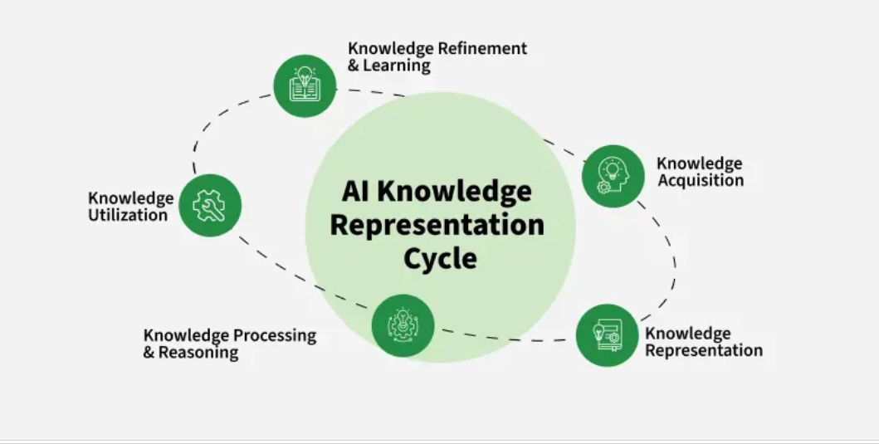
AI Knowledge Cycle

Slide 19
Types of Knowledge
1. Declarative Knowledge - Descriptive Knowledge
2. Procedural Knowledge - How-To Knowledge
3. Meta Knowledge
4. Heuritic Knowledge - Experience Based Knowledge
5. Common-Sense Knowledge
6. Domain Specific Knowledge

Slide 20
1.3 Introductio to Expert System
Expert systems are a crucial subset of artificial intelligence (AI) that simulate the decision-making ability of a human expert. These systems use a knowledge base filled with domain-specific information and rules to interpret and solve complex problems. For example, a medical expert system can analyze a patient’s symptoms and suggest possible diagnoses or treatments. Similarly, a financial expert system can evaluate market trends and recommend investment strategies.

Slide 21
Why It is Important ?
1. Preserving Expertise
2. Improving Decision-Making
3. Saving Time and Money
4. Accessibility

Slide 22
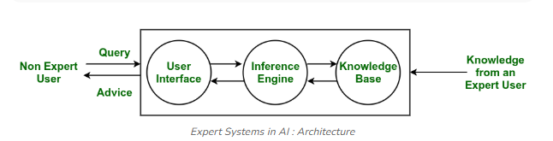
Architecture
1. Knowledge Base – The Heart
This is the system’s memory.
It stores all the important facts, rules, and expert knowledge.
If the knowledge is wrong, the system’s advice will also be wrong.
Example: rules for fraud detection in a bank.
2. Inference Engine – The Brain
This is where the thinking happens.
It reads the rules from the Knowledge Base and uses reasoning to reach conclusions.
Two ways it thinks:
Forward chaining: Starts from facts → reaches a conclusion
Backward chaining: Starts from a goal → checks if the facts support it

Slide 23
User Interface – The Bridge
This is how users talk to the system.
Users enter questions or problems
The system gives answers or suggestions
Has to be simple so even non-experts can use it
Explanation Module – The Teacher
This explains why the system gave a particular answer.
Builds trust
Shows the step-by-step reasoning
Very important in medical, legal, and financial systems
Knowledge Acquisition Module – The Updater
This keeps the knowledge base fresh.
Adds new rules
Updates outdated information
Learns from experts or new data
Without this, the system becomes old and useless over time.

Slide 24
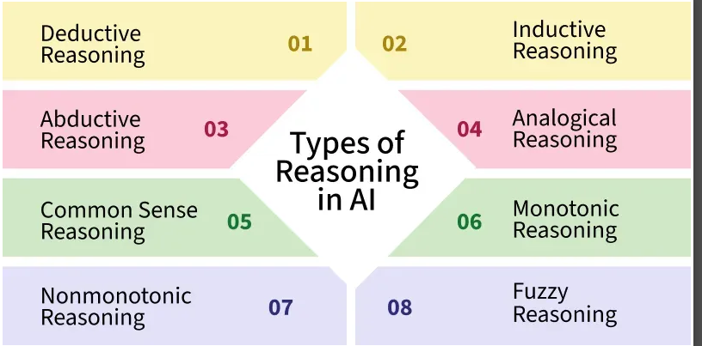
1.4 Introduction to Reasoning
In Artificial Intelligence, reasoning is the process by which machines simulate human-like decision-making, problem-solving and predictions. Just as humans use logic to navigate the world, AI systems rely on different types of reasoning to draw conclusions, interpret data and adapt to new situations.

Slide 25
1. Deductive Reasoning
This is Most Strightforward Reasoning Type.
→ From general rule → to specific conclusion
Example :
  Rule: All birds have wings.
  Case: Sparrow is a bird.
  Conclusion: Sparrow has wings.
Where used in AI:
  Expert systems
  Medical diagnosis
  Rule-based decision making

Slide 26
2. Inductive Reasoning
→ From specific observations → to a general rule
Not 100% guaranteed but usually true.
AI uses this for learning patterns.
Example:
  Mango sweet
  Apple sweet
  Banana sweet
  Conclusion: Most fruits are sweet.
Where used in AI:
  Machine learning training
  Pattern recognition
  Recommendations

Slide 27
3. Abductive Reasoning
→ Best possible explanation from incomplete data
AI doesn’t know everything, so it guesses the most likely cause.
Example:
  Observation: Patient has fever + cough
  Possible Explanation: Maybe they have an infection.
Where used in AI:
  Medical diagnosis
  Fault detection
  Crime investigation systems

Slide 28
4. Analogical Reasoning
Solving a new problem by comparing it with a similar known problem
Just like how we say, “Yeh situation us jaisi lag rahi hai…”
Example:
  If you know how to solve a 2×2 Rubik cube,
  you compare it with the 3×3 cube and find similar patterns.
Where used in AI:
  Case-based reasoning
  Chatbots

Slide 29
5. Common Sense Reasoning
→ Reasoning using everyday knowledge that humans naturally have
AI tries to act like a normal human would.
Example:
If a boy drops a glass,
common sense says the glass will break.
Used in Robots...

Slide 30
6. Monotonic Reasoning
Once a conclusion is made, it never changes
Even if new information arrives, the old conclusion stays fixed.
Example:
If rules say:
“All students must attend class,”
even if more details come later, the rule doesn’t change.

Slide 31
7. Non-Monotonic Reasoning
→ Conclusions change when new information arrives
Just like real life — we change our mind when new facts appear.
Example:
You believe: “Birds can fly.”
Then you learn about penguins.
Now your conclusion changes.

Slide 32
8. Fuzzy Reasoning
Works with degrees of truth, not just True/False
Because real life is not black and white — it’s all shades.
Example:
  Temperature:
    Not just hot or cold
    But 60% hot and 40% warm
Where used in AI:
  AC temperature control

Slide 33
1.5 Introduction to Intelligent Agent in an AI
Picture an intelligent agent as that one friend who doesn’t just sit around — they observe, think, and act.
In AI, an intelligent agent is basically a system that:
Perceives its environment
Decides what to do based on what it knows
Acts in a way that moves it toward some goal

Slide 34
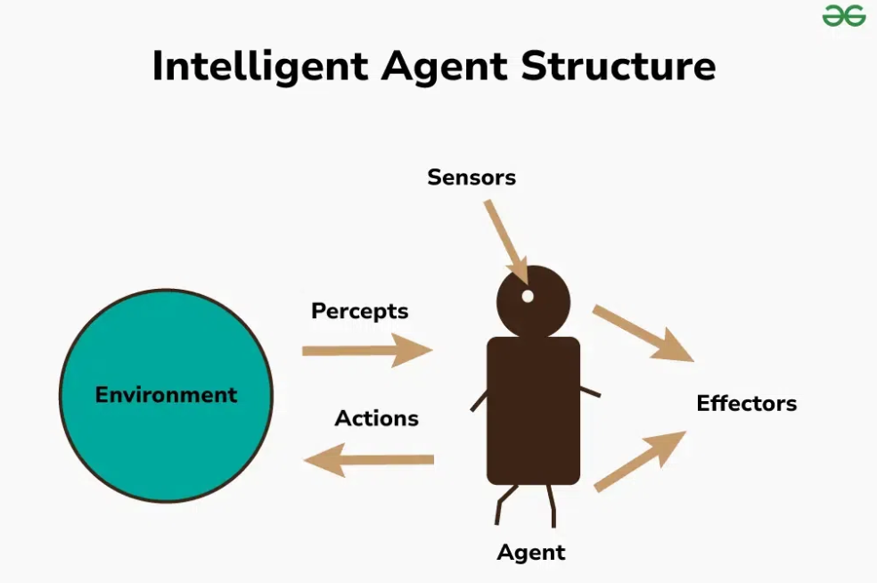
Basicallt it is doing this tasks.
Perception and Information Processing
Reasoning and Inference
Decision-Making Under Uncertainty:
Adaptation and Learning:

Slide 35
PEAS Representation of AI Agent
1. Performance Measure
2. Environment
3. Actuators
4. Sensors

Slide 36
1.6 Introduction to NLP
Natural Language Processing (NLP) enables computers to understand and interpret human language. While computers excel at processing structured data, such as spreadsheets or databases, natural language in its unstructured form (text, speech, etc.) presents a unique challenge. NLP bridges this gap by allowing machines to process and understand human languages, making it an essential tool in modern AI systems.

Slide 37
Need for NLP
The growing amount of unstructured natural language data in the world makes it increasingly important for machines to comprehend and analyze it effectively. By training NLP models, we can equip computers to process language data in a variety of forms, from written text to voice input. With centuries of human-written literature and massive data available, it’s vital to teach computers to interpret that wealth of information. However, this task comes with significant challenges, such as resolving ambiguities in meaning, Named-Entity Recognition (NER), and coreference resolution.
While NLP systems are improving, they still face difficulties in understanding the exact meaning of sentences.
For example, consider the phrase: "The boy radiated fire-like vibes." Does it refer to a motivating personality or imply something literal? Such ambiguities make text analysis complex for computers.

Slide 38
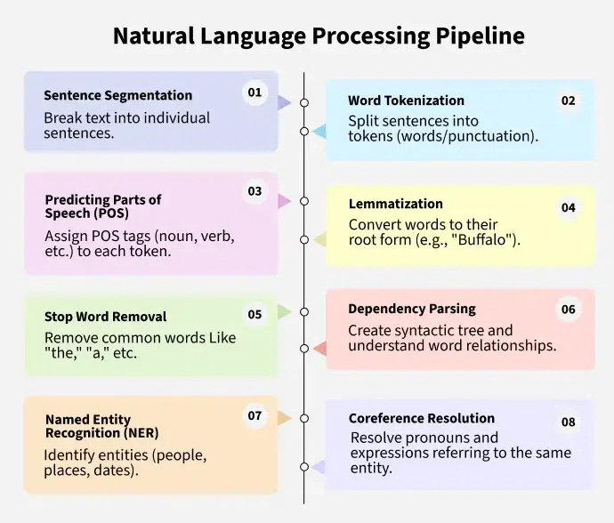
NLP Pipeline

Slide 39
Applications of NLP
Speech Recognition: Converting spoken language into text, which powers voice assistants like Siri and Alexa.
Language Translation: Automatically translating text from one language to another (e.g., Google Translate).
Chatbots and Virtual Assistants: Understanding and responding to user queries in natural language (e.g., customer support).
Text Summarization: Condensing long documents into shorter summaries without losing important information.
Sentiment Analysis: Understanding opinions expressed in text, which is useful in social media monitoring, product reviews, and customer feedback analysis.
Information Retrieval.

Slide 40
Thank You
Vraj Suratwala

