Slide 1
Python Notes
Vraj Suratwala
Department of ICT, VNSGU, Surat

Slide 2
Topics Covered - Module -1
Introduction to Python
Features and Application of Python
Python Environment Setup.
Working with Scripts file in pyhton.
Python variables and Data Type
Python Operators - Comparision and Logical and Identity
Working with Python strings and it’s inbuilt functions.
Conditional Statement and UDF along with Lambda Expressions.
Python Iterators

Slide 3
Introduction to Python ?
Python was created by Guido van Rossum in 1991 and further developed by the Python Software Foundation.
It was designed with focus on code readability and its syntax allows us to express concepts in fewer lines of code.
Python has solidified its position as a dominant force. Its intuitive syntax, robust libraries, and thriving community make it a favorite amongst beginners and professional developers alike.
Whether you're embarking on your programming journey or seeking to expand your skillset, Python offers a multitude of advantages that propel it to the forefront of development.

Slide 4
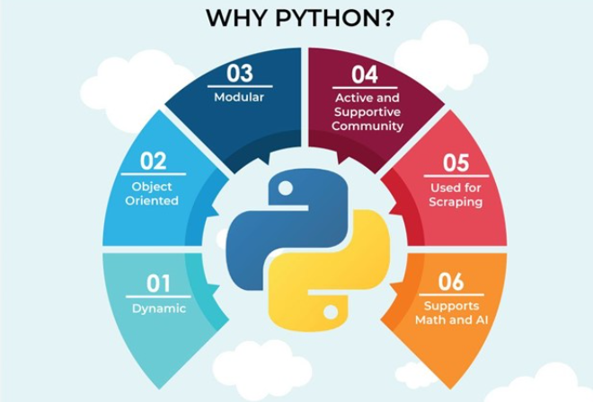
What is Python?
Python is general purpose, object-oriented and high level programming language.

Slide 5
Features of Python
1. Easy
1.1 Easy to Code
1.2 Easy to Read
2. Expressive
3. Free and Open-Source
4. High-Level
5. Portable
6. Interpreted
7. Object-Oriented
8. Extensible
9. Embedded
10. Large Extensible Library
11. GUI
12. Dynamically Typed

Slide 6
Application of Python
1. Web Development
2. App Development
3. Gamme Development
4. Scientific Applications.
5. Education Program.
6. Desktop Development
7. AI Application
8. Graphic Designing

Slide 7
Python Environment Setup
(using venv) - 1. Install Python : Download from python.org and install.
Tip: Check “Add Python to PATH” on Windows.
2. Verify Installation : python -m venv myenv
3. Activate Virtual Environment : myenv\Scripts\activate
4. Install Packages
Use pip install package_name inside activated env.
Deactivate Environment
Run deactivate when done.

Slide 8
Python Variable and Data Type
Python Data types are the classification or categorization of data items. It represents the kind of value that tells what operations can be performed on a particular data.
Numeric - int, float, complex
Sequence Type - string, list, tuple
Mapping Type - dict
Boolean - bool
Set Type - set, frozenset
Binary Types - bytes, bytearray, memoryview

Slide 9
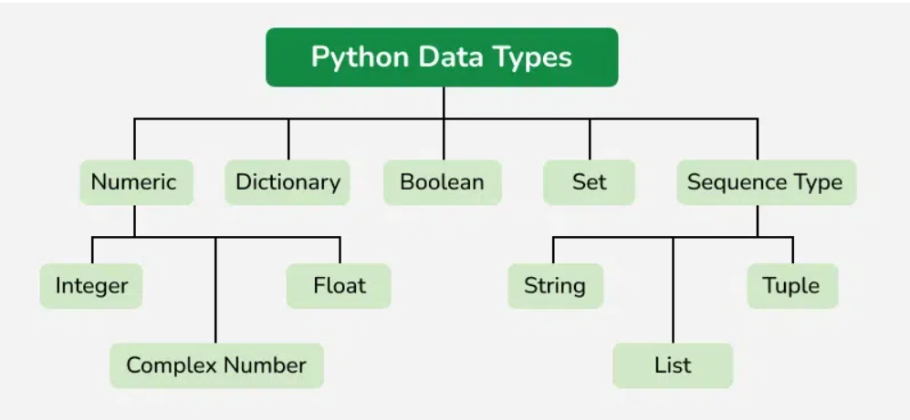
Python Variable and Data Type

Slide 10
Python Operators
What is Operators ?
Operators are one that can work with different types of Operands.
There are Various Type if Operators in Python.
Arithmetic
Assignment
Comparision
Logical
Identity
Membership
Bitwise
Reference : https://www.tutorialsteacher.com/python/python-operators

Slide 11
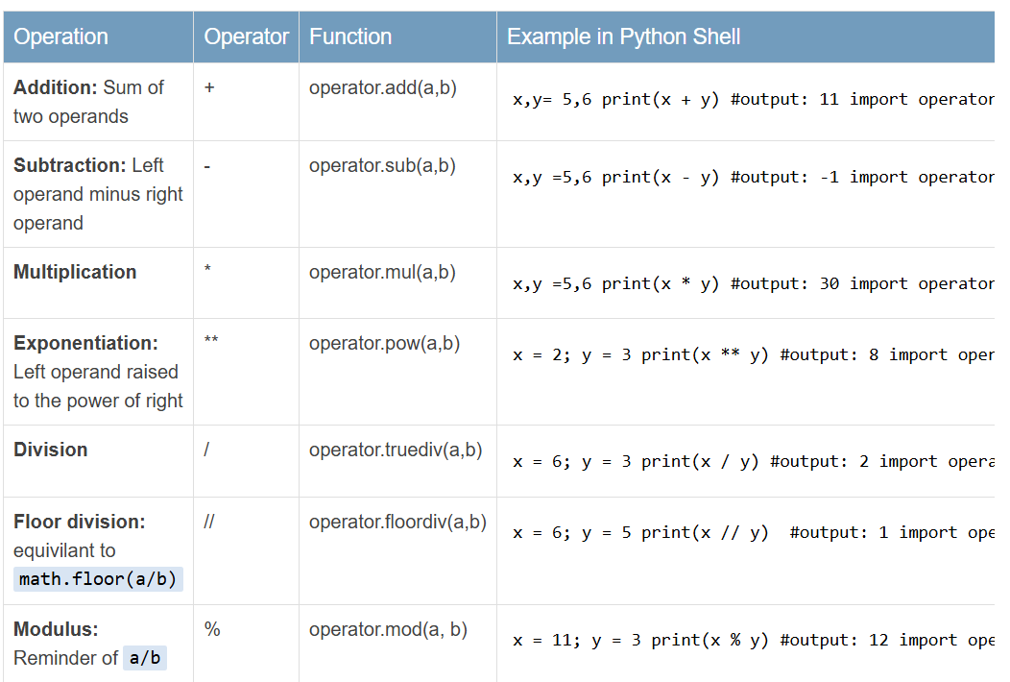
Arithmetic Operators

Slide 12
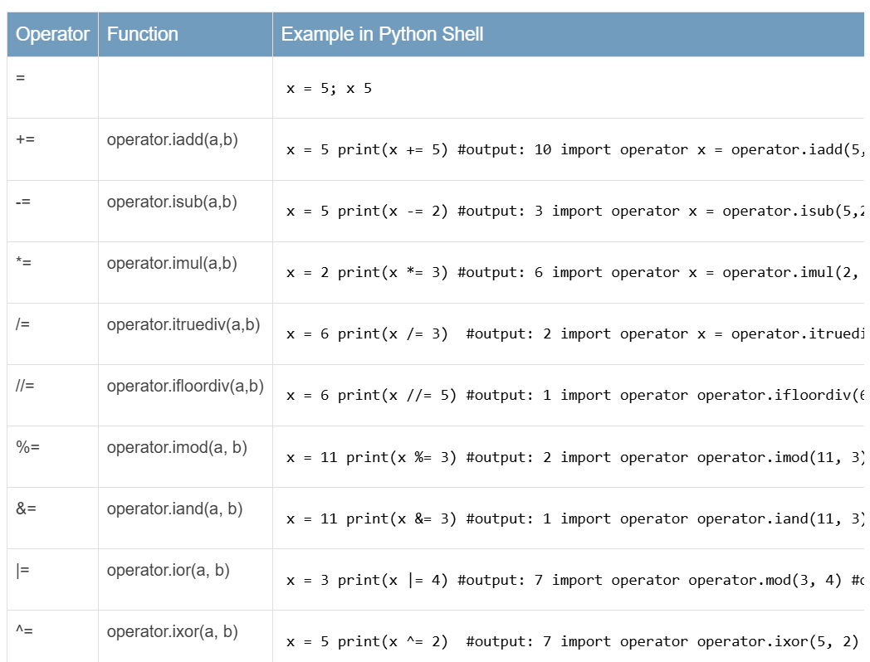
Assignment Operators

Slide 13
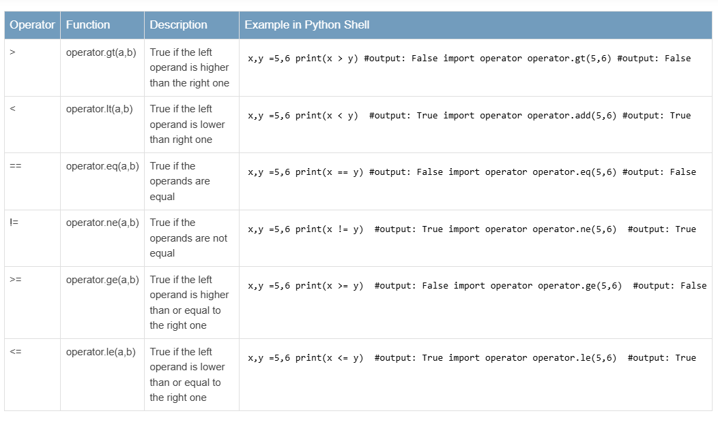
Comparision Operators

Slide 14
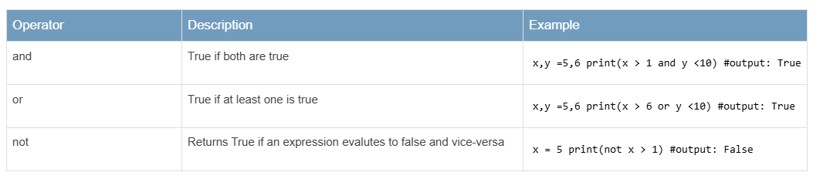
Logical Operators

Slide 15
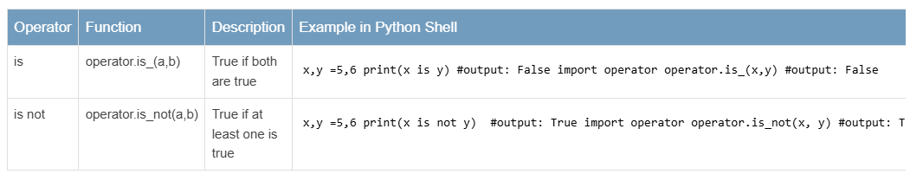
Identity Operators

Slide 16
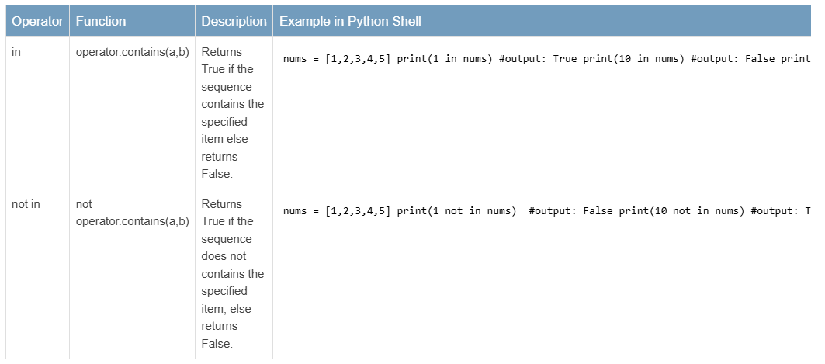
Membership Test Operators

Slide 17
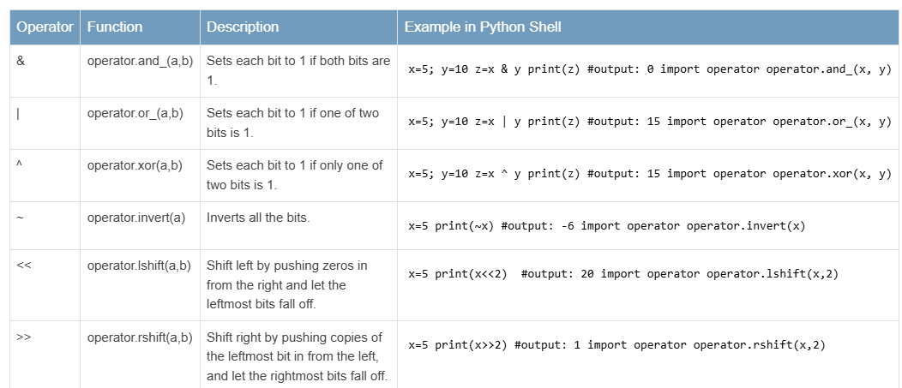
Bitwise Operators

Slide 18
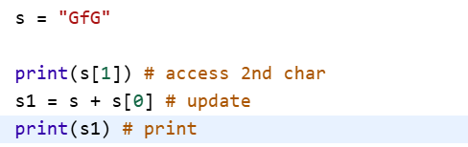
Working with Strings in Python using it’s inbuilt functions!
A string is a sequence of characters. Python treats anything inside quotes as a string. This includes letters, numbers, and symbols.
Reference for Strings : https://www.geeksforgeeks.org/python/python-string/
Simple Example :

Slide 19
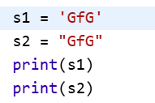
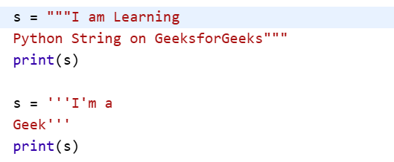
Creating a string
Strings can be created using either single (') or double (") quotes.
Multi-Line String :

Slide 20
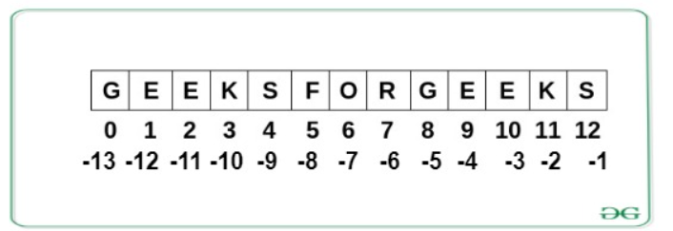
Accessing The Characters in Python
There are two ways to access the string or any character or any character set in python.
1. Positive Indexing.
2. Negative Indexing.

Slide 21
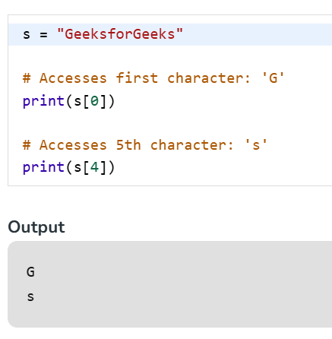
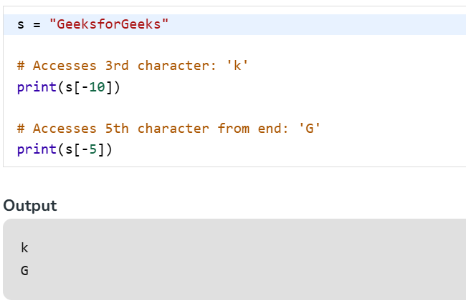
Accessing The Characters in Python

Slide 22
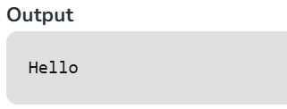
String Slicing
in Python is a way to get specific parts of a string by using start, end and step values. It’s especially useful for text manipulation and data parsing.
s = "Hello, Python!"
print(s[0:5])

Slide 23
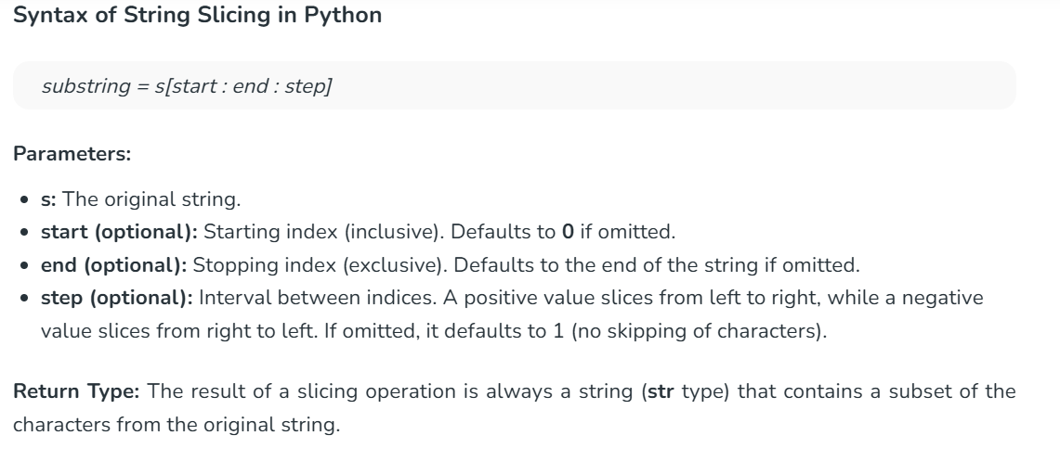
String Slicing

Slide 24
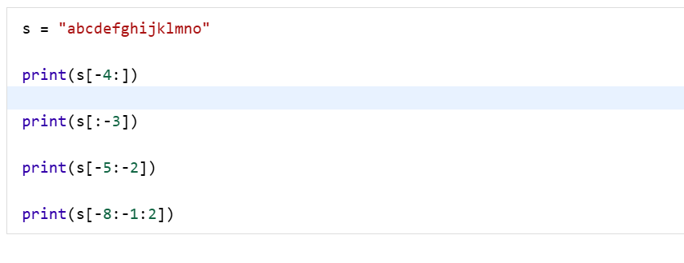
Slicing With Negative Index

Slide 25
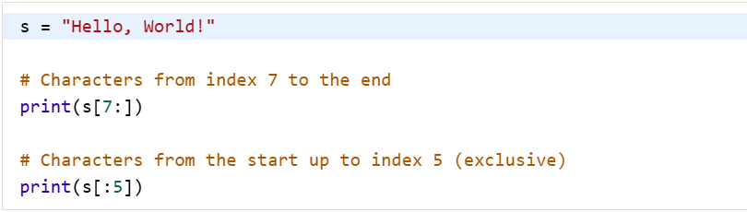
Get all Character after Specific Position

Slide 26
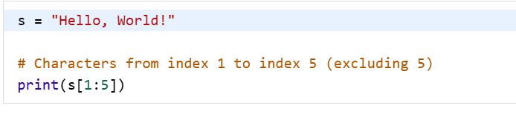
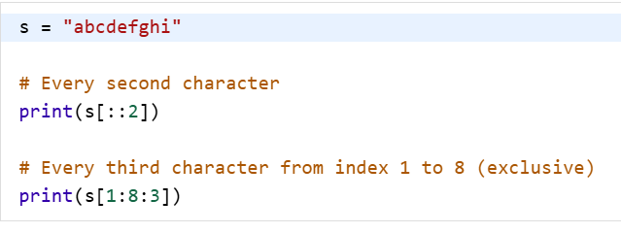
Extract Characters Between Two Positions
Get Characters at Specific Intervals

Slide 27
In-built functions for strings
lower(): Converts all uppercase characters in a string into lowercase
upper(): Converts all lowercase characters in a string into uppercase
title(): Convert string to title case
swapcase(): Swap the cases of all characters in a string
capitalize(): Convert the first character of a string to uppercase
more : in-built functions

Slide 28
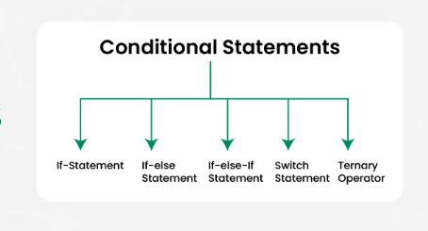
Conditional Statement
Conditional statements in programming are used to control the flow of a program based on certain conditions.

Slide 29
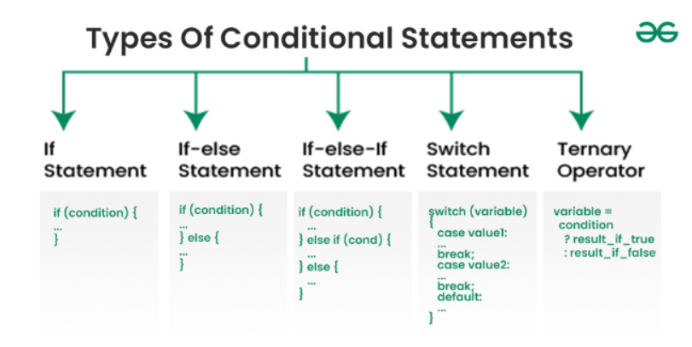
Syntax of Conditional Statement
MORE : https://www.geeksforgeeks.org/dsa/conditional-statements-in-programming/

Slide 30
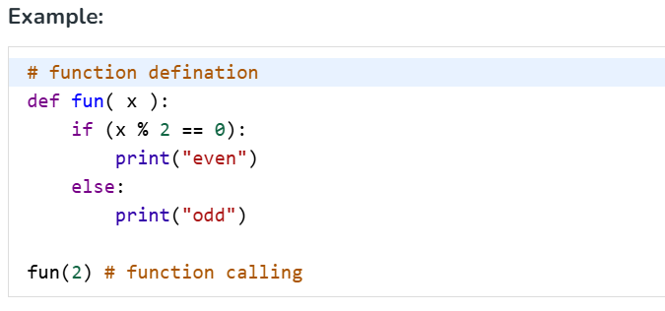
Python UDF
A User-Defined Function (UDF) is a function created by the user to perform specific tasks in a program.
Unlike built-in functions provided by a programming language, UDFs allow for customization and code reusability, improving program structure and efficiency.

Slide 31
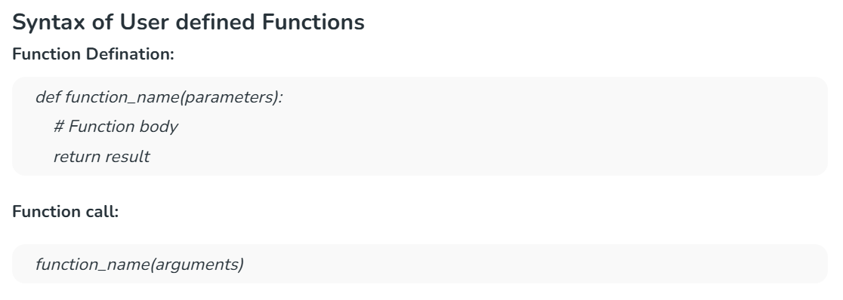
Simple Syntax

Slide 32
Types of UDF
1. Parameterized Functions
2. Functions with default arguments
3. Keyword argument functions
4. Variable length argument functions
5. Functions with Return value
6. Lambda functions.

Slide 33
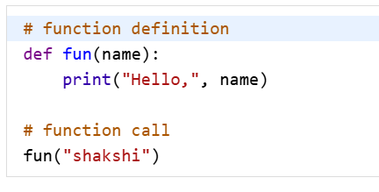
1. Parameterized Functions
These functions accept parameters (arguments) to process and return results dynamically. Parameters allow for flexibility, enabling the function to handle different inputs each time it is called.

Slide 34
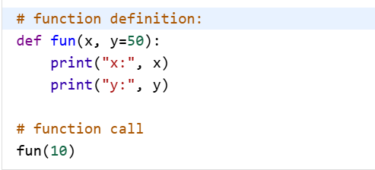
2. Functions with default arguments
A function can have default values assigned to its parameters. If no argument is provided when calling the function, it takes the default value.

Slide 35
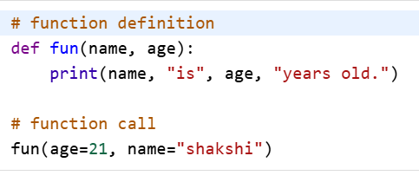
3. Keyword argument functions
Function arguments can be passed using keywords to improve code readability.
This ensures the correct mapping of values to parameters, regardless of their order.

Slide 36
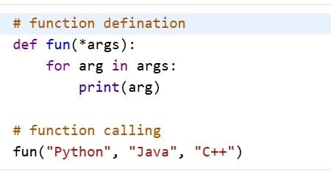
4. Variable length argument functions
When the number of arguments is unknown, a function can accept multiple arguments using *args (for non-keyword arguments) or **kwargs (for keyword arguments).

Slide 37
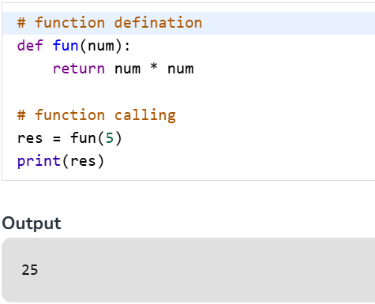
5. function with Return Value.
A function can return a value using the return statement.
This allows the function to send back a result for further computation.

Slide 38
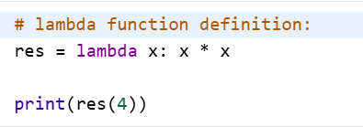
6. Lambda functions
A lambda function is an anonymous (nameless) function that is defined in a single line using the lambda keyword.
It is used for short, simple operations where defining a full function is unnecessary.

Slide 39
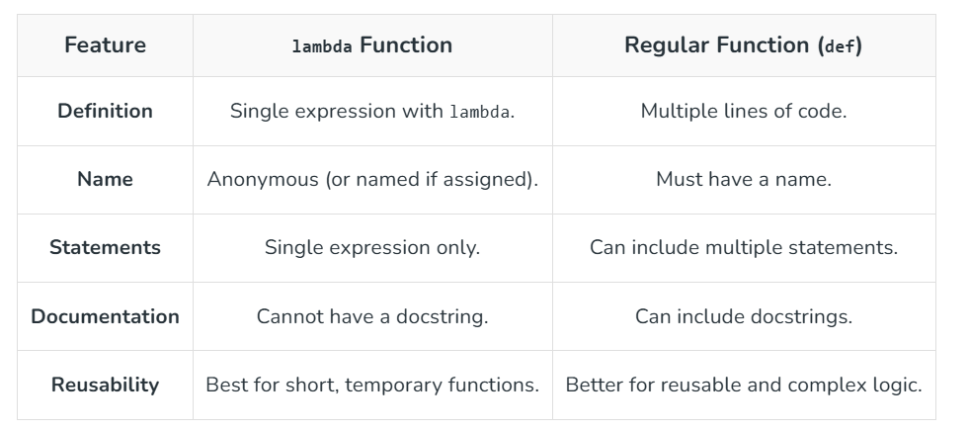
Lambda Function vs Normal Functions

Slide 40
Iterators in python
An iterator in Python is an object used to traverse through all the elements of a collection (like lists, tuples, or dictionaries) one element at a time. It follows the iterator protocol, which involves two key methods:
__iter__(): Returns the iterator object itself.
__next__(): Returns the next value from the sequence. Raises StopIteration when the sequence ends.

Slide 41
Why do we need iterators in Python ?
Lazy Evaluation : Processes items only when needed, saving memory.
Generator Integration : Pairs well with generators and functional tools.
Stateful Traversal : Remembers position between calls.
Uniform Looping : Works across data types with the same syntax.
Composable Logic : Easily build complex pipelines using tools like itertools.

Slide 42
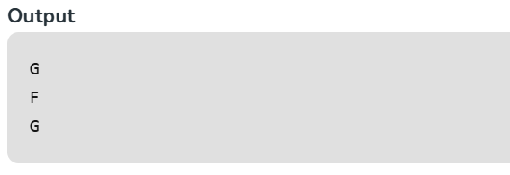
Built-in Iterator Example
s = "GFG"
it = iter(s)
print(next(it))
print(next(it))
print(next(it))

Slide 43
Creating a custom Iterator
Creating a custom iterator in Python involves defining a class that implements the __iter__() and __next__() methods according to the Python iterator protocol.
Steps to follow:
Define the Class: Start by defining a class that will act as the iterator.
Initialize Attributes: In the __init__() method of the class, initialize any required attributes that will be used throughout the iteration process.
Implement __iter__(): This method should return the iterator object itself. This is usually as simple as returning self.
Implement __next__(): This method should provide the next item in the sequence each time it's called.

Slide 44
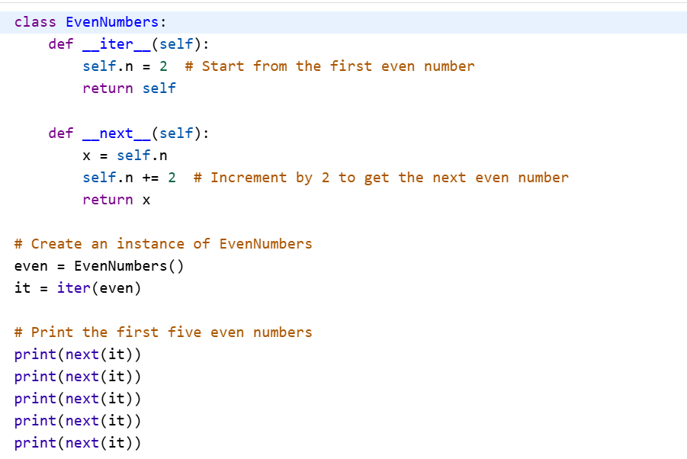
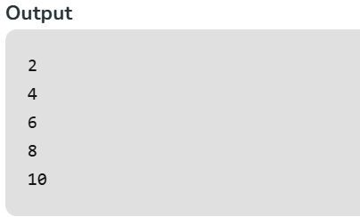
Custom Example :

Slide 45
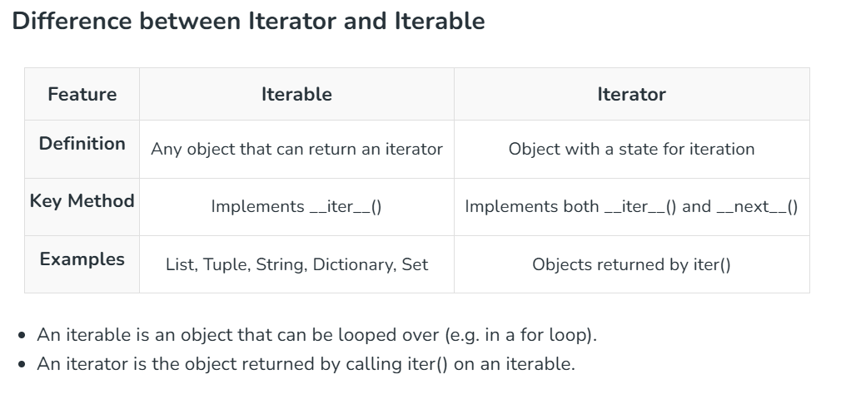
Iteratble vs Iterator

