Slide 1
Python Basic Notes
Vraj Suratwala

Slide 2
Topics Covered
Matrix, Scalars, vectors and tensors
Arrays in Python - Python Array!
Additional Concepts :
Orphan Objects
Object Interning
Descriptors
Grabage Collections
GIL
Weak References
__slots__
Monket Patching

Slide 3
Matrix, Scalars, vectors and tensors
In the context of mathematics and machine learning, scalar, vector, matrix, and tensor are all different types of mathematical objects that represent different concepts and have different properties.
Scalars : Scalars are singular numerical entities, devoid of any directional attributes.
They serve as the elemental components utilized in mathematical computations and algorithmic frameworks across these domains.
In practical terms, scalars often represent fundamental quantities such as constants, probabilities, or error metrics.

Slide 4
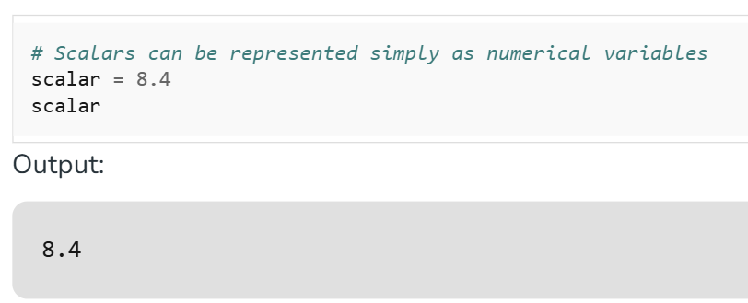
Scalars
For instance, within Machine Learning, a scalar may denote the accuracy of a model or the value of a loss function.

Slide 5
Vectors
A vector is a sequence of numbers arranged in a single row or column, representing an element of a vector space. In Python, vectors can be implemented using lists, NumPy arrays, or other libraries.
Key Features :
Single-dimensional: Vectors are one-dimensional, unlike matrices which are two-dimensional.
Efficient Operations: Libraries like NumPy allow vectorized operations, enabling faster computations without explicit loops.

Slide 6
Vectors
Example :
import numpy as np
# Creating a vector
vector = np.array([1, 2, 3])

Slide 7
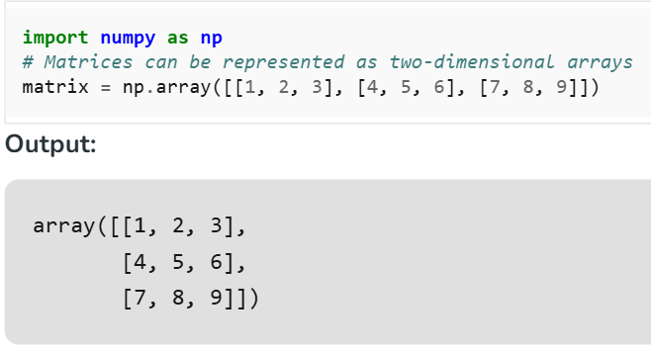
Matrix
Matrices, as two-dimensional arrays of numerical values, enjoy widespread utility across AI-ML-DS endeavors.
They serve as foundational structures for organizing and manipulating tabular data, wherein rows typically represent observations and columns denote features or variables.

Slide 8
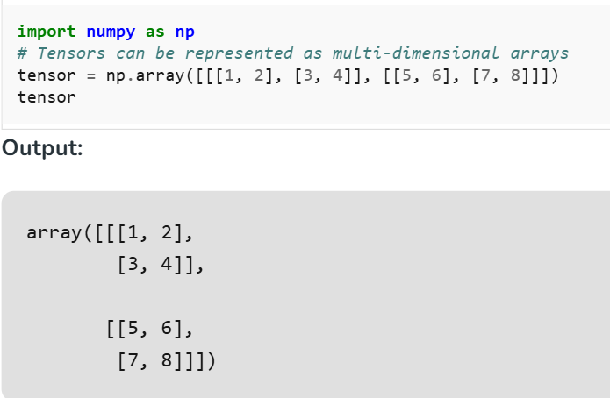
Tensors
Tensors in Data Science generalize the concept of vectors and matrices to better dimensions. They are multidimensional arrays of numerical values which can constitute complex facts structures and relationships.

Slide 9
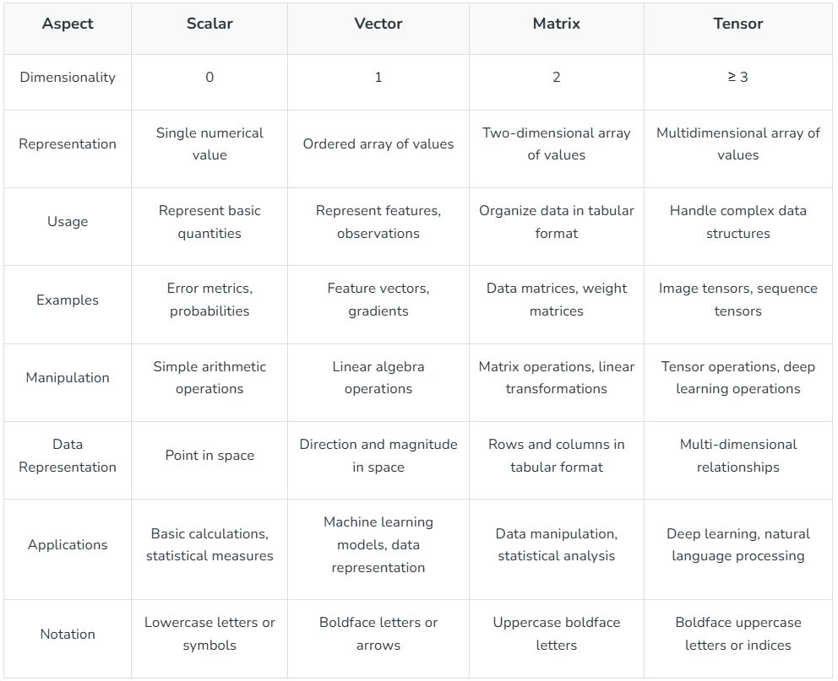

Slide 10
Arrays in Python
An array in Python is a data structure that stores multiple values of the same data type in a single variable.
Python does not have built-in arrays like C/C++ — instead, it provides the array module.
Arrays are different from lists:
List: Can store elements of different data types.
Array: Stores elements of the same type, more memory-efficient.

Slide 11
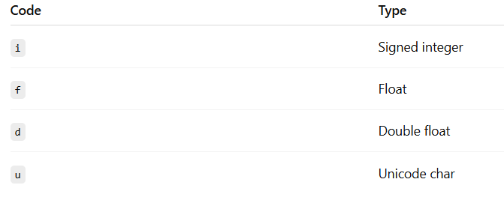
Importing and Creating an Array
importing an array :
import array as arr
Creating an array :
import array as arr
number = arr.array(‘i’, [10, 20, 30, 40])
where i is representing the integer data type!

Slide 12
Accessing that Array and Modifying it!
Access :
print(numbers[0]) # First element
print(numbers[-1]) # Last element
Modifying :
numbers[1] = 25
numbers.append(50) # Add element at end
numbers.insert(2, 35) # Insert at position
numbers.remove(25) # Remove by value
numbers.pop(1)
Looping :
for num in numbers:
print(num)

Slide 13
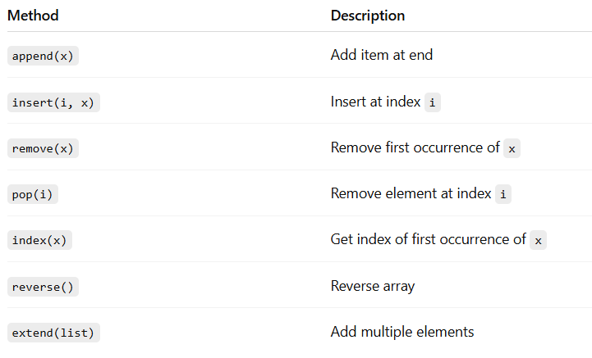
Method of Python Array

Slide 14
Advantage and Disadvantages of Python Array
Advantages :
Memory-efficient for large same-type datasets
Faster element access compared to lists (when same type)
Disadvantages :
Can store only one Data Type
Less Flexible then Lists

Slide 15
Additonal Topics
Hidden Gems of Pyhton

Slide 16
Orphan Objects
Definition: An object in memory that has no variable referencing it.
Created When:
A variable holding the object is reassigned.
The object goes out of scope.
Example:
class Demo:
pass
#Object :
obj = Demo()
obj = None #The Original Demo Object is Orphan now!
Why important: Orphan objects get cleaned up by garbage collection (GC), but sometimes delays can cause memory to bloat.

Slide 17
Object Interning
Python reuses certain immutable objects to save memory.
Integers from -5 to 256 and some strings are preallocated.
a = 100
b = 100
print(a is b) # True
Note: This doesn’t apply to all numbers/strings — interning is implementation-dependent.

Slide 18
Descriptors (The Magic Behind @property)
Objects that control access to attributes.
Powers property, staticmethod, classmethod.
class MyDescriptor:
def __get__(self, obj, objtype=None):
return "Value from descriptor"
class Demo:
attr = MyDescriptor()
d = Demo()
print(d.attr) # "Value from descriptor"

Slide 19
Grabage Collections
Python uses reference counting + cyclic GC.
Circular references delay cleanup.
how to know this ?
import gc
print(gc.get_objects())

Slide 20
The GIL - Global Interpreter Lock
Only one thread runs Python bytecode at a time.
Multi-threading doesn’t speed up CPU-heavy tasks, but works fine for I/O tasks.
Solution for CPU-bound: multiprocessing.

Slide 21
Weak References
Analogy :
Imagine you have a toy:
You hold it in your hand — that’s a strong grip (strong reference).
Your friend just points at it and says, “That’s a cool toy!” — that’s a weak grip (weak reference).
Now, if you drop the toy, your friend’s pointing doesn’t stop the toy from being thrown away. That’s how weak references work — they don’t protect the object from being deleted.
A weak reference is like a soft reminder of an object. It lets you look at the object, but doesn’t hold onto it tightly. So if Python decides to clean up the object (because no one else is using it), the weak reference won’t stop that from happening.

Slide 22
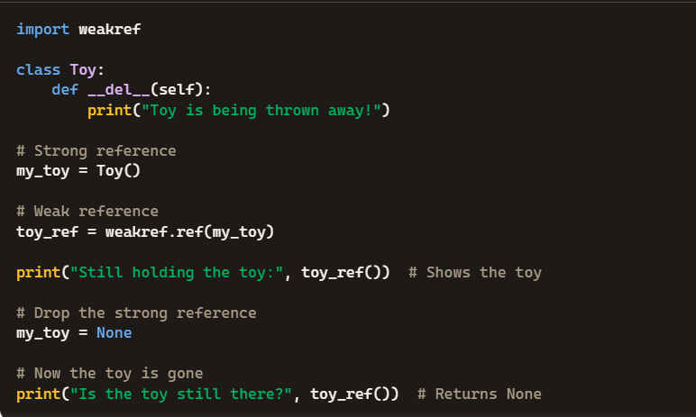
Weak References

Slide 23
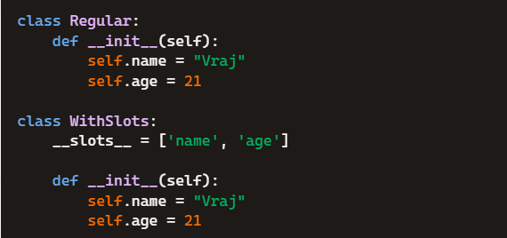
__slots__
Normally, Python stores object attributes in a dictionary (__dict__). This makes it flexible, but also memory-heavy.
When you define __slots__, you tell Python:
“These are the only attributes this class will ever have — don’t use a dictionary.”
This saves memory and makes attribute access faster.
Basic Example :

Slide 24
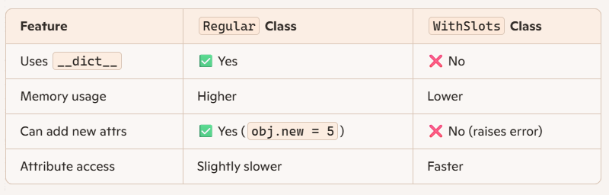
__slots__

Slide 25

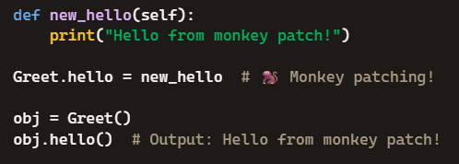
Monkey Patching
Monkey patching means changing or extending code at runtime — usually by modifying classes or functions that you didn’t write yourself.
Basic Example :

Slide 26
References
https://www.geeksforgeeks.org/machine-learning/difference-between-scalar-vector-matrix-and-tensor/#what-is-scalar
https://copilot.microsoft.com/
https://chatgpt.com/

