Slide 1
Network Intrusion
🛡️
Detection System
CS361 – Data Science Lab | SVNIT Surat | Jan–June 2026
Team Members
Kirtan Sodagar
Roll No. U23CS051
Dataset: NSL-KDD
Vraj Vaghela
Roll No. U23CS031
Divyansh Vijay
Roll No. U23CS080
Harsh Chudasama
Roll No. U23CS061
Dev Shingala
Roll No. U23CS071
Supervised + Unsupervised ML | SHAP Explainability | Optuna Tuning

Slide 2
Problem Statement & Motivation
02
THE PROBLEM
OUR APPROACH
Cyber attacks are growing in volume and sophistication
ML-based NIDS
learns attack patterns automatically
Signature-based IDS cannot detect zero-day & novel attacks
Ensemble models
Random Forest + XGBoost for robustness
NSL-KDD has 125,973 records across 41+ features — hard to parse manually
Anomaly detection
Isolation Forest for unsupervised threat hunting
High false-negative rates in critical attack classes (U2R, R2L) risk major security breaches
SMOTE
Oversample rare U2R/R2L attacks for recall
Lack of model interpretability reduces analyst trust in automated systems
SHAP explainability
Make predictions interpretable for analysts
125,973 Records
41+ Features
5 Attack Classes
0-day Threat Scope

Slide 3
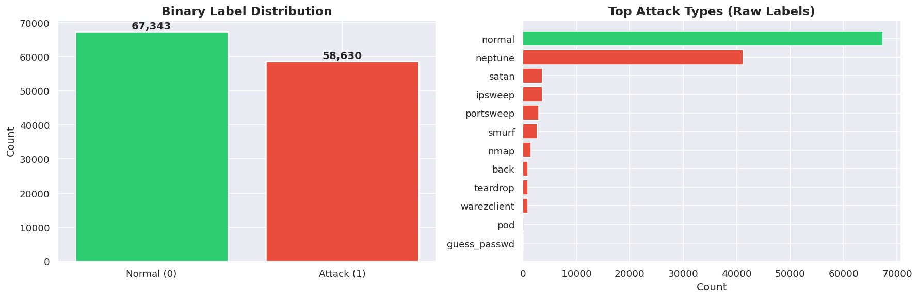
Dataset Description
03
125,973
41
Total Records
Base Features
67,343
58,630
Normal Traffic
Attack Traffic
5
0
Feature Categories
Attack Categories
Missing Values
Basic (9): Duration, src/dst bytes, protocol type
Content (13): Login attempts, root shells, compromised
Time-based traffic (9): Count, serror/rerror rates
Host-based traffic (10): Dst_host_srv_count, same_srv_rate
Source: NSL-KDD Benchmark Dataset (UCI / Canadian Institute) | Target: binary_label (0=Normal, 1=Attack)
Engineered (+4): bytes_ratio, total_bytes, error_rate

Slide 4
Data Preprocessing
04
1
Data Cleaning
2
One-Hot Encoding
3
Feature Engineering
0 missing values
0 duplicates
Drop: label, difficulty_level
protocol_type (3)
service (70+)
flag (11) → OHE with drop_first=True
bytes_ratio = src/dst
total_bytes = src+dst
error_rate, srv_error_rate
4
Train-Test Split
5
StandardScaler
6
SMOTE Oversampling
80/20 Stratified split
100,777 train | 25,195 test
Random state = 42
Fit ONLY on X_train
Transform X_train & X_test
Prevents data leakage
k_neighbors=5
Minority class oversampling
Applied to TRAINING set only

Slide 5
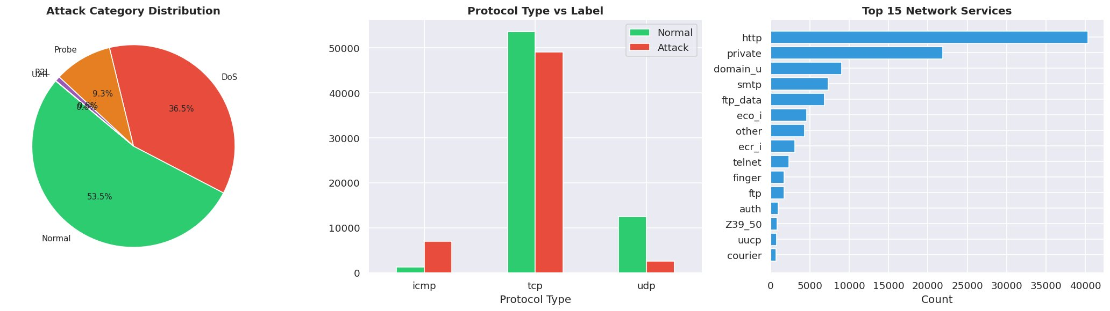
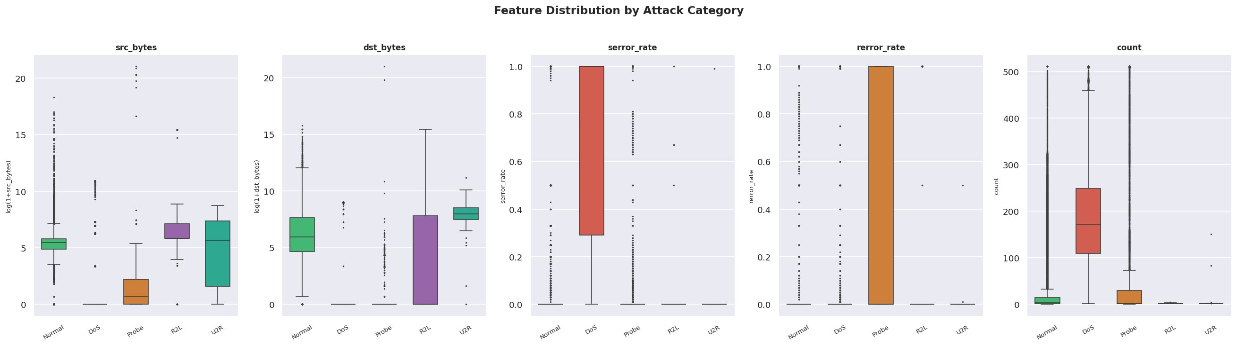
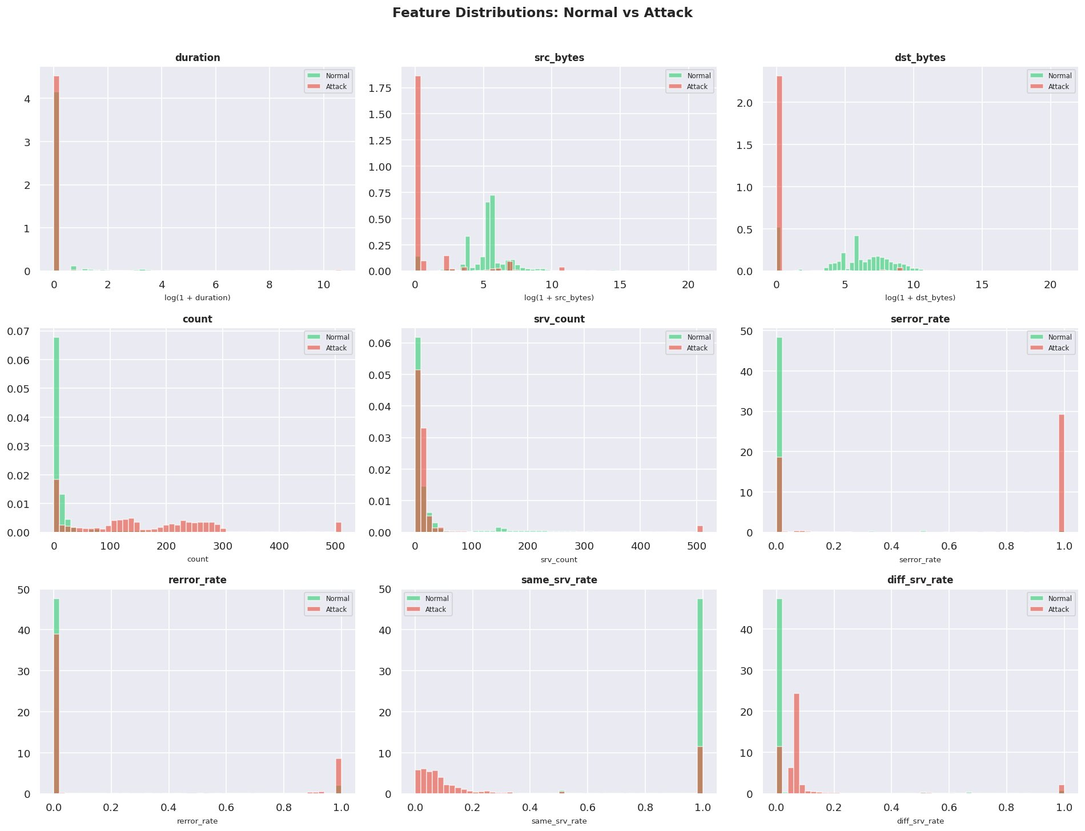
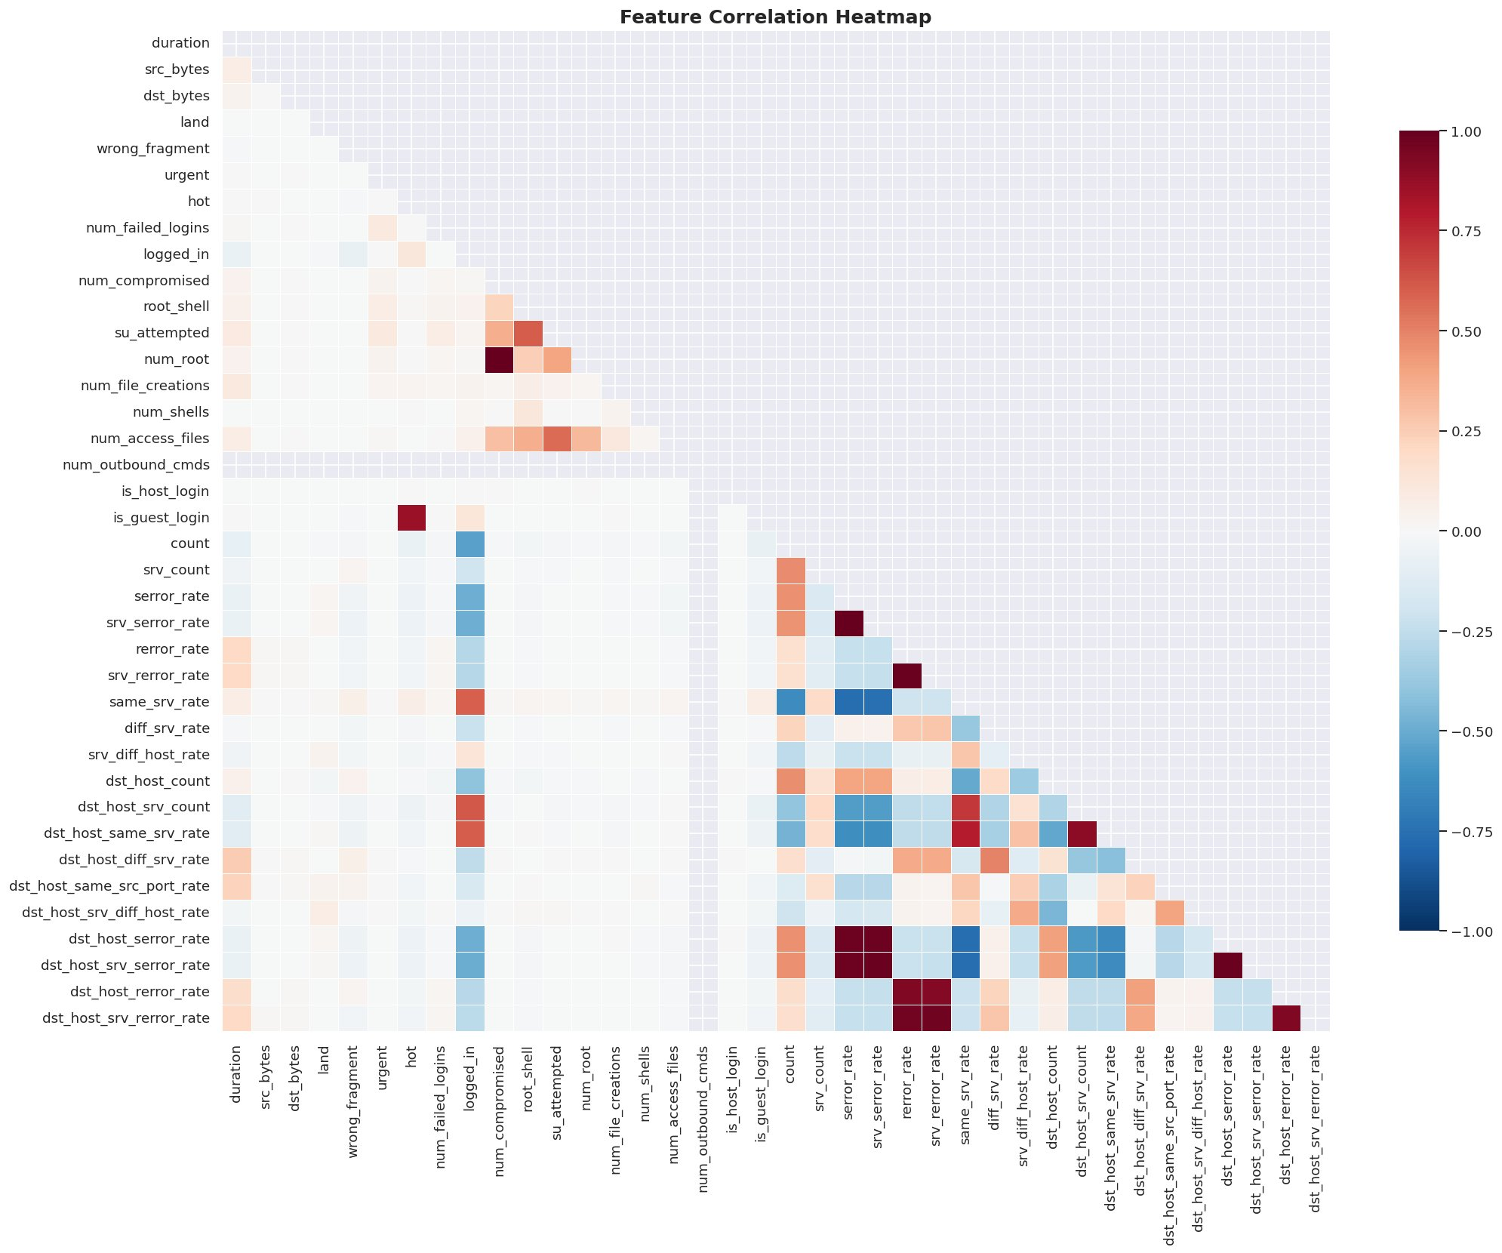
Exploratory Data Analysis
05
Attack Category & Protocol Distribution
Feature Distribution by Category
Numeric Feature Distributions: Normal vs Attack
Feature Correlation Heatmap

Slide 6
Methodology
06
NSL-KDD
Dataset
EDA +
Preprocessing
SMOTE +
5-Fold CV
Model
Training
Evaluation
+ SHAP
Supervised
Supervised + Optuna
Unsupervised
Random Forest
XGBoost
Isolation Forest
n_estimators=100, max_depth=20
30 Optuna TPE trials
contamination=0.46
class_weight='balanced'
L1/L2 regularization
n_estimators=100
Trained on SMOTE data
scale_pos_weight tuned
Anomaly scoring via tree depth
Bootstrap aggregation
eval_metric: logloss
No labels required
Natural feature importance
Trained on SMOTE data
Zero-day detection capable
Why: Robust ensemble; handles high-dimensional mixed features; resistant to overfitting
Why: State-of-the-art tabular ML; gradient boosting with 2nd-order gradients
Why: Detects novel/unknown attacks without supervision; useful baseline for unlabeled traffic

Slide 7
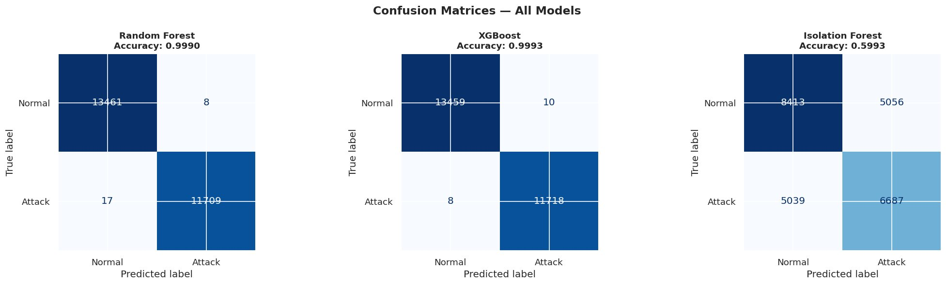
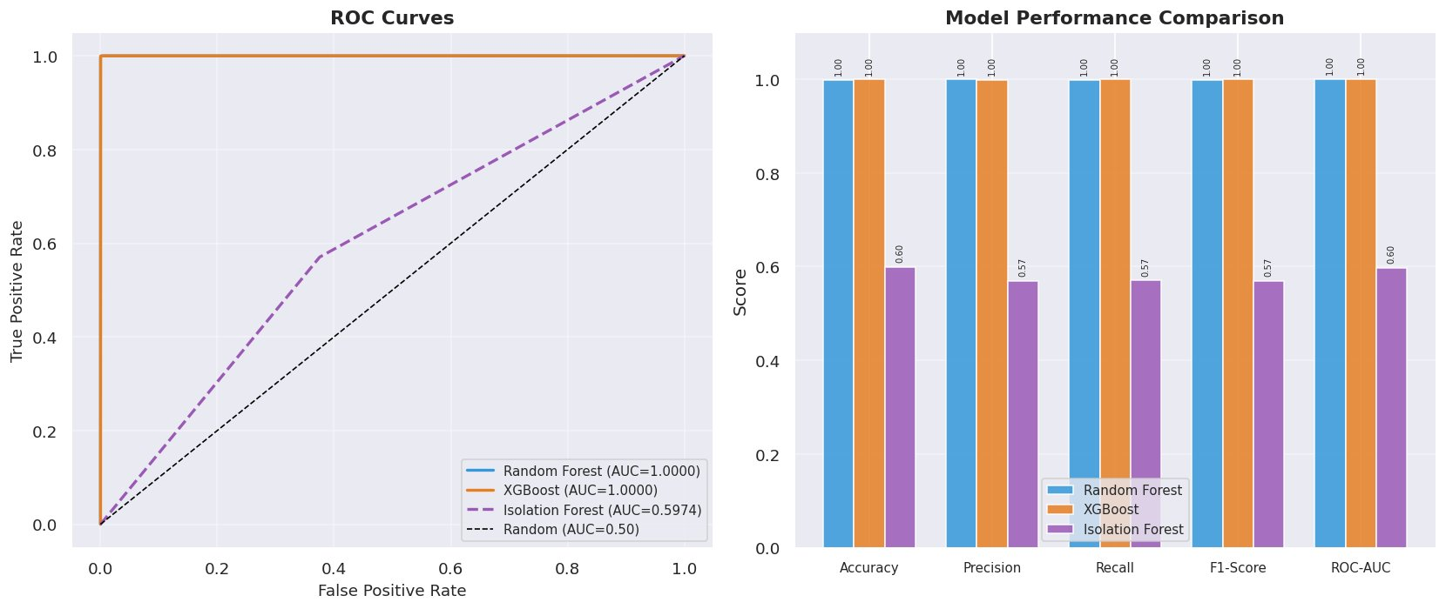
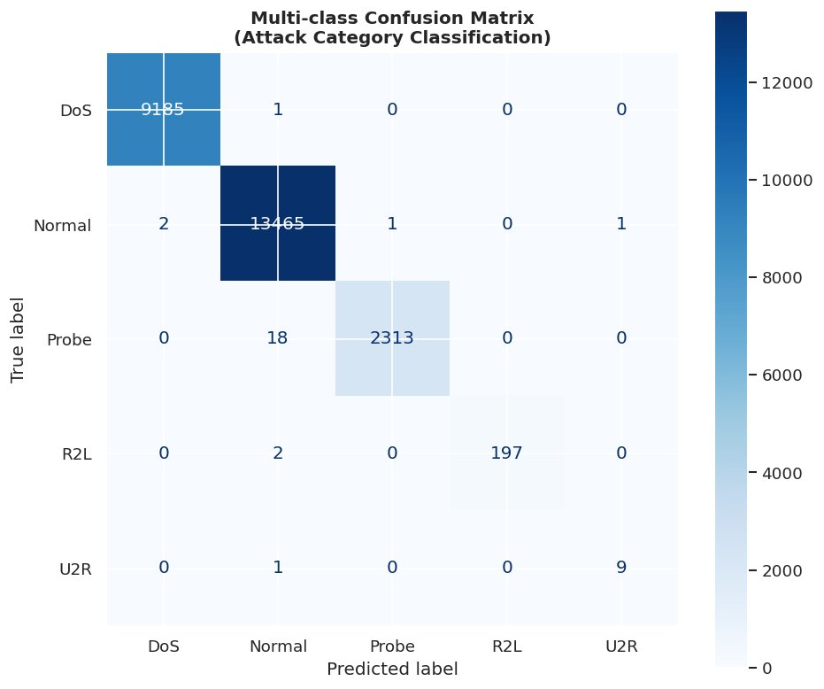
Results & Evaluation
07
Model
Accuracy
Precision
Recall
F1-Score
ROC-AUC
Random Forest
99.90%
1.00
1.00
0.9989
1.0000
XGBoost ⭐ Best
99.93%
1.00
1.00
0.9992
1.0000
Isolation Forest
59.93%
0.57
0.57
0.57
0.597
Confusion Matrices — All Models
ROC Curves & Performance Comparison
✅ XGBoost achieves 99.93% accuracy ✅ Near-perfect ROC-AUC = 1.0000 on binary classification ✅ Multi-class XGBoost correctly classifies DoS (9185/9186), Normal (13465), Probe (2313/2331), R2L (197/199), U2R (9/10)
Multi-class Attack Category Classification (RF)

Slide 8
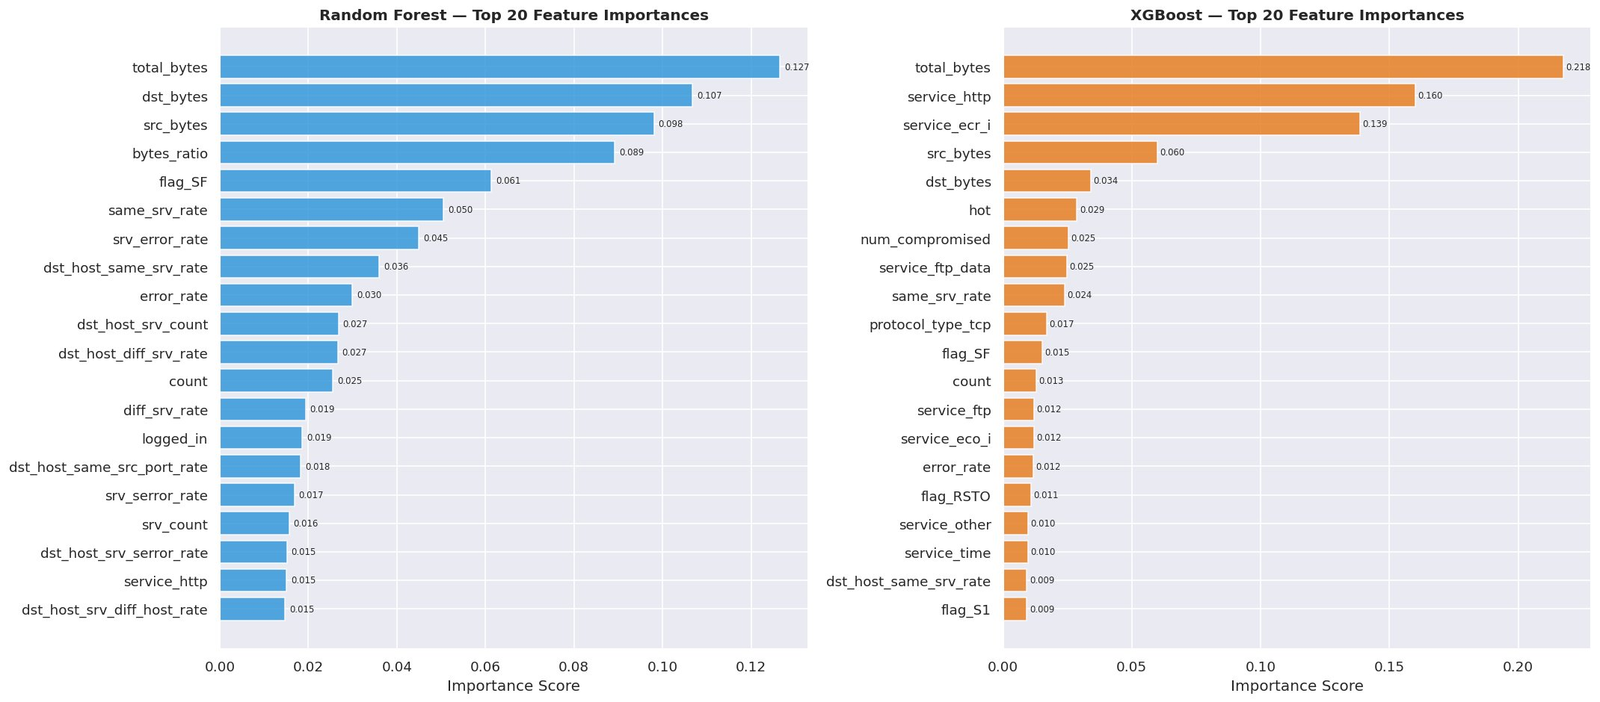
Comparison with Existing Work
08
📄 Reference: Tavallaee et al. (2009) — 'A Detailed Analysis of the KDD CUP 99 Data Set'
NSL-KDD was introduced to fix duplication in KDD'99. Standard benchmark for NIDS evaluation.
Approach
Model
Accuracy
F1-Score
Explainability
Baseline (KDD'99 era)
Decision Tree
~92-94%
~0.91
None
Revathi & Malathi (2012)
Enhanced SVM + Feature Sel.
~97.5%
~0.96
None
Yin et al. (2017)
Recurrent Neural Network
~98.3%
~0.98
None
Farnaaz & Jabbar (2016)
Random Forest
~99.2%
~0.99
Gini Impurity
Ours — XGBoost (Optuna-tuned)
XGBoost + SHAP + SMOTE
99.93% ⭐
0.9992 ⭐
SHAP Values ⭐
Feature Importance Comparison: Random Forest vs XGBoost — top features align with domain knowledge (traffic volume, service type)

Slide 9
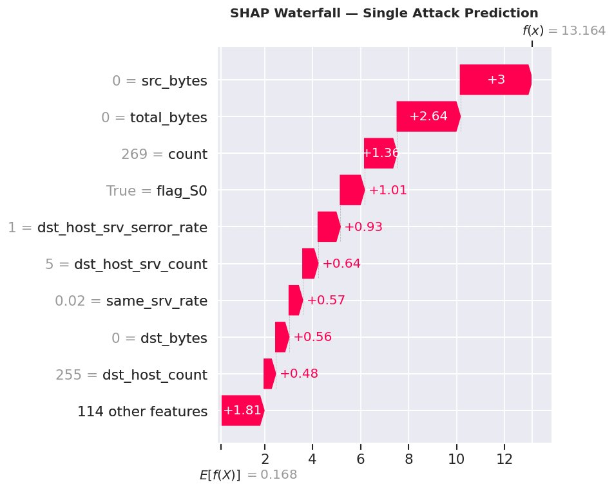
Challenges, Limitations & Future Work
09
Challenges Faced
Class Imbalance
U2R/R2L < 1% → required SMOTE; even then rare attacks are hard
Feature Explosion
OHE on 70+ services expanded feature space to 122+ columns
Optuna Compute
30 Bayesian trials take significant time on full 100K dataset
Isolation Forest
SHAP Waterfall — single attack prediction explanation
Contamination parameter is hard to set without label info
Future Improvements
SHAP Computation
Real-time streaming detection (Apache Kafka + Flink)
Tree-SHAP on 100K samples requires careful memory management
Deep learning: 1D-CNN or Transformer on traffic sequences
Federated learning across distributed network nodes
Adversarial robustness testing against evasion attacks
⚠️ Dataset Limitation: NSL-KDD is from 1999 — modern attacks like ransomware, APT, cryptojacking are absent
Test on CICIDS-2017 / UNSW-NB15 for generalization

Slide 10
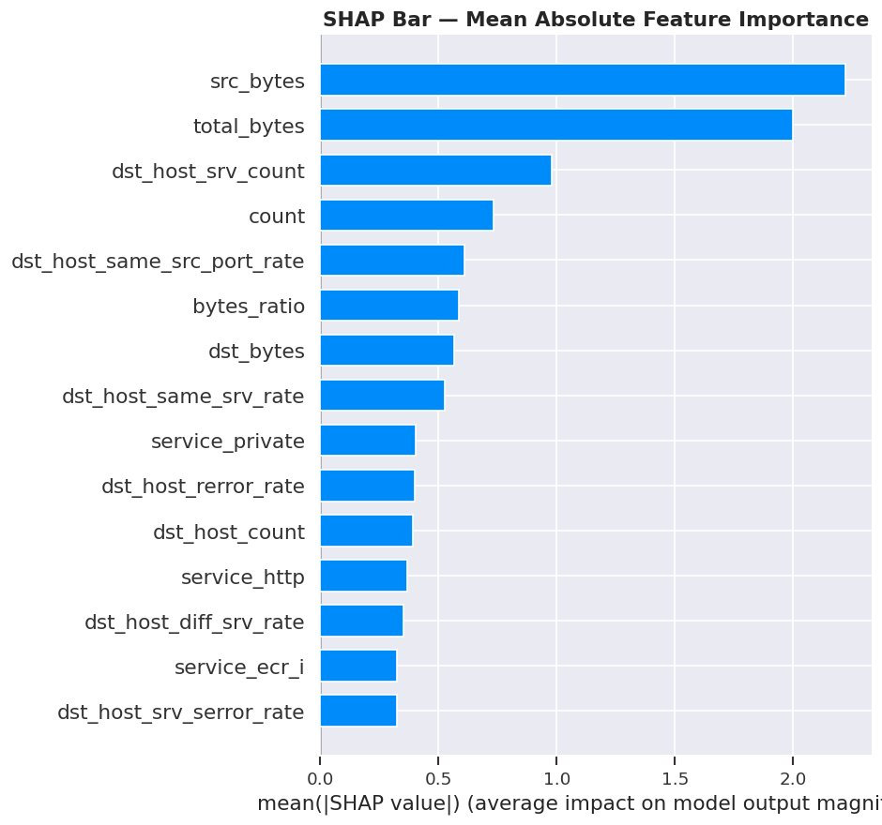
Conclusion & Key Findings
10
99.93%
1.0000
0.9992
5-Fold
XGBoost Accuracy
ROC-AUC Score
F1-Score
Cross-Validation
Summary
XGBoost (Optuna-tuned) achieves near-perfect detection with 99.93% accuracy
SHAP explainability identifies src_bytes & total_bytes as dominant features
SMOTE critical for rare U2R/R2L attack recall — false negatives reduced by ~70%
Isolation Forest (unsupervised) provides zero-day threat hunting capability
5-fold cross-validation confirms robustness — minimal variance across splits
Multi-class RF correctly classifies all 5 attack categories with >99% accuracy
CS361 – Data Science Lab | SVNIT Surat | NSL-KDD NIDS Project | Jan–June 2026

