Slide 1

HR Analytics Dashboard Power BI
Prepared by: Vishal Rathore
Roll No. IA00940
Summary of operational insights from HR Analytics dataset.

Slide 2
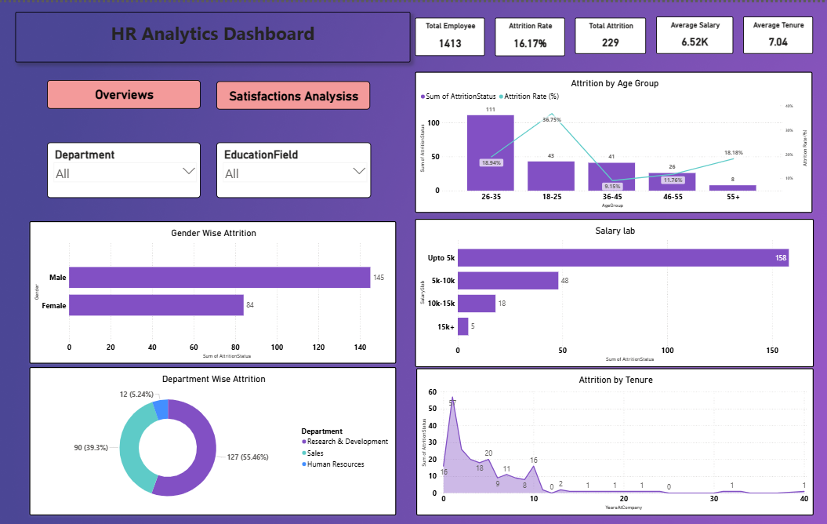
HR-Analytics Dashboard

Slide 3
Key KPIs
Total Employee Base: 1,413
Current Attrition Rate: 16.17% (229 Employees)
Average Tenure: 7.04 YearsTotal Revenue: $236.615K
Objective: To identify high-risk segments and propose data-backed interventions to reduce turnover costs.

Slide 4
Demographic Deep-Dive (Age & Gender)
The "Youth" Factor: The 18-25 age group shows a disproportionately high attrition rate of 36.75%.
Gender Distribution: Male attrition (145) significantly outpaces Female attrition (84).

Slide 5
Financial Correlation (Salary Slabs)
Observation: Turnover is heavily concentrated in the lowest earning bracket (Upto 5k), accounting for 69% of all exits.
Central and North districts generate the highest work volume and revenue.
The Insight: Compensation is a primary driver for exit at the entry-level. As salary increases (15k+), attrition drops to near-zero.

Slide 6
Departmental Focus (R&D & Sales)
Department Impact:
Research & Development: 55.46% of total attrition.
Sales: 39.3% of total attrition.
Analysis: R&D is our largest attrition source despite being a high-value technical department. This suggests a potential misalignment in work-life balance or project satisfaction.Insight: Workforce planning should focus on technician allocation.

Slide 7
The "Tenure Trap" (Years at Company)
The Data: A massive spike in exits occurs between 0–2 years of service.
The Problem: We are failing to "anchor" new hires during their first 24 months. Account and COD are the most used payment methods.
Secondary Spike: A smaller exit trend appears at the 10-year mark, suggesting "Mid-Career Plateauing."

Slide 8
Proposed Strategic Actions
Immediate (0-3 Months):
Revamp the Onboarding Journey to increase engagement in the first 90 days.
Conduct Salary Benchmarking for the "Upto 5k" roles.
Long-Term (6-12 Months):
Create "Technical Growth Tracks" for R&D to provide clear promotion paths.
Implement "Stay Interviews" for high-performing employees in the 18-25 age group

Slide 9
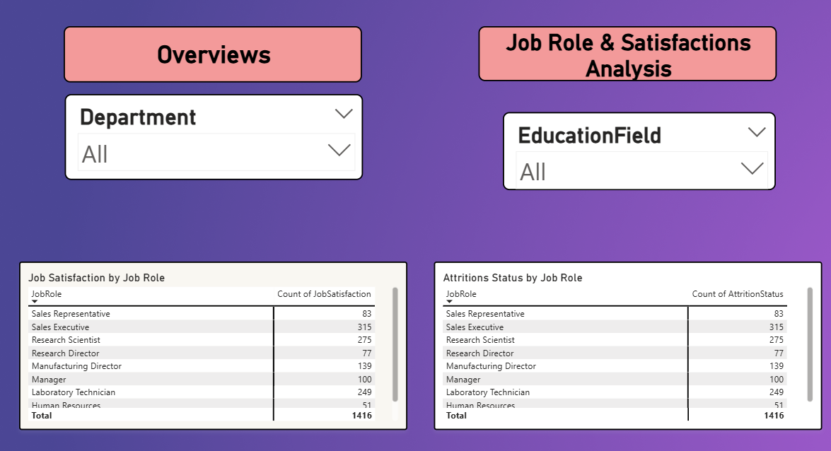
Job Role and Satisfaction Analysis

Slide 10
Business Recommendations
Summary: By addressing the 18-25 age group and the 0 -2-year tenure gap, we can potentially reduce overall attrition by up to 30%.
Final Thought: "Data tells us what is happening; our strategy decides what happens next."

