Slide 1

Work Order Analysis Dashboard Power BI
Prepared by: Vishal Rathore
Roll No. IA00940
Summary of operational insights from Work Order dataset.

Slide 2
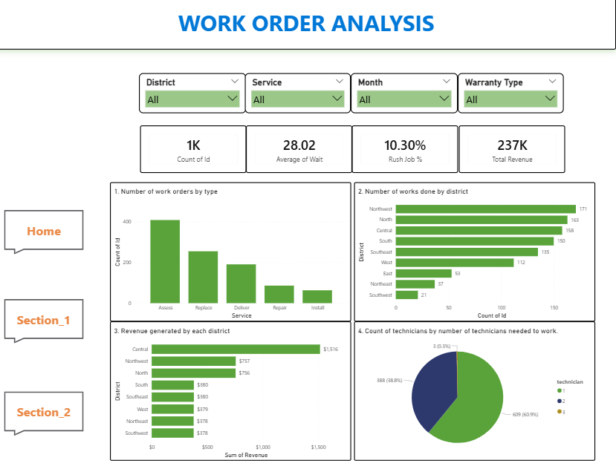
Home Dashboard

Slide 3
Key KPIs
Total Work Orders: 1,000 K
Average Wait Time: 28.02
Rush Jobs: 10.3%
Total Revenue: $236.615K
Insight: Moderate rush demand and stable revenue from service operations.

Slide 4
Service Type Analysis
Assess services have the highest number of work orders.
Replace and Deliver services are mid‑range.
Repair and Install services are comparatively lower.
Insight: Demand is concentrated in diagnostic/assessment services.

Slide 5
District Performance
Central and North districts generate the highest work volume and revenue.
Southwest and Northeast districts have lower activity.
Insight: Service demand is geographically concentrated.

Slide 6
Technician & Labor Analysis
Most jobs require 1–2 technicians.
Install and Repair require the highest technician average.
Insight: Workforce planning should focus on technician allocation.

Slide 7
Warranty & Payment Insights
Majority of jobs have no warranty.
Some jobs covered under labours work or parts warranty.
Account and COD are the most used payment methods.

Slide 8
Cost & Revenue Insights
Install and Repair services generate higher costs and revenue.
Deliver services have the lowest operational cost.
Insight: Profit margins likely highest in mid‑complexity services.

Slide 9
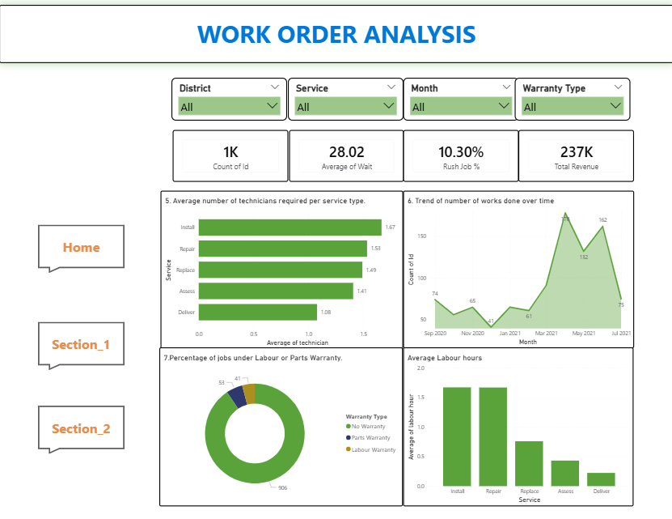
Section_1

Slide 10
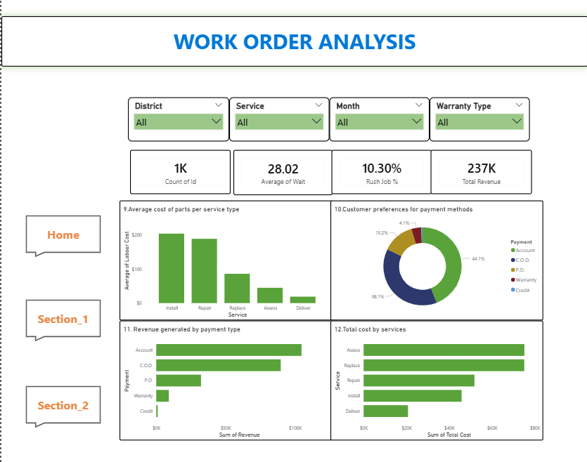
Section_2

Slide 11
Business Recommendations
• Increase technician allocation in high demand districts.
• Promote maintenance packages to reduce rush jobs.
• Improve service coverage in low performing districts.
• Optimize pricing for high‑cost services like Install and Repair.
• Encourage digital payments for faster processing.

