Slide 1

Merging Processes at EverSure
Business Process Management Project
Team Members: Vibhu, Arnav, Archie, Isha, Richa, Sahaj
Course: BUS 353: Business Process Management

Slide 2





Project Overview
EverSure
Challenge
20+ years in business insurance
Acquired digital competitor to remain competitive
Goal
Project Objectives
Merge traditional and digital processes effectively
Model current processes using BPMN
Analyze efficiency and identify issues
Propose improvements for merged process

Slide 3
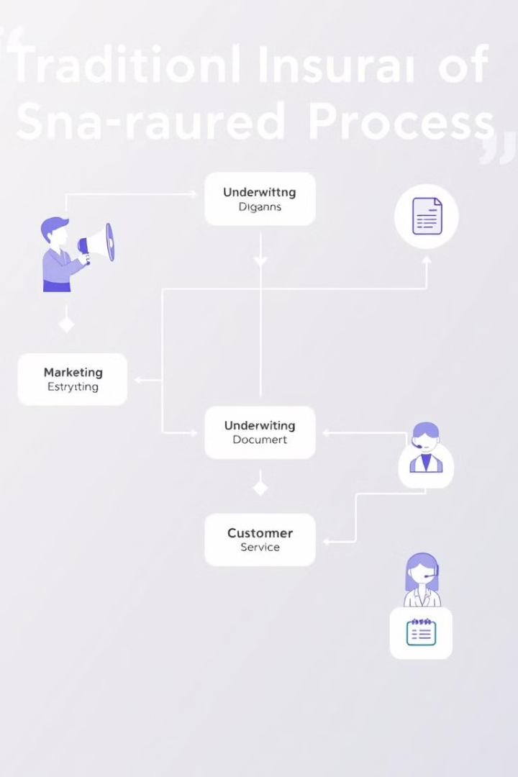
Traditional Process BPMN Model
High-Touch Approach
Relationship-based sales process with personalized customer interactions
Multiple Handoffs
Several transfers between sales representatives and administrative staff
High-Value Contracts
20,000€ average contract value
Low Volume
100 visits/month with focused attention on each client

Slide 4
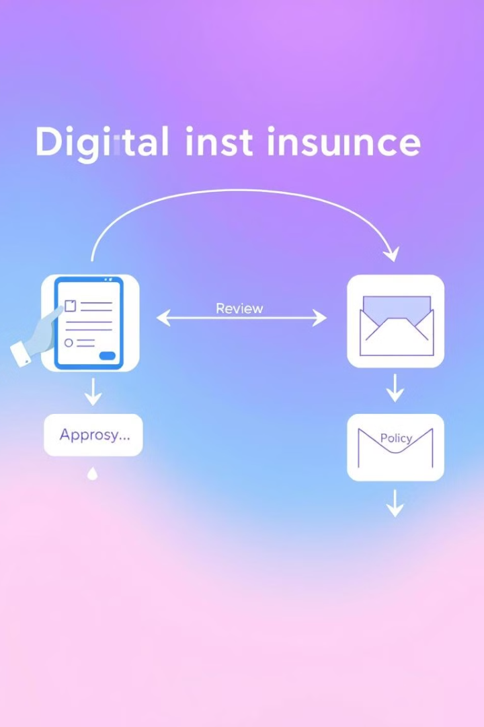




Digital Process BPMN Model
Automated Lead Generation
Digital acquisition and filtering of potential clients
Standardized Offers
Minimal customization for efficiency
Lower-value Contracts
500€ average contract value
High Volume
1,000 leads/month processed

Slide 5
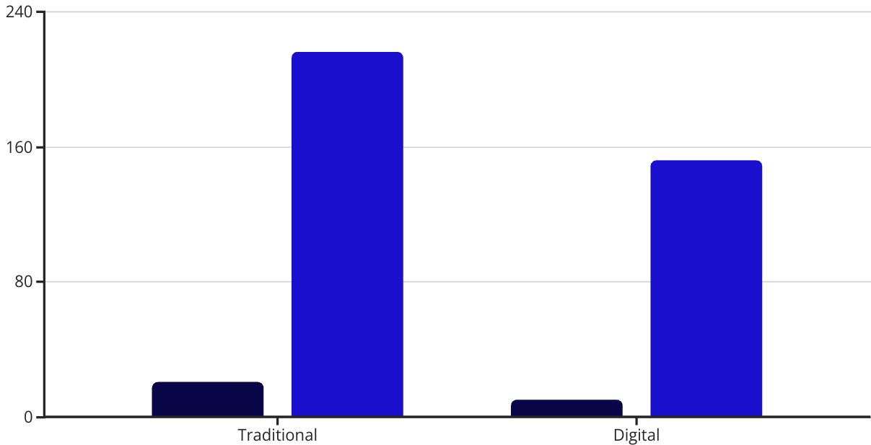
Cycle Time Efficiency Analysis
Processing Time (hours)
Waiting Time (hours)
Traditional Process: Processing time: 21 hours, Waiting time: 216 hours, Cycle time efficiency: 8.86%
Digital Process: Processing time: 10.27 hours, Waiting time: 152 hours, Cycle time efficiency: 6.33%
Both processes have significant efficiency issues

Slide 6
Issue 1: Inefficient Information Systems
Multiple Disconnected Systems
Consequences
Traditional: CNTR and OPER
Higher error rates in digital process (15% vs. 5%)
Digital: INSU and AUIN
Duplicate customer information
Missed cross-selling opportunities
Higher IT costs

Slide 7



Issue 2: Excessive Waiting Times
Customer Report Preparation
1 week waiting time
Meeting Scheduling
2 weeks total time
Offer Preparation
3 days total time
Impact:
Extended sales cycle
Reduced competitiveness
Fewer customers served
Opportunity cost of 20% more potential customers

Slide 8






Issue 3: Poor Lead Quality
Initial Filtering
50% of leads filtered out
Non-responsive Leads
70% of remaining leads never respond
Low Conversion
Only 10% of leads with offers convert
Impact:
Wasted marketing effort
Low return on investment
Inefficient resource allocation

Slide 9








Redesign Proposal 1: Unified Information System
CNTR
OPER
Traditional contracts system
Traditional operations system
AUIN
INSU
Digital automation system
Digital insurance system
Benefits:
Reduced error rates (from 15% to 5%)
10% reduction in back office processing time
20,000€ annual IT cost savings
Improved cross-selling opportunities
BPR principles: Technology enablement, Integration, Standardization

Slide 10

Redesign Proposal 2: Hybrid Lead Generation
20%
15%
50%
Improved Lead Ratio
Conversion Rate
Response Rate
Better quality prospects
Up from 10%
Down from 70% non-response
What: Combined approach with advanced lead scoring
BPR principles: Task elimination, Triage, Empower

Slide 11
Thank You !
We welcome your Questions and Feedbacks.

