Slide 1
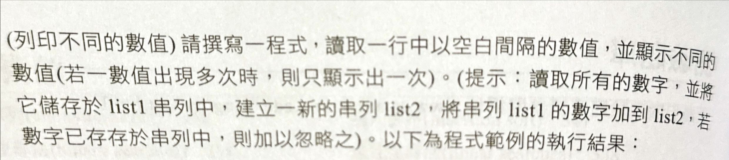
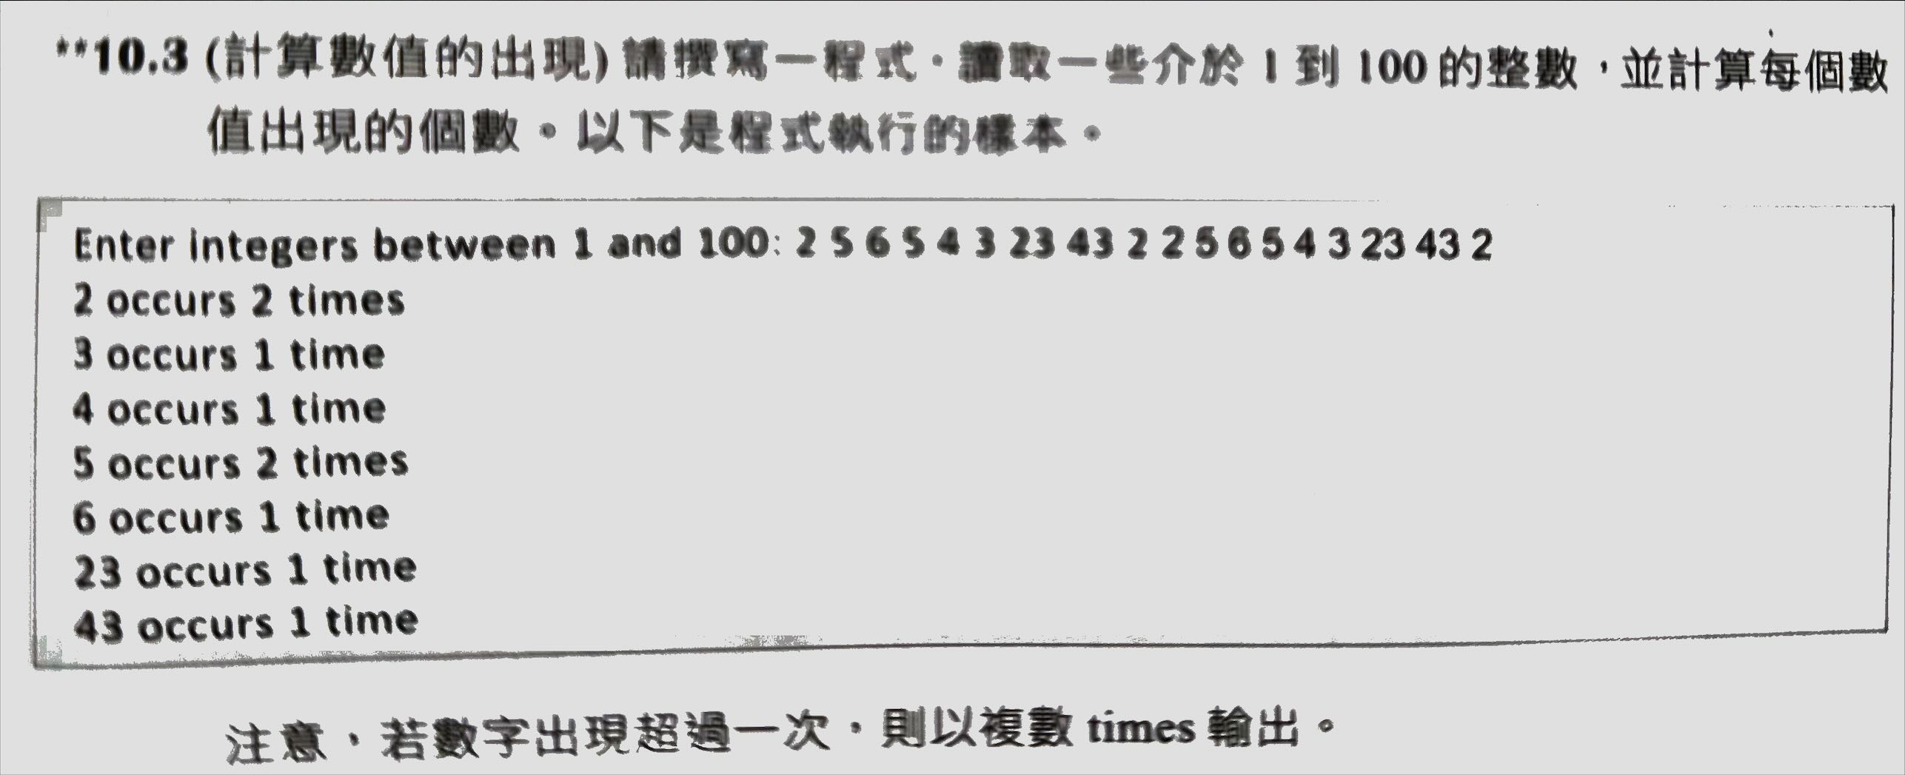
Homework
1.
2.

Slide 2
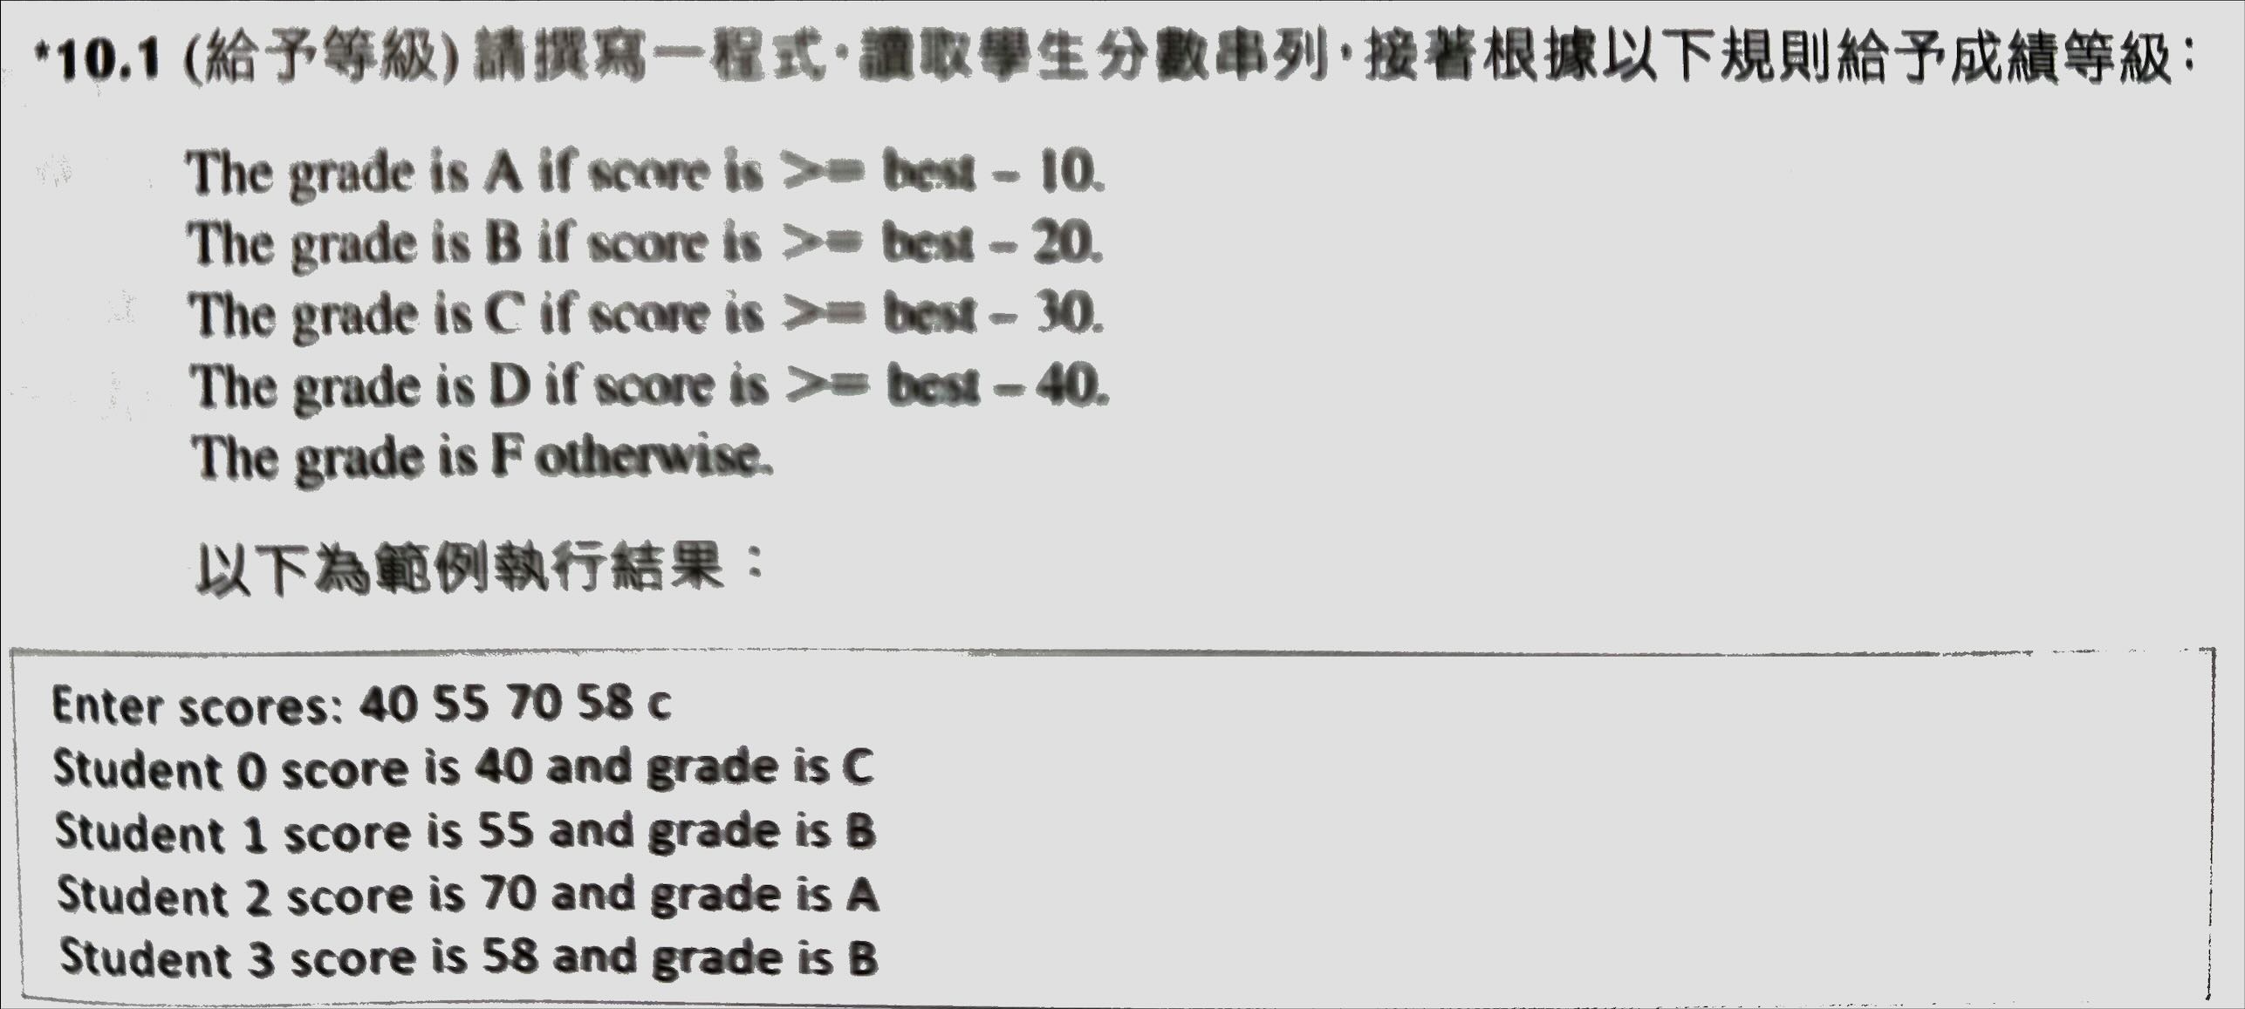
Homework 2
3.

Slide 3
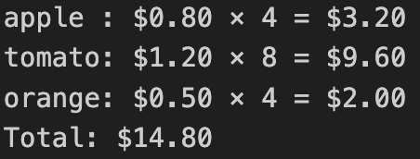
Homework 3
4. Please process the long string in the file, ‘3_4_input.txt’ and calculate:
(1)Total # of words:
(2)Total # of word’s type:
(3)The first three words that most frequently appear in the article and their #:
(4)List the first three words that only appear once in the article in lexical order.
(5)Count the # of each character’s (a-z, 0-9) appearance in the article and print it out.
Ex: a->100
b->50
c->88…
5. In a grocery store, the price lists are as below:
fruits_prices = {"apple": 0.80, "grape": 0.60, "orange": 0.40}
veggies_prices = {"tomato": 1.80, "pepper": 1.40, "onion": 1.23}
The order list is : order = {”grape": 4, "tomato": 10, "orange": 4, “pepper”:1}.
Please write a program with only one “for loop” to calculate the total price of each item and the total amount of the bill for the order list.
Ex:

Slide 4
測資 3_1_input.txt Ans: {1, 2, 3, 4, 5, 6, 33, 7, 8, 100, 44, 22} 順序不重要
測資3_2_input_1.txt Ans: Invalid input
測資3_2_input_2.txt Ans: Invalid input
測資3_2_input_3.txt
Ans: (順序不重要 單數要time 複數要times)
7 occurs 1 time
2 occurs 4 times
5 occurs 4 times
6 occurs 2 times
4 occurs 2 times
3 occurs 2 times
23 occurs 2 times
43 occurs 2 times

Slide 5
3. 測資3_3_input.txt (順序要一樣)
Student 0 score is 10 and grade is F
Student 1 score is 100 and grade is A
Student 2 score is 33 and grade is F
Student 3 score is 40 and grade is F
Student 4 score is 60 and grade is D
Student 5 score is 77 and grade is C
Student 6 score is 89 and grade is B
Student 7 score is 90 and grade is A
Student 8 score is 55 and grade is F
Student 9 score is 0 and grade is F

Slide 6
a->2650
b->467
c->1238
d->1040
e->4184
f->844
g->538
h->1681
i->2576
j->72
k->176
l->1389
m->867
n->2357
o->2614
p->646
q->42
r->2099
s->2229
t->3098
u->769
v->476
w->438
x->68
y->561
z->21
0->19
1->80
2->19
3->15
4->15
5->26
6->18
7->18
8->18
9->54
4. 答案Title不重要
Total # of words: 6799
Total # of word's types: 2109
The first three words that most frequently appear in the article: [('the', 547), ('of', 409), ('a', 209)]
The first three words that appear only once in the article: ['14thcentury', '1665', '1715']

Slide 7
5. Code僅能有一個迴圈
答案格式不用完全一模一樣
grape : $0.60 x 4 = $2.40
tomato: $1.80 x 10 = $18.00
orange: $0.40 x 4 = $1.60
pepper: $1.40 x 1 = $1.40
Total: $23.40

