Slide 1
CS 261 – RECITATION 5
SPRING 2010. OREGON STATE UNIVERSITY.

Slide 2

BINARY SEARCH TREE
Binary : Every node maximum 2 children
Search : Construction based on Binary search
What is binary search?
Example: The way we search in a dictionary
Not dictionary.com !
Binary search trees are binary tree’s where every node’s object value is:
Greater than or equal to all its descendants in the left sub tree
Less than or equal to all its descendants in the right sub tree

Slide 3
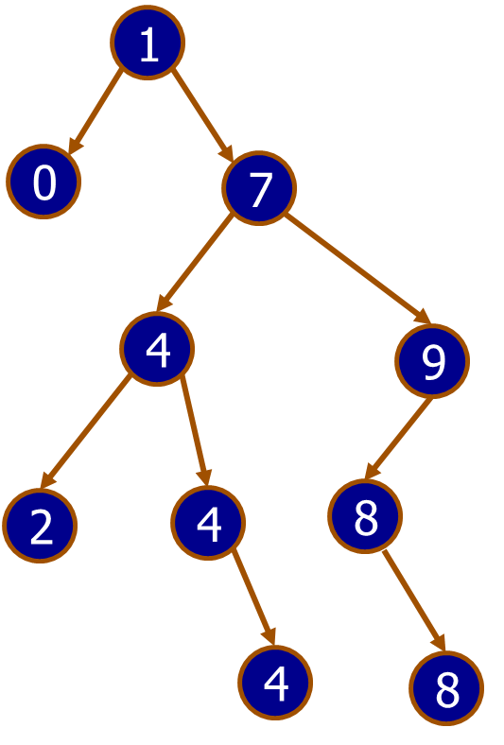
EXAMPLE OF TREE
What is the root?
What is the parent of nodes 4 and 9?
What are the interior nodes?
What are the leaf nodes?
What is the sibling of 9?
What are the descendents of 7?
What is the height of 7?
Is this a binary search tree?

Slide 4
THE DATA STRUCTURE: BST
Distinguishing properties of the tree as WHOLE:
Root : every tree has one and only one root.
Num of nodes
So, we have
Properties of individual nodes:
Value: Each existing node has certain value
Left and Right children: These can be be null. Eg. 0 in the adjacent tree
So, we have:
struct BSTree {
struct Node *root;
int cnt;
};
struct Node {
TYPE val;
struct Node *left;
struct Node *rght;
};

Slide 5
OPERATIONS ON A BST
int main() {
struct BSTree *tree1 = newBSTree();
}
void initBSTree(struct BSTree *tree)
{
tree->cnt = 0;
tree->root = 0;
}
struct BSTree *newBSTree()
{
struct BSTree *tree = (struct BSTree *)malloc(sizeof(struct BSTree));
assert(tree != 0);
initBSTree(tree);
return tree;
}

Slide 6
OPERATIONS ON BST (CONTD..)
Lets see the operations in action.
http://people.ksp.sk/~kuko/bak/big/
Note: The above applet does not accept duplicate entries in the BST (like most of BST implementations)
Try following functions in the applet:
void addBSTree(struct BSTree *tree, TYPE val);
int containsBSTree(struct BSTree *tree, TYPE val);
void removeBSTree(struct BSTree *tree, TYPE val);

Slide 7
IN-DEPTH ANALYSIS OF REMOVE
Find leftmost node of the right child of the node to be removed
Which is leftmost node of the right child of 7?
8
So, free(node 7) and replace it by (node 8)
Node removeNode(Node current, TYPE value)
if value = current.value
if right child is null
return left child
else
replace value with leftmost child of right child
set right child to be removeLeftmost(right)
else if value < current.value
left child = removeNode(left child, value)
else right child = removeNode(right child, value)
return current node
null

Slide 8
INSIGHT INTO ASSIGNMENT 4
In the earlier examples, we considered integer values like 3, 4, 8 as nodes.
But in real-world examples we will have to arrange complex data structures in a tree according to one of its properties.
Eg. Arrange pizzas on the basis of number of toppings.
Here, we have to store all the data regarding the pizza as a node.
But the arrangement of these nodes will be based on a single property (numToppings)
Name=Mushroom
numTop=3
Price=7.5
Name=Chicken
numTop=2
Price=8.5
Name=Pepperoni
numTop=5
Price=8

Slide 9
IMPORTANT TASKS
Figure out way to compare instances of data structures
int compare(TYPE left, TYPE right)
{
      /*
      if left < right return -1
      if left > right return 1
      if left = right return 0
      */
}

Slide 10
GUESS THE ANIMAL GAME
Implementing a binary tree
  Interior nodes: Questions
  Leaf nodes: Animal names
  “Yes” answer: Move to left subtree
  “No” answer: Move to right subtree
Does it mew?
yes
no
Is it domestic?
Does it bark?
yes
no
yes
no
cat
Big cat
dog
elephant

Slide 11
EXAMPLE RUN
Is the animal a cat?
N
Really? What was your animal?
Dog
Please enter a question that is true for a cat but not of a Dog..
Does it mew?
You Win!! I'll remember that. Please play again later.

Slide 12
NOW WE HAVE SOME DATA IN THE FILE
Case 1 :
Does it mew?
Y
Is the animal a cat
Y
I win! Thanks for playing!
Case 2:
Does it mew?
Y
Is the animal a cat
N
Really? What was your animal?
Big Cat
Please enter a question that is true for a cat but not of a Big Cat
Is it domestic?
You win!! I'll remember that. Please play again later.

