Slide 1
Using Cloud top Temperature for Cyclone forecast using Machine Learning approach
Vrishabh Kenkre |19ME01009 | Under the Supervision of Dr. Srinivasa Ramanujam Kannan

Slide 2
Contents
Prelude
Methodologies Used
Diurnal Variation
Neural Network approach
Result
References

Slide 3
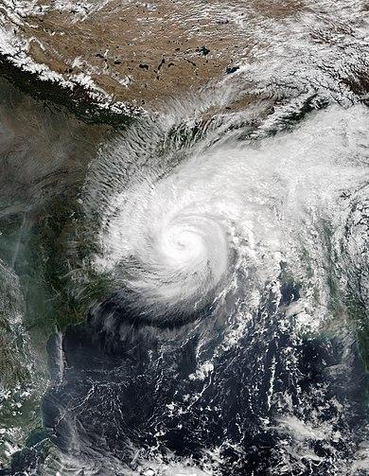
Prelude
Tropical cyclone forecasting is the science of forecasting where a tropical cyclone's center, and its effects, are expected to be at some point in the future.
To predict the occurrence and path of cyclone at minimum of 5-7 days before its arrival with sufficient accuracy from satellite image data.
Notes:
Insert a map of your country.

Slide 4
Methodologies Used
Diurnal Variation study of TC’s characteristics for forecasting
Neural Network model for predicting Cyclone track using stacked LSTM.
Notes:
Insert a picture of one of the geographic features of your country.

Slide 5
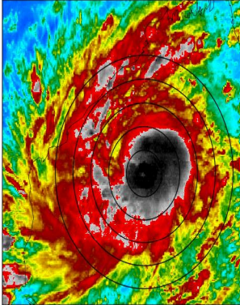
Diurnal Variation study of TC’s characteristics for forecasting
Brightness temperature is the temperature at which a black body in thermal equilibrium with its surroundings would have to be in order to duplicate the observed intensity of a grey body object at a frequency nu.
For our analysis we take three thresholds of TIR-BT namely deep cold clouds (TIR-BT < 210 K), cold clouds (210 K< TIR-BT < 240 K) and warm clouds (TIR-BT > 240 K).
Notes:
Insert a picture illustrating a season in your country.

Slide 6
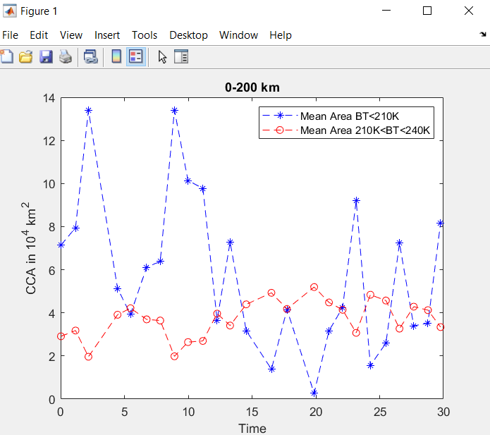
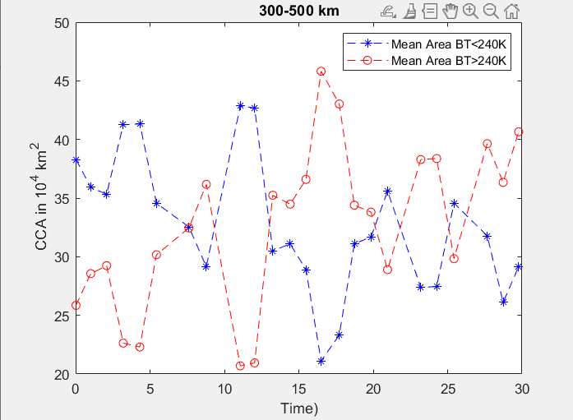
Diurnal Variation study of TC’s characteristics for forecasting
Variation of cloud cover area and cloud top temperature of specific cyclone.
The temporal evolution of the areal extent of the clouds and TIR-BT for the cyclone Hudhud is studied.
It can be noted from the CCA plots that diurnal variation of CCA of deep cold clouds and cold clouds are opposite in phase and magnitude in the inner region of the cyclones. Similar trends are observed for outer region of cold clouds
Notes:
Insert a picture of an animal and or plant found in your country.

Slide 7
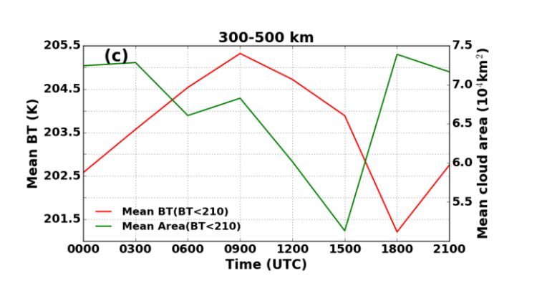
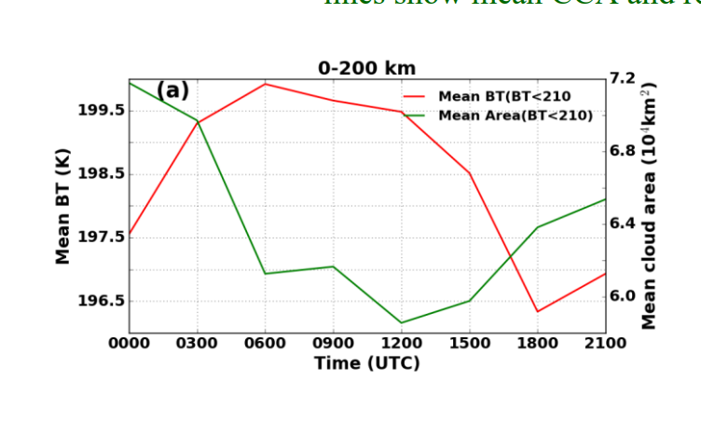
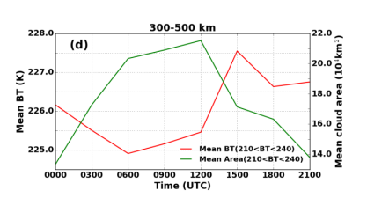
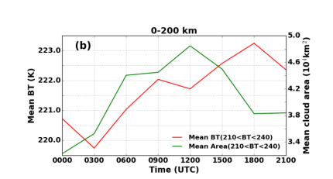
Diurnal Variation study of TC’s characteristics for forecasting
Notes:
Add key points in the history of your country to the timeline.

Slide 8
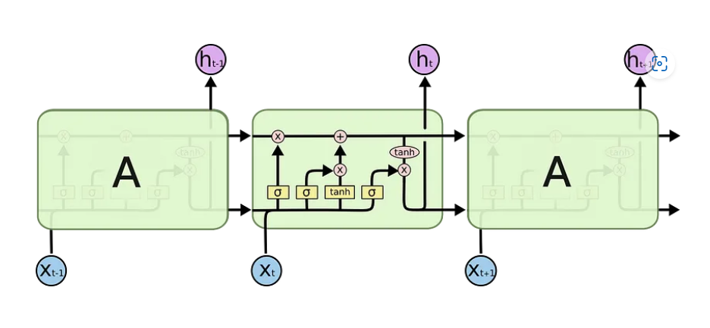
Neural Network model for predicting Cyclone track using stacked LSTM.
Long Short Term Memory networks — usually just called “LSTMs” — are a special kind of RNN, capable of learning long-term dependencies.
LSTMs are explicitly designed to avoid the long-term dependency problem.
LSTM- Long Short-Term Memory. Long Short Term Memory networks —… | by Prasoon Singh | Analytics Vidhya | Medium
Notes:
Insert a picture illustrating a custom or tradition here.

Slide 9
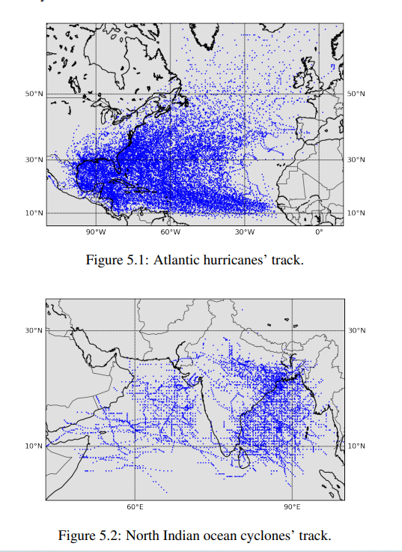
Neural Network model for predicting Cyclone track using stacked LSTM.
Data- Hurricane data from NOAA database and BTD data in NI basin from RSMC.
All cyclone from 1920 to 2012 with 6-hr interval. Around 16,394 recordings.
Factors taken- ECP, MSSWS, Lat, Long.
Instead of Lattitude and Longitude we take Distance and direction.
Notes:
Insert a picture of the head leader of your country.

Slide 10
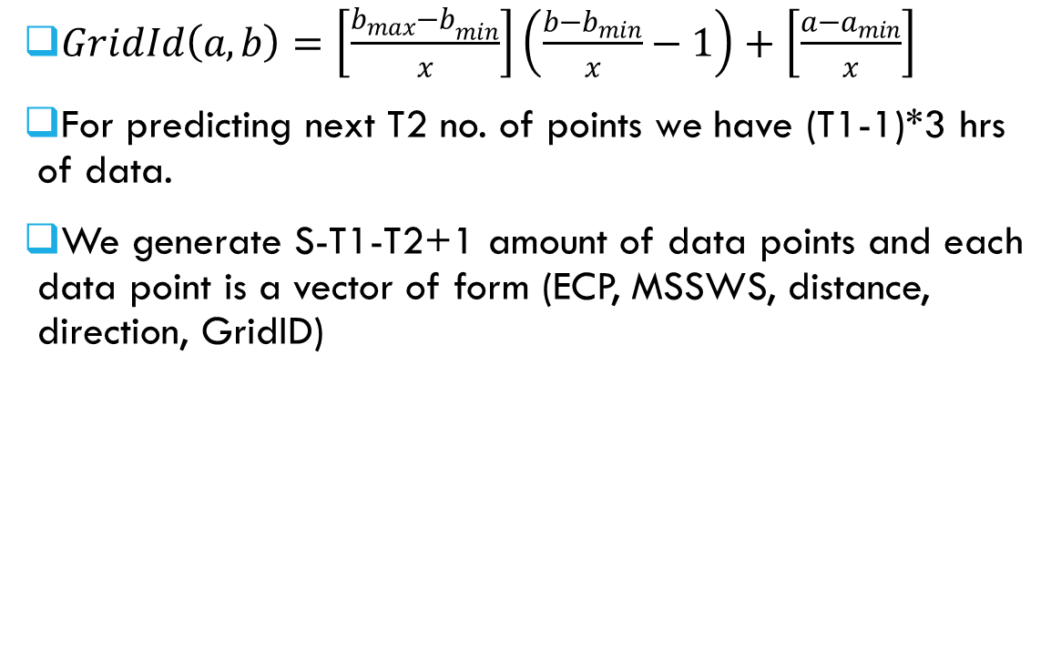
Neural Network model for predicting Cyclone track using stacked LSTM.
$GridId\left(a,b\right)=\left[\frac{{b_{max}−b}_{min}}{x}\right]\left(\frac{b−b_{min}}{x}−1\right)+\left[\frac{{a−a}_{min}}{x}\right]$
For predicting next T2 no. of points we have (T1-1)*3 hrs of data.
We generate S-T1-T2+1 amount of data points and each data point is a vector of form (ECP, MSSWS, distance, direction, GridID)
Notes:
Insert a picture that illustrates some part of your country’s economy.

Slide 11
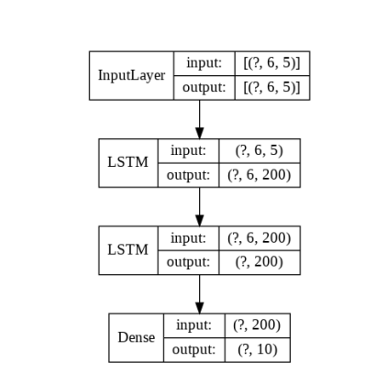
Neural Network model for predicting Cyclone track using stacked LSTM.
It has one input layer, 2 hidden layers of size 200 each and an output layer.
Loss function is Mean Square error, Adam optimizer was used with learning rate of 0.01, and ReLU as activation function.
Notes:
Insert a picture of one of the points of interest for your country.

Slide 12
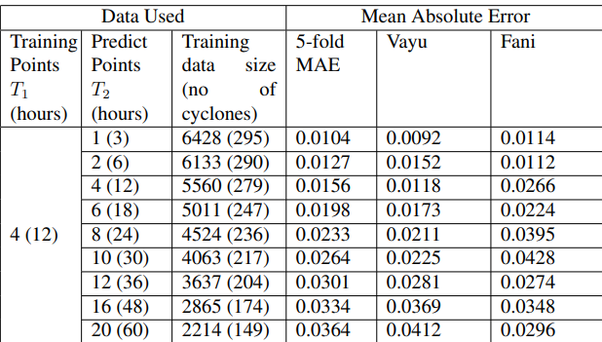
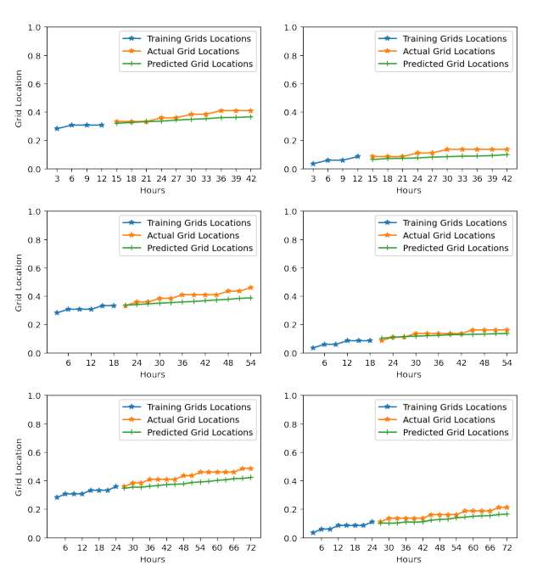
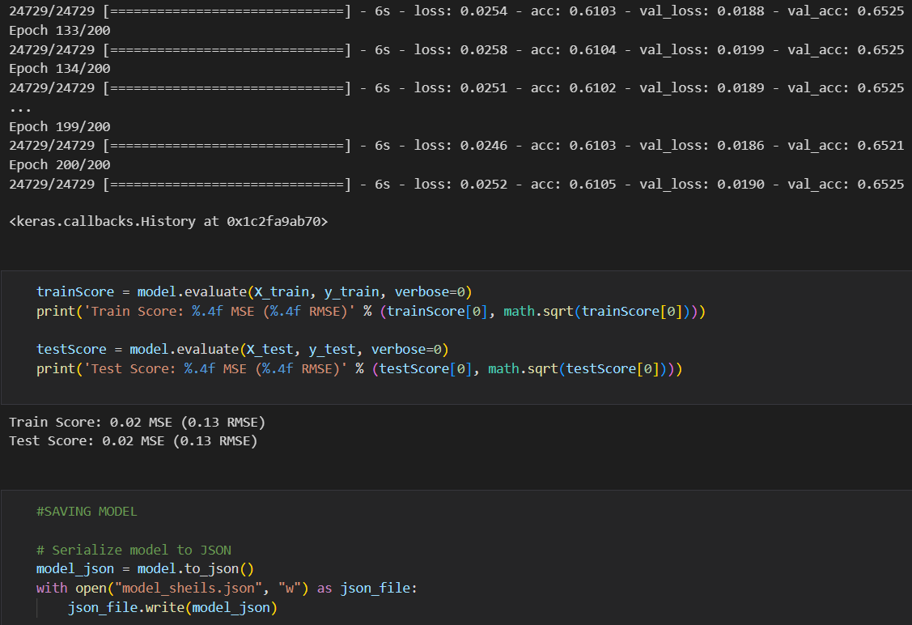
Results
Fig: Model performance on Indian ocean cyclone data
Fig:- Showing no. of epochs and MSE error
Fig:- Grid prediction charts for Cyclone Vayu and Fani for T1 = 4, 6, 8 and T2 = 10, 12, 16.

Slide 13
References
https://gmd.copernicus.org/articles/15/7051/2022/gmd-15-7051-2022.pdf
https://towardsdatascience.com/read-era5-directly-into-memory-with-python-511a2740bba0
https://www.ijcmas.com/special/9/Vikash%20Kumar%20Sharma,%20et%20al.pdf
https://www.nature.com/articles/s41598-019-52437-6
https://ieeexplore.ieee.org/document/8489077
https://agupubs.onlinelibrary.wiley.com/doi/full/10.1029/2020GL090397
https://www.ncbi.nlm.nih.gov/pmc/articles/PMC5779857/
https://iee.psu.edu/events/investigating-diurnal-cycle-tropical-cyclones
https://github.com/GMfatcat/ConvLSTM-CNN-for-tropical-cyclone
https://unidata.github.io/python-training/workshop/Bonus/downloading-gfs-with-siphon/
Pegahfar, N., Gharaylou, M. Entropy evolution characteristics during an intense tropical cyclone. Meteorol Atmos Phys 132, 461–482 (2020). https://doi.org/10.1007/s00703-019-00701-9

Slide 14
Thank You

