Slide 1
Using Cloud top Temperature for Cyclone forecast using Machine Learning approach
By- Vrishabh Kenkre
Roll no.- 19ME01009
Under the supervision of – Dr. Srinivasa Ramanujam Kannan

Slide 2
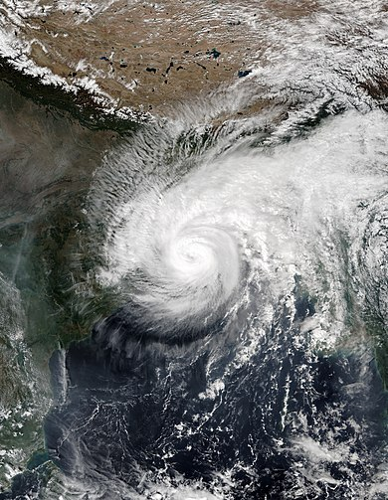
Prelude
Tropical cyclone forecasting is the science of forecasting where a tropical cyclone's center, and its effects, are expected to be at some point in the future.
To predict the occurrence of cyclone at minimum of 5-7 days before its arrival with sufficient accuracy from satellite image data.
https://en.wikipedia.org/wiki/Cyclone_Matmo%E2%80%93Bulbul

Slide 3
Methodologies used
Entropy
Air–sea thermodynamic disequilibrium(ASTD)
Brightness Temperature

Slide 4
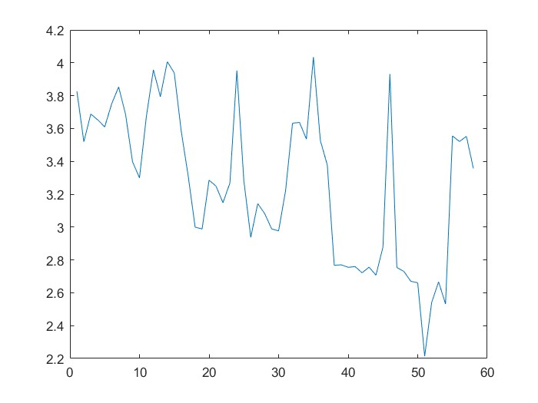
Entropy of Information
The entropy of a variable is the average level of "information", "surprise", or "uncertainty" inherent to the variable's possible outcomes.
The information of this relationship is described by the function
log₂(1/p(E))
OR
I(E) = - log₂(p(E))
Cyclone Bulbul entropy variation

Slide 5
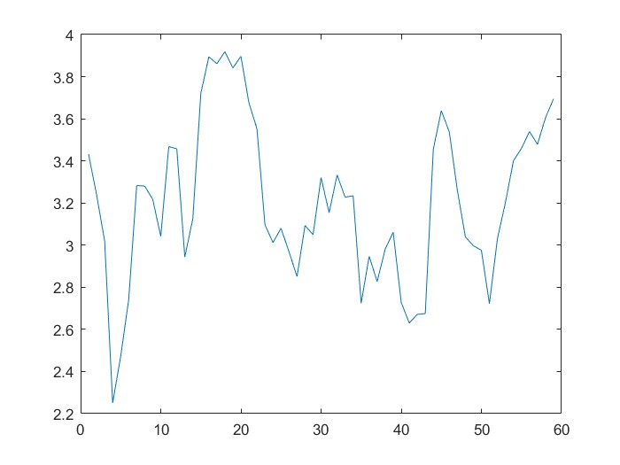
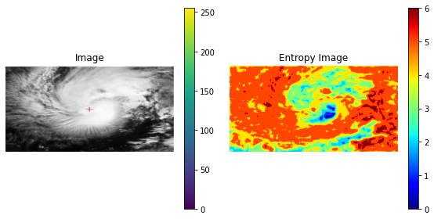
Entropy of Information
Entropy Η of a discrete random variable X, which is distributed according to p: X → [ 0 , 1] such that p(x) = P[X=x]
H(x) = -∑ p(x)* log₂(p(x))
Cyclone Amphan entropy variation

Slide 6
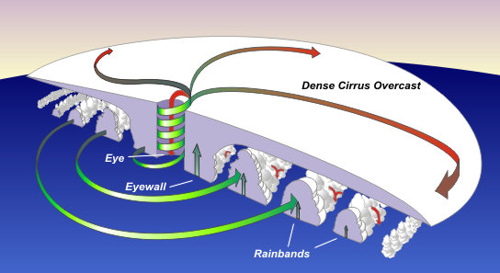
Cumulonimbus clouds
There is deep convection in the atmosphere which results in formation of High level clouds.
High level clouds have height greater than 18,000ft(18,000 to 52,000ft).
Cirrocumulus and Cumulonimbus clouds are associated with strong winds and heavy rainfall.
Temperature of these clouds is less than −80°∁.
https://www.weather.gov/jetstream/tc_structure

Slide 7
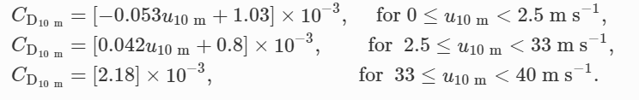
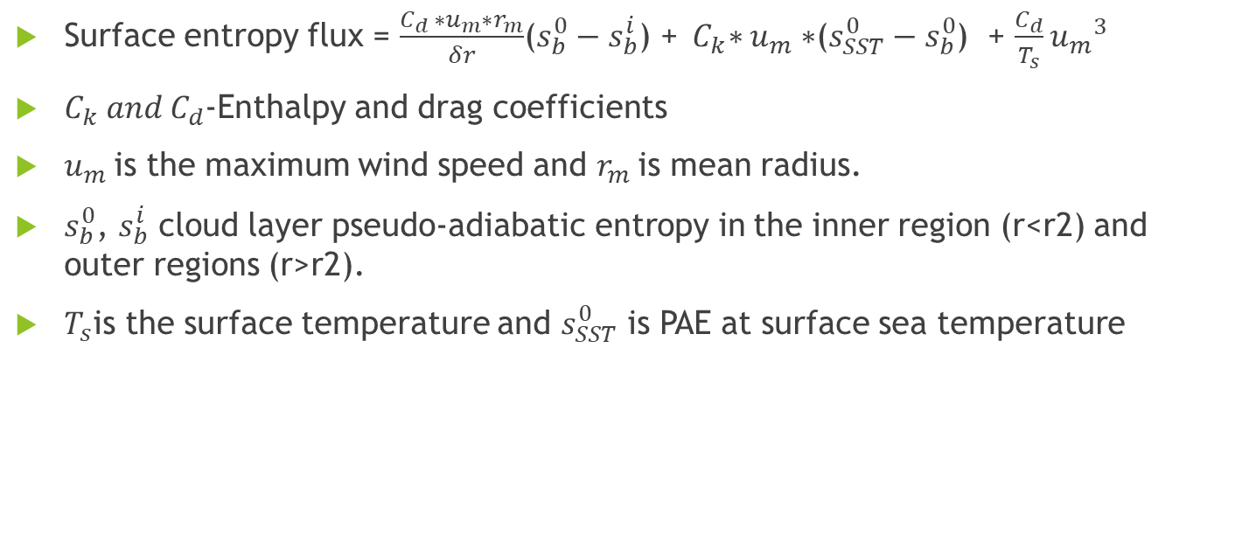
Entropy of Cumulonimbus clouds
Surface entropy flux = $\frac{C_{d }∗u_{m}∗r_{m}}{δr}$($s_{b}^{0}−s_{b}^{i}$) +${ C}_{k}∗u_{m}∗$($s_{SST}^{0}−s_{b}^{0}$) + $\frac{C_{d}}{T_{s}}{u_{m}}^{3}$
$C_{k} and C_{d}$-Enthalpy and drag coefficients
$u_{m}$is the maximum wind speed and $r_{m}$is mean radius.
$s_{b}^{0}$, $s_{b}^{i}$ cloud layer pseudo-adiabatic entropy in the inner region (r<r2) and outer regions (r>r2).
$T_{s}$is the surface temperature and $s_{SST}^{0}$ is PAE at surface sea temperature
Pegahfar, N., Gharaylou, M. Entropy evolution characteristics during an intense tropical cyclone. Meteorol Atmos Phys 132, 461–482 (2020). https://doi.org/10.1007/s00703-019-00701-9

Slide 8
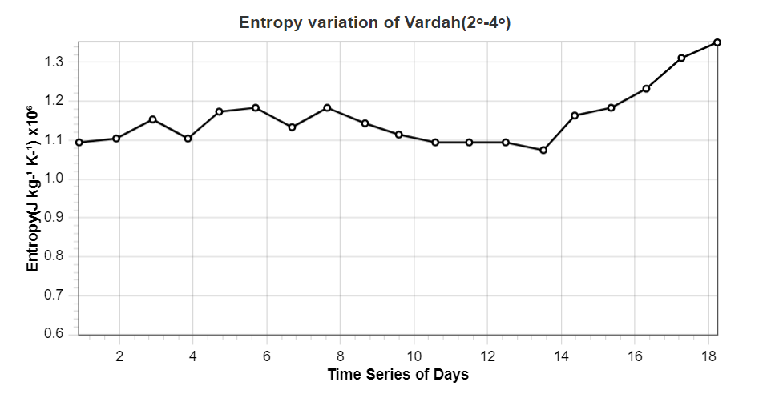
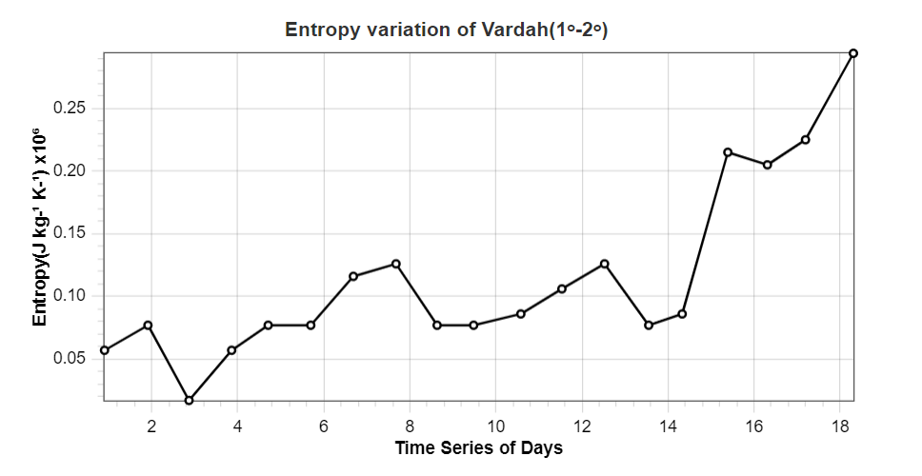
Entropy of Cumulonimbus clouds

Slide 9
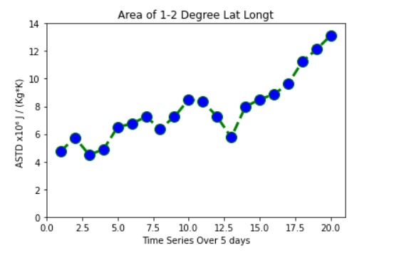
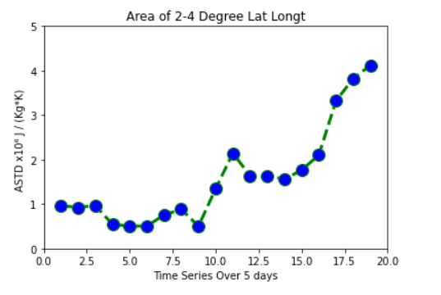

ASTD
Air-sea thermodynamic disequilibrium is calculated as $s_{0}^{∗}−s_{600}$ where $s^{∗}$ is pseudo-adiabatic entropy of saturation at sea surface temperature and $s_{600}$ is pseudo-adiabatic entropy at 600hPa.
More the disequilibrium, more is the chances for genesis of cyclone.

Slide 10
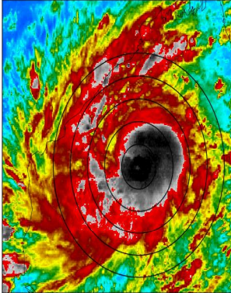
Brightness Temperature
Brightness temperature is the temperature at which a black body in thermal equilibrium with its surroundings would have to be in order to duplicate the observed intensity of a grey body object at a frequency nu.
TIR-BT of 230-240 K, TIR-BT < 210 K , and TIRBT < 235 K are indicate the presence of convective clouds, deep convective cloud and high cloud respectively. TIR-BT < 208 K is a deep convective precipitating clouds.
For our analysis we take three thresholds of TIR-BT namely deep cold clouds (TIR-BT < 210 K), cold clouds (210 K< TIR-BT < 240 K) and warm clouds (TIR-BT > 240 K).

Slide 11
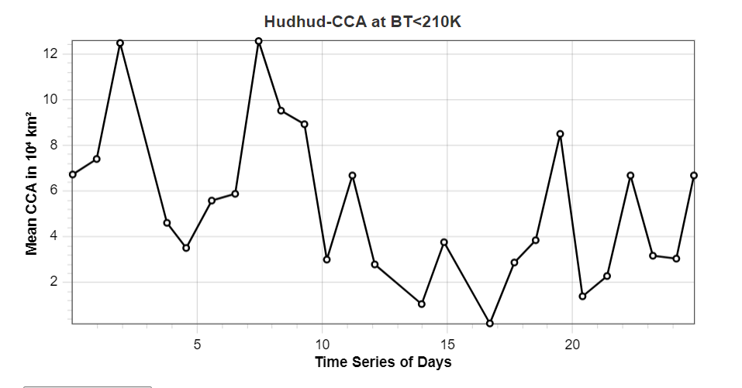
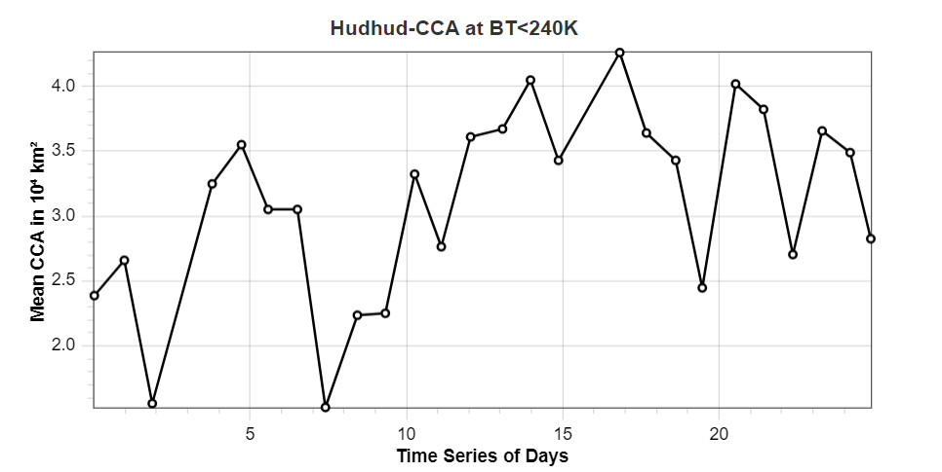
Brightness Temperature
Variation of cloud cover area and cloud top temperature of specific cyclone.
The temporal evolution of the areal extent of the clouds and TIR-BT for the cyclone Hudhud and Vardah during their life cycles is shown.
It can be noted from the CCA plots that diurnal variation of CCA of deep cold clouds and cold clouds are opposite in phase and magnitude in the inner region of the cyclones. Similar trends are observed for outer region of cold clouds
Hudhud variation for 210K<BT<240K
Hudhud variation for BT<210K

Slide 12
References
Entropy evolution characteristics during an intense tropical cyclone N. Pegahfar & M. Gharaylou
The Influence of Near-Surface, High-Entropy Air in Hurricane Eyes on Maximum Hurricane Intensity. George H. Bryan and Richard Rotunno
Bryan GH (2008) On the computation of pseudoadiabatic entropy and equivalent potential temperature. Mon Weather Rev 136(12):5239–5245
Climatological Analysis of Tropical Cyclone Intensity Changes under Moderate Vertical Wind Shear. Rosimar Rios-Berrios and Ryan D. Torn
A ventilation index for tropical cyclones by Brian Tang and Kerry Emanuel
https://glossary.ametsoc.org/wiki/Reversible_moist-adiabatic_process#:~:text=A%20moist%2Dadiabatic%20process%20in,or%20to%20the%20air%2C%20respectively.
https://glossary.ametsoc.org/wiki/Pseudoadiabatic_process
https://www.ripublication.com/ijaer17/ijaerv12n22_146.pdf
https://www.researchgate.net/publication/344284728_On_the_dynamics_of_cyclogenesis_rapid_intensification_and_recurvature_of_the_very_severe_cyclonic_storm_Ockhi_httpsrdcubeb7jcN
https://www.ijcmas.com/special/9/Vikash%20Kumar%20Sharma,%20et%20al.pdf
https://ieeexplore.ieee.org/stamp/stamp.jsp?arnumber=8977395
https://rsmcnewdelhi.imd.gov.in/report.php?internal_menu=MzM=

Slide 13
Thank You

