Slide 1


IMAGE ENHANCEMENT USING PARTICLE SWARM OPTIMIZATION
Arka Pal | Siddhik Reddy | Sukriti Tripathy
Kevin Paulose | Vrishabh Kenkre | Hudson Samuel

Slide 2
PROBLEM STATEMENT AND OBJECTIVES
Maximize an objective fitness criterion in order to enhance the contrast & detail in an image by adapting the parameters of a novel extension to a local enhancement technique
Results must be excellent in terms of both the maximization of the number of pixels in the edges and the adopted objective evaluation, keeping in mind a reduced computational time.
A real-coded PSO is to be applied to adapt the gray-level intensity transformation in the image.
The fitness of each image is taken as a swarm particle and its subjective score is given by the human interpreter.
This is a non linear and non continuous optimization.

Slide 3
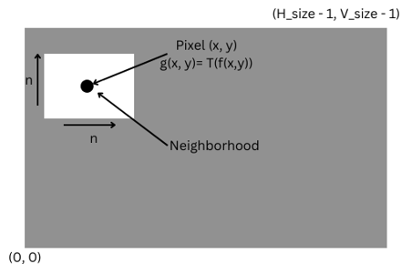
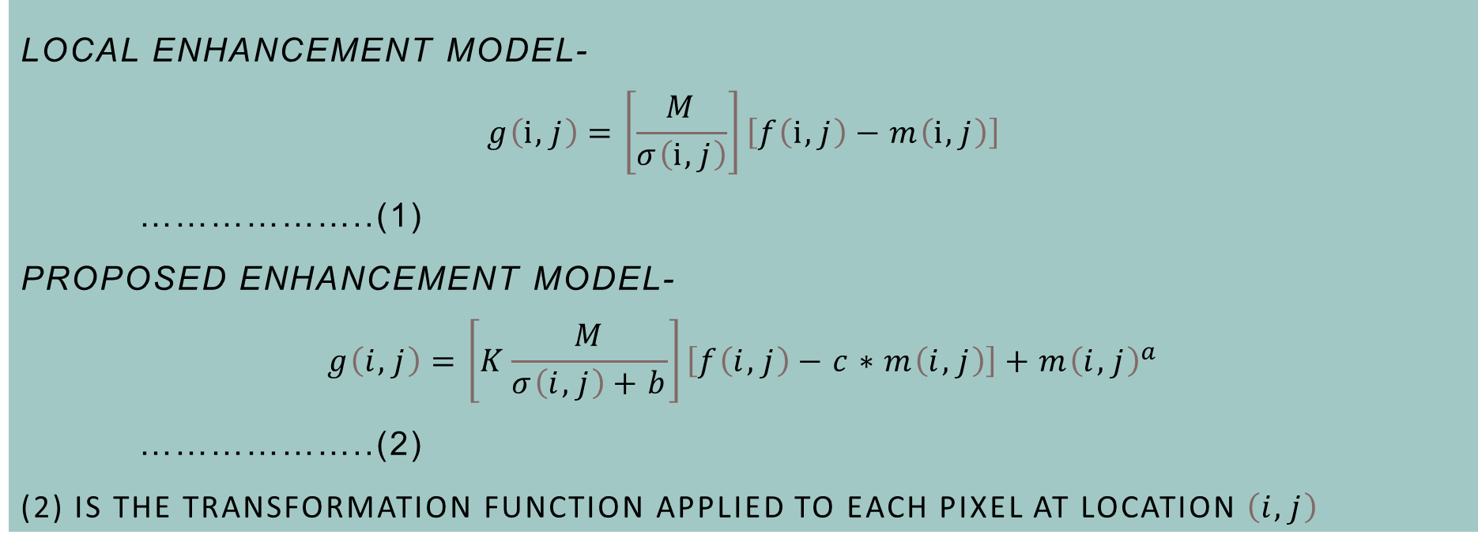
The proposed method using PSO has many advantages.
It uses a local enhancement technique based on the standard deviation and the mean value of the pixels.
It uses an objective fitness criterion that is proportional to the number of edges in the image.
Enhancements models

Slide 4
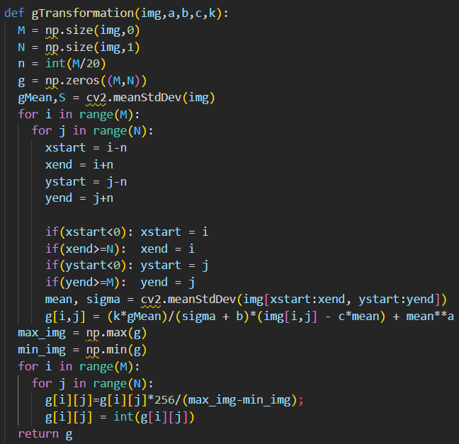
Notes:
The Sobel detector used here is an automatic threshold detector

Slide 5
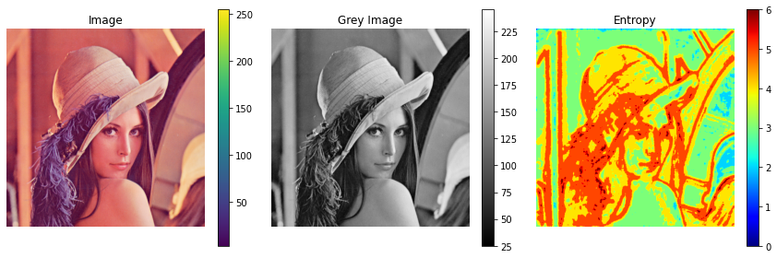
ENTROPY OF IMAGES
The entropy or average information of an image is a measure of the degree of randomness in the image.
The entropy is useful in the context of image coding : it is a lower limit for the average coding length in bits per pixel which can be realized by an optimum coding scheme without any loss of information.
We have used Shannon entropy ,i.e, basically the "amount of information" in a variable.
We get the average value of entropies using the function
skimage.measure.shannon_entropy(img)
Notes:
The Sobel detector used here is an automatic threshold detector

Slide 6
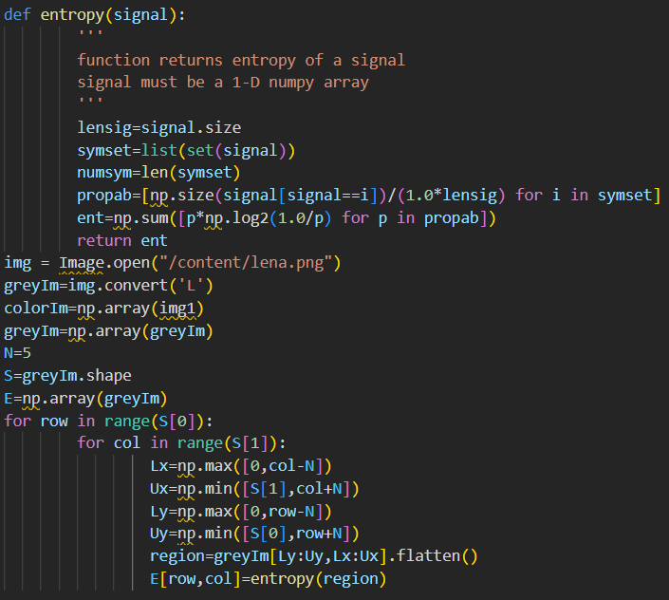
Notes:
The Sobel detector used here is an automatic threshold detector

Slide 7
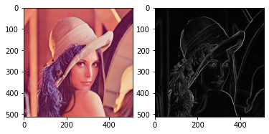
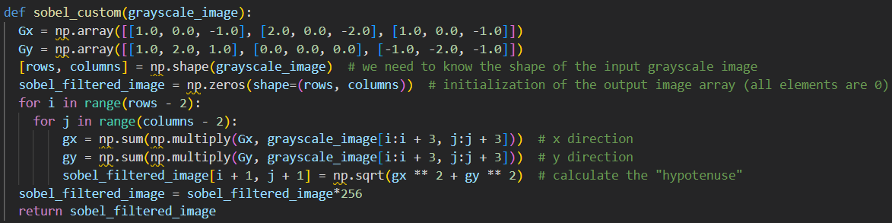
Sobel Edge Detector
The Sobel filter is used for edge detection. It works by calculating the gradient of image intensity at each pixel within the image.
It finds the direction of the largest increase from light to dark and the rate of change in that direction.
Notes:
The Sobel filter is used for edge detection. It works by calculating the gradient of image intensity at each pixel within the image.
It finds the direction of the largest increase from light to dark and the rate of change in that direction.
The Sobel detector used here is an automatic threshold detector

Slide 8
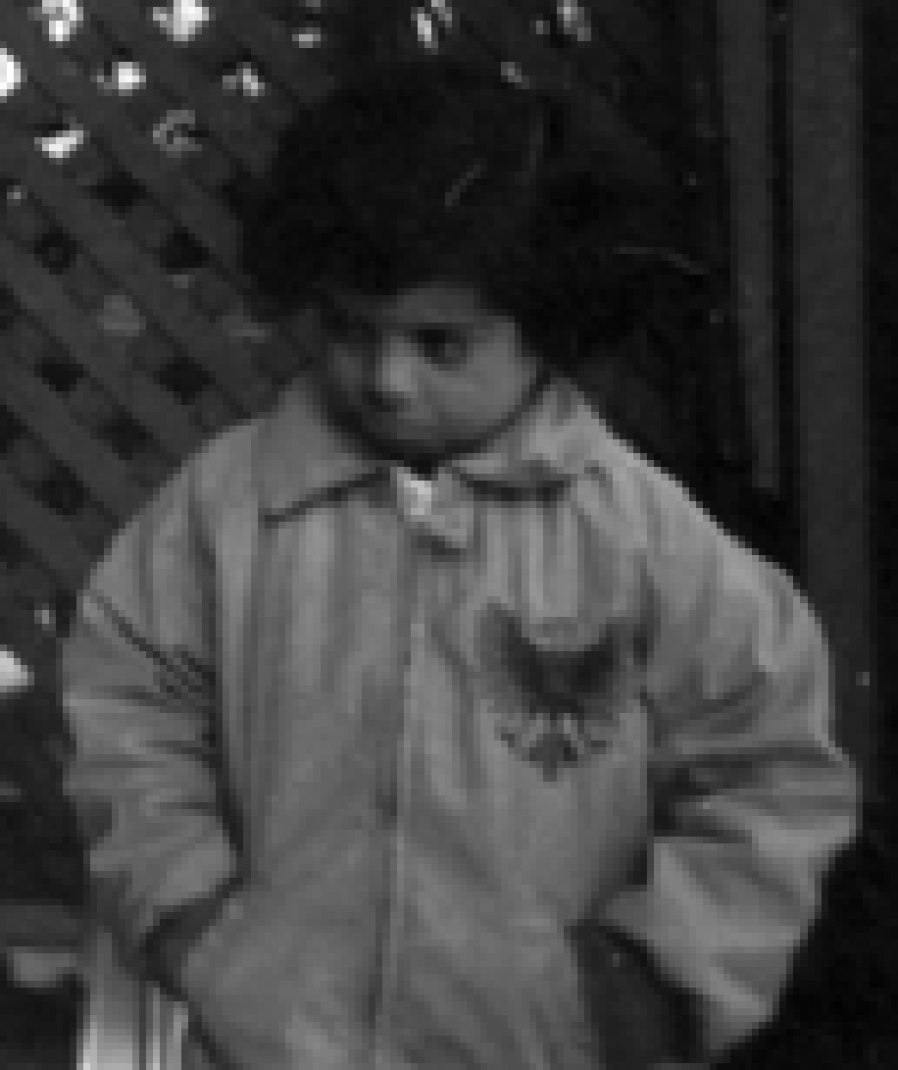
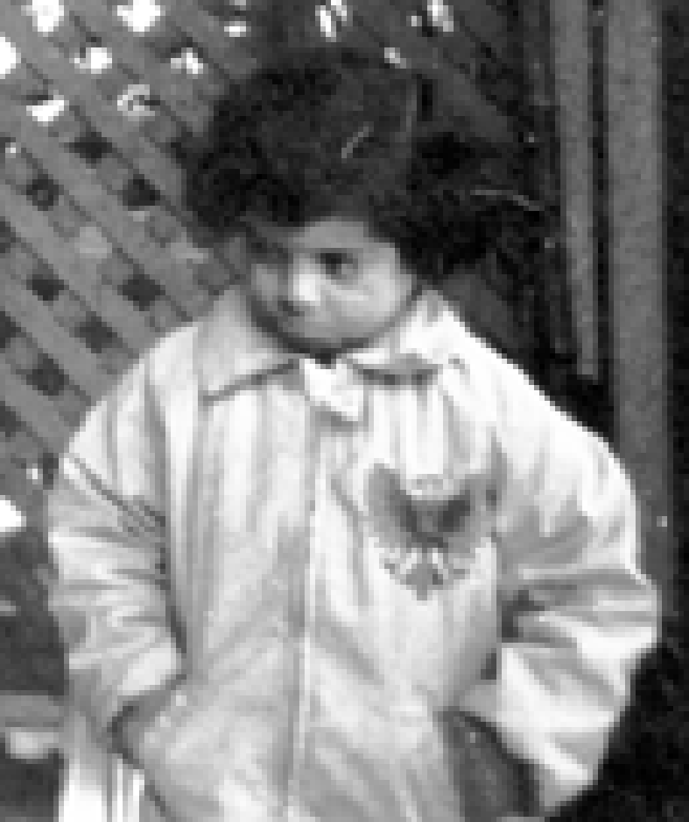
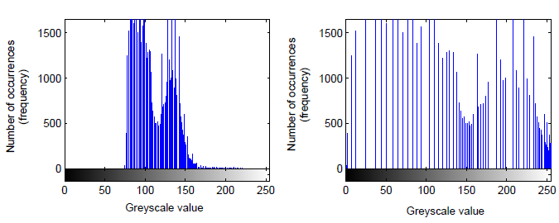
FIGURE 1: GLOBAL HISTOGRAM EQUALIZATION UPPER LEFT: UNEQUALED IMAGE, UPPER RIGHT: SAME IMAGE AFTER HISTOGRAM EQUALIZATION, LOWER LEFT: UNEQUALED HISTOGRAM, LOWER RIGHT: EQUALIZED GLOBAL HISTOGRAM.
Using Fitness Criterion (Enhancement Criterion)

Slide 9
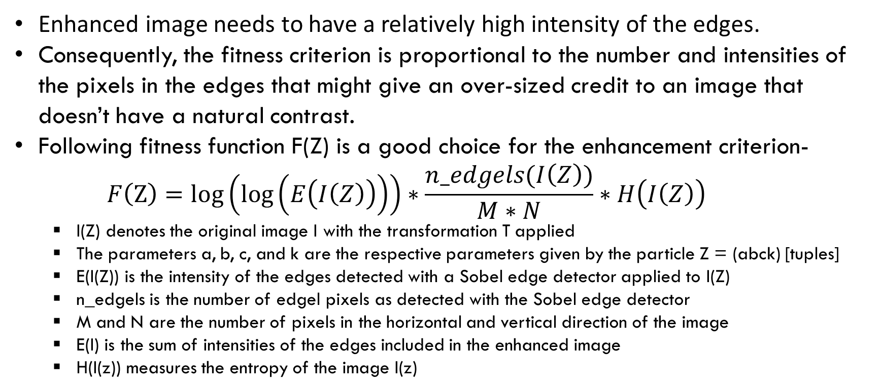
ENHANCEMENT CRITERION
Notes:
The Sobel detector used here is an automatic threshold detector

Slide 10
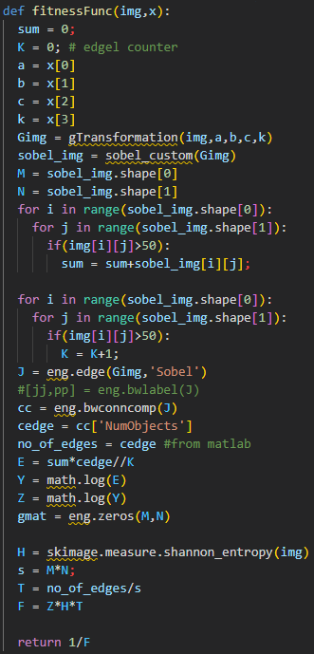
Notes:
The Sobel detector used here is an automatic threshold detector

Slide 11

PSO ALGORITHM
The proposed PSO objective is to find the solution that maximizes F(Z). To achieve these objectives we need to:
Increase the relative number of pixels in the edges of the image.
Increase the overall intensity of edges, and
Transform the histogram of the image to one that approximates a uniform distribution by maximizing the entropic measure.
For each particle Initialize particle For each particle Calculate fitness value If the fitness value is better than the best fitness value (pbest) in history set current value as the new pbest End Choose the particle with the best fitness value of all the particles as the gbest For each particle Calculate particle velocity according to Eq. 4 Update particle position according to Eq. 5 End Continue while maximum iterations or minimum error criteria is not attained
The Pseudo code of the PSO procedure
Particle velocity-
…..….(6)
Notes:
The Sobel detector used here is an automatic threshold detector

Slide 12
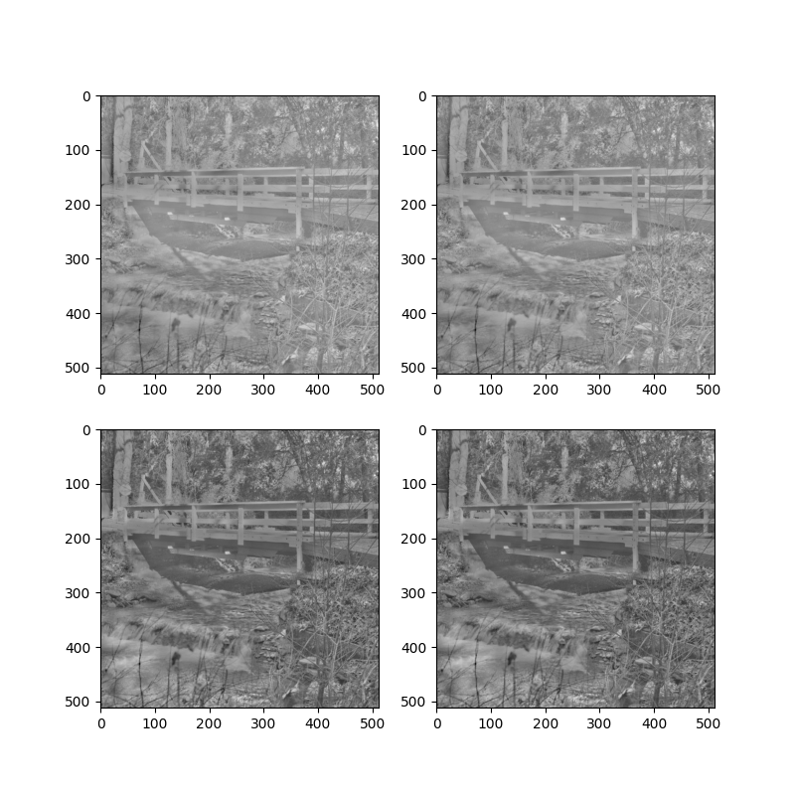
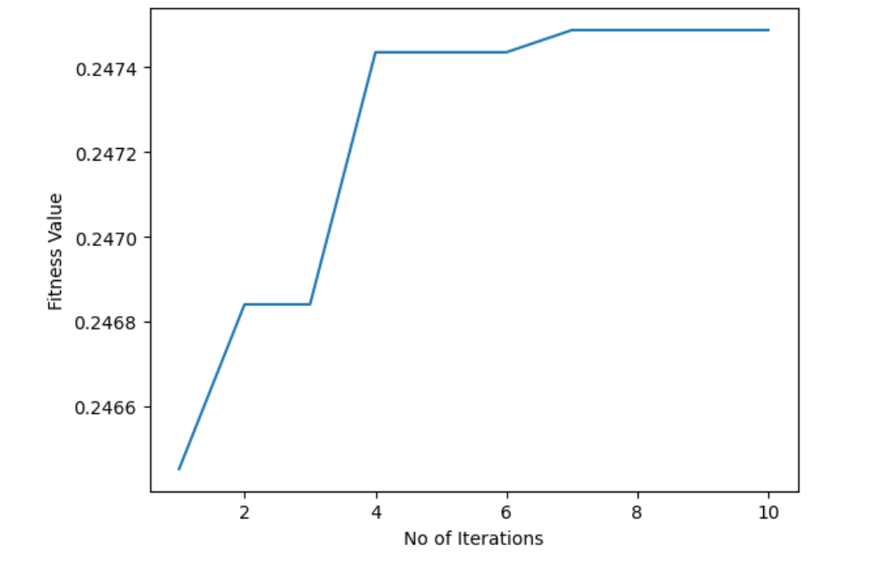
The Bridge
Notes:
The Sobel detector used here is an automatic threshold detector

Slide 13
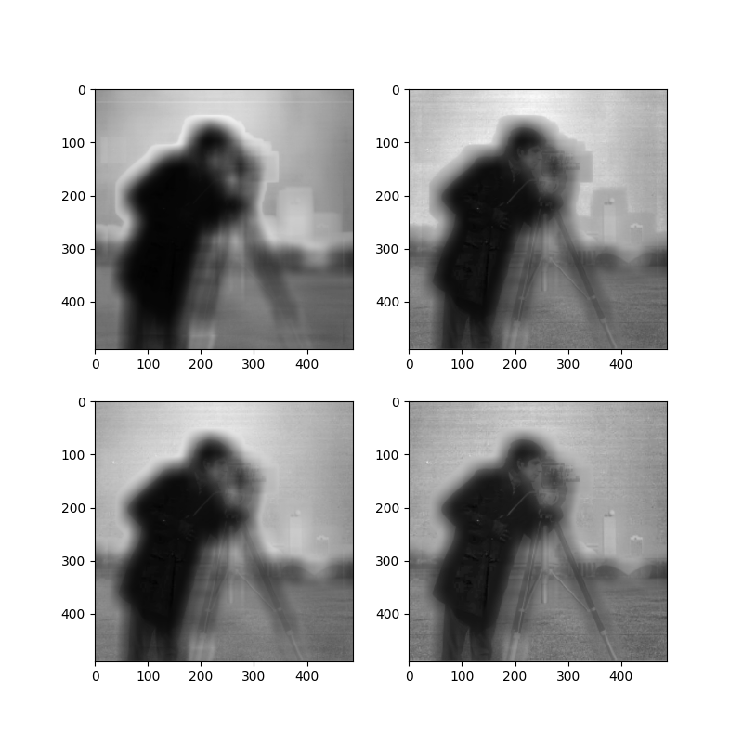
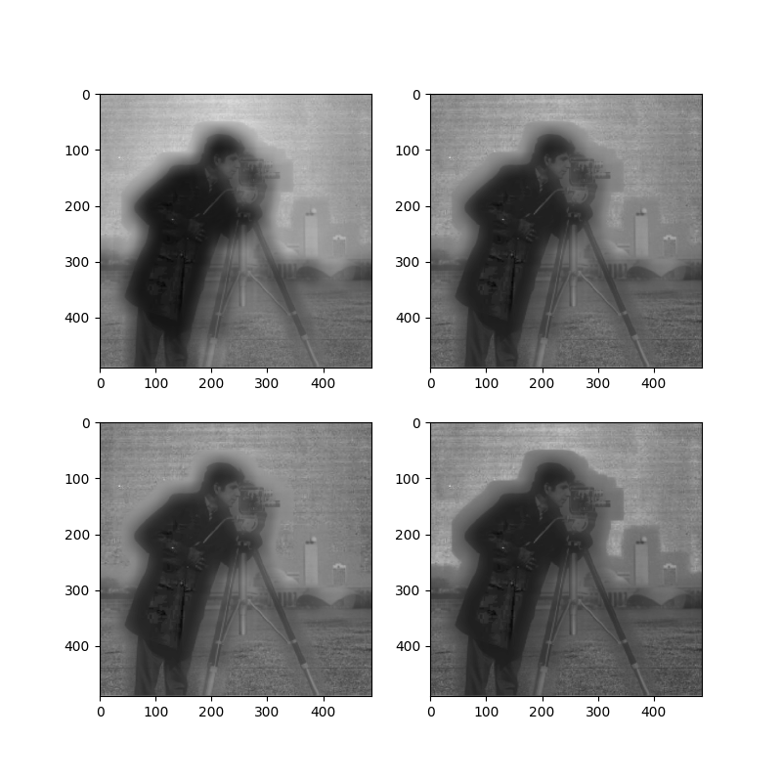
The cameraman
Notes:
The Sobel detector used here is an automatic threshold detector

Slide 14
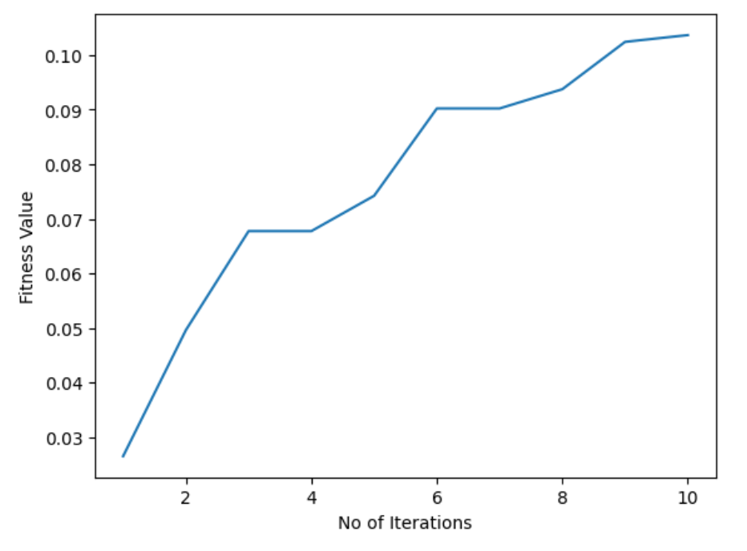
The cameraman
Notes:
The Sobel detector used here is an automatic threshold detector

Slide 15
References
Towards Automatic Image Enhancement Using Genetic Algorithms, C. Munteanu, A. Rosa, LaSEEB-ISR-Instituto Superior Ttcnico, Universidade TCcnica de Lisboa,
Image Enhancement Using Particle Swarm Optimization, Malik Braik, Alaa Sheta and Aladdin Ayesh, Proceedings of the World Congress on Engineering 2007 Vol I WCE 2007, July 2 - 4, 2007, London, U.K.
https://iq.opengenus.org/contrast-enhancement-algorithms/
https://www.geeksforgeeks.org/python-program-to-detect-the-edges-of-an-image-using-opencv-sobel-edge-detection/
Notes:
The Sobel detector used here is an automatic threshold detector

Slide 16
THANK YOU
Notes:
The Sobel detector used here is an automatic threshold detector

