Slide 2
Introduction to LEX

Slide 3
Scanner, Parser, Lex and Yacc
symbol
table
Source
Program
Scanner
Parser
token
C Compiler
name.tab.c
name.tab.h
lex.yy.c
Lex/ flex
Yacc/ bison
Lex spec (.l)
Yacc spec (name.y)

Slide 4
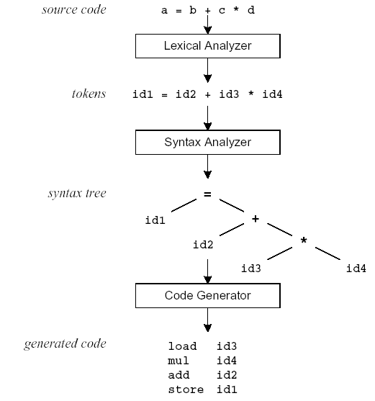
Compilation Sequence

Slide 5
What is Lex?
The main job of a lexical analyzer (scanner) is to break up an input stream into more usable elements (tokens)
a = b + c * d;
ID ASSIGN ID PLUS ID MULT ID SEMI
Lex is an utility to help you rapidly generate your scanners

Slide 6
Lex – Lexical Analyzer
Lexical analyzers tokenize input streams
Tokens are the terminals of a language
English
words, punctuation marks, …
Programming language
Identifiers, operators, keywords, …
Regular expressions define terminals/tokens

Slide 7
Lex Source Program
Lex source is a program which consists of
regular expressions and
corresponding program fragments
digit [0-9]
letter [a-zA-Z]
%%
{letter}({letter}|{digit})* printf(“id: %s\n”, yytext);
\n printf(“new line\n”);
%%
main() {
yylex();
}

Slide 8
Lex Source to C Program
The table is translated to a C program (lex.yy.c) which
reads an input stream
partitions the input into strings which match the given expressions and
copies it to an output stream if necessary

Slide 9

An Overview of Lex
Lex
Lex.yy.c
X.l
C compiler
a.out
Source program
a.out
Tokens

Slide 10
Skeleton of a Lex Specification (.l file)
lex.yy.c is generated after running
> lex x.l
%{
C global variables definitions, constant definitions and regular definitions comments
%}
[DECLARATION SECTION]
%%
r1 {action1} Patterns must start from column 1
r2 {action 2}
[RULES SECTION]
%%
[ C auxiliary subroutines]
They are the functions that me be used to write action parts
This part will be directly embedded into top of lex.yy.c file
Define how to scan and what action to take for each token
Any user code.

Slide 11
The most simple Lex program is therefore
%%
The first %% is always required as there must be rules section. However if there are no rules, the default action is to match everything and copy it to output

Slide 12
Lex v.s. Yacc
Lex
Lex generates C code for a lexical analyzer, or scanner
Lex uses patterns that match strings in the input and converts the strings to tokens
Yacc
Yacc generates C code for syntax analyzer, or parser.
Yacc uses grammar rules that allow it to analyze tokens from Lex and create a syntax tree.

Slide 13
Lex with Yacc
Lex source
(Lexical Rules)
Yacc source
(Grammar Rules)
Lex
Yacc
lex.yy.c
y.tab.c
call
yylex()
yyparse()
Parsed
Input
Input
return token

Slide 14
Regular Expressions

Slide 15
Lex Regular Expressions (Extended Regular Expressions)
A regular expression matches a set of strings
Regular expression
Operators
Character classes(within character class operators loose their meaning. Two characters are - and ^(circumflex)
Arbitrary character
Optional expressions
Alternation and grouping
Context sensitivity
Repetitions and definitions

Slide 16
Operators
“ \ [ ] ^ - ? . * + | ( ) $ / { } % < >
If they are to be used as text characters, an escape should be used
\$ = “$”
\\ = “\”
Every character but blank, tab (\t), newline (\n) and the list above is always a text character

Slide 17
Character Classes []
[abc] matches a single character, which may be a, b, or c
Every operator meaning is ignored except \ - and ^
e.g.
[ab] => a or b
[a-z] => a or b or c or … or z
[-+0-9] => all the digits and the two signs
[^a-zA-Z] => any character which is not a
letter

Slide 18
Arbitrary Character .
To match almost any character, the operator character . is the class of all characters except newline
[\40-\176] matches all printable characters in the ASCII character set, from octal 40 (blank) to octal 176 (tilde~)

Slide 19
Optional & Repeated Expressions
a? => zero or one instance of a
a* => zero or more instances of a
a+ => one or more instances of a
E.g.
ab?c => ac or abc
[a-z]+ => all strings of lower case letters
[a-zA-Z][a-zA-Z0-9]* => all alphanumeric strings with a leading alphabetic character

Slide 20
Precedence of Operators
Level of precedence
Kleene closure (*), ?, +
concatenation
alternation (|)
All operators are left associative.
Ex: a*b|cd* = ((a*)b)|(c(d*))

Slide 21
Pattern Matching Primitives
Metacharacter | Matches
. | any character except newline
\n | newline
* | zero or more copies of the preceding expression
+ | one or more copies of the preceding expression
? | zero or one copy of the preceding expression
^ | beginning of line / complement
$ | end of line
a|b | a or b
(ab)+ | one or more copies of ab (grouping)
[ab] | a or b
a{3} | 3 instances of a
“a+b” | literal “a+b”

Slide 22
Lex Predefined Variables
Name | Function
char *yytext | pointer to matched string
int yyleng | length of matched string
FILE *yyin | input stream pointer
FILE *yyout | output stream pointer
int yylex(void) | call to invoke lexer, returns token
char* yymore(void) | return the next token
int yyless(int n) | retain the first n characters in yytext
int yywrap(void) | wrapup, return 1 if done, 0 if not done
ECHO | write matched string
REJECT | go to the next alternative rule
INITAL | initial start condition
BEGIN | condition switch start condition

Slide 23
User Subroutines Section
You can use your Lex routines in the same ways you use routines in other programming languages.
%{
void foo();
%}
letter [a-zA-Z]
%%
{letter}+ foo();
%%
…
void foo() {
…
}

Slide 24
User Subroutines Section (cont’d)
The section where main() is placed
%{
int counter = 0;
%}
letter [a-zA-Z]
%%
{letter}+ {printf(“a word\n”); counter++;}
%%
main() {
yylex();
printf(“There are total %d words\n”, counter);
}

Slide 25
Example Lex Specification 1
%{
#include <stdio.h>
%} digit [0-9] letter [A-Za-z] id {letter}({letter}|{digit})*
%%
{digit}+ { printf(“number: %s\n”, yytext); }
{id} { printf(“ident: %s\n”, yytext); }
. { printf(“other: %s\n”, yytext); }
%%
main()
{ yylex();
}
Regular definitions
Translation rules

Slide 26
Example Lex Specification 2
%{ /* definitions of manifest constants */
#define LT (256) …
%} delim [ \t\n] ws {delim}+ letter [A-Za-z] digit [0-9] id {letter}({letter}|{digit})* number {digit}+(\.{digit}+)?(E[+\-]?{digit}+)? %% {ws} { } if {return IF;} then {return THEN;} else {return ELSE;} {id} {yylval = install_id(); return ID;} {number} {yylval = install_num(); return NUMBER;} “<“ {yylval = LT; return RELOP;} “<=“ {yylval = LE; return RELOP;}
“=“ {yylval = EQ; return RELOP;}
“<>“ {yylval = NE; return RELOP;} “>“ {yylval = GT; return RELOP;}
“>=“ {yylval = GE; return RELOP;}
%%
int install_id() …
Return token to parser
Token attribute
Install yytext as identifier in symbol table

Slide 27
Example Lex Specification 3 Counts no of lines, words and characters in source program
%{
#include <stdio.h>
int ch = 0, wd = 0, nl = 0;
%} delim [ \t\n]+
%%
\n { ch++; nl++; }
^{delim} { ch+=yyleng; wd++; }
. { ch++; }
%%
main()
{ yylex();
printf("%8d%8d%8d\n", nl, wd, ch);
return 0;
}
Regular definition
Translation rules

Slide 28
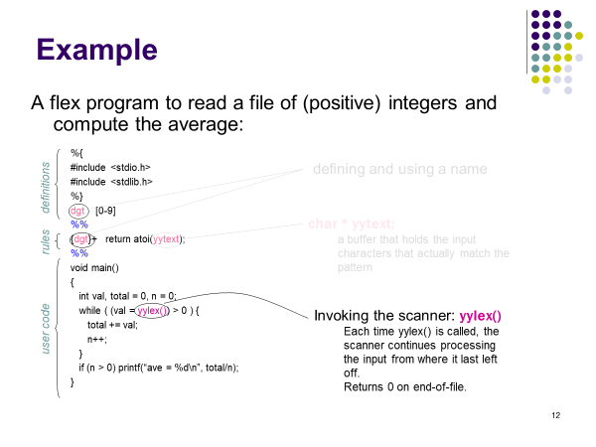

Slide 29
Internal Structure of Lex
Lex
Regular
expressions
Minimal
DFA
NFA
DFA
The final states of the DFA are
associated with actions

Slide 30
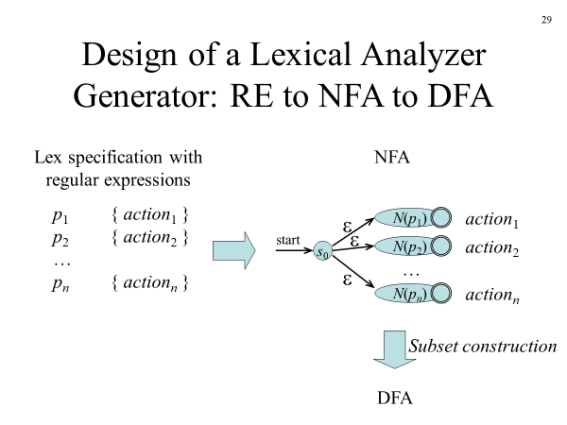

Slide 31
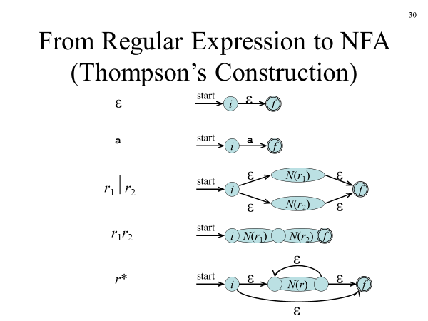

Slide 32
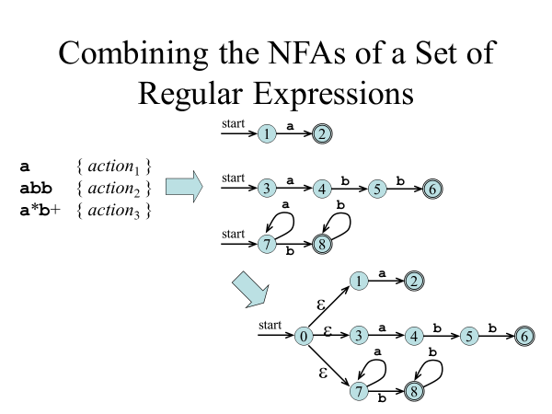

Slide 33
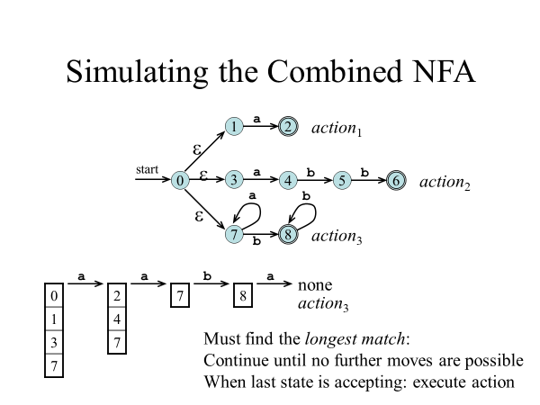

Slide 34
Usage
To run Lex on a source file, type lex scanner.l
It produces a file named lex.yy.c which is a C program for the lexical analyzer.
To compile lex.yy.c, type cc lex.yy.c –ll
To run the lexical analyzer program, type
./a.out < inputfile

Slide 35
Versions of Lex
AT&T -- lex http://www.combo.org/lex_yacc_page/lex.html
GNU -- flex http://www.gnu.org/manual/flex-2.5.4/flex.html
a Win32 version of flex : http://www.monmouth.com/~wstreett/lex-yacc/lex-yacc.html or Cygwin : http://sources.redhat.com/cygwin/
Lex on different machines is not created equal.

