Slide 1
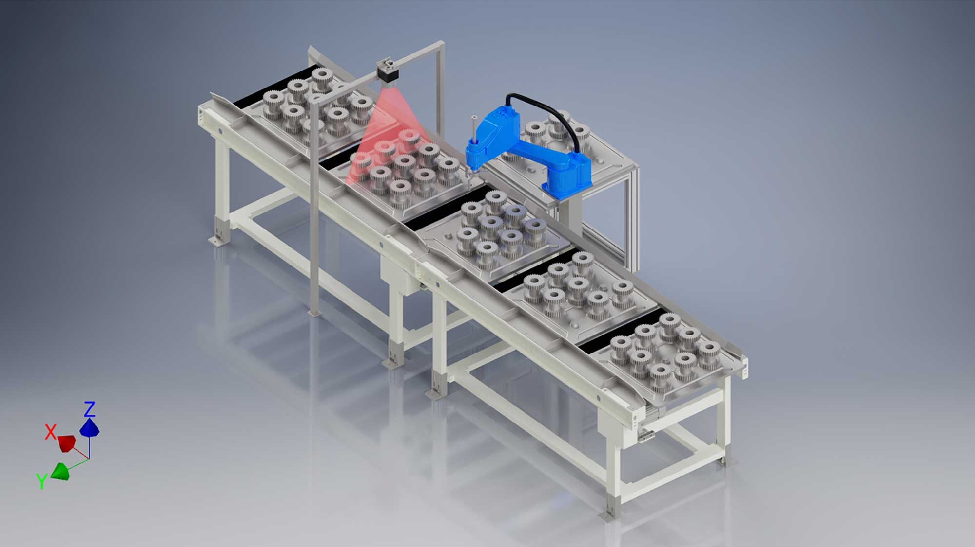
B.M.S. COLLEGE OF ENGINEERING
Operating Systems · Alternative Assessment Tool
OS Reliability in
AI-Assisted Lean
Visual Inspection
Race conditions and real-time scheduling in a smart manufacturing cell inspired by lean manufacturing and MELSOFT VIXIO-style workflows.
Yashwanth J · 1BM24AI196
Vrishin Dutt CG · 1BM24AI195
Semester 4 · B.E. AIML
Image: AI-enabled conveyor inspection cell

Slide 2
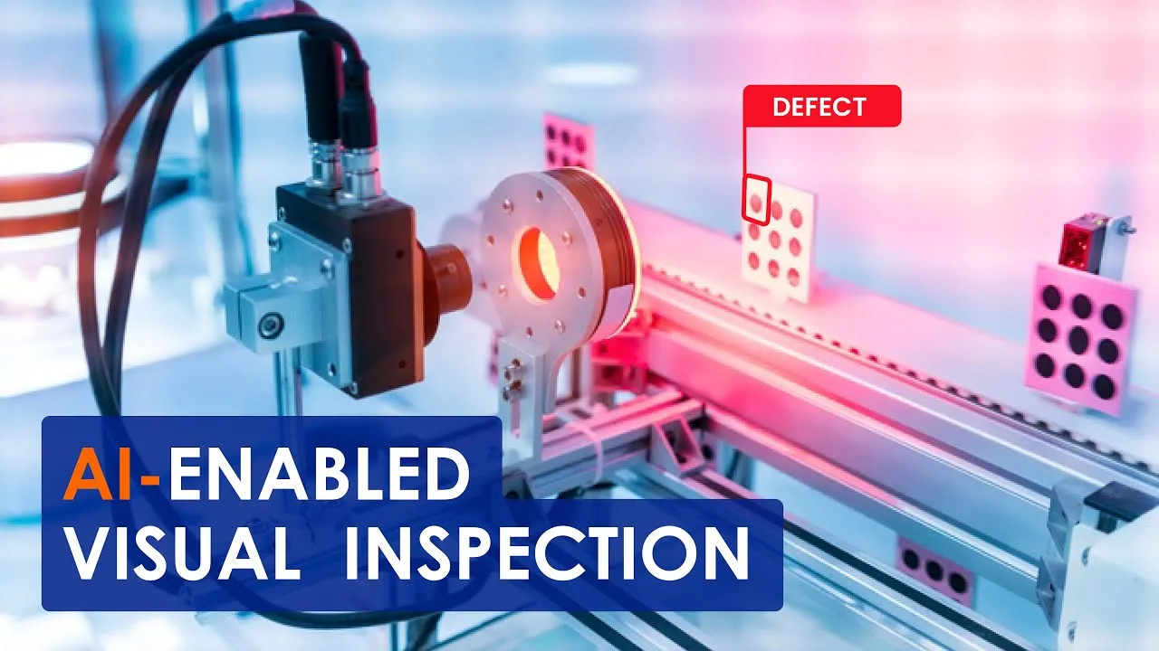
PROBLEM
Why this is an OS project
Automation shifts quality risk from human judgement to software coordination.
A smart inspection cell runs sensor, camera, AI inference, rule inspection, actuator, and logging tasks concurrently. If shared product state is not synchronized, the output can depend on timing rather than logic.
7
5
2
concurrent tasks
schedulers
race modes
Core thesis: in automated inspection, race conditions can become quality-control failures.
OS Reliability in AI-Assisted Lean Visual Inspection
Slide 2

Slide 3
CASE STUDY
Lean inspection cell as concurrent tasks
Each physical station maps to an OS abstraction.
The conveyor creates both shared-state risk and timing pressure. The same system can therefore demonstrate race conditions and scheduling algorithms coherently.
Sensor
Camera
AI
Rule
Decision
Actuator
Logger
producer
frame
CPU-bound
deterministic
fusion
deadline
I/O
Shared resources: product_id, frame_id, inspection_result, actuator_command, log_entry.
OS Reliability in AI-Assisted Lean Visual Inspection
Slide 3

Slide 4
RACE CONDITION
Failure mode: wrong product–inspection mapping
The race condition corrupts the identity chain, not just a counter.
AI processing
P017 image
Sensor updates
current_product_id = P030
Result for P017
stored under P030
current_product_id = product.product_id
# AI task reads later
mapped_product_id = current_product_id
inspection_results[mapped_product_id] = ai_result
Consequence: a defective product may pass or a good product may be rejected. The OS failure becomes a physical quality-control failure.
OS Reliability in AI-Assisted Lean Visual Inspection
Slide 4

Slide 5
SYNCHRONIZATION
Fix: ProductPacket + queue discipline
Identity is preserved by design instead of relying on global mutable state.
Unsafe mode shares product identity globally. Safe mode gives each product an immutable packet and moves it through producer-consumer queues.
Sensor
Global ID
AI Result
Unsafe: mutable shared identity
Packet
Camera Q
Inspect Q
Actuator
Safe: product identity travels with the packet
OS Reliability in AI-Assisted Lean Visual Inspection
Slide 5

Slide 6
SCHEDULING
The conveyor turns scheduling into deadlines
Late tasks can miss the physical rejection window.
Each product creates jobs with arrival time, burst time, and absolute deadline. The actuator decision must complete before the product passes the reject gate.
Sensor
2 units
Camera
4 units
AI
12 units
Actuator
4 units
t0
t+25
t+70
t+100
t+160
arrival
camera
AI
actuator
logger
Scheduling objective: reduce deadline misses while keeping task flow explainable.
OS Reliability in AI-Assisted Lean Visual Inspection
Slide 6

Slide 7
ALGORITHMS
Five schedulers compared
One baseline does not capture a real-time inspection cell.
FCFS
Arrival order
Simple baseline; ignores urgency.
Round Robin
Time quantum
Fair, but fragments urgent work.
Priority
Criticality first
Protects actuator/sensor if priorities are correct.
RMS
Shortest period first
Useful for periodic control loops.
EDF
Nearest deadline first
Best conceptual fit for conveyor deadlines.
Interpretation: EDF and RMS are strongest real-time lenses; FCFS and RR remain useful baselines.
OS Reliability in AI-Assisted Lean Visual Inspection
Slide 7

Slide 8
RESULTS
Scheduling comparison
Deadline misses and waiting time show why arrival-order scheduling is weak.
Missed deadlines
Average waiting time
RMS performs well under periodic priorities; EDF is still the cleanest conceptual fit because deadlines are explicit.
OS Reliability in AI-Assisted Lean Visual Inspection
Slide 8

Slide 9
RESULTS
Race comparison: synchronization works
Safe mode collapses race events to zero.
Unsafe mode
Global current_product_id is mutable. AI result can attach to the wrong product.
Safe mode
ProductPacket carries identity through queues. The mapping is preserved.
OS lesson: the fix is synchronization, not a more complex inspection model.
OS Reliability in AI-Assisted Lean Visual Inspection
Slide 9

Slide 10
SOFTWARE ARTIFACT
Backend simulation pipeline
Modular, replayable, and ready for digital-twin visualization.
Race model
Safe pipeline
Schedulers
Exporter
Preview
unsafe events
queues
EDF/RMS/etc.
JSON/CSV
browser/terminal
./run_project.sh
python -m backend.replay_events
python3 -m http.server 8000
open http://localhost:8000/preview/
Generated outputs include event timelines, Unreal-friendly CSVs, comparative charts, report assets, and a browser replay layer.
OS Reliability in AI-Assisted Lean Visual Inspection
Slide 10

Slide 11
DIGITAL TWIN
Unreal + VIXIO-style future path
The project abstracts the OS reliability layer under AI visual inspection.
Python OS
Backend
JSON / CSV
Events
Unreal
Event Manager
3D Conveyor
Digital Twin
VIXIO-style inspection node: AI can complement rule-based inspection and support primary screening.
Boundary: this is not a direct VIXIO clone or integration; it is a compatible workflow abstraction.
Source: Mitsubishi Electric official MELSOFT VIXIO product page.
OS Reliability in AI-Assisted Lean Visual Inspection
Slide 11

Slide 12
DEMO PLAN
How to present it cleanly
Show the artifact, then explain the OS concepts it proves.
1
Run backend
./run_project.sh
2
Unsafe replay
race events visible
3
Safe replay
race events = 0
4
Browser preview
unsafe · safe · EDF · RMS · FCFS · RR · priority
5
Outputs
charts + JSON/CSV + Unreal handoff
GitHub: https://github.com/VrishinDutt/OS_Lean_Visual_Inspection_Digital_Twin
OS Reliability in AI-Assisted Lean Visual Inspection
Slide 12

Slide 13
FUTURE SCOPE
Where this can go next
From OS AAT to a tangible industrial demonstrator.
Computer vision
Replace synthetic defects with real image datasets or anomaly detection.
Industrial comms
Add MQTT / OPC-UA for PLC/SCADA-style handoff.
Unreal digital twin
Animate conveyor, camera, actuator, race warnings, and scheduling modes.
Advanced OS analysis
Add priority inversion, starvation, multicore scheduling, fault recovery.
VIXIO-style workflow
Treat AI inspection as one node while OS layer ensures identity and timing integrity.
Forward thesis: lean manufacturing does not only need better inspection models; it needs reliable coordination beneath them.
OS Reliability in AI-Assisted Lean Visual Inspection
Slide 13

Slide 14
Final takeaway
Reliable automation needs
correct logic + correct coordination.
Synchronization protects shared state.
Scheduling protects time-critical execution.
Digital twins make OS failures visible.
In a smart inspection cell, a race condition is not just a bug — it is a potential quality-control failure.
Yashwanth J · Vrishin Dutt CG
References: Operating System Concepts; Modern Operating Systems; Mitsubishi Electric MELSOFT VIXIO official product page; Python and Unreal Engine documentation.

