Slide 1
Project Presentation of Industry Oriented Hands on Experience
(22CS422)
On
DIGITAL FORENSICS IN CYBERSECURITY
Submitted By:
Anushka(2210991322)
Drishti Bhardwaj (2210990306)
Vriti Jaitley (2210994862)
Geetanshu Mantro (2210990324)
Supervised By:
Dr. Shikha Tuteja
Associate Professor
Department of Computer Science and Engineering,
Chitkara University, Punjab

Slide 2
Introduction to Digital Forensics
• Digital forensics is a critical branch of cybersecurity focused on investigating cyber incidents.
• It involves identifying, preserving, analyzing, and presenting digital evidence.
• Increasing cyber threats have made forensic investigations essential for organizations.
• Digital evidence supports both cybersecurity operations and legal proceedings.
Identifying
Preserving
Analyzing
Presenting Evidence
2

Slide 3
Background of the Study
• Rapid digital transformation has increased dependence on interconnected systems.
• Cyberattacks such as phishing, malware, ransomware, and data breaches are growing rapidly.
• Organizations require effective mechanisms to investigate and prevent cybercrime.
• Digital forensic frameworks provide structured approaches for incident investigation.
Cyberattacks
Phishing
Malware
Ransom ware
……….
3

Slide 4
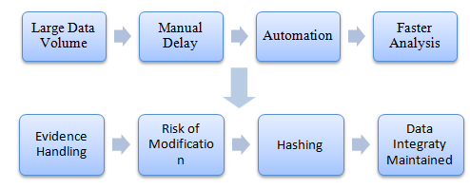
Problem Statement
• Investigators face massive volumes of digital evidence and system logs.
• Encryption and anti-forensic techniques complicate investigations.
• Manual forensic analysis consumes significant time and resources.
• Automated and scalable solutions are necessary for modern investigations.
4

Slide 5
Research Objectives
• To analyze modern digital forensic investigation techniques.
• To implement network and disk forensic analysis in a controlled environment.
• To evaluate automation using Python and Scapy.
• To improve evidence analysis efficiency while maintaining data integrity.
5

Slide 6


Experimental Environment
• VMware Workstation used for creating an isolated virtual laboratory.
• Kali Linux configured as the attacking and forensic analysis system.
• Windows machine configured as the target environment.
• Controlled setup ensured safe attack simulation and evidence collection.
6

Slide 7
Digital Forensics Investigation Process
• Identification and collection of digital evidence from multiple sources.
• Preservation of evidence using cryptographic hashing techniques.
• Examination and analysis of captured data using forensic tools.
• Reporting and documentation of findings for investigation review.
Setup Controlled Environment
Simulate Cyber Attack
Evidence Acquisition
Evidence Preservation
Evidence Examination
Automation Processing
Analysis & Correlation
Result Generation
Reporting
Evidence Identification
7

Slide 8
Tools and Technologies
• Wireshark – Network packet capture and traffic monitoring.
• Autopsy – Disk forensics and artifact extraction platform.
• Python & Scapy – Automation and packet analysis scripting.
• VMware Workstation – Secure virtualized testing environment.
Digital Forensics in Cybersecurity
Tools
Techniques
Frameworks
Autopsy
FTK
Wireshark
Disk Analysis
Network Analysis
Log Analysis
IDIP Model
DFIF Model
Automation
Python
Bash Scripts
8

Slide 9

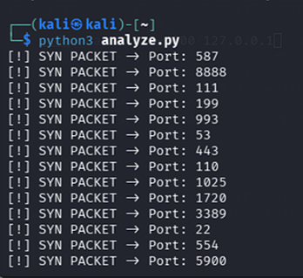
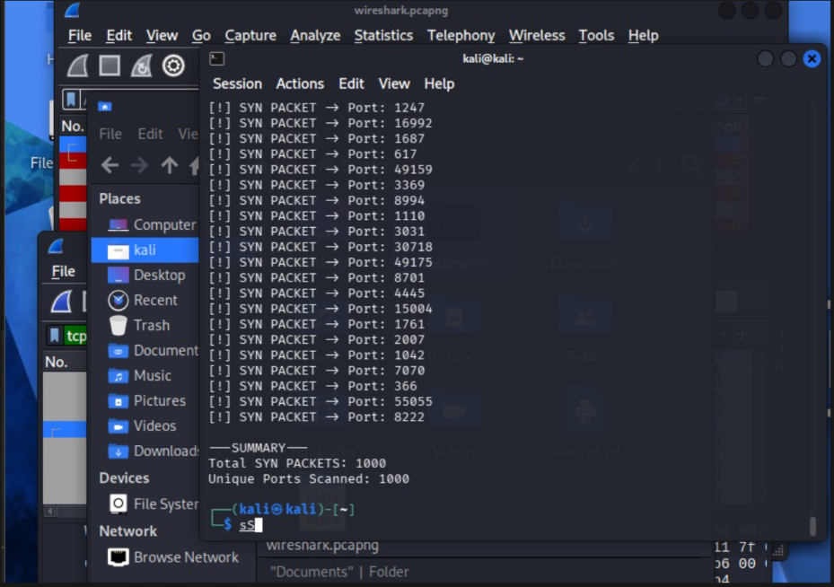
Network Forensics Implementation
• Nmap SYN scan executed to simulate reconnaissance attacks.
• Wireshark captured suspicious TCP SYN packet traffic.
• Traffic filtering used tcp.flags.syn == 1 for targeted analysis.
• Packet behaviour confirmed systematic port scanning activity.
9

Slide 10
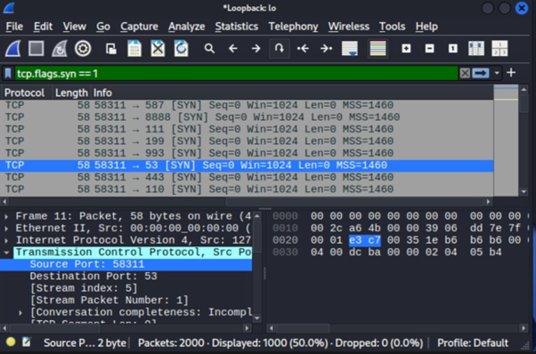
Wireshark Packet Analysis
• Captured packets were analyzed at the TCP protocol level.
• SYN packets revealed connection initiation attempts.
• Source and destination ports identified active reconnaissance behavior.
• Packet inspection enabled accurate threat identification.
Fig : Wireshark capture showing SYN packets
10

Slide 11
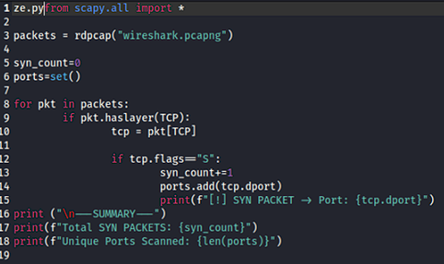
Python Automation using Scapy
• Python scripts automated analysis of PCAP capture files.
• Scapy library extracted SYN packets and destination ports.
• Automated scripts summarized packet statistics efficiently.
• Automation reduced investigation time compared to manual analysis.
Fig : Python script output showing analysis
11

Slide 12


Disk Forensics using Autopsy
• Disk images from the Windows VM were analyzed using Autopsy.
• Deleted files and hidden artifacts were successfully recovered.
• File metadata and timestamps supported evidence reconstruction.
• Organized evidence views improved forensic examination.
12

Slide 13
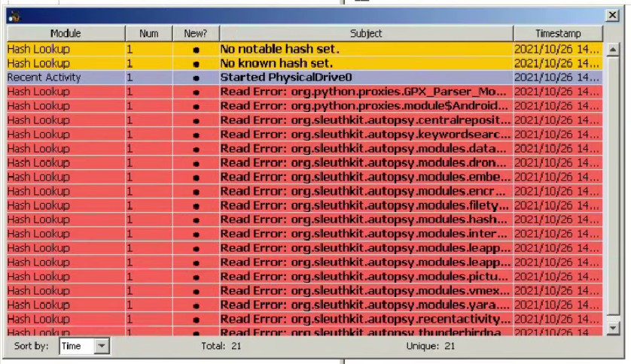
Artifact Extration and user Activity
• Browser history, cookies, and downloads were extracted.
• Shell Bags identified previously accessed folders and directories.
• OS account details and login activity were reconstructed.
• Suspicious encrypted files and keyword hits were identified.
Fig : Messages- Status Update
13

Slide 14
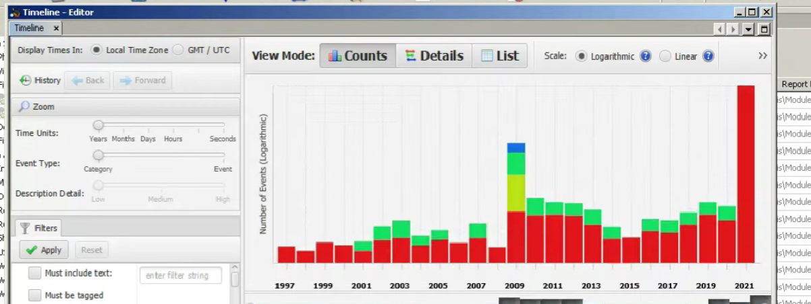
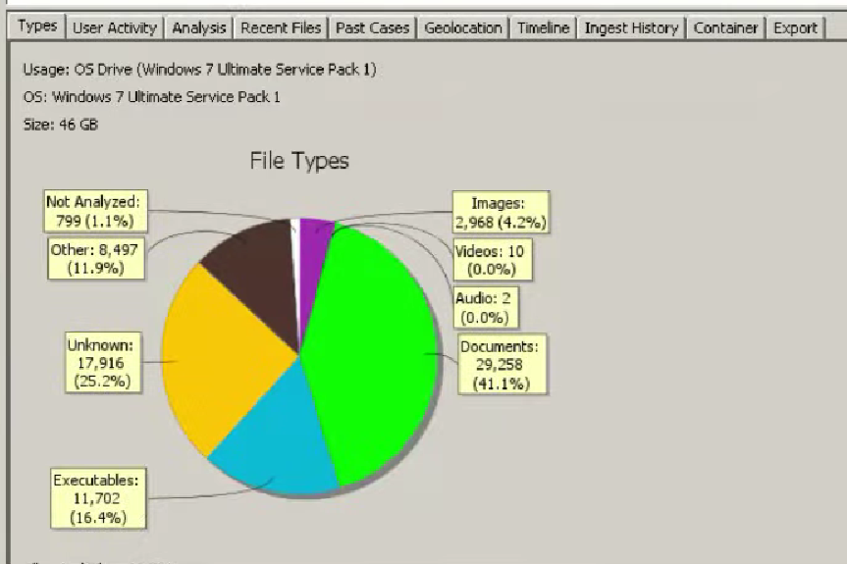
Timeline and Data Source Analysis
• Timeline visualization established chronological activity patterns.
• Data source summaries categorized files by type and usage.
• Investigation history provided detailed evidence tracking.
• Structured analysis improved incident reconstruction.
Fig : Timeline Analysis
Fig : Data Source Summary
14

Slide 15
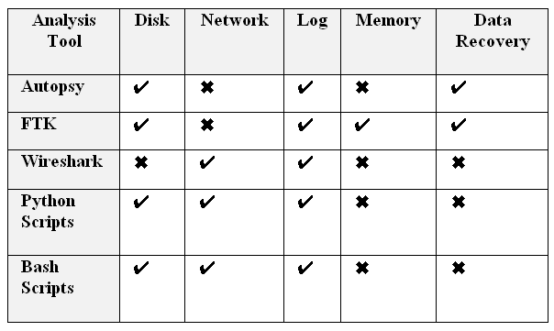
Major Findings
• Automated scripts detected 1000 SYN packets targeting unique ports.
• Wireshark confirmed suspicious reconnaissance traffic.
• Autopsy extracted over 4000 web history entries.
• Structured forensic workflows improved analysis accuracy.
15

Slide 16
Benefits of Automation in Forensics
• Faster processing of large-scale digital evidence.
• Reduced dependency on manual investigation procedures.
• Improved consistency and accuracy of forensic analysis.
• Enhanced scalability for enterprise-level investigations.
16

Slide 17
Conclusion
• Digital forensics plays a major role in cybersecurity defense mechanisms.
• Integration of Autopsy, Wireshark, and Python improved investigation efficiency.
• Automated workflows enhanced scalability and reduced analysis delays.
• Structured forensic frameworks provide reliable and legally admissible evidence.
17

Slide 18
Thank You
18

