Slide 1
Where 4-Bit Quantization Breaks
Small Tool-Calling Agents, and Which Repairs Fix It
CMPE 295A · Advisor review · October 30, 2026
Ekant Kapgate
Vritika Malhotra
Yashashav Devalapalli Kamalraj
Advisor: Dr. Bertin Cordova-Diba
M1 status · responses to the six points from October 16 · first cluster results · plan to M2
Notes:
Thirty-minute review. First where we stand after M1, then how Workbook 2 answers each of the six points you raised on October 16, then the first results on the CoE HPC, the schedule split between 295A and 295B, and six decisions we need from you. Workbook 2 was submitted on October 29; every change made for your points is in bold there.

Slide 2
Progress since October 16
252 / 253
3 GPU types
31 vs 5.9
6 / 6
M1 skeleton episodes from one command (BFCL on CUDA and CPU, τ² airline, R1–R3); every step logged and classified
Cluster live since Oct 26: llama.cpp built for P100, A100, H100; tool-call smoke test passes on all three
Missing calls per 100 steps, Q4_0 vs BF16: Qwen3-0.6B on all 200 BFCL multi-turn tasks (1,600 episodes on the cluster, Oct 28)
Advisor points from Oct 16 answered in Workbook 2, each in bold where it lands
Done, Oct 16–29
Open
M1 walking skeleton on Colab (local=true fallback) · Slurm association fixed, cluster measured · clean-clone check passed on the cluster · first damage runs on 200 tasks · Workbook 2 with PERT chart and the six responses · all component PRs (#3–#9) merged to main (Oct 26 and 28)
Clean-clone rerun under a second member’s own account · human labels for the 30-step rater sample · one τ² episode pending · simulator as an A100 job (M2)
All M1 numbers are development data, not study results · Workbook 2, Chapter 8 and Table 37
Notes:
M1 ran on Colab under the fallback rule because cluster jobs were blocked until October 26. Since then the cluster works: llama.cpp is built for all three GPU types and the rebuilt model files are byte-identical to the pilot. On October 27 we ran the clean-clone check on the cluster twice; the second time an independent agent rebuilt everything from source in a private folder. Both passed. Those checks ran under one team account, so the M1 rule still needs a second member to repeat it under their own.

Slide 3
Advisor points from October 16
# | Your point (Oct 16) | What we changed | Where
1 | SD on every bar graph | ± 1 SD over 4 sampled trials; greedy bars a 95% Wilson interval (SD = 0); rule in the analysis plan | Fig. 5a; notes under Tables 35a, 36a; Ch. 7
2 | Mixed effects: in or out | In, as a registered analysis next to the bootstrap: three models (lme4 in R) and a rule for when they disagree | Ch. 3; Ch. 7 analysis plan
3 | Rename “Project Architecture” | Ch. 5 is now “System and Infrastructure Architecture” with two views: software (Fig. 1) and deployment (Fig. 1a) | Ch. 5
4 | Divide the plan by course | Scope by course: 295A ends with M4 and a launched QAD run (L1); training continues over the break (L2) | Table 38a; Fig. 6a
5 | Architecture changes from the HPC | Eight measured cluster facts and the change each forced, e.g. the τ² simulator moves inside the cluster | Table 19a
6 | Repair on another domain (CV) | Optional 295B layer: a vision-language agent with R1 and R2, go/no-go at M6 | FR-O6 (Table 8)
Workbook 2 (submitted Oct 29): every change made for these points is in bold, as Canvas asks
Notes:
One line per point. The next six slides take them one at a time. Everything here is in Workbook 2 in bold so you can find it.

Slide 4
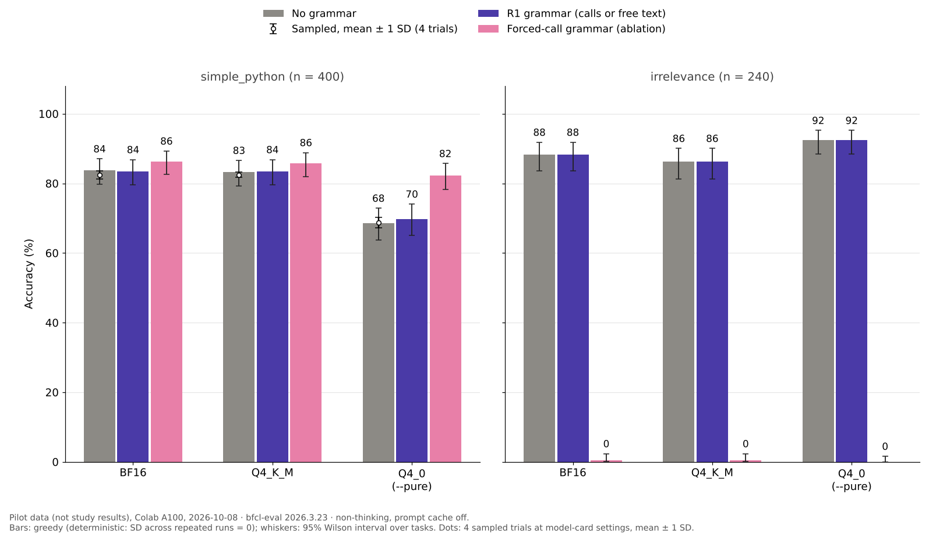
Point 1 · Dispersion on every bar graph
Sampled runs
Mean ± 1 SD over the 4 trials, e.g. simple_python Q4_0 68.75 ± 1.57
Greedy runs
Deterministic (SD = 0), so a 95% Wilson interval over tasks: Q4_0 68.5% [63.8–72.9]
Reporting rule (Ch. 7)
Every effect gets its 95% paired-bootstrap interval; the report job fails if a figure has no error bars
What the figure shows: BFCL accuracy of each format without a grammar (grey), with the R1 grammar (purple) and with a forced-call grammar (pink, a test only). Bars: greedy run; whiskers: 95% Wilson interval over tasks; white dots: mean ± 1 SD over 4 sampled trials. Pilot data, Colab A100, Oct 8.
Notes:
Greedy decoding gives the same answer every time, so its standard deviation is zero; a zero-width error bar would not show the uncertainty. For greedy bars we show the uncertainty over tasks instead, a 95% Wilson interval. Sampled runs show mean plus or minus one SD over the four trials. The rule is enforced in code: the plotting function has no default for error bars.

Slide 5
Point 2 · Mixed-effects analysis
Model | Formula (lme4::glmer in R) | Answers
A · Poisson | failures ~ configuration + (1 | task), offset log(steps); negative binomial if overdispersed | Failure rate ratio per configuration
B · Binomial | failure ~ precision × step type + precision × turn depth + (1 | task/episode) | Where in an episode 4-bit damage appears
C · Binomial | success ~ configuration + (1 | task) | Episode success
Decision rule: a conclusion is robust only when the mixed model agrees with the primary bootstrap in direction and in Holm-corrected significance; otherwise we report it as not robust, with both estimates.
Why R: statsmodels has no frequentist binomial or Poisson mixed model · convergence fallbacks: bobyqa optimizer, then drop the episode intercept, then report the failure · R script and planted-effect check due at M2, frozen in the OSF registration
Workbook 2, Ch. 3 (bullet no longer “optional”) and Ch. 7 Statistical Analysis Plan
Notes:
The mixed-effects analysis is now part of the registered plan. The bootstrap stays the primary test because it makes fewest assumptions; the mixed models are registered next to it, and the rule says what happens if they disagree. Model B is the one that answers RQ1 most directly: where in an episode the damage appears.

Slide 6
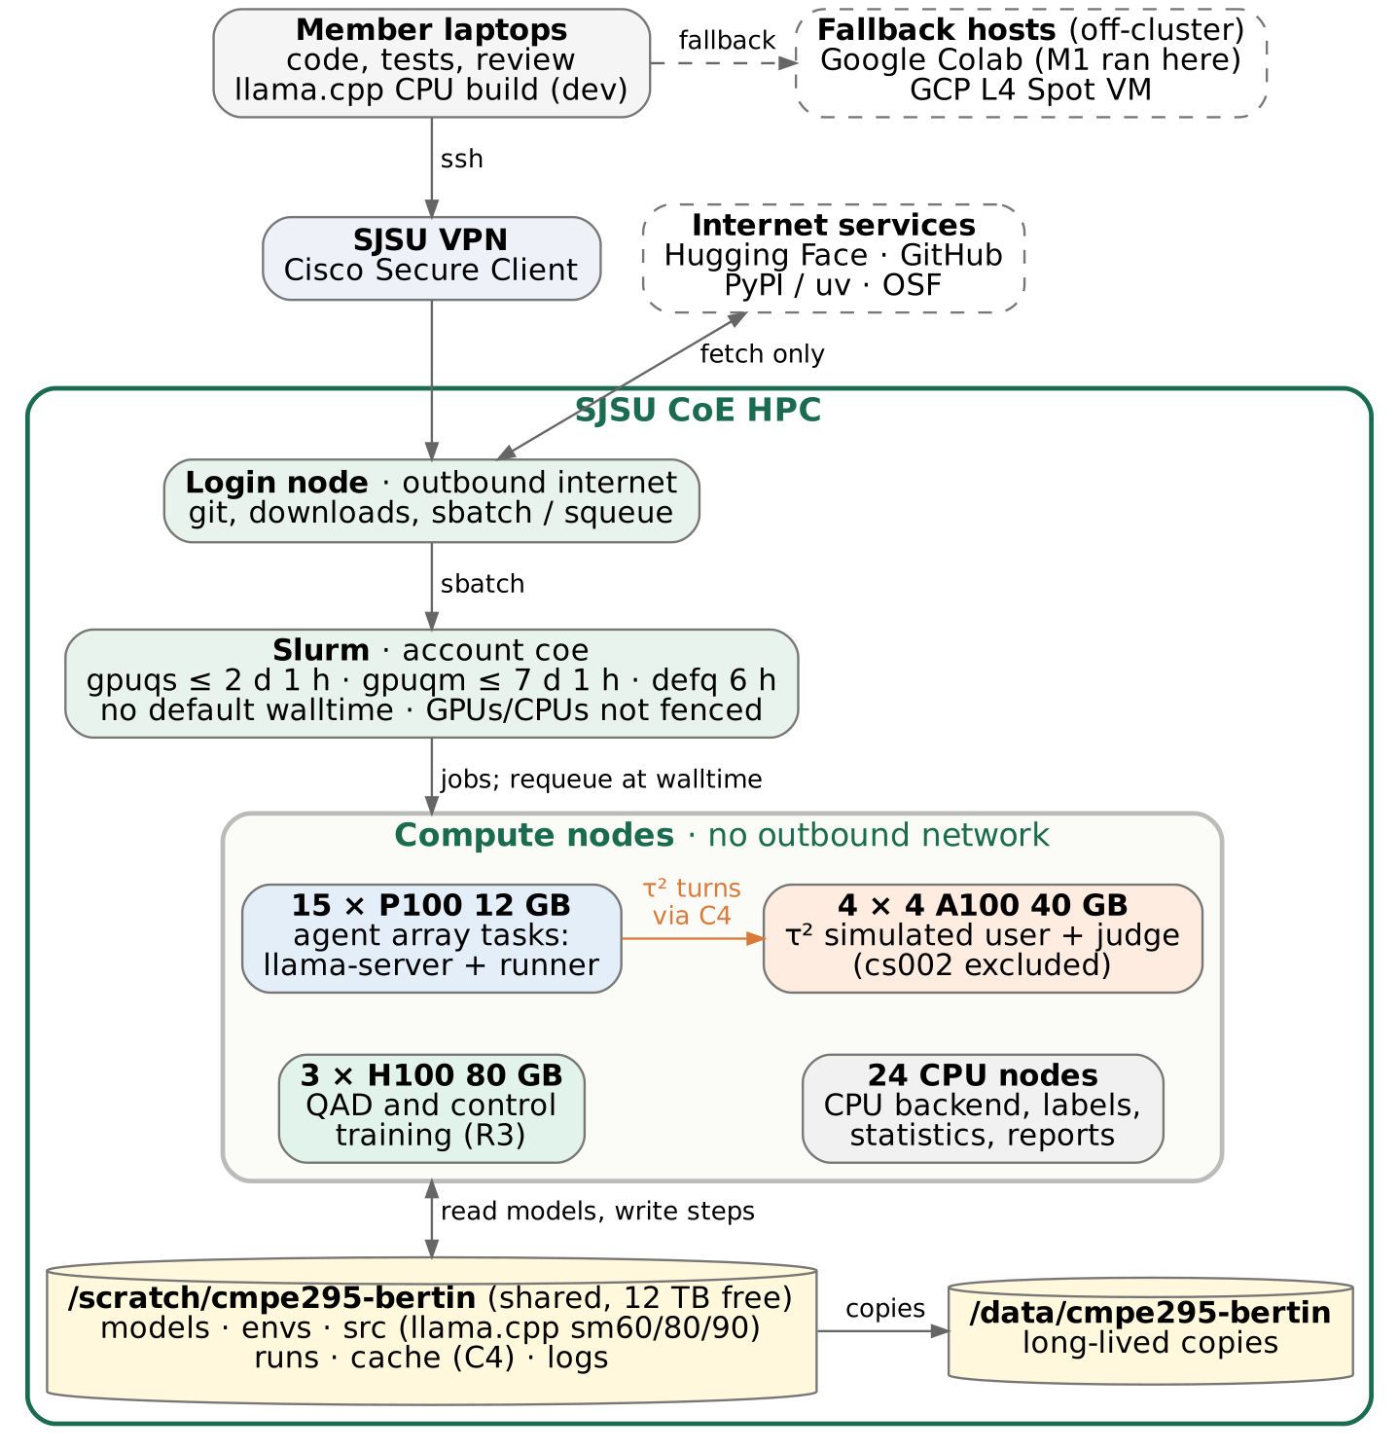
Point 3 · System and infrastructure architecture
Chapter 5 retitled
Two views: software (Fig. 1, components C1–C11 and data flow) and infrastructure (Fig. 1a, where each part runs)
15 × P100 12 GB
Agent array tasks: llama-server + runner
4 × 4 A100 40 GB
τ² simulated user and judge (cs002 excluded)
3 × H100 80 GB
QAD and control training (R3)
24 CPU nodes
CPU backend, labels, statistics, reports
Login node only has internet
Downloads there; jobs read only from /scratch/cmpe295-bertin
Figure 1a: how members reach the cluster (VPN → login node → Slurm), the four node types and what runs on each, and the shared storage. Dashed boxes are off-cluster.
Notes:
The software view is unchanged from Workbook 1. The new infrastructure view shows what we measured on October 26: four node types, one shared scratch folder, and no internet on compute nodes.

Slide 7
Point 4 · Scope by course: 295A and 295B
CMPE 295A · Aug 31 – Dec 20
Winter break · Dec 21 – Jan 24
CMPE 295B · Jan 25 – May 14
M1 walking skeleton (reached)
M2 BF16 references (Nov 6)
M3 damage map v1 (Dec 4)
M4 R1 and R2 evaluated (Dec 18)
L1: QAD pipeline on the H100, 0.6B run launched, first checkpoint verified
L2: QAD and control training for the remaining models, unattended on the H100 with requeue
M5 R3 evaluated (Jan 29)
M6 costs complete (Feb 5)
M7 workshop paper (Feb 19)
M8 release v1.0 (May 14)
Optional: vision-language layer (FR-O6)
Course: Workbook 1, Workbook 2, demo and report Ch. 1–2 (Dec 4)
No course deliverables
Course: 295B workbooks, final report, Expo demo
Workbook 2, Table 38a and Figure 6a · splitting the training into L1 and L2 keeps the critical path; the buffer before M8 is 19 days
Notes:
295A closes with the damage map and the first two repairs evaluated, plus the QAD pipeline proven on the smallest model. The long training runs happen over the break, so 295B starts with R3 evaluation and costs, then the paper.

Slide 8
Point 5 · Architecture changes from the HPC
Measured on the cluster (Oct 26) | Change to the architecture | Where
Compute nodes have no outbound network | Every setup step split: fetch on the login node, build or run in a job, offline flags | scripts/, slurm/
Jobs cannot reach an outside VM | τ² simulated user moves to an A100 job inside the cluster; the GCP VM becomes the fallback (planned for M2) | C4, DEP-3
No default walltime; gpuqs 2 d 1 h, gpuqm 7 d 1 h | Every job sets -t; array tasks requeue themselves 180 s before the limit and resume; QAD checkpoints every 30 min | C2, C9
GPUs and CPUs are not fenced | Threads from SLURM_CPUS_PER_TASK; GPU, node and driver logged; exclusive nodes for cost runs | hpc_env.sh, C5
Mixed GPUs and drivers (575.57, 590.44) | One llama.cpp build for sm 60/80/90; GPU type a recorded factor; parity test per GPU type | FR-E17
Home folder full; 12 TB group scratch | Models, environments, caches and runs in /scratch/cmpe295-bertin, group-shared | hpc_env.sh
At most 2 nodes per user (QOS) | One configuration per GPU on 4-GPU A100 nodes: 4 at once, ~2 s per episode (P100 ~15 s) | Slurm job (script not yet on main)
Node cs002 cannot start CUDA | Excluded from A100 jobs; smoke test before each batch | smoke_s1.sbatch
Workbook 2, Table 19a · scripts on main
Notes:
The main change concerns the simulator. Workbook 1 put it on a GCP VM, but jobs on the cluster cannot reach outside machines, so we will run it as an A100 job inside the cluster and keep the VM only as a fallback. That also drops the expected cloud cost toward zero.

Slide 9
Point 6 · A second domain: vision-language agents
What (FR-O6, RQ5)
Why not classic computer vision
One small open vision-language model as GGUF under the same 4-bit formats, on a visual tool-calling task set, with R1 and R2 applied unchanged and the same step classes and metrics.
A CNN classifier has no tool calls for our repairs to fix. A tool-calling VLM reuses the testbed, the classifier and the repairs, so the comparison stays like for like.
Guardrails: no work before M5 · a one-day spike (S11) checks that llama.cpp serves the model on a P100 and that a scored task set exists · go/no-go at M6 (Feb 5) · if dropped, BFCL and τ² carry RQ1–RQ4 · the QAD work (K, L1, L2) is unaffected
Workbook 2, Table 8 (FR-O6) and Schedule Risks
Notes:
We took your suggestion as an optional layer rather than a new study. The question for you is whether a vision-language agent counts as the different domain you had in mind.

Slide 10
M1 results (development data)
Configuration (Qwen3-0.6B) | BFCL multi-turn (20 tasks) | τ² airline (3 tasks)
BF16, CUDA | 0 of 40 | 0 of 6
Q4_K_M, CUDA | 0 of 40 | 0 of 6
Q4_0, CUDA | 0 of 40 | 0 of 6
Q4_0, CPU | 0 of 40 | 0 of 6
R1: Q4_0 + grammar | 0 of 20 | 0 of 3
R2: Q8_0 | 0 of 20 | 0 of 3
R3: toy QAD Q4_0 | 0 of 20 | 0 of 2 (1 pending)
6 → 12 → 29
10 → 0
Missing calls, BF16 → Q4_K_M → Q4_0
Invalid-argument steps with R1
0 → 6
32%
Malformed calls, BF16 → Q4_0
Q4_0 steps identical on CPU and CUDA
Implication for M2
Step-level outcomes become the primary outcome; backend recorded as a factor
Valid episodes out of episodes run (2 seeds) · Colab, Oct 24–26 · development data · Workbook 2, Table 36a
Notes:
Episode accuracy is 0% at 0.6B for every configuration, so the comparison uses step counts: missing calls rise from 6 to 29 and malformed calls from 0 to 6, and the R1 grammar removes every invalid-argument step. CPU and CUDA agree on only a third of aligned steps, so the backend has to be a factor.

Slide 11
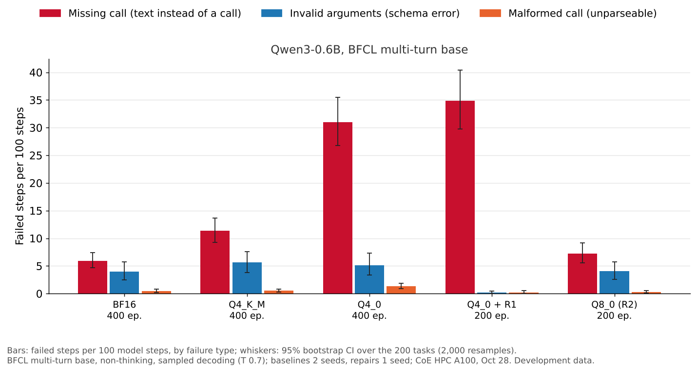
First damage results: Qwen3-0.6B on 200 BFCL tasks
Missing calls by format
Per 100 steps: BF16 5.9 [4.7–7.4] · Q4_K_M 11.4 [9.3–13.7] · Q4_0 31.0 [26.8–35.5]
Effect of R1 (grammar)
Invalid arguments 5.1 → 0.2 per 100 steps, but missing calls stay at 34.8 [29.8–40.4] (supports H2)
Effect of R2 (Q8_0)
Missing calls 7.2 [5.5–9.1] and invalid arguments 4.0, close to BF16
Valid episodes | BF16 | Q4_K_M | Q4_0 | Q4_0 + R1 | Q8_0 (R2)
Qwen3-0.6B | 16 / 400 (4.0%) | 10 / 400 (2.5%) | 2 / 400 (0.5%) | 2 / 200 (1.0%) | 6 / 200 (3.0%)
CoE HPC, 4 × A100 node, Oct 28 · 1,600 episodes, 10,483 steps · development data · brackets: 95% bootstrap CI over tasks
Notes:
This is the result M1 was missing. With all 200 BFCL multi-turn tasks instead of 20, the step-level differences are clear and their intervals do not overlap: Q4_0 skips the tool call five times as often as BF16. The R1 grammar removes malformed and schema-invalid calls but cannot make the model call a tool, which is H2. Q8_0 brings the rate back to the BF16 level. Episode accuracy stays low at 0.6B, which is why the step outcome is the primary outcome; the next slide shows what happens at 1.7B and 4B.

Slide 12
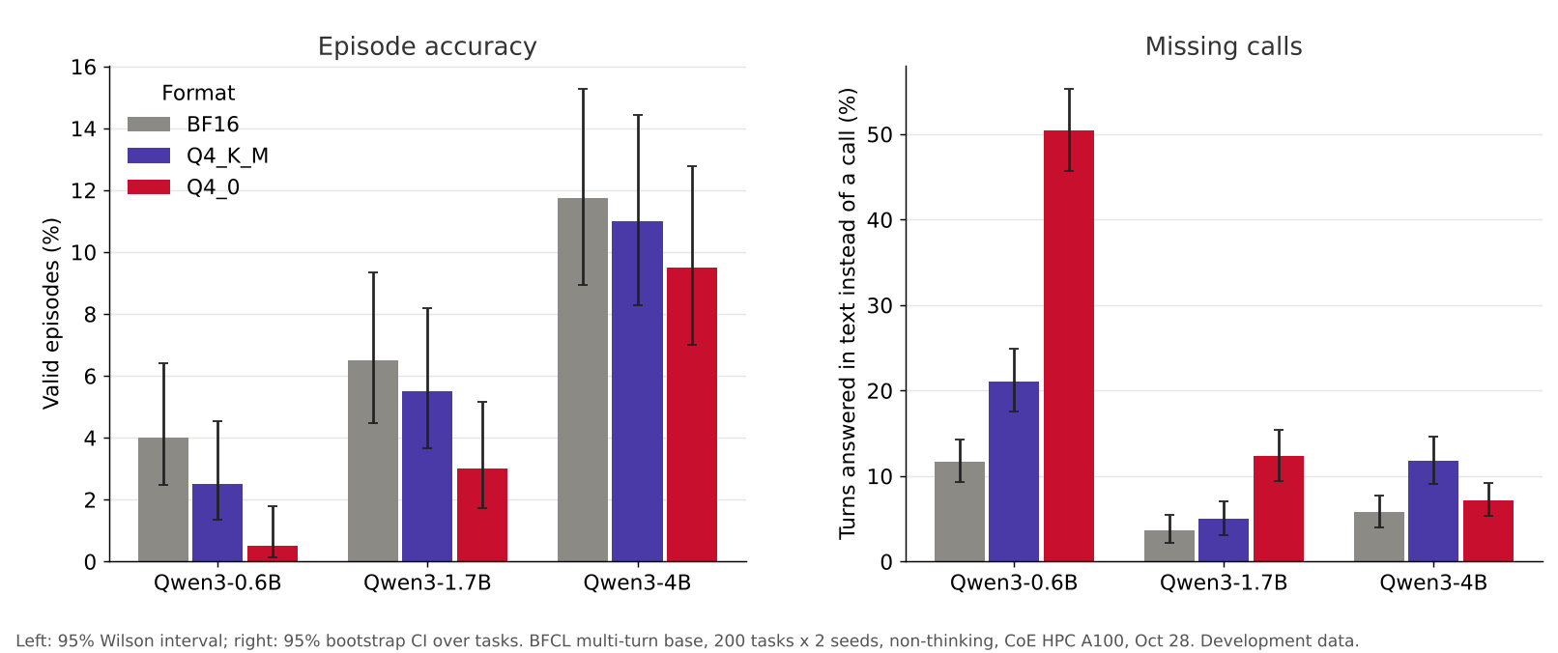
Model size: Qwen3-0.6B, 1.7B and 4B, same 200 tasks
Valid episodes, BF16 / Q4_K_M / Q4_0: 0.6B 16 / 10 / 2, 1.7B 26 / 22 / 12, 4B 47 / 44 / 38 (of 400). Turns answered in text instead of a call fall with size; Q4_0 is worst at 0.6B and 1.7B, but at 4B Q4_K_M is worst (11.8% vs 7.1% for Q4_0 and 5.8% for BF16).
Left: 95% Wilson interval; right: 95% bootstrap CI over tasks · 200 BFCL multi-turn base tasks × 2 seeds per format · CoE HPC A100, Oct 28 · development data
Notes:
Larger models complete more episodes, and the missing-call damage shrinks with size. The ranking of the two 4-bit formats is not fixed: at 4B, Q4_K_M answers in text more often than pure Q4_0. That is one reason the study measures each format and model rather than assuming more bits per weight means less damage. Episode accuracy is still at most 12% on this category, so the step outcome stays primary.

Slide 13
First results on the CoE HPC (Oct 26–27)
144 / 231 / 350
21 min
PASS × 2
κ = 1.00
Tool-call smoke test, tokens/s on P100 / A100 / H100 (S1 passes on all three)
llama.cpp built from source for sm 60, 80 and 90 in one job; model files byte-identical to the pilot
Clean-clone check: same 253-spec plan and hash, 10 Q4_0 episodes, 60 steps all classified, 0 of 10 as reference
AI rater: blind second labelling of 30 steps (6 classes) from 100 new cluster episodes, against the written codebook
How these were run
Codebook gap found
Both checks on Oct 27 ran under one team cluster account; the full rebuild was done by an independent AI agent, and the 30 labels came from an AI rater (a different model from the one that drafted the classifier). Before M2 the team repeats the check under a second member’s own account and adds human labels for the same 30 steps.
A tool that returns an error payload (e.g. “No such file”) is labelled ok_call, because exec_error needs the executor’s own error. Codebook v0 (M2) decides whether tool-level errors get their own class.
Slurm jobs 97498, 97528, 97611–97655 · Workbook 2, Tables 37 and 37b, Ch. 7
Notes:
κ of 1.00 shows the written rules are unambiguous when the rater sees the logged facts; it is not a measure of human agreement, which still needs a team member’s labels and the 300-step check before the main runs. The gap it found is a design question for codebook v0.

Slide 14
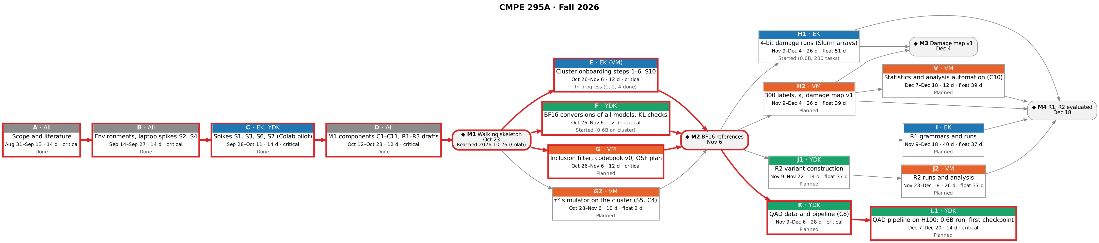
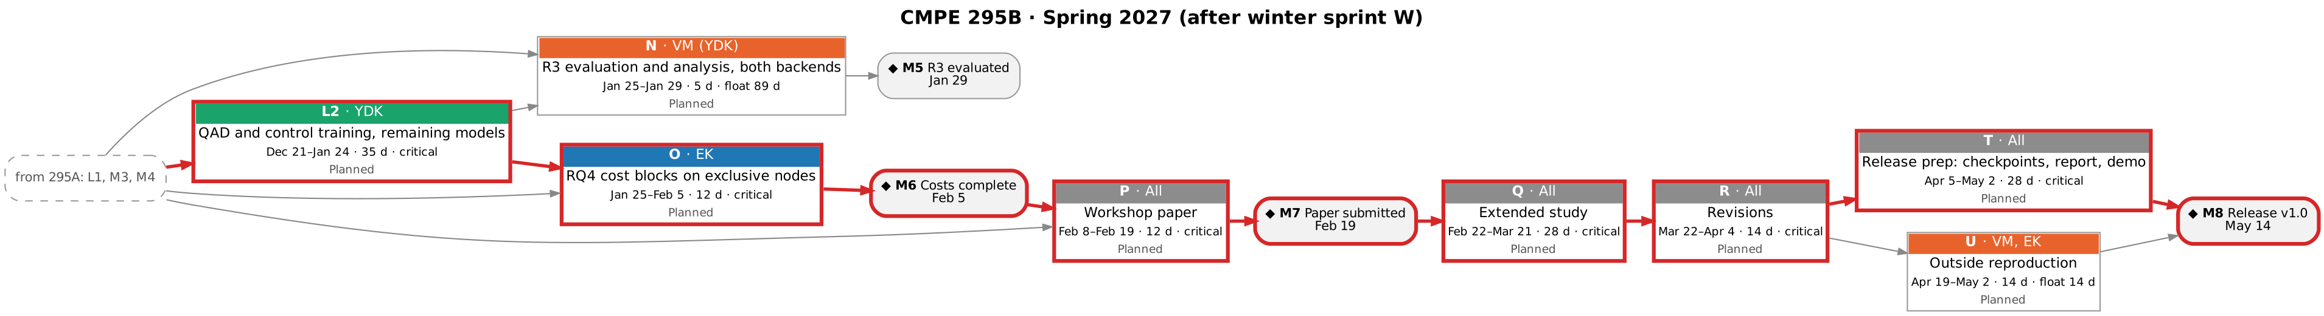
Schedule and critical path
EK lead
VM lead
YDK lead
Whole team
Critical path (zero float)
Each box: package, lead, dates, duration, float, status · each member leads about 104 days of work · float: damage runs 51 days, R1 and R2 37 · 19 days of buffer before M8 (May 14) · Workbook 2, Figure 6a, Table 39a
Notes:
Durations are the planned calendar days; float comes from forward and backward passes. A slip in the QAD pipeline or training moves everything after it, which is why the H100 training starts before the winter break. The damage runs and R1/R2 have weeks of float.

Slide 15
Plan to M2 (Nov 6)
Testbed & runtime
Benchmarks & analysis
Models & repairs
Clean-clone rerun under a second member’s own account · S1 and S10 on the cluster · CUDA-vs-CPU parity test (FR-E17) · Slurm array runner with requeue
Human labels for the 30-step rater sample · decide on tool-level errors · inclusion filter · codebook v0 · OSF pre-registration with the mixed-effects plan
BF16 conversions of all models with KL checks · τ² simulator as an A100 job · mixed-effects R script and its planted-effect check
M2 on Nov 6: BF16 references for every model on the cluster, two members’ own cluster runs, codebook v0, and human labels for the 30-step rater sample.
Workbook 2, Tables 37b and 39 (Sprint 5)
Notes:
All five component pull requests were merged to main on October 28. The pending τ² episode is retried with the C4 fix.

Slide 16
Decisions we need from you
1
Accept M1 as reached on Colab, with the cluster criteria and the second member’s rerun at M2
2
Make step-level outcomes the primary M2 outcome (episode accuracy is 0% at 0.6B)
3
τ² simulator from M2: an A100 job inside the cluster (recommended), or keep the GCP VM
4
Confirm the dispersion convention and the mixed-effects analysis as on points 1 and 2
5
M4 on Dec 18 as planned, or Dec 11 so 295A closes on a finished milestone
6
Accept the vision-language extension as optional 295B scope, go/no-go at M6
Notes:
Two smaller items in the Workbook list need no discussion unless you want it: keep only τ² tasks whose gold actions write to the database, and record the backend as a factor with greedy parity tests.

Slide 17
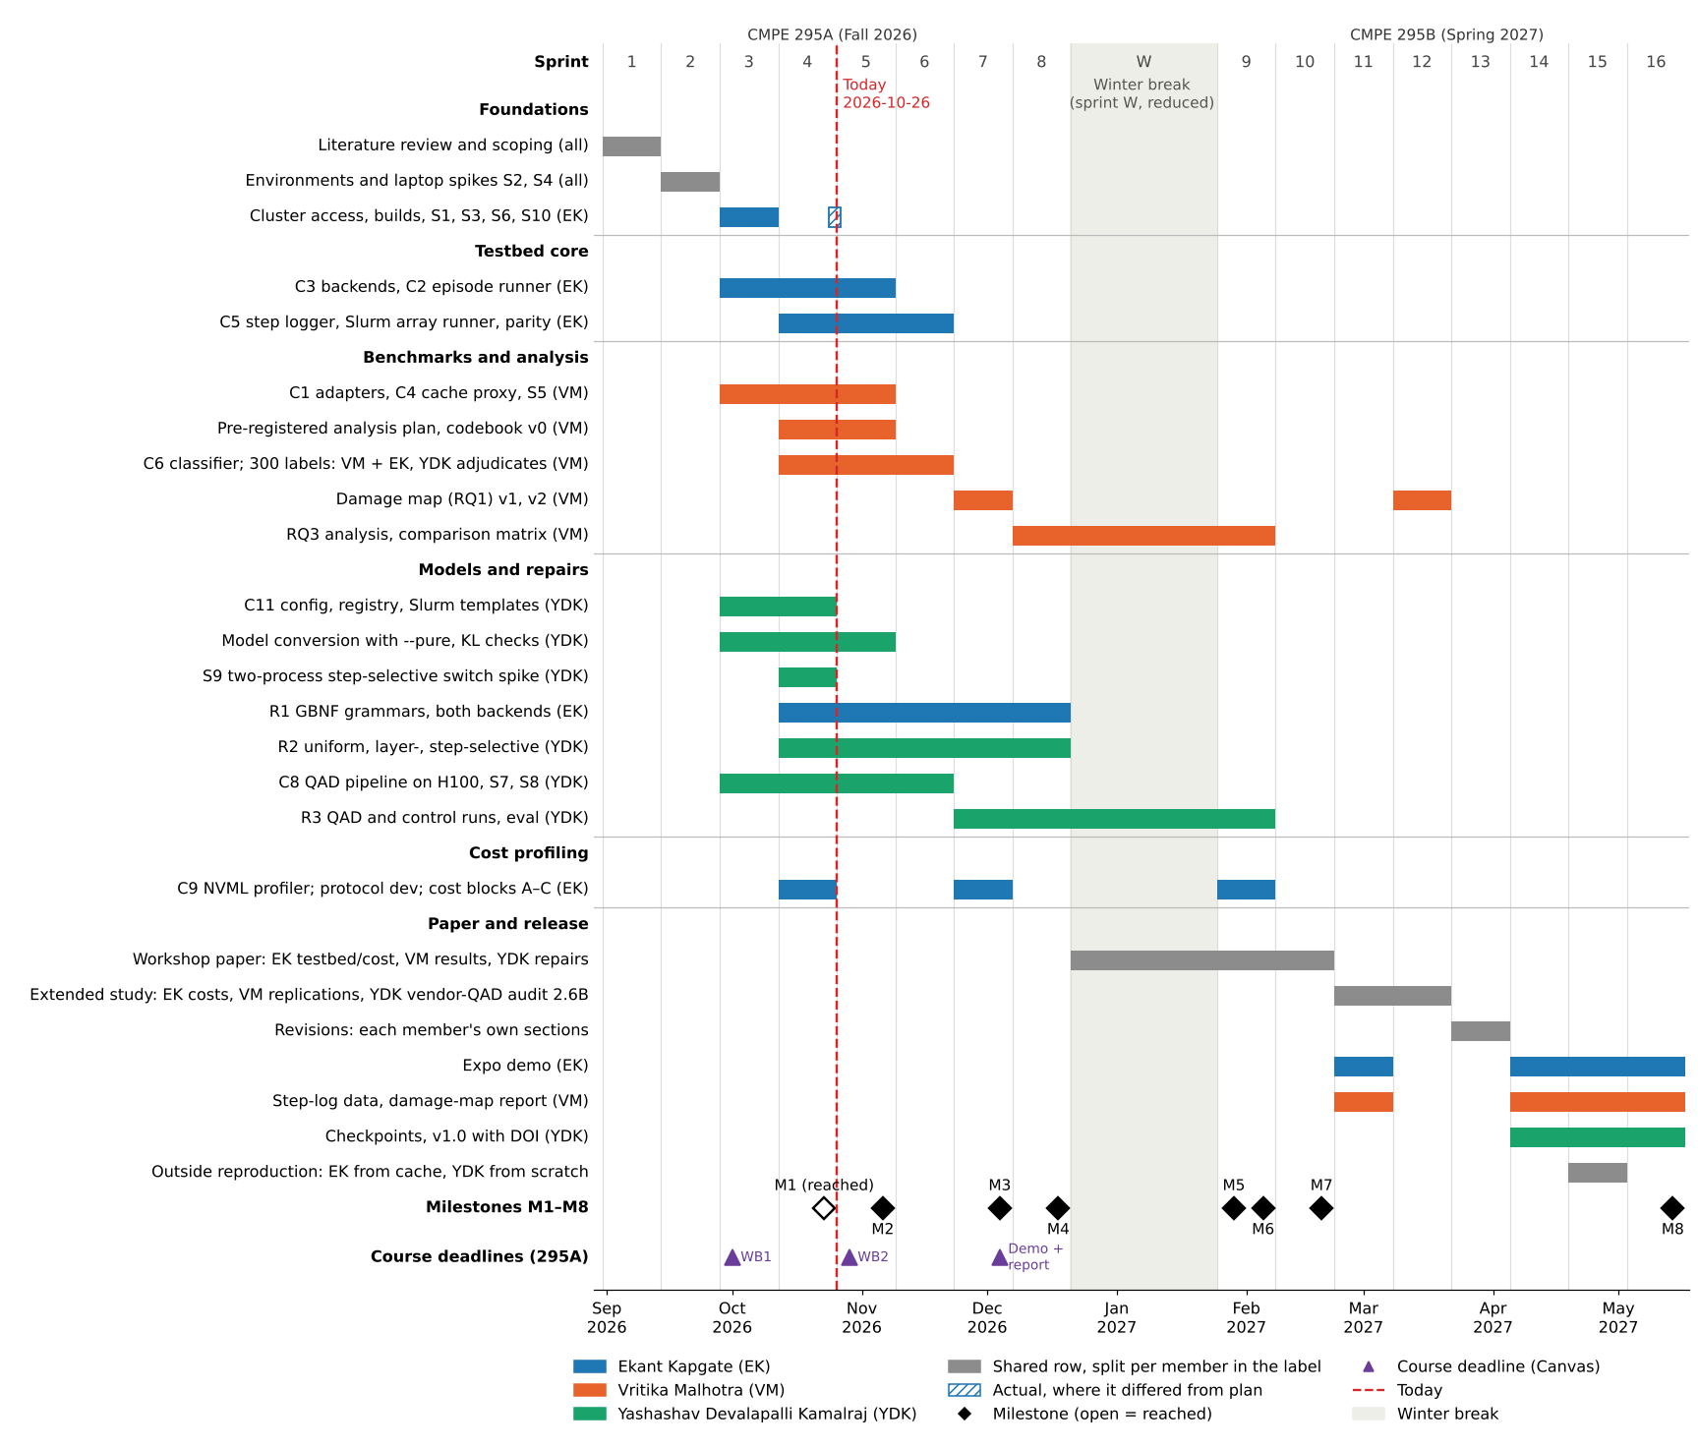
Full schedule, Fall 2026 to Spring 2027
What the figure shows: every task by sprint for both semesters; bar colour = lead (blue EK, orange VM, green YDK, grey whole team); dashed line = status date Oct 26; diamonds = milestones; triangles = course deadlines. Workbook 2, Figure 6.

Slide 18
Where each Workbook 2 rubric item is answered
Rubric item | Where in Workbook 2
WB2-6 Evaluation Methodology | Ch. 3 baselines (Tables 11–15); Ch. 7 validity, statistical analysis and evaluation plans; Ch. 8 pilot (Table 35a) and M1 results (Table 36a)
WB2-7 System Design / Methodology | Ch. 5 System and Infrastructure Architecture (Figures 1, 1a; Tables 19, 19a, 20); Ch. 6 design; Ch. 8 reproduction steps
WB2-8 Implementation Plan and Progress | Ch. 8 (Tables 31–37b): environment, spikes, pilot, M1 results, progress log, plan to M2, cluster onboarding, decisions
WB2-9 Project Schedule | Ch. 9: Gantt (Figure 6), PERT (Figure 6a, Table 39a), milestones and scope by course (Tables 38, 38a), sprint plan (Table 39)
Workbook 2, Table 20a

