Slide 1
Where 4-Bit Quantization Breaks
Small Tool-Calling Agents, and Which Repairs Fix It
CMPE 295A · Advisor review · October 16, 2026
Ekant Kapgate
Vritika Malhotra
Yashashav Devalapalli Kamalraj
Advisor: Dr. Bertin Cordova-Diba
Progress since Workbook 1 · pilot findings · plan to M1 and M2
Notes:
Thirty-minute review. We cover what we did since the Workbook 1 talk on October 9, what the pilot found, what we are changing, and our plan to M1 on October 23 and M2 on November 6. We end with five decisions we need from you.

Slide 2
Progress since Workbook 1
1,390
−2.7 pts
57 vs 11
61 / 400
BFCL non-live tasks run for each format: BF16, Q4_K_M and Q4_0
Q4_K_M vs BF16 (p = 0.027). We did not see the large drop reported in the paper
simple_python tasks where Q4_0 answered in text instead of calling the tool (BF16: 11)
Q4_0 outputs changed when prompt caching was on, so we turn caching off
Done, Oct 1–16
Open
Spikes S1–S3, single-turn S4, S6 and S7 run on Colab · follow-up checks · full rerun with 4 random seeds · Workbook 1 talk (Oct 9)
HPC access is in the pipeline from Prof. Gao · Ekant is rerunning S1, S3, S6 · S4 multi-turn, S5, S8 in progress · M1 due Oct 23
All pilot numbers are test data, not study results
Notes:
Every part the walking skeleton needs has run at least once on Colab. These four numbers are the main results. HPC access is in the pipeline from Prof. Gao, and three spikes are being rerun by their owners.

Slide 3
Testbed architecture: what has run and what changed
C11 Config & Registry Run manifest now records prompt cache, thinking mode, server settings, file hashes NEW · in progress
BENCHMARKS & EPISODES
INFERENCE
TRAINING & EXPORT
C1 Benchmark Adapter
C3 llama.cpp v0.6.0
C8 QAD pipeline (R3)
bfcl-eval single-turn ran · handler subclass (NEW)
CUDA + CPU, same tokens · cache off (NEW)
S7: stop and resume gives the same loss
C2 Episode Runner
C7 R1 grammar
Export & verify
In progress, for M1
Calls or text answers · forced call only for testing
S8 Q4_0 export in progress
C4 Simulated-User Cache
C7 R2 added bits
Planned; S5 in progress
Q8_0 + S9 switch in progress
C5 Step Logger
C6 Classifier
C10 Stats
C9 Cost Profiler
In progress
+ missing-call class (NEW)
Ran: McNemar, 4 seeds
Ran: NVML mJ/token
Now: Colab A100 + CPU
Next: CoE HPC P100 (eval) · H100/A100 (QAD) · CPU nodes
+ GCP L4 simulator VM (planned)
Green border = ran in the pilot · solid grey = in progress · dashed = planned · blue = changed after the pilot. Same run spec on both hosts; only the host changes.
Notes:
This is the Workbook 1 architecture updated with the pilot. Green boxes have run on Colab. Blue text shows what we changed after the pilot. When HPC access is active, only the host at the bottom changes. The original figure is in the backup slides.

Slide 4
Pilot results on BFCL
Qwen3-0.6B, BFCL (v2 protocol) | BF16 | Q4_K_M | Q4_0
simple_python, greedy (n = 400) | 83.75 | 83.25 | 68.50
Non-live overall, greedy (1,150 call tasks) | 69.52 | 66.81 | 56.38
Non-live, 4 sampled seeds (mean ± sd) | 68.7 ± 0.6 | 65.3 ± 1.0 | 56.6 ± 1.7
Irrelevance, correct no-call (n = 240) | 88.33 | 86.25 | 92.50
No tool call on simple_python (tasks) | 11 | 8 | 57
Bits per weight, whole file | 16.06 | 5.15 | 4.57
Q4_K_M: −2.7 points
72 tasks went from right to wrong and 47 from wrong to right (p = 0.027, 1,150 tasks). On 400 tasks alone the drop was not significant.
Q4_0 --pure: −13.1 points
193 tasks went from right to wrong and 33 from wrong to right. Most errors are missed tool calls.
Colab A100, Oct 8 · llama.cpp v0.6.0 · bfcl-eval 2026.3.23 · non-thinking mode, prompt caching off · test data, not study results
Notes:
We ran the official BFCL evaluator without changes. Our only additions were non-thinking mode and turning prompt caching off. Q4_K_M lost 2.7 points, which is small but significant over 1,150 tasks. Q4_0 lost 13 points. Q4_K_M is 5.15 bits per weight on this model, not the 4.9 we planned with.

Slide 5
We did not see the published Q4_K_M drop
Our variant (BFCL v4) | BF16 | Q4_K_M
Non-thinking, greedy, non-live | 69.52 | 66.81
Thinking, model-card sampling, simple_python | 86.00 | 85.00
unsloth Q4_K_M file, non-live | 69.52 | 67.92
bartowski Q4_K_M file, non-live | 69.52 | 69.00
Ollama qwen3:0.6b file, non-live | 69.52 | 66.40
Taheri et al. [19], BFCL V3 non-live, instruction-following prompt
62.3 → 16.8
Qwen3-0.6B, BF16 → Q4_K_M
What it means for RQ1
Not tested yet
The drop may depend on the prompt format. Our study will measure where the drop happens.
The paper’s prompt, its test harness, and BFCL V3. Note: Qwen only publishes a Q8_0 file for the 0.6B model.
Pilot data, Colab A100, Oct 8 · non-live = bfcl “non-live overall” over 1,150 call tasks · BF16 for third-party rows is our own reference
Notes:
The paper reports a drop from 62.3 to 16.8. We tried thinking mode, sampling and three other Q4_K_M files, and none showed that drop. We have not tried the paper’s own prompt, harness or BFCL V3. This supports RQ1: the study should measure where the drop happens.

Slide 6
Q4_0 often answers in text instead of calling the tool
58 Q4_0 “no call” outputs on simple_python, hand-labelled
“The King of France in 1510 was Louis XIV.”
Direct answer, correct
19
Direct answer, wrong or invented
19
“The current time in Sydney, Australia is 20:03.”
Q4_0 outputs where a tool call was required
Answer needing live data it lacks
7
Direct answer, unclear
4
Proposal for codebook v0
Asks the user for details
5
Add a “missing call” failure type to C6. This also explains why Q4_0 scores higher than BF16 on irrelevance (92.5 vs 88.3).
Says it will call, does not
3
Call the parser cannot read
1
Single rater so far, second rater pending · cache-off greedy run, non-thinking · BF16 skips the call on 11 of 400 tasks, Q4_0 on 57
Notes:
We read all 58 Q4_0 outputs with no tool call. 49 answer the question directly, and 26 of those are wrong or made up. A grammar cannot fix this, and our Workbook 1 failure list does not include it, so we propose a new failure type.

Slide 7
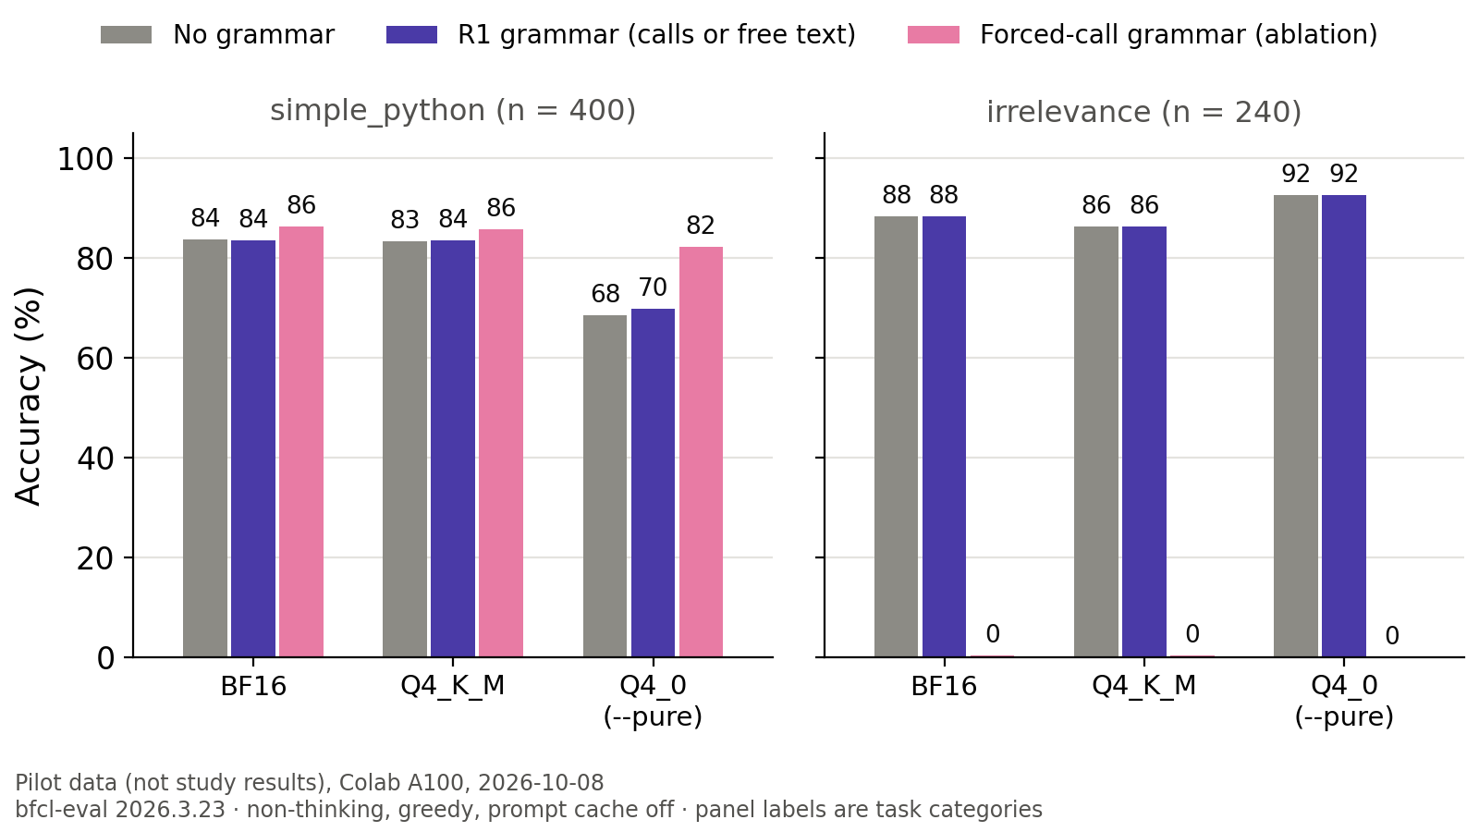
Grammar repair (R1) results
R1 (calls or free text)
Adds 0.9 / 2.5 / 2.3 points on non-live. Q4_K_M with R1 (69.29) is close to BF16 (69.52).
Forced call: test only
Raises Q4_0 from 68.5 to 82.3 on simple_python, but scores 0–0.4% on irrelevance.
Matches H2
R1 fixes badly formed calls. It does not fix text answers or wrong values.
Non-live gains in order BF16 / Q4_K_M / Q4_0 · pilot data, Colab A100, Oct 8 · greedy, non-thinking, prompt cache off
Notes:
The grammar shown at the Workbook 1 talk forced a tool call. That scores zero on irrelevance tasks, where the right answer is no call. Our R1 allows text answers, as planned in Workbook 1. It fixes badly formed calls but cannot stop Q4_0 from answering in text.

Slide 8
Reproducibility and cost
61 / 400
CPU = CUDA
50 / 50
Q4_0 outputs changed with prompt caching on. With it off, reruns match exactly (400/400).
Same output tokens on both backends for all three files (S2 criterion).
QAD steps with identical loss after a kill at step 27 and resume from step 25 (S7).
Cost on a Colab A100 (indicative) | BF16 | Q4_K_M | Q4_0
Energy per decoded token, mJ (10 runs) | 349 ± 14 | 185 ± 10 | 134 ± 6
Decode tokens/s (1,024 tokens) | 291.5 | 342.2 | 379.3
Peak GPU memory, MiB (incl. 518 baseline) | 3,096 | 2,316 | 2,262
Shared Colab VM, clocks unlocked: RQ4 numbers come only from exclusive cluster cost blocks (DEP-5)
Notes:
Greedy decoding alone did not give the same outputs: prompt caching changed 61 of 400. With caching off, reruns matched exactly. The cost numbers show the measurement works; final cost numbers will come from the cluster.

Slide 9
Design changes from the pilot
Finding | Change | Owner · when
Prompt caching changes outputs | Cache off on every request; logged in the run manifest | Ekant, Yashashav · M1
Forced-call grammar fails on irrelevance | R1 keeps free-text branch; always report irrelevance | Ekant · M1
Q4_0 answers in text instead of calling | Propose “missing call” class; separate tag-spacing check | Vritika · M2
BFCL’s Qwen handler uses thinking mode | Handler subclass in our repo; thinking mode per run spec | Vritika, Yashashav · M1
Q4_K_M = 5.15 bits per weight | Report measured sizes in RQ4, not nominal ones | Yashashav · M2
Qwen ships only Q8_0 GGUF for 0.6B | Q4_K_M described as the third-party format | Done in Workbook v2
Full list: Workbook v3, Table 35b · nothing here changes the research questions or the grid
Notes:
None of these changes the research questions or the experiment plan. They make the measurements more reliable.

Slide 10
Spike status
S1
S2
S3
S4
S5
Build + tool call
CPU = CUDA tokens
Grammar, lazy check
BFCL evaluator
Simulator on L4
Ran on Colab
Criterion met
Ran on Colab
Single-turn ran; multi-turn in progress
In progress
S6
S7
S8
S9
S10
NVML energy
QAD kill + resume
Q4_0 GGUF export
Two-copy switch
Slurm limits
Ran on Colab
Ran on Colab
In progress
Planned, Sprint 4
Waiting for accounts
When a spike counts as done
Only after its owner or backup reruns it on the cluster. Ekant is rerunning S1, S3 and S6 now.
Status as of Oct 16 · pilot spikes run Oct 8 by the backup owner (Yashashav) · code attribution in the repository’s CONTRIBUTORS.md
Notes:
Seven spikes have run on Colab. Under our rule, a spike is done only after its owner or backup reruns it on the cluster. S10 is the first job once HPC access is active.

Slide 11
Plan to M1 (Oct 23) and M2 (Nov 6)
Ekant · testbed & runtime
Vritika · benchmarks & analysis
Yashashav · models & repairs
To M1: rerun S1, S3, S6; C2 runner; C3 generate() with cache off; C5 logger; R1 default grammar; CI
To M1: S4 multi-turn; C1 loaders (20 BFCL + 3 τ²); handler subclass; C6 rules v0; second rater
To M1: C11 registry + run manifest; S8 export; R2 Q8_0 + S9; lockfile, Dockerfile; cluster scripts
To M2: S1 + S10 on cluster; Slurm array runner; CUDA–CPU parity; throughput pilot
To M2: full C1; inclusion filter; S5 + C4 cache; codebook v0; OSF draft for your review
To M2: BF16 GGUF of all 6 models + KL checks; Singularity; L4 VM; QAD data; S7 under Slurm
M1 on Oct 23: one command runs Qwen3-0.6B BF16 / Q4_K_M / Q4_0 on 20 BFCL + 3 τ² tasks, 2 seeds, plus one minimal R1, R2, R3 run; every step logged and classified; reproduced by two members.
Full per-member plan: Workbook v3, Table 37a · Colab and laptops until the cluster is active; the same run spec moves over unchanged
Notes:
This follows the Workbook 1 sprint plan with the pilot changes added. M1 is one week away, so the M1 tasks are the minimum each part needs.

Slide 12
HPC access
Status: in the pipeline from Prof. Gao
Until the accounts are active, we keep working on Colab and laptops.
# | First steps once we have access (on the VPN, never on the login node) | Owner
1 | Record partitions, GPU types and limits (sinfo, scontrol) | Ekant
2 | Build llama.cpp v0.6.0 for the P100 GPUs and for CPU | Ekant
3 | Set up Python environments for the testbed and bfcl-eval | Vritika
4 | GPU test: one tool call on a P100 through sbatch | Ekant
5 | S10: run 8 jobs, kill one and resume it; check internet access | Ekant, Vritika
6 | S7 again on an A100 or H100 with a 10-minute time limit | Yashashav
We are writing setup scripts this week so each step is one command
Notes:
HPC access is in the pipeline from Prof. Gao. These are the first steps once it is active. If it is not active by October 19, M1 runs on Colab and the cluster checks move to M2.

Slide 13
Decisions we need from you
1
Treat the October pilot as test data. R1 allows text answers; the forced-call grammar is only a test
2
If HPC is not active by Oct 19, run M1 on Colab and move the cluster checks to M2
3
Add a “missing call” failure type to codebook v0 (decide before M2)
4
Change RQ1’s motivation: measure where 4-bit damage happens, since we did not see the published drop
5
Help us follow up on HPC access if it is still not active on Oct 19
Notes:
If we only have time for two, the first two matter most for M1.

Slide 14
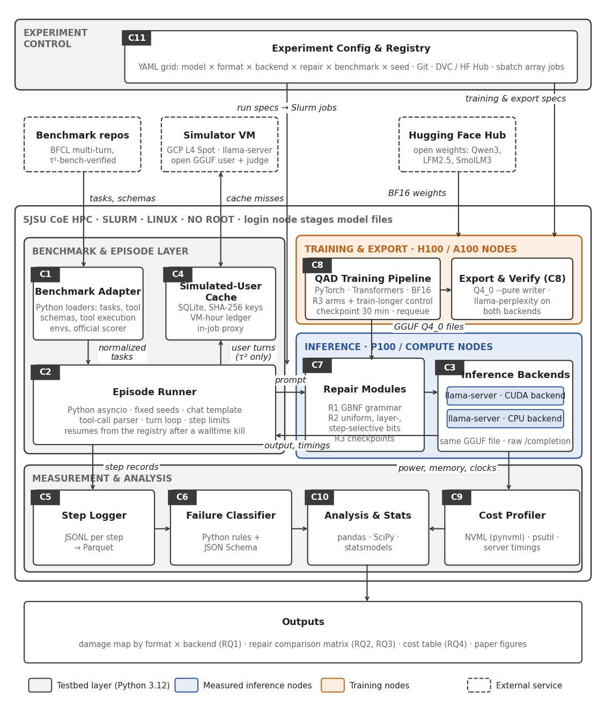
Architecture as submitted in Workbook 1
Workbook 1, Figure 1 · the updated view is slide 3
Notes:
The original Workbook 1 figure, for comparison with slide 3.

Slide 15
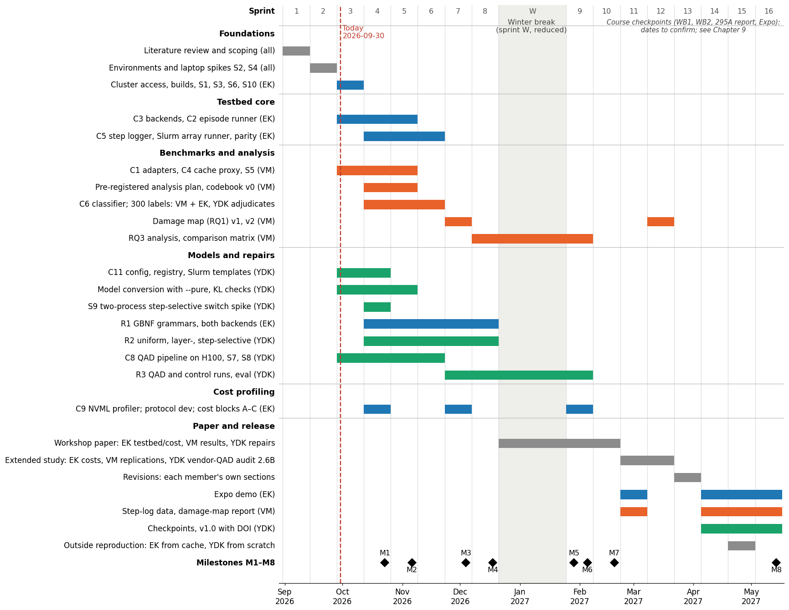
Full schedule, Fall 2026 to Spring 2027
Workbook 1, Figure 6 · milestone dates unchanged in Workbook v3
Notes:
Milestone dates have not changed. The dashed line in this figure still marks September 30.

